Slide 1
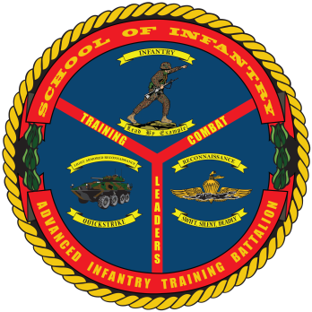
BASIC RECONNAISSANCE PRIMER COURSE
Purpose: To train students in the basic skills associated with being a Reconnaissance Man in order to prepare them for the Basic Reconnaissance Course (BRC) and follow-on service within a Reconnaissance unit.
Task List:
1000 Level:
Individual and Team Reconnaissance Skills
Amphibious Reconnaissance Operations
Methodology: The Basic Reconnaissance Primer Course (BRPC) provides the student with a basic knowledge of knots and management of mountaineering equipment, water survival and combat conditioning. The course combines lecture, demonstration, and practical application with both written and performance evaluation. BRPC is a high intensity course with the primary focus being physical preparation for BRC, specifically developing aquatic competency and physical endurance.
Course Length: 25 Training Days/ Approximately 5 weeks

