Slide 1
Production Estimation

Slide 2
Overview
To teach you how to accurately estimate an equipment oriented mission by using given estimation production formulas and procedures.

Slide 3
Learning Objectives
Terminal Learning Objective
Enabling Learning Objective

Slide 4
Method and Media
Lecture, demonstration, and practical application Methods
Computer Generated Slides

Slide 5
Evaluation
Practical applications using each Production Estimation Formula.
Open book exam!

Slide 6
Safety/Cease Training
Safety
Cease Training

Slide 7
ANY QUESTIONS?

Slide 8
Estimating
The art of determining the size of the job, labor, equipment needed to perform the job and quantities of materials.
To do any type of estimation, you need to know some basic formulas.

Slide 9
Soil States
Soil is found in three states.
  Sometimes it is necessary to convert from one volume to another.
  To do this we use table #1-1.
Bank
Loose
Compacted

Slide 10
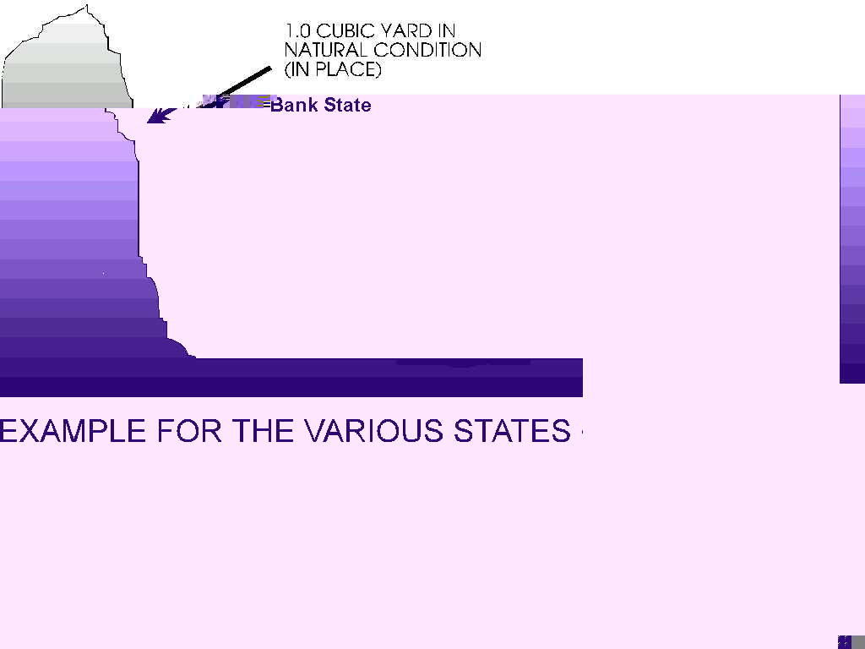
Bank State
Any soil that has not been disturbed from its natural state for at least ten years.
  This is also known as Bank Cubic Yards (BCY).

Slide 11
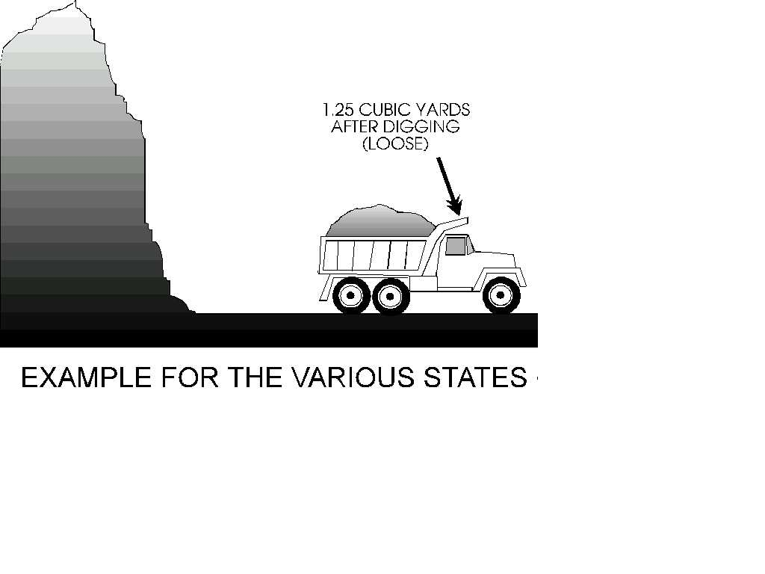
Loose State
Any soil that has been disturbed.
  Note: Soil is always in a loose state when hauled, worked or stockpiled.
  This is also known as Loose Cubic Yards (LCY).

Slide 12
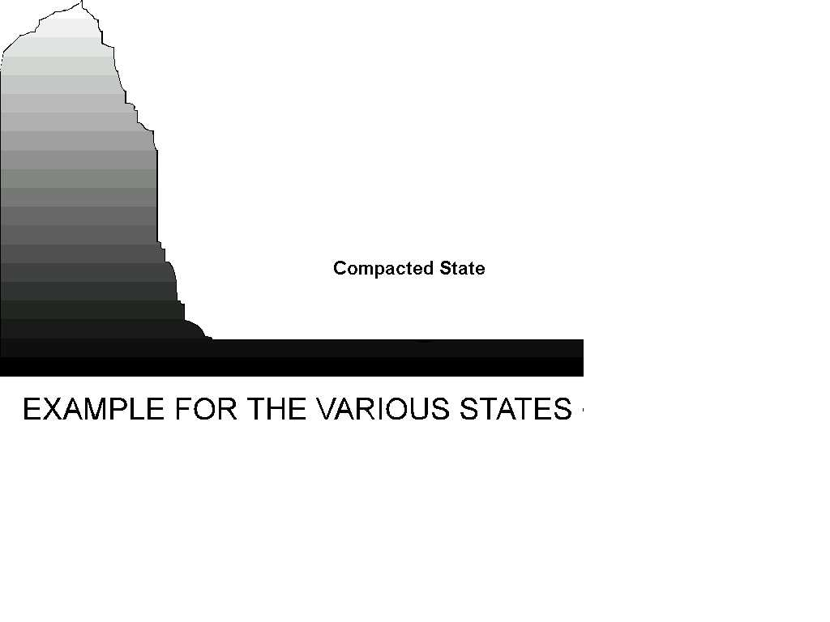
Compacted State
Any soil that has been compacted by artificial means.
  This is also known as Compacted Cubic Yards (CCY).

Slide 13
Table #1-1 Soil Conversion Factors

Slide 14
Example
If we needed to make a road that is 1,500’ long with a 3” lift of gravel and 24’ wide, it would be necessary to compute the volume first in compacted cubic yards and then convert it to a loose state.
This determines how much material our haul units would have to move.
This is done by multiplying the volume of the compacted material by a conversion factor.

Slide 15
Solution
3” ÷ 12” = .25’
1500’ (L) x .25’ (H) x 24’ (W) =
9000’ ÷ 27 = 333.33 or 334 CCY
334 CCY
x1.17 Conversion Factor
390.78 or 391 LCY
Note: Round up to the next full cubic yard.

Slide 16
What Have You Learned?
Problem #1
Your crew is tasked to dig a trench which is 300’ long, 9’ wide, and 6’ deep.
  Earth loam, dry and the soil has been undisturbed for more than 10 years.
  Using a 420 DV
  How many loose cubic yards of soil will you remove?
Solution
300’ x 9’ x 6’
27 = 600 BCY
600 BCY x 1.25 =750 LCY

Slide 17
What Have You Learned?
Problem #2
In the previous problem you removed ___ LCY of soil.
However you requirement for a road you are working on is 16,600 CCY.
Will you have enough soil to do the road?
If yes, how much over?
If no, how much under?
Solution
750 LCY x .72 = 540 CCY
16,600 CCY
- 540 CCY
16,060 CCY under

Slide 18
Production Time
Each piece of equipment has its own production formula.
Basic Formulas
Cubic Yards Per Hour (CYPH)
Loose Cubic Yards/Hour (LCYPH)
Bank Cubic Yards/Hour (BCYPH)
Compacted Cubic Yards/Hour (CCYPH)

Slide 19
Cubic Yards Per Day (CYPD)
Total cubic yards moved per hour multiplied by the total hours worked per day.
Example:
  100 CYPH x 8 hr work/day =
  800 CYPD
  Note: Round down CYPD

Slide 20
Production Days
Total requirement of material needed divided by the total CYPD moved.
Example:
  16,600 req CY ÷ 800 CYPD =
  20.75 or 21 days
  Note: Round up days to next full day.

Slide 21
What Have You Learned?
Problem #3
  You are moving 150 LCYPH
  Working 5 hours per day.
  The requirement to be moved is 17,000 LCY.
  LCYPD?
  Total Days?

Slide 22
Solution
150 LCYPH x 5 Hrs/day = 750 LCYPD
17,000 Req LCY ÷ 750 LCYPD =
22.67 or 23 days

Slide 23
What Have You Learned?
Problem #4
  You are moving 250 LCYPH
  Working 8 Hrs/day.
  The requirement to be move is 18,000 LCY.
  LCYPD?
  Total Days?

Slide 24
Solution
250 LCYPH x 8 Hrs/day = 2,000 LCYPD
18,000 Req LCY ÷ 2000 LCYPD = 9 days

Slide 25
Questions

Slide 26
Scrapers
  Designed for loading, hauling and dumping on long haul earthmoving operations.
  Has 3 basic operational parts; the bowl, the apron, and the ejector.
  The bowl, which is equipped with a cutting edge on the front bottom, is the loading and carrying component.
  The apron is the front wall of the bowl, and can be raised and lowered independently of the bowl.
  The ejector is the rear wall of the bowl. It is moved back to load, and forward to discharge materials.

Slide 27
Scraper Uses
Scrapers serve the primary purpose of loading and hauling material.
  The distinct advantage of the scraper, is the ability to load, haul, and spread in one continuous cycle.
  Capacity is measured in heaped and struck capacity.
  Capable of working alone for leveling operations, but is supplemented with push-tractors for cut and fill operations.

Slide 28
Classification
Classified according to load capacity and rated load.
  A heap load is the maximum load of the machine.
  A struck load is the minimum effective load.

Slide 29
Characteristics
  Wheeled vehicle characterized by a tractor and a scraper.
  Prime movers in cut and fill operations and in bringing elevations to rough, final grades.
  Open bowl design, they can be loaded from above.
  3 types of cutting edges:
  Straight, Curved, and the 3 piece cutting edge.
  The 621B has a rated load weight of 48,000 lbs.

Slide 30
Operation
  Hydraulically operated and powered by a tractor.
  Most efficient during downhill loading.
  Other methods of production include straddle loading and pump loading.
  All loading should be accomplished with a pusher, within (1) minute, and within (100) feet of travel.

Slide 31
Types Of Loads
Struck load:
  Loaded with soil until the material is approximately even with the top of the side boards.
  The capacity of the 621B Scraper, when struck loaded, is 14 loose cubic yards.
Heap load:
  Loaded with soil when the material is overflowing the side boards.
  The capacity of the 621B Scraper, when heap loaded, is 18 Loose Cubic Yards.

Slide 32
Actual Load Size (ALS)
Actual load size (ALS) will vary considerably, being somewhere between struck & heap due to variables such as:
  Soil weight
  Moisture Content
  Manner in which scraper is being loaded.

Slide 33
Scraper Production
Are there any questions?
There are 15 steps involved with scraper production estimations.

Slide 34
Questions?

Slide 35
Step 1 Scraper Production:
Soil Weight
Soil weight is used in all production.
To determine the actual soil weight (ASW) per cubic yard, start by taking the soil weight from table #2-2.

Slide 36
Table #2-2 Approximate Weight of Soil
PER CUBIC YARD
Type Of Soil Pounds Per (CY) Type Of Soil Pounds Per (CY)
Cinders 1,200 lbs. Limestone 2,500 lbs.
Clay, Dry 2,000 lbs. Sandstone 2,200 lbs.
Clay, Wet 3,000 lbs. Sand, Dry 2,900 lbs.
Clay, Gravel 2,700 lbs. Sand, Wet 3,100 lbs.
Gravel, Dry 3,000 lbs. Shale & Soft Rock 2,700 lbs.
Gravel, Wet 3,100 lbs. Slag, Bank 1,940 lbs.
Earth Loam, Dry 2,200 lbs. Slate 2,500 lbs.
Earth Loam, Wet 3,200 lbs. Trap Rock 3,500 lbs.
Hardpan 3,100 lbs. Coral, Hard 2,440 lbs.
Coral, Soft 2,030 lbs.

Slide 37
Moisture Content
Moisture weight in the soil.
  Although table #2-2 shows some soils with moisture, it may be necessary to get an exact moisture content to determine soil weight.
  The moisture will be expressed as a percentage of the dry soil.
Soil analysis personnel are trained to determine the moisture content, and the weight of this moisture must be calculated and added to the weight of the DRY soil.

Slide 38
Actual Soil Weight (ASW)
For classroom purposes:
  If you are given a wet soil, take the weight of the wet soil off table #2-2.
  If you are not given either wet or dry condition, take the weight of dry soil off table #2-2.
  If you are given a wet soil and a moisture content, take the weight of dry soil and multiply the moisture content.
Never round off ASW

Slide 39
Actual Soil Weight (ASW)
Method used to determine ASW.
Example:
Earth Loam with a 7% moisture content.
  Earth loam weighs 2,200 lbs/cubic yard.
  Multiply 2,200 by 1.07 to get the moisture weight of 2354 lbs.
The initial moisture content is 7% of the original weight.
  Therefore, the actual soil weight is 107% of the original weight.
  Convert the percentage to a decimal.
  Multiply the original soil weight by 1.07 and you get 2,354 lbs. ASW.

Slide 40
Scraper Production Step #1
Actual Soil Weight (ASW).
  Remember never round off ASW.
Example:
Earth Loam weighs 2,200 lbs./CY. With 7% moisture content.
2,200 x 1.07 = 2,354 ASW

Slide 41
Try A Few
Figure out the Actual Soil Weight (ASW) of the following:
  Wet clay, with 14% Moisture.
  Wet sand, with 17% moisture.
  Soft coral, with 2% moisture.
  Earth loam
  Clay & gravel, with 18% moisture.

Slide 42
Solutions
2,000 x 1.14 = 2,280 ASW
2,900 x 1.17 = 3,393 ASW
2,030 x 1.02 = 2,070.60 ASW
2,200 ASW
2,700 x 1.18 = 3,186 ASW

Slide 43
Scraper Production Step #2
Cubic Yards of a Load.
  You have to determine the maximum cubic yards you can haul without exceeding 48,000 lbs. (max load) or 18 cubic yards (max capacity).
  To do this divide 48,000 by the ASW/CY
Example:
48,000 lbs. (rated capacity)
2,354 lbs. (Actual Soil Weight)
20.39 CY No more than 18 CY
If the resulting figure is less than 18, use that entire number as it appears on the calculator in step #3.
If Push or Self Loading, this is your Actual Load Size (ALS) - go to Step #5.

Slide 44
Scraper Production Step #3
Buckets Loaded.
  Buckets loaded must be a whole number.
  Divide cubic yards of a load by the bucket size.
Example:
  Using a TRAM with a
  2 ½ or 2.5 cy. bucket
18 Cubic Yards
2.5 Cubic Yards (bucket size from table #3-2)
7.2 buckets or 7 bucket loads
Note: Round down to whole buckets loaded.

Slide 45
Bucket Sizes Table #3-2
Type of Equipment Bucket size
Tram 624KR 2½ or 2.5 CY
MC1155E 1¾ or 1.75 CY
ATC CLAMSHELL 1¼ or 1.25 CY
420D Front Bucket 1 or 1.25
420D Backhoe Bucket ¼ or .25

Slide 46
Scraper Production Step #4
Actual Load Size.
  The true amount of soil in haul unit.
  Number of buckets multiplied by the bucket size.
Example:
7 #of Buckets
x 2.5 TRAM Bucket Size
17.5 cy Actual Load Size (ALS)
Note: Never round off ALS.

Slide 47
Scraper Production Step #5
Load Weight (LW).
  Multiply your ASW by your ALS.
  Keep your load weight under 48,000 lbs.
  Table #2-2 shows the weight of cinders as 1200 lbs./LCY.
  A struck load would weigh 16,800 lbs., while the heap load would weigh 21,600 lbs..
  These weights would be easily hauled, but it is a different story with other materials.
  Take a look at Earth Loam, wet for instance:
  3,200 weight of Earth Loam, wet/CY 3,200
  x 14 LCY Struck x 18 LCY Heaped
  44,800 lbs. Struck Loaded 57,600 lbs. Heaped

Slide 48
Example
Each cubic yard weighs 2,354 lbs. (step #1), and you are hauling 17.5 cubic yards.
2,354 ASW
x17.5 ALS
41,195 load weight (LW)
Note: Never round off load weight.

Slide 49

Scraper Production Step #6
Short Tons
  First determine the gross weight of the vehicle with load.
  Divide the gross weight by 2,000 lbs. (the weight of one ton).
Example:
A 621B weighs 66,590 lbs.
41,195 LW (step #5)
+66,590 Tractor weight
107,785 Gross weight
÷ 2,000 Weight of 1 ton
53.89 Short tons (ST)
Note: Never round off short tons (ST).
CLEAR CALCULATOR

Slide 50
What Have You Learned?
Problem #1
  Figure the ASW of Gravel with a 12% moisture content.
Solution:
3,000 Weight of dry gravel
x1.12 Moisture content
3,360 lbs. ASW

Slide 51
What Have You Learned?
Problem #2
  When hauling this gravel in a 621B loaded with a TRAM 624KR, what would the load weight be?

Slide 52
What Have You Learned?
Solution:
48,000 Rated Capacity
÷3,360 ASW
14.29 CY of load
÷ 2.5 Bucket size
5.72 or 5 # buckets loaded
5 # buckets loaded
x2.5 Bucket size
12.50 ALS
x3,360 ASW
42,000 LW

Slide 53
What Have You Learned?
Problem #3
  If the 621B has a load weight of 46,590 lbs., what would your short tons be?
Solution:
46,590 LW
+66,590 Tractor weight
113,180 Gross weight
÷ 2,000 1 ton
56.59 ST

Slide 54
Scraper Production
Take a break!

Slide 55
Scraper Production Step #7
Rolling Resistance
  The resistance of movement to wheeled vehicles over a haul surface caused by irregularities in the surface such as compacting and displacement of material, caused by the flexing of tire sidewalls on the roadway.
  Rolling resistance is measured by the rim pull in pounds per short ton required to overcome resistance.
  This resistance effects the cycle time.

Slide 56
Scraper Production Step #7
To do this multiply short tons (from step #6) by the rolling resistance factor (RRF) found in table #4-2).
The resulting answer will be your rolling resistance (RR).
Table #4-2 Rolling Resistance Factors

Slide 57
Example
Determine the rolling resistance for a 621B scraper traveling over firm, smooth-rolling roadway flexing slightly under load 1” penetration.
The weight of the soil in the scraper is 41,195 lbs.(from Step #5)
53.89 ST (from step #6)
x 65 RRF (from table #4-2)
3502.85 or 3503 RR
Note: Round Off Rule
  Round up 5 or greater, round down 4 or less for RR.

Slide 58
What Have You Learned?
Problem #1
  Figure the Rolling Resistance for the following situation.
  621B Scraper
  Struck loaded (self loaded)
  Hard pan
  Rutted, dirt roadway, flexing considerably under load with 2”-3” penetration.
Step #1
  3,100 ASW
Step #2
  N/A
Step #3
  N/A
Step #4
  N/A

Slide 59
What Have You Learned?
Step #5
  3,100 ASW
  x 14 ALS
  43,400 LW
Step #6
  43,400 LW
  +66,590 TR WT
  109,990 GW
  ÷ 2,000 1 ton
  55.00 ST
Step #7
  55.00 ST
  x 100 RRF
  5,500 RR

Slide 60
What Have You Learned?
Problem #2
Figure rolling resistance for the following situation.
  621B scraper
  Loaded with a Tram (2½ CY bucket)
  Trap rock
  Hard, smooth, stabilized roadway without penetration.
Step #1
  3,500 ASW
Step #2
  48,000 Rated Capacity
  ÷3,500 ASW
  13.71 CY of a load
Step #3
  13.71 CY of a load
  ÷ 2.5 Bucket size
  5.49 or 5 Bucket loads

Slide 61
What Have You Learned?
Step #6
  437250 LW
  + 66,590 TR WT
  110,340 GW
  ÷ 2,000 1 ST
  55.17 ST
Step #7
  55.17 ST
  x 40 RRF
  2,206.80 or 2,207 RR
Step #4
  5 Buckets loaded
  x2.5 Bucket size
  12.50 ALS
Step #5
  3,500 ASW
  x12.50 ALS
  43,750 LW

Slide 62
Scraper Production Step #8
Grade Resistance (GR) or Grade Assistance (GA).
  Grade resistance or Grade assistance is the increase, or decrease, in the amount of pounds of pull required as the result of adverse or favorable grades on haul roads.
  Rules of thumb generally accepted as reliable measures of the effect of grades are as follows:
  Grade resistance effects the cycle time by slowing the scraper.

Slide 63
Scraper Production Step #8
Each 1% of uphill grade increases the resistance by 20 lbs. Per short ton pull of gross vehicle weight.
Formula:
  Short tons x 20 (constant) x % of grade = Grade resistance or assistance.

Slide 64
Example
The total weight of the loaded scraper on the haul is 107,785 lbs. (from step #6)
  Calculate the grade resistance factor for climbing a (+2) uphill grade.

Slide 65
Example Solution
53.89 x 20 x 2 = 2155.6 or 2156
ST x 20 x % grade = grade resistance (GR)
Note:
  Round up 5 or greater, round down 4 or less (GR/GA).

Slide 66
Scraper Production Step #8
Each 1% of downhill grade decreases the amount of pull required by 20 lbs. Per short ton of gross vehicle weight.

Slide 67
Example
For the return, the tractor is empty so the total weight is 66,590 lbs.
  Calculate the grade assistance factor for (-2) downhill grade.

Slide 68
Example Solution
33.30 x 20 x -2 = -1,332
ST empty x 20 x % of grade = Grade Assistance (GA)
Note:
  Round up 5 or greater, round down 4 or less. (GR/GA)

Slide 69
What Have You Learned?
Problem #1 Determine Grade Resistance for a 621B with the following factors:
  Struck load
  Sand
  7% initial moisture
  3% Uphill grade

Slide 70
What Have You Learned?
Step #1
  2,900 Soil WT
  x 1.07 Moisture
  3,103 ASW
Step #2
  N/A
Step #3
  N/A
Step #4
  N/A
Step #5
  3,103 ASW
  x 14 ALS
  43,442 LW
Step #6
  43,442 LW
  +66,590 TR WT
  110,032 GW
  ÷ 2,000 1 ST
  55.02 ST

Slide 71
What Have You Learned?
Step #7
  N/A
Step #8
  55.02 ST
  x 20 Constant
  x 3 % of grade
  3,301.20 or 3,301 GR

Slide 72
What Have You Learned?
Problem #2
  Determine rolling and grade resistance for a 621B on the haul with the following factors:
  Heap load
  Sandstone
  Rutted, dirt roadway, no stabilization under load 4”-6” penetration.
  6% uphill grade

Slide 73
What Have You Learned?
Step #1
  2,200 ASW
Step #2
  N/A
Step #3
  N/A
Step #4
  N/A
Step #5
  2,200 ASW
  x 18 ALS
  39,600 LW
Step #6
  39,600 LW
  + 66,590 TR WT
  106,190 GW
  ÷ 2,000 1 ST
  53.10 ST

Slide 74
What Have You Learned?
Step #7
  53.10 ST
  x 150 RRF
  7,965 RR
Step #8
  53.10 ST
  x 20 Constant
  x 6 % of grade
  6,372 GR

Slide 75
Scraper Production
Take a break!

Slide 76
Scraper Production Step #9
Required Pounds Of Pull (REQPP)
  The total power required to move a unit.
  We can find our REQPP by adding GR with RR from uphill, or Subtract GA from RR for downhill.
  When on level ground, your RR is your REQPP.

Slide 77
Example 1
When traveling uphill a vehicle must overcome both rolling resistance and grade resistance.
  3,503 RR
  +2156 (+GR)
  5,659 REQPP Using table #5-2, you can see that the scraper will not give you enough Rim Pounds Pull(RPP) in 8th or 7th gear, but 6th gear you have enough RPP. The travel speed is 14 Mph.
  Table #5-2 Power Characteristics of 621B Scraper

Slide 78
Scraper Production Step #9
Note:
  If your TM doesn’t have the table, you can use the following formula to get your RPP.
  375 x Engine HP x 80% Efficiency
  travel speed in mph. =
  Rim Pounds Pull (RPP)

Slide 79
Example 2
When traveling downhill a vehicle must overcome rolling resistance less grade assistance.
  2,165 RR
  -1,332 GA
  833 REQPP
  Using table #5-2, we see that the scraper will give you enough RPP in 8th gear.
  The travel speed is 26 mph.
When traveling over level terrain, a vehicle must overcome rolling resistance only.
  3,503 RR = 3,503 REQPP
  Using table #5-2, we see that the scraper will give you enough RPP in 7th gear.
  The travel speed is 19 mph.

Slide 80

What Have You Learned?
Problem #1
  Determine travel speed with the following factors:
  621B scraper
  Struck Load
  Earth loam
  10% initial moisture
  Hard, smooth roadway with no penetration under load.
  4% downhill grade.

Slide 81
What Have You Learned?
Step #1
  2,200 Dry soil WT
  x 1.10 Moisture
  2,420 ASW
Step #2
  N/A
Step #3
  N/A
Step #4
  N/A
Step #5
  2,420 ASW
  x 14 ALS
  33,880 LW
Step #6
  33,880 LW
  + 66,590 TR WT
  100,470 GW
  ÷ 2,000 1 ST
  50.24 ST

Slide 82
What Have You Learned?
Step #7
  50.24 ST
  x 40 RRF
  2,009.6 or 2,010 RR
Step #8
  50.24 ST
  x 20 constant
  x -4 % grade
  -4,019.2 or -4,019 GA
Step #9
  2,010 RR
  -4,019 GA
  -2,009 REQPP
  8th gear 26 mph

Slide 83
What Have You Learned?
Problem #2
  Determine the travel speed with the following factors:
  621B Scraper
  Struck load
  Clay and gravel
  3% initial moisture
  Rutted, dirt roadway, no stabilization under load, 4”-6” penetration.
  6% uphill grade.

Slide 84
What Have You Learned?
Step #1
  2,700 Dry soil WT
  x1.03 Moisture
  2,781 ASW
Step #2
  N/A
Step #3
  N/A
Step #4
  N/A
Step #5
  2,781 ASW
  x 14 ALS
  38,934 LW
Step #6
  38,934 LW
  + 66,590 TR WT
  105,524 GW
  ÷ 2,000 1 ST
  52.76 ST

Slide 85
What Have You Learned?
Step #7
  52.76 ST
  x 150 RRF
  7,914 RR
Step #8
  52.76 ST
  x 20 Constant
  x 6 % grade
  6,331.2 or 6,331 GR
Step #9
  7,914 RR
  + 6,331 GR
  14,245 REQPP
  3rd gear 6 mph

Slide 86
Scraper Production Step #9
Return
  The return is done by repeating steps 6-9 and using empty vehicle weight to get short tons.
Example:
  Step #6: Short tons (ST) with empty vehicle weight.
  66,590 GW
  ÷2,000 1 ST
  33.30 ST (ST, constant for an empty 621B)
  Step #7: Rolling Resistance (RR)
  33.30 ST
  x 65 RRF
  2,164.5 or 2,165 RR
  Step #8: Grade Resistance/Assistance (GR/GA)
  33.30 ST x 20 x -2 =
  -1,332 GA

Slide 87
Scraper Production Step #9
Step #9: Required Pounds Of Pull (REQPP) & Travel Speed.
  2,165 RR
  -1,332 GA
  833 REQPP
  8th gear / 26 mph
Now that you have you travel speed for haul and return, you can formulate the cycle time (step 10).

Slide 88
Scraper Production Step #10
Cycle Time
  The time required to Load, Haul, Spread, and Return.
  This is figured by adding Fixed Time (Fix-T) and Travel Time (TT) to get Cycle Time (CT)

Slide 89
Scraper Production Step #10
Fixed Time:
  Is the time spent during an equipment cycle other than hauling and returning.
  This includes positioning , loading, unloading, turning, accelerating and decelerating, all of which are fairly constant or fixed.
  Fixed times are determined from Table #6-2.
  To use Table #6-2, start with what gear you are in.

Slide 90
Scraper Production Step #10
Table #6-2 Fixed Time
Equipment 1st,2nd,3rd 4th 5th,6th,7th,8th
Loading Gear Haul Gear Haul Gear Haul
Scraper
Struck Heap Struck Heap Struck Heap
Scraper Loading 2.50 N/A 2.80 N/A 3.0 N/A
Itself
1155E 7.0 9.0 7.30 9.30 7.50 9.50
TRAM 6.0 7.0 6.30 7.30 6.50 7.50
1085 w/1.5 bucket 12.0 14.0 12.30 14.30 12.50 14.50
1085 w/.75 bucket 16.0 22.0 16.30 22.30 16.50 22.50
HSHMC clamshell 16.0 19.0 16.30 19.30 16.50 19.50
Scraper Push 1.43 1.71 1.73 2.01 1.93 2.21
Loaded
Take a Look at the note in your handout.

Slide 91
Scraper Production Step #10
Travel Time:
  The time spent on the haul road transporting material and returning empty.
  Travel Time depends on: size of hauling unit, rolling resistance, grade resistance, and distance traveled.
  All of which have already been figured to get your gear selection and speed to put in your cycle time formula.

Slide 92
Scraper Production Step #10
To figure cycle time (CT) you must first figure travel time (TT).
  To get travel time divide the distance in feet of the haul or return road by the sum of the travel speed (TS) in mph multiplied by 88.
  Do this for the haul and return.
  The total time plus fixed time will equal total cycle time.
  Note: 88 is he conversion factor to change the speed in mph to feet traveled per minute.

Slide 93
Example
A 621B scraper, hauling 17.5 CY of material, travels 7500’ to the fill area using 6th gear and returns empty by a different route of 8200’ in 8th gear.
What is the total cycle time, if the 621B is being loaded by a TRAM.
7500’ haul dist.
14 TS x 88 =
6.09 HT
8200’ return dist.
26 TS x 88 =
3.58 RT
6.09 + 3.58 + 7.5 =
17.17 min
  Note: never round off time.

Slide 94

What Have You Learned?
Problem #1
  Figure total cycle time.
  621B, self loaded
  Haul distance - 8250’
  Return distance - 7125’
  Haul gear - 4th
  Return gear - 8th

Slide 95
Solution
8250’ HD
8 TS x 88 = 11.72 HT
7125’ RD
26 TS x 88 = 3.11 RT
11.72 + 3.11 + 2.80 =
17.63 CT

Slide 96
What Have You Learned?
Problem #2
  Figure total cycle time.
  621B, self loaded
  Haul distance - 9000’
  Return distance - 9176’
  Haul gear - 6th
  Return gear - 8th

Slide 97
Solution
9000’ HD
14 TS x 88 = 7.31 HT
9176’ RD
26 TS x 88 = 4.01 RT
7.31 + 4.01 + 3.0 =
14.32 min CT

Slide 98
Scraper Production
Take A Break!

Slide 99
Scraper Production Step #11
Trips Per Hour
  To determine trips per hour (TPH) divide the working minutes per hour (normally a 60 min. work hour) by the cycle time.
  Note: never round off TPH.
Example:
  How many trips per hour can a 621B make during a 60 min. work hour if it has a 17.17 min cycle time?
  60 min. worked/hr
  17.17 CT =
  3.49 TPH

Slide 100
Scraper Production Step #12
Hourly Production Rate (LCYPH)
  To determine the hourly production rate, you must know the actual load size (in LCY), the number of trips per hour, and the efficiency factor of the operator and equipment.
TPH
x ALS
x Efficiency Factor
= LCYPH
Note: always round down LCYPH.

Slide 101
Scraper Production Step #12
Table #7-2 Efficiency Factor
Example:
  What is the hourly production rate for a 621B with an average operator, working days, making 3.49 TPH, with a load of 17.5 LCY?
  3.49 TPH x 17.5 ALS x .60 = 36.65 or 36 LCYPH

Slide 102
Scraper Production Step #13
Soil Conversion (SC) (if needed)
  in some cases the hourly production rate may be needed in compacted cubic yards (CCY) for a road or runway.
  Note: round down CYPH.
Bank
Loose
Compacted

Slide 103
Scraper Production Step #14
Total Hours Required To Complete Mission
  To determine the total time required to complete the mission, you must know the total volume to be moved, the hourly production rate, and the number of scrapers you will use on the job.
Volume needed (_CY)
_CYPH x #of scrapers =
Total Hours Required
Note: never round off time.
Example:
  19,440 CCY
  25 CCYPH x 3 scrapers =
  259.20 hours required

Slide 104
Scraper Production Step #15
Total Production Days
  To get the production days required to complete the mission, divide total hours required by the hours worked per day, which will equal the total number of days required.
Example:
  259.20 hours req. ÷ 8 hrs/day
  = 32.40 or 33 days
Note: Round days to next full day.

Slide 105
What Have You Learned?
Problem# 1
Figure total number production days with the following factors:
  3 621B
  Struck loaded, loam
  7 hr. production day
  Excellent operator
  13.08 min. cycle time
  Compacted volume required for job 250,000 CY
  Working 60 min/hr

Slide 106
Solution
Step #11
  60 Min/hr
  ÷13.08 CT
  4.59 TPH
Step #12
  4.59 TPH
  x 14 ALS
  x1.0 Efficiency factor
  64.26 or 64 LCYPH
Step #13
  64 LCYPH
  x.72 Conversion Factor
  46.08 or 46 CCYPH
Step #14
  250,000 Req vol
  46 x 3 = 1,811.59 hrs
Step #15
  1,811.59 hrs req
  ÷ 7 Hrs/day
  258.8 or 259 Days

Slide 107
What Have You Learned?
Problem #2 A project requires you to build a parking lot using gravel. How many work nights, at 8 hours per night, are require to complete the project? You are working only during hours of darkness. The job conditions are as follows.
  5 621B, Compacted fill required 150,000 CY
  Struck loaded, Gravel, moisture content 14%
  Haul distance 7000 ft, return same route
  Grade of haul road 6% downhill, Average operator
  Rutted, dirt roadway, with no stabilization under 4” to 6” penetration.
  Working 60 min/hr

Slide 108
Solution
Step #1
  3000
  X 1.14
  3420 ASW
Step #5
  3420 ASW
  x 14 ALS
  47,880 LW
Step #6
  47880
  +66590
  114470
  ÷ 2000
  57.24 ST
Step #7
  57.24
  x 150
  8586 RR (HAUL)

Slide 109
Solution
Step #7
  33.30
  X 150
  4995 RR(RETURN)
Step #8
  57.24
  x 20
  x -6
  -6868.8 or 6869 GA (haul)
Step #8
  33.30
  x 20
  x 6
  3,996 GR (RETURN)
Step #9
  8586 RR
  -6869 GA
  1717 RPP (HAUL) 8TH 26MPH

Slide 110
Solution
Step #9
  4995 RR
  +3996 GR
  8991 RPP(RETURN)
  5TH 11MPH
Step #10
  7000’
  26 x 88 = 3.06 HT
Step #10
  7000’
  11 x 88 = 7.23. RT
  3.06 + 7.23 + 3.00 = 13.29
Step #11
  60 Min/HR
  ÷13.29 CT
  4.51 TPH

Slide 111
Solution
Step #12
  4.51 TPH
  x 14 ALS
  x .4 EFF. FAC.
  25.26 or 25 LCYPH
Step #13
  25 LCYPH
  x .86 Conv. Fac.
  21.50 or 21 CCPH
Step #14
  150000
  21 x 5 = 1428.57 THR
Step #15
1428.57 THR
  ÷ 8 HRS/NIGHT
  178.57 or 179 NIGHTS

Slide 112
QUESTIONS??
Take a break!!

Slide 113
Push Loading
One of the most effective methods of loading a scraper.
Decreases time, and distance.
Usually, a 621B is pushed by a MCT.
The MCT has a reinforced blade for push loading.
Load time should be 1 min. or less.
The optimum loading distance is around 90’ - 125’.
The optimum depth of cut is 4” - 6”.
  Varies according to type of soil,moisture content, loadability, operator, load size,and method of employment.

Slide 114
Push Loading
2 mph for the MCT and first gear for the 621B.
The Mph listed In table #5-2 for the scraper and table #8-2 for the MCT reflect maximum and/or average speed in mph.
When push loading is employed, the maximum mph will not be the loaded mph reflected in the tables, therefore, for classroom purposes, use 2 mph when push loading.

Slide 115
Push Tractor Step #1
Figuring the number of push tractors (PT) needed.
  Load Time (LT)
  The time required to load the haul unit during which the dozer is in contact with the push block of the scraper.
Length of cut
mph x 88 = LT in min.
Example:
  150’ length of cut
  2 mph x 88 = .85 LT

Slide 116
Push Tractor Step #2
Boost Time (BT)
  The time expended after the scraper is loaded during which the push tractor assists the scraper in attaining momentum. (for boost time use a constant of .25)

Slide 117
Push Tractor Step #3
Return Time (RT)
  the time required for the push tractor to return to the starting point.
  This portion of the cycle time will be greatly reduced by chain or shuttle loading.
LT x 1.4 = RT
Example:
  .85 LT
  x 1.4 Constant
  1.19 min.RT

Slide 118
Push Tractor Step #4
Formulate Cycle Time
  (Load Time x 1.4) + Boost Time = PT Cycle Time (CT)
Example:
  (.85 x 1.4) + .25 = 1.44 min PT CT
  NOTE: NEVER ROUND OFF TIME

Slide 119
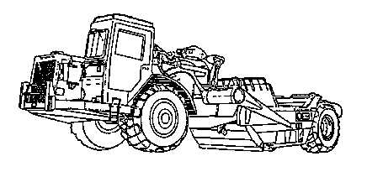
Push Tractor Step #5
Number Of Scrapers A Push-Tractor Can Support
  This is found by dividing scraper cycle time by the push-tractor time.
  Example:
  How many scrapers can a single push-tractor support if the scraper cycle time is 4 min. and the push-tractor cycle time is 1.3 min.?
4 min Scraper CT
÷1.3 min PT CT
3.08 Round down to 3 scrapers.

Slide 120
Push Tractor Step #6
Number of Push-Tractors Required
  This is found by dividing the number of scrapers on the job, by the number of scrapers a push-tractor can support.
  Note: Round up number of push-tractors required.
Example:
  How many push-tractors are required on a job that has 9 621B’s, if a single push-tractor can support 3 scrapers?
  9 Scrapers
  ÷ 3 Scrapers/tractor
  3 Push-tractors

Slide 121
What Have You Learned?
Problem #1
  Figure the number of push-tractors required for :
  4 621B
  12.58 min cycle time
  150’ cut

Slide 122
Solution
Step #1
  150 Length of cut
  ÷(2x88) mph & conv.factor
  .85 LT
Step #2
  .25 BT
Step #3
  .85 LT
  x 1.4 Conv. factor
  1.19 RT
Step #4
  1.19 RT
  +.25 BT
  1.44 min PT CT
Step #5
  12.58 CT
  ÷1.44 PT CT
  8.74 or 8 Scrapers/PT

Slide 123
Solution
Step #6
  4 Scrapers
  ÷ 8 Scrapers/PT
  .50 or 1 PT required

Slide 124

What Have You Learned?
Problem #2
  Figure the number of push-tractors required for:
  7 621B’s
  8.92 CT
  125’ Cut

Slide 125
Solution
Step #1
  125 Length of cut
  ÷(2x88) mph & conv. Factor
  .71 LT
Step #2
  .25 BT
Step #3
  .71 LT
  x 1.4 Conv. Factor
  .99 RT
Step #4
  .99 RT
  +.25 BT
  1.24 min PT CT
Step #5
  8.92 CT
  ÷1.24 PT CT
  7.19 or 7 Scrapers/PT

Slide 126
Solution
Step #6
  7 Scrapers
  ÷ 7 Scrapers/PT
  1 PT required

Slide 127

What Have You Learned?
Problem #3
  A project requires you build a road using clay and gravel with an 8% moisture content.
  The borrow pit area allows you to push load the 621Bs with MCTs.
  How many days are required?
  Show and label all figures and formulas.

Slide 128
Solution
Days
Step #1
  2,916 ASW
Step #2
  14 CY/load
Step #3
  N/A
Step #4
  N/A
Step #5
  40,824 LW
Step #6
  Haul
  107,414 GW
  53.71 ST
  Return
  33.30 ST
Step #7
  Haul
  5,371 RR
  Return
  3,330 RR
Step #8
  Haul
  7,519 GR
  Return
  4,662 GA

Slide 129
Solution
Step #9
  Haul
  12,890 REQPP
  4th gear 8 mph
  Return
  -1,332 REQPP
  8th gear 26 mph
Step #10
  9.38 HT
  2.88 RT
  13.99 CT
Step #11
  4.29 TPH
Step #12
  36 LCYPH
Step #13
  22 CCYPH
Step #14
  1,325.76 Hrs Req
Step #15
  133 Days

Slide 130
Solution
# of PT Required
Step #1
  .45 LT
Step #2
  .25 BT
Step #3
  .63RT
Step #4
  .88 PT CT
Step #5
  15 #scrapers/dozer
Step #6
  1 PT required

Slide 131
Push Tractor Production
Questions?
Take A Break!

Slide 132
Dozer Production
Introduction
  Dozers and scrapers are the most common pieces of equipment on a project.
  It is important to be able to properly use these earthmovers to, get maximum production, to establish production estimation rates, and to insure the prompt completion of an earth moving task.

Slide 133
Dozer Uses
Used as prime movers for pushing or pulling loads.
Used for power units for winches and hoists.
As moving mounts for dozer blades.
Used primarily where it is advantageous to obtain high drawbar pull and traction.
Most suitable equipment for pushing or pulling loads through marshy areas.

Slide 134
Dozer Classification
Crawler tractors are classified according to weight.
  Light (1150 & 1155)
  Medium (MCT)
  Heavy (D8)

Slide 135
Dozer Characteristics
Supported on the ground by track assemblies.
Commonly called bulldozers, they are the work horses of construction.
Usually the first piece of equipment on job site, last to leave.
Used to cut haul roads, move dirt, trees, rocks, and many other.
Simply a tractor with a blade mounted on the front which is used for pushing objects or materials.

Slide 136
Dozer Characteristics
Once the blade is removed, it’s used as a towing unit.
Since the weight of the machine is supported by the track sections, the crawler tractor has great traction pull.
The ability to “lock” one side section of track while pulling with the other one enables the crawler tractor to pull itself out of material that would easily cause a wheeled machine to become stuck.

Slide 137
Dozer Operation
Equipped with a diesel engine rated from 85 to 202 horsepower, and either 4 or 6 cylinders, depending on make and model.
Low ground bearing pressure, varying form 6 - 9 lbs./Sq. in., which gives it distinct “floatation” advantage.
Capable of operating in muck or water as deep as the height of the track.
Can move to jobsite on own power, but transporting is preferred.

Slide 138
Dozer Production
Estimated using the production from Table #9-3, and then adjusting the table with six correction factors.

Slide 139
Dozer Production
Formula
  Factor 1 x Factor 2 x Factor 3 x Factor 4 x Factor 5 x Factor 6 = LCYPH
  Note: Round down LCYPH
  For classroom purposes, if you are not given the information for any step, that step will be N/A.

Slide 140
Dozer Production Factor #1
Maximum Basic Production
  Find the average dozing distance line on the bottom of the scale.
  Read up until you intercept the production curve for the dozer you are using.
  Then read to the left to get the production rate in LCYPH.
Note:
  On the charts the 4S is the 1150E and the 7S is the MCT.
Example
  Determine the maximum basic production for a MCT with an average dozing distance of 200’.
  200 LCYPH
  Round down

Slide 141
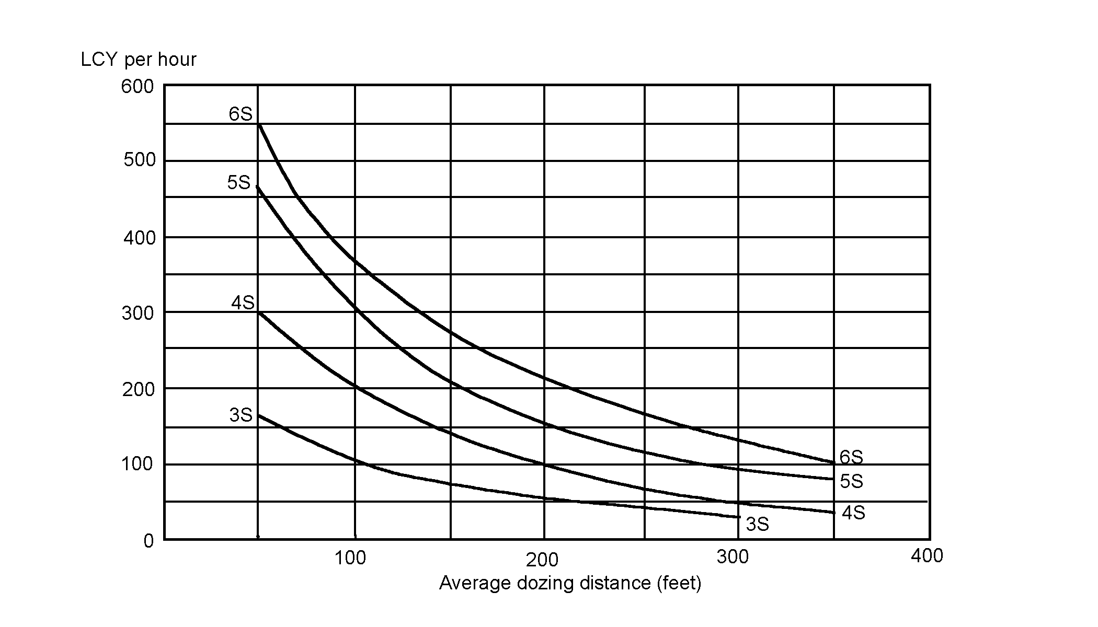
Dozer Production Factor #1 (1150)

Slide 142
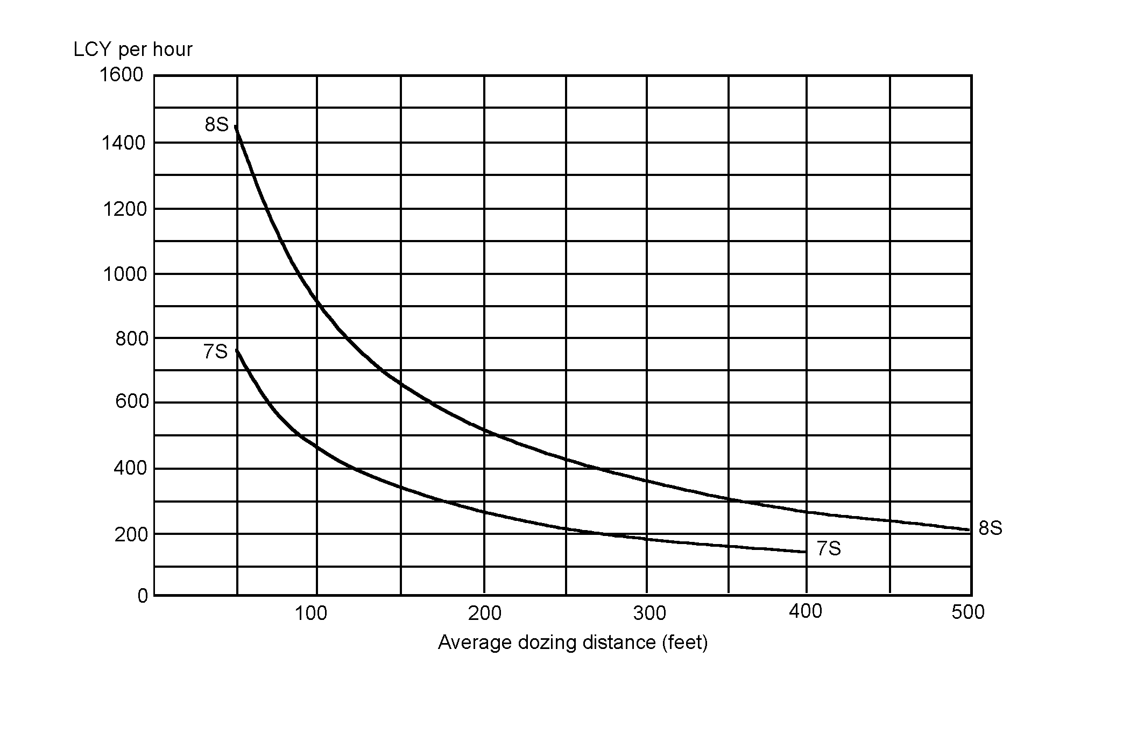
Dozer Production Factor #1 (MCT)

Slide 143
Dozer Production Factor #2
Grade Correction Factor
  Using table #10-3 find the % of grade (-) favorable, (+) unfavorable, on the top of the scale, read down until you intercept the grade correction curve.
  Read to the right to determine the grade correction factor.
  Each vertical line on this scale represents multiples of two.
  Each horizontal line represents 0.04.
  Note: For classroom purposes round off, up or down to the closest factor.

Slide 144
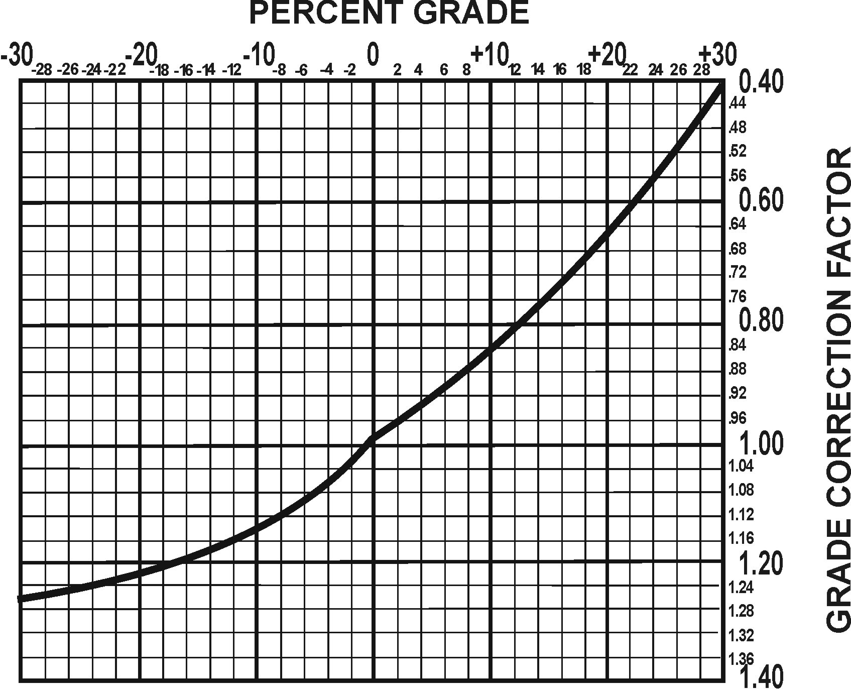

Slide 145
Example
If you had to move the material up a 2% grade (+), what would be your grade correction factor?
  .96

Slide 146
Dozer Production Factor #3
Soil Weight Correction Factor
  Using table #2-2 as before, get your ASW.
  Divide 2,300 lbs./CY by you ASW to find the correction factor.
  2,300 lbs. is a constant which is the weight of soil used to determine table #9-3.
Example:
  You are working in clay with a 5% moisture content.
  2,300 Constant
  ÷2,100 ASW
  1.10 Soil weight correction factor
  Note: Never round off.

Slide 147
Dozer Production Factor #4
Soil Type Correction Factor
  The dozer blade is designed to cut the material and give is a rolling effect for a production factor of 1.00.
  Material found in different states will effect dozer production as in the following table.
  Table #11-3 Soil Correction Factor

Slide 148
Dozer Production Factor #5
Equipment/Operator Efficiency Correction Factor
  These factors include operator efficiency and visibility (dust, rain, snow, fog, and darkness) with a job efficiency of a 60 min. hour.
Table #7-2 Equipment/Operator Efficiency Factor

Slide 149
Dozer Production Factor #6
Management Technique Correction Factor
Table #12-3

Slide 150
Dozer Production Step #1
Production Calculation
  Factor #1
  x Factor #2
  x Factor #3
  x Factor #4
  x Factor #5
  x Factor #6
  LCYPH/dozer
Note: Round down LCYPH

Slide 151
Dozer Production Step #2
Soil Conversion Factor (if required)
  Convert soil by using table #1-1 as before.
Bank
Loose
Compacted

Slide 152
Dozer Production Step #3
Example:
  How long would it take to move 4,500 CCY of clay, using 3 MCTs with a production rate of 143 CCYPH?
  4,500 CCY
  ÷(143x3) Basic prod. Rate x # dozers
  10.49 hrs. required
  Note: Never round off time.
Total Hours Required
  Quantity to be moved, divided by the hourly production rate, multiplied by the number of dozers you have employed, equals the total time in hours to complete the job.

Slide 153
Dozer Production Step #4
Total Production (Days)
Example:
  10.49 Hrs required
  ÷ 8 Hrs/day
  1.31 or 2 Days
Note: round days to next full day.

Slide 154
Dozer Production Step #5
Total Number of Dozers Required
  Quantity of material to be moved.
  Divided by the hourly production rate.
  Multiplied by the number of hours you have to complete the job.
Example:
  How many MCTs would be needed to move 4,500 CCY of loam in 5 hrs. if the dozers have a hourly production rate of 143 CCYPH?
  4,500 CCY required
  ÷ (143x5) CCYPH x hrs.
  6.29 or 7 D7Gs
Note: Always round up

Slide 155
What Have You Learned?
Problem #1
  Using the information in your handout, determine how long it will take 2 MCTs to complete the job:

Slide 156
Solution
Factor #1
  300 LCYPH Max. basic prod.
Factor #2
  .96 Grade correction factor
Factor #3
  2,040 ASW
  1.13 Soil wt correction factor
Factor #4
  .80 Soil correction factor
Factor #5
  .45 Equip/Op correct. factor
Factor #6
  1.15 Mngt. correct. Factor
Step #1
  134.73 or 134 LCYPH
Step #2
  84.42 or 84 CCYPH
Step #3
  9.21 Hours

Slide 157
What Have You Learned?
Problem #2
  Using the information in your student handout, determine how many MC1150Es are required to complete the job in 5 hours.

Slide 158
Solution
Factor #1
  200 LCYPH Max. basic prod.
Factor #2
  .92 Grade correction factor
Factor #3
  2200 ASW
  1.05 Soil wt correction factor
Factor #4
  .80 Soil correction factor
Factor #5
  1.00 Equip/op correct. factor
Factor #6
  1.20 Mngt. Correct. factor
Step #1
  185.47 or 185 LCYPH
Step #2, 3, 4
  N/A
Step #5
  3.22 or (4) MC1150Es

Slide 159

Dozer Production Estimation
Are there any questions?
Take a break!

Slide 160
Clearing, Grubbing, and Stripping
Clearing and Grubbing
    Consists of removing all trees, fallen timber, brush, and other vegetation from a designated area.
    Clearing techniques vary with the type of vegetation, soil,and moisture conditions.
    Table #14-3 shows average clearing rates for normal conditions.

Slide 161
Stripping
Consists of removing and disposing of the top soil and vegetation which would be objectionable as a sub-grade for a road or runway.
    Brush and small trees: Dozers operating in 1st or 2nd gear can clear brush and small trees (6” or less in diameter) at the rate of 900 - 1000 sq.yd./hr.
    Medium trees: 7” - 12” trees an average of 2 - 9 min./tree.
    Large trees: More than 12” an average of 5 - 20 min./tree.

Slide 162
Production Estimation
Production Estimates
  There are two methods for estimating clearing, grubbing and stripping.
  The Quick Method: Table #13-3 gives quick estimates for clearing, grubbing and stripping trees. (Avg. 50 trees/acre)
  Use these estimates only when a detailed reconnaissance and tree count are not possible.

Slide 163
Production Estimation
Quick method
  Use this method when a detailed reconnaissance and tree count are not possible.
  Example: Look at the example in your handout.
Step #1: Determine the area to be cleared in acres.
  Change miles to feet.
  2 mi. x 5,280’ = 10,560’
  60’ W x 10,560’ L
  43,560sq ft/acre=14.55acres
Step #2: Determine size and # of dozers available.
  Size MCT # of MCT 2
Step #3: Determine the size of trees to be cleared.
  sm trees med trees lg trees

Slide 164
Production Estimation
Step #4: Determine Production Rates (hrs/acre) for clearing.
  Use table #13-3.
  Small trees 2.5.hr/acre
Step #5: Determine Basic Production Rate (avg hrs/acre)
  Average individual production rates if needed.
Hr/acre(sm)
+ Hr/acre(med)
+ Hr/acre(lg)
÷ # of different trees =
Basic Production Rate (hrs/acre)
Step #6: Determine Equipment and Operator Efficiency Factor, using Table #7-2.

Slide 165
Production Estimation
Step #7: Total Hours Required to Complete Mission
  14.55 acres x 2.50 prod. (hr/acre) x 1.6 disp. & strip.
  0.75 efficiency x 2 #of dozers =
  38.80 total hours
  Note:
  If estimating clearing and grubbing only, omit 1.6 from numerator in equation.
  The 1.6 hrs. is there for disposal and stripping vegetation.

Slide 166
Production Estimation
Step #8: Total Production (Days)
  38.80 Hrs req ÷ 8 hrs/day = 4.85 or 5 Days
  Note:
    Round days to next full day.

Slide 167
What Have You Learned?
Figure out the problem in your student handout using the Quick Method.

Slide 168
Solution
5280’ Feet/Mile 387.84
x 5 Miles ÷(.75 x 3)
26,400’ Length 172.37 THR
x 80
2,112,000 SQFT
÷ 43,560’ SQFT Acre
48.48 Acres
5 Production
x 1.6 Stripping
387.84

Slide 169
Production Estimation
Example:
Tree Count Method
  Step #1: Determine area to be cleared in Acres
  L’ x W’
  43,560 sq ft/acre
  Step #2: Determine size and number of dozers available.
Step #3: Determine the avg. # of each size trees and brush/acre.
Step #4: Determine Basic Production Rate (hrs/acre) per tree size using table #14-3.

Slide 170
Production Estimation
Step #4 cont.
_ small trees x .50 min/tree = min/acre
_ med. trees x 9 min/tree = min/acre
_ large trees x 20 min/tree = min/acre
min/acre(small) + min/acre(med) + min/acre(lg) = hrs/acre
60 min/hour
Step #5: Determine Equipment & Operator Efficiency Factor

Slide 171
Production Estimation
Step #6: Total Hours Required To complete Mission
  (Acres) x (hrs/acre) x 1.6
  (Efficiency) x (# Dozers) = total hours
Step #7: Total Production Days
  Hrs req ÷ Hrs/work day = days

Slide 172
Clearing, Grubbing, and Stripping
Are there any questions?
Take a break!

Slide 173
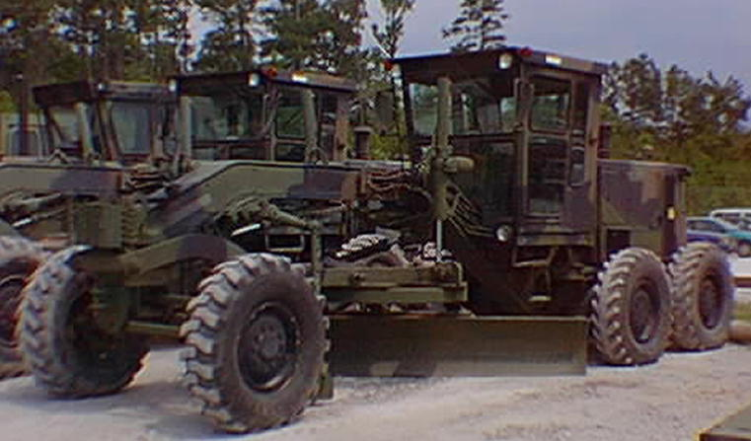
Grader Production
Introduction
  Graders a multipurpose machines used primarily for general construction and maintenance of roads and runways.
  When properly used, the grader can be employed for crowning and leveling, mixing and spreading materials, ditching and bank sloping, and side-casting material.

Slide 174
Grader Uses
Serve as finishers.
  Capable of finishing slopes and grades, blending and mixing materials, snow removal, and scarifying.
  Used in conjunction with other earth movers when leveling, maintaining and spreading.
  Additional safety precautions should be used when equipment is performing different tasks in the same area.

Slide 175
Grader Classification
Classified as multipurpose machines.
  Can be used in a wide variety of operations from the beginning to the end of construction.

Slide 176
Grader Characteristics
Wheeled vehicles characterized by a moldboard or blade and scarifier.
  Graders bring elevations to a final grade.
  The blade is used to side cast material it encounters.
  Blade ends can be raised or lowered together or separately.
  Blade can be pitched.
  The scarifier is used to break up material too hard for the blade to cut.
  It is composed of 11 removable teeth capable of cutting to a depth of 12”.

Slide 177
Grader Operation
Hydraulically operated and powered by a diesel engine.
  Effective during leveling, ditching, and snow removal.
  During ditching operations, the grader can make progressive cuts to a depth of 3’.
  The grader has a high center of gravity.
  Used to create bank slopes.
  Maintains haul roads. This is done by working material from one side of the road to the other.
  Corrugated material should be scarified prior to leveling and compacted after the grader has made the final leveling passes.
  During snow removal, the blade should be inspected hourly for excessive wear.

Slide 178
Grader Production
A work time formula may be used to prepare preliminary estimates of the total time in hours required to complete a grader operation.
Total Time = P x D
S x E
  P = # of passes required
  D = Distance in miles/ pass
  E = Grader efficiency
  S = Speed of grader
The time required to complete a grader operation depends on the number of passes necessary and the speed maintained on each pass.
  In turn, this speed depends largely on the skill of the operator and the type of material.

Slide 179
Grader Factors
Number of Passes (P): The number of passes depends on the operation.
  Careful consideration must be made when determining the “# of passes” required.
  These passes must be based upon the effective grading width of the moldboard in the material worked, and/or the # of passes required for cut or fill a given lane which will bring the surface to the desired grade.
  Note: When a grader makes a number of passes covering a distance of less than 1000’, it is normally more efficient to back the grader the entire distance to the start point. This is considered a pass.

Slide 180
Grader Factors
Distance (D): Distance traveled in each pass is expressed in miles and is determined before construction begins.
Note: If the distance has been measured in feet, you must change it into miles.
Efficiency Factor (E): The grader efficiency factor takes into account the fact that a 60 min. work hour is attained.
Efficiency varies depending on supervision, operator skill, maintenance requirements and the site conditions.
This formula is based on a 60% efficiency factor.
Efficiency = 0.60

Slide 181
Grader Factors
Speed (S): Speed is expressed in mph.
It is the most difficult factor in the formula to estimate correctly.
As work progresses, conditions may require that speed estimates be increased or decreased.
The work output is computed for each operation which is performed at a different rate of speed.
The sum of all the values obtained in each part is the total time required for the operation.
Care must be taken to use the correct number of passes for each speed used.

Slide 182
Grader Production
Table #15-4 130G Grader Speed Per Gear
Speed both forward and reverse in MPH

Slide 183
Production Estimation
Example:
  (Passes 1 & 2 in 2nd gear)
  2 (passes) x 5 (distance) = 10
  3.7 (speed) x .60 (efficiency factor) 2.22 = 4.5 hrs.
  (Passes 3 & 4 in 3rd gear)
  2 (passes) x 5 (distance) = 10
  5.8 (speed) x .60 (efficiency factor) 3.48 = 2.87 hrs.
  (Passes 5 & 6 in 5th gear)
  2 (passes) x 5 (distance) = 10
  15.5 (speed) x .60 (efficiency factor) 9.3 = 1.08 hrs.
  4.5 + 2.87 + 1.08 = 8.45 total hrs.
  Total Production Days
  8.45 hrs. ÷ 8 hrs/day = 1.06 or 2 days

Slide 184
Production Estimation
Example:
  1500 ft = .28 miles
  5280
  (Passes 1 & 2 in 2nd gear)
  2 (passes) x .28 (distance) = .56
  3.7 (speed) x .60 (efficiency factor) 2.22 =.25 hrs.
  (Passes 3, 4 & 5 in 3rd gear)
  3 (passes) x .28 (distance) = .84
  5.8 (speed) x .60 (efficiency factor) 3.48 = .24 hrs.
  .25 + .24 = .49 total hrs.
  Total Production Days
  .49 hrs. ÷ 8 hrs/day = 0.06 or 1 day

Slide 185
Production Estimation
What Have You Learned?
Problem #1
Problem #2

Slide 186
Solution Problem #1
Passes 1 & 2
2 x 6
2.3x.60 = 8.70hrs
Passes 3 & 4
2 x 6
3.7x.60 = 5.41hrs
Passes 5 & 6
2 x 6
9.6x.60 = 2.08
16.19 THR

Slide 187
Solution #2
2,640 ÷ 5,280 = .5 Miles
Passes 1 & 2
2 x .5 = .72 hrs
2.3 x .60
Passes 3 & 4
2 x .5
5.8 x .60 = .29 hrs
Passes 5 & 6
2 x .5
15.5 x .60 = .11 hrs
.72
+ .29
.11
1.12 THR

Slide 188
Questions?
Break!

Slide 189
Scoop Loader Production
Introduction
  Loaders are available in varied sizes and bucket capacities.
  Loaders have a hinged frame which provides the steering, this steering method is referred to as articulated, and provides greater maneuverability.
  Articulated steering provides zero clearance for personnel at the point of articulation.
  Most loaders have a towing pintle for towing small trailers.
  Special caution should be exercised when the bucket is fully raised, because the chances of rollover or tipping are greatly increased.

Slide 190
Production Estimation
Uses
  Primarily used for front end loading.
  Also used for excavating, snow removal, and back filling.
  It is capable of many other operations with the proper attachments such as; forks, sweeper, snowplow, and multi segmented bucket.
  Used around rock quarries, when equipped with rock-type tread tires.
  Used in various tasks, including, stripping overburden, charging hoppers, and carrying materials.

Slide 191
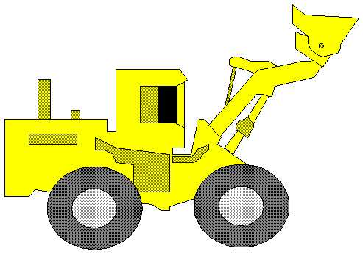
Production Estimation
Classification
  Classified according to bucket size.
  Normal bucket sizes are 2½ and 5 cubic yards.

Slide 192
Production Estimation
Characteristics
  Wheeled vehicles characterized by an attachment for lifting and loading.
  Most common scoop loader attachments are the shovel type bucket and the forklift.
  Hydraulically operated.
  Two types of buckets: the general purpose and the multi-segmented bucket.
  The GP is a one piece bucket made of heavy duty all welded steel.

Slide 193
Production Estimation
  The multi-segmented bucket is a hinged jaw bucket, commonly referred to as a clamshell.
  The two piece bucket has many capabilities not available to the single piece.
  These include, clamshell, dozer, and scraper operations.

Slide 194
Production Estimation
Operation
  Hydraulically operated and powered by a diesel engine.
  Extremely versatile and capable of many operations.
  When working in a stockpile, the bucket should be parallel to the ground when loading and raised after penetration.
  Crowding the material will prevent spilling, and maximize loading.
  When loading trucks the “V” method should be used.
  A loader can dig excavations such as defilades and gun emplacements.

Slide 195
Production Estimation
Production
  Scoop loaders are affected by numerous factors which must be considered prior to their employment.
  Among these factors are:
  Operator skill
  Extent of prior loosening of material
  Weight and volume of the material
  Slope of the operating area
  Height of material
  Climatic conditions
  Management factors.

Slide 196
Production Estimation
The Marine Corps has 2 scoop loaders in the system.
  MC1155E
  624KR TRAM
  The 420DV can also be used.
Estimating using the following formula:

Slide 197
Production Estimation
Step #1: Determine Basic (Maximum) Production
  Bucket size (CY) x Secs. working/hour
  Loader cycle time (Secs.) =
  Basic Production (LCYPH)
  Note: you can find the seconds you are working per hour by multiplying the minutes you are working per hour by 60.
  Example:
  2.5 x 3,600
  35 = 257.14 or 257 LCYPH

Slide 198
Production Estimation
Step #2: Determine Efficiency Factor (Table 17-5)
  Efficiency depends on both job conditions and management conditions.
  To arrive at an efficiency factor, these conditions must be subjectively evaluated.
  Job Factors - the physical conditions that affect the production rate of specific jobs, other than the type of material to be handled.

Slide 199
Production Estimation
Job Factors to Consider:
  Topography and work dimensions, including depth of cut and amount of movement required.
  Surface and weather conditions, including the season of the year and drainage conditions.
  Specifications that control handling of work or indicate the operational sequence.
  Equipment maintenance, and directing personnel.

Slide 200

Production Estimation
Management Factors to Consider:
  Planning, organizing, and laying out the job; supervising and controlling the operation.
  Selecting, training, and directing personnel.

Slide 201
Production Estimation
Table #17-5 Management Factors

Slide 202
Production Estimation
Step #3: Determine Net Production (LCYPH)
  To determine the net production in LCYPH, multiply the basis production in LCYPH by the efficiency factor.
Example:
  What is the NET production in LCYPH of a scoop loader with a basic production rate of 257 LCYPH, and an efficiency factor of .71?
  257 LCYPH
  x .71 Eff. Fact.
  182.47 or 182 LCYPH

Slide 203
Production Estimation
Step #4: Soil Conversion (If Needed)
  If your requirement, or quantity to be moved, is expressed in either CCY or BCY, you must convert your net production.
Bank
Loose
Compacted

Slide 204
Production Estimation
Step #5: Total Time Required (HRS)
  Determine the total time required to complete the mission.
Qty. to be moved
Hrly prod rate x # of loaders =
Total Time (hrs)
Never round off time

Slide 205
Production Estimation
Step #6: Total # of Days Required
  Determine the total # of days the project will take.
# hrs req
# hrs wk/day = # days
Note: round up to the next full day

Slide 206
Production Estimation
What have you learned?
Problem #1
Problem #2

Slide 207
Solution #1
2.5 BUCKET SIZE
x 3,600 SECS/HR Worked
9,000
÷ 120 LOADER CT
75 LCYPH
x .65 EFF FAC
48.75 or 48 LCYPH
x .72 CONV FAC
34.56 or 34 CCYPH

Slide 208
Solution #2
1.75 BUCKET SIZE
x 2,700 SECS/HR Worked
4,725
÷ 90 LOADER CT
52.50 or 52 LCYPH
x .52 EFF FAC
27.04 or 27 LCYPH

Slide 209
Production Estimation
Ratio of Loading Units to Hauling Units
  You need to determine how many loaders is required to keep up with the haul units.

Slide 210
Production Estimation
Use the following formula to figure out how many haul units 1 loader can handle with no waiting.
  Haul Unit Cycle Time
  Load Time (Table #18-5) = # haul units/loader
Note: Round down # of haul units.
Table #18-5 Loading Time

Slide 211
Production Estimation
Notes:
  If the actual load size falls between a struck and a heap load, use the heap load time for the load time.
  These are average fixed times only and are based on an average operator who is familiar with the attachments and equipment operation.
  These times are a basic starting point only.
  Actual fixed times can vary considerably due to varying conditions.
  Timing of several actual cycles is necessary in order to obtain a more realistic fixed time average for a job.

Slide 212
Production Estimation
Example:
  How many haul units can 1 Tram handle, if the haul units are hauling 15 CY of material and their cycle time is 14.5 minutes?
  14.5
  6 = 2.42 or 2 haul units
  Round down
Next you need to determine the total number of loading units needed.
All you would need to do is divide the number of haul units by the amount of haul units 1 loader can handle.

Slide 213
Production Estimation
Total Number of Loading units Needed:
  Use the following formula:
  # HAUL UNITS ÷ HAUL UNIT CYCLE TIME = # LOADING UNITS NEEDED
  LOAD TIME (TABLE# 18-5)
  Note: Round up # loading units

Slide 214

Production Estimation
What have you learned?
Problem #1
Problem #2

Slide 215
Solution #1
8.42 HAUL UNIT CT
÷ 5 LOAD TIME
1.68 or 1 HAUL UNIT

Slide 216
Solution # 2
7 # Of HAUL UNITS
÷ 33 HAUL UNIT CT
.21
x 6 LOAD TIME
1.27 or 2 LOADING UNITS
REQUIRED

Slide 217
Production Estimation
Are there any questions?
Take a break!

Slide 218
Production Estimation
Backhoes and Excavators
  Fast-acting variable-flow hydraulic systems and easy-to-operate controls give excavators the high implement speed and breakout force to excavate trenches, the precision to set pipes, and the capacity to back fill.
  These vehicles have the mobility to move quickly from job to job.

Slide 219
Production Estimation
Use
  Best suited for trench excavating, since it digs well below the unit’s wheel or tracks.
  Large variety of booms, sticks, buckets, and attachments give them versatility to excavate trenches, load trucks, clean ditches, break up old concrete, install outlet pipes, and many others.

Slide 220
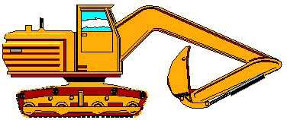
Production Estimation
Classification:
  Classified by horsepower.
  The 420DV Backhoe Loader is rated at 88hp

Slide 221
Production Estimation
420DV Backhoe Loader
  Fully hydraulic rough terrain equipped with manually control 4WD
  Will negotiate a max. grade of 35%
  Front bucket is 1 ¼ cy
  Back hoe bucket ¼ cy

Slide 222
Production Estimation
Operation
  Used for sub-ground work.
  A survey should be conducted for underground hazards, as well as surface obstacles.
  It is important that the machine be positioned properly on the job site to gain its greatest effectiveness.
  Before operating level the machine.
  Lower the bucket to the ground.
  Insure the gear shift is in neutral.
  .

Slide 223
Production Estimation
  Determine the size of the bucket that you will use to load with.
  Use Table #3-2 as before in scraper production.
Example:
  You are tasked with digging a trench with the 420D, with the GP bucket.
  Bucket size = ..25
Production Estimates:
  Backhoe and excavator production can be determined by using the following steps:
  Step #1: Bucket Size

Slide 224
Production Estimation
Step #2: Cycles/Hour (CPH)
  Determine the cycles/hour using the cycle time of the excavator and the minutes the operator will be working.
  Table #19-6 Depth of Cut
Note: These are average fixed times only and are based on an average operator who is familiar with attachments and equipment operation. Times will vary so it is necessary to time the cycle time to get a more accurate fixed time average.

Slide 225
Production Estimation
After determining the factors, place them in the formula below:
  Min. worked/hr x 60 sec/min.
  Cycle time in seconds = Cycles/hr
  Note: Never round off CPH
Example: If you are operating a 420DV tractor for 50 min/hr, and your cycle time is 35 sec., how many cycles/hr will you operate?
  50 x 60
  35 = 85.71 Cycles/hr (CPH)

Slide 226
Production Estimation
Step #3: Efficiency Factors
  Efficiency factors depends on both the job factors and management factors.
  Determine the factor as in loader estimations.
Step #4: Hourly Production Rate (LCYPH)
  To determine the hourly production rate (LCYPH), take the factors from steps 1 -3 and place them in the formula below:
  Bucket Size x Cycles/hr x Efficiency Factor = LCYPH
  Note: Round down LCYPH

Slide 227
Production Estimation
Step #5: Soil Conversion (If Needed)
LCYPH x Soil Conv. Fact. = Converted CYPH
  Note: Round down CYPH.
Bank
Loose
Compacted

Slide 228
Production Estimation
Step #6: Total Time Required (HRS)
  Determine the total time required to complete the mission.
  Qty. to be moved
Hrly Prod. Rate x # of equip.=
Total time in hours

Slide 229
Production Estimation
Step #7: Total # of Days Required
  Determine the total number of days that a project will take.
# Hrs. Req.
# Hrs. Worked/day =
# of days required
Note: Round up to next full day.

Slide 230
Production Estimation
What have you learned?
Problem #1
Problem #2

Slide 231
Solution # 1
.25 Bucket Size
30 Min/Hr Worked 1250 Req Volume
X 60 Secs/Min ÷ 12 Prod
1800 Secs/Hr Worked 104.17 THR
÷ 22 CT ÷ 8 Hrs/Day
81.28 CPH 13.02 or 14 Days
X .25 Bucket Size
X .60 EFF FAC
12.76 or 12 LCYPH

Slide 232
Solution # 2
50 MIN/HR Worked 63 REQ VOL
X 60 SEC/HR ÷ 9 PROD
3,000 SEC/HR Worked 7 THR
÷ 45 CT ÷ 8 HRS/DAY
66.67 CPH .88 or 1 DAY
X .25 BUCKET SIZE
X .78 EFF FAC
13.52 OR 13 LCYPH
X .70 CONV FAC
9.10 OR 9 BCYPH

Slide 233
Questions
Break!

Slide 234
CLAMSHELL PRODUCTION

Slide 235
Production Estimation
Because of the factors which effect operation of the clamshell, it is difficult to arrive at production rates that are dependable.
  The difficulty of loading the bucket in different types of soil.
  The height of the lift.
  The slow swing required.
  The method of disposing of the load.
  The best method is to time the cycle time.

Slide 236
Production Estimation
Example:
  Determine the production rate and time required to complete the job.
  Step #1: Convert Working Minutes/Hour to Working Seconds/Hour.
  50 work min/hr x 60 sec/hr = 3,000 sec/hr
  Step #2: Determine the Efficiency Factor:
  Use table 17-5

Slide 237
Production Estimation
Step #3: Production Formula:
  Bucket size x step #1 x step #2
  45 sec Cycle time (in sec) = 46 LCYPH
Step #4: Soil Conversion (If Needed)
  Convert the soil using your soil conversion factors.
Step #5: Determine Total Time Required To Complete The Job
  450 LCY (to be moved)
  46 LCYPH x #of Clamshells = 9.78 hrs req.

Slide 238
Production Estimation
Step #6: Total Production Days
  9.78 hrs req ÷ 8 hrs/day = 1.22 or 2 days
What have you learned?

Slide 239
Solution
45 MIN/HR Worked 15,000 VOL REQ
x 60 SECS/HR ÷ 47 PROD
2,700 SEC/HR 329.79 HRS
x 1.25 BUCKET SIZE ÷ 7 HRS/DAY
x .71 EFF FAC 47.11 or 48 DAYS
2396.25
÷ 50 CT
47.93 or 47 LCYPH

Slide 240
Questions

Slide 241
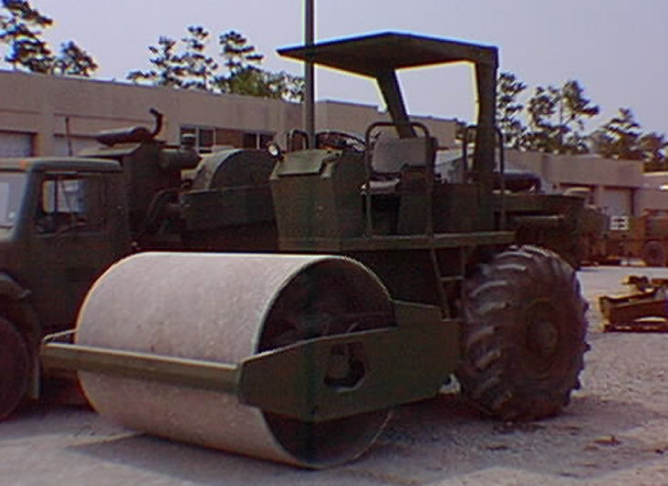
Production Estimation
Introduction:
  Compaction is the process of mechanically densifying a soil by the application of a moving load.
  No other construction process, applied to natural soils, so drastically affects a soil’s properties.
  Although compaction does not effect all soils alike, the advantages gained by compaction have made it a standard and essential part of the horizontal construction process.

Slide 242
Production Estimation
Uses:
  Compaction equipment is used strictly for mechanical stabilization.
  Proper compaction is the most critical part of construction.
  It allows the structure to meet load bearing requirements.
  In road and airfields, compaction is used from the sub-grade to the final wearing surface.

Slide 243
Production Estimation
Classification:
  Classified by weight, type and method of operation.
  There are basically 2 types of compactors:
  Towed and self-propelled.
  However when classified by method of operation, there are 3 categories:
  Pneumatic, vibratory, and rollers.
  Classification by weight uses the maximum static weight delivered to the surface.

Slide 244
Production Estimation
Characteristics:
  There are many different types, models, and functions, ranging form hand-held models used for compaction in small areas to larger models used in heavy construction.
  Some are diesel powered, gasoline powered, or pneumatic powered.

Slide 245
Production Estimation
Operation:
  Compactors are driven, towed, or manually operated.
  Because of the basic design of compactors, it is best to operate the power unit behind the compactor.
  The exception to this is with towed compactors.
  Extreme caution must be used when compacting on slopes.
  By nature compactors are slow,ranging from 3-7 mph.
  Operators should be switched often to prevent boredom and fatigue.

Slide 246
Production Estimation
Selection And Testing Of Equipment:
  Even though the Marine Corps has one type of compactor (vibratory), the military community has several to choose from.
  If the job you are working on needs a specific type that the Corps does not have, do not forget that you may be able to temporarily loan one from another service.

Slide 247
Production Estimation
Selection Factors:
  Soil-compacting equipment normally available to the military engineer includes sheepsfoot rollers, tamping-foot, pneumatic-tired rollers, smooth steel-wheel rollers, and vibratory types.
  By knowing the characteristics, capabilities, and limitations of the different types of rollers, a project officer can select the most appropriate type.
  Take a look at Table #20-8 which shows the spectrum of capabilities of each type of roller and the type of compactive effort associated with each roller.
  Note: Use this table only if test strip is unattainable.

Slide 248
Production Estimation
Production:
  Once you have selected the correct compaction equipment, use the following formula to calculate compactor production in compacted cubic yards per hour.
  16.3 x W x S X L X E
  P = CCYPH

Slide 249
Production Estimation
16.3 x W x S x L x E
P
16.3 = Constant used in formula.
W = Effective width of the roller 6’. The compactor drum is 7’ wide, however to eliminate non-compacted strips, each pass should overlap the preceding pass by 1’.
S = Compactor speed, in mph. (Table #21-8)
L = Compacted lift thickness, in inches. (Table #21-8)
E = Efficiency factor (Table #22-8)
P = # of passes required (Table #21-8)

Slide 250
Production Estimation
Step #1: Soil Type
  Production starts with determining what type of soil you are working in.
Example:
  You are compacting clay. The operator is working 50 min/hr during the day. The total amount to be compacted is 1,500 CCY. You are working 8 hrs/day.
  Soil Type: CL
Step #2: Compaction Requirements
  Using the type of soil you are working get the speed, lift thickness and # of passes from table #21-8.
  S: 3 mph
  L: 8”
  P: 7

Slide 251
Production Estimation
Step #3: Operator/Time Factor
  Due to the fact an operator cannot physically operate a vibratory compactor for more than 50 min. without a break, it is necessary to figure an efficiency factor using Table #22-8.
  E: .83
Step #4: Production Calculation
  16.3 x W x S x L x E
  16.3 x 6’ x 3 x 8” x .83
  7
  P
= 278.31 or 278 CCYPH

Slide 252
Production Estimation
Step #5: Total Hours Required
  Total to be compacted
  _____1,500 CCY_____
  278 CCYPH x 1 Comp.
  Hrly prod rate x # comp.
  = 5.40 Total hrs required

Slide 253
Production Estimation
Step #6: Total Production Days
  Hrs Req ÷ hrs worked/day
  5.40 ÷ 8 = .68 or 1 day
  Note: Round days to next full day.

Slide 254
Production Estimation
Ratio of LCYPH to Compactors (If Needed)
  Use this step if there is more than one compactor available.
Example:
  If you have 36 LCYPH of clay being delivered by 3 621B, how many compactors will it take to keep up with the delivery rate so there will be no slow down in production?
  36 LCYPH x .63 soil conversion
  278 CCYPH = .08 or 1 compactor
  Note: Always round up

Slide 255
Production Estimation
What have you learned?
Problem #1
Problem #2

Slide 256
Solution # 1
16.3 CONSTANT
X 6 EFF WIDTH
X 3 SPEED
X 8 LIFT
X.75 EFF FAC
1760.40
÷ 14 PASSES
125.74 or 125 CCYPH

Slide 257
Solution #2
16.3 CONSTANT 880 SOIL DELV.
X 6 EFF WIDTH X .63 CONV FAC
X 2 SPEED 554.40
X 6 LIFT ÷ 176 CCYPH
X .75 EFF FAC 3.15
880.20 or 4 COMP REQ
÷ 5 PASSES
176.04 or
176 CCYPH

Slide 258
Questions

Slide 259
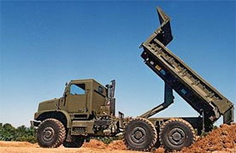
Production Estimation
Dump Truck

Slide 260
Production Estimation
Introduction:
  The most common hauling equipment used for military purposes are the 2½, 5, 7 (MK29 MK30),15 and 20 ton trucks.
  The 2½ ton truck is capable of hauling 2½ cubic yards of material.
  The 5 ton 5 cubic yards.
  The 20 ton, used mainly at a quarry, carries 12 cubic yards.
  This will vary according to the type of material being used.
  Materials weighing more than 2,000 lbs./LCY will reduce load size.

Slide 261
Production Estimation
Uses:
  Primarily used to haul and deliver material.
  Also used to transport troops and equipment in support of the unit mission.
  Equipped with a towing hook and are a tremendous asset for moving equipment and trailers.
  Trucks equipped with winches are valuable for recovery operations.

Slide 262
Production Estimation
Classification:
  Classified by weight they carry in tons, by truck volume in cubic yards, or by the heaped capacity in cubic yards.
  For example a 5 ton truck can carry 5.88 cubic yards of loose dry clay weighing 1,700 lbs/LCY but is restricted to the 5 cubic yard capacity.
  Wet clay weighing 3,200 lbs/LCY, for instance would be restricted by the 5 ton capacity.

Slide 263
Production Estimation
Characteristics:
  Characterized by a hydraulic lift cylinder that is used to raise and lower the bed.
  Most trucks are capable of all wheel drive that permit operation in different terrain's.
  The truck becomes top heavy when fully raised, so caution should be taken on side slopes.
  For safest operation, the assistant operator should dismount and act as ground guide.

Slide 264
Production Estimation
Operation:
  Hydraulically operated and powered by a diesel engine.
  Haul at the highest speed possible, without speeding.
  When several trucks are hauling it is essential to maintain proper speeds in order to prevent delays or bottlenecks.
  Lay out traffic patterns in loading and dumping sites to minimize backing, passing, and cross traffic.
  Keep trucks clean. The time spent cleaning and oiling truck bodies must be considered in computing transportation requirements.

Slide 265
Production Estimation
Operation (Cont.)
  The 900 series dumps cannot raise the bed and move forward at the same time.
  Where as the 800 series MK29 and MK30 dumps can, allowing them to spread the loaded material.
  Dump truck capacities are expressed 2 ways:
  Tons (Use Tables, #23-9, 1-3.1, 1-12.1 or check data plate for load weight.)
  Cubic yards (Use Table 23-9 for CY or call motor transport)

Slide 266
Production Estimation
Table #23-9 Truck Volumes
Note: Table information comes from TM 9 2320-260-10 and TM 9 2320-260-10

Slide 267
TABLE 1-12.1 Dump Body (MK29 and MK30)
Item | Specification
Struck Payload Capacity – Paved Surface | 21,060 lbs (9,561 kg)
Heaped Payload Capacity – Paved Surface | 28,000 lbs (12,712 kg)
Struck or Payload Capacity – Cross Country | 14,200 lbs (6,447 kg)
Recommended Personnel Capacity | 16 (NOTE: Also Refer to paragraph 2-31 for warning information)
NOTE: TABLE 1-3.1 AND 1-12.1 INFORMATION COMES FROM TM 10629-10B

Slide 268
Production Estimation
FOR CLASSROOM PURPOSES DO NOT EXCEED 10CY (20,000LBS) CAPACITY!
Outside the classroom, note the type of surface you are traveling on, this will change the capacity.

Slide 269
Production Estimation
Production:
  Other than scrapers, dump trucks are the primary haul units for earth work in the military inventory.
  Generally used for hauling distances more than 5,000’.
  There is ten steps to calculate dump truck production.

Slide 270
Production Estimation
Step #1: Actual Soil Weight
  To determine the actual soil weight per cubic yard, take the dry soil weight from (Table #2-2).
  If you are given a moisture content, multiply the weight of the soil dry by the moisture content.
  This gives you your ASW in pounds.

Slide 271
Production Estimation
Step #2: Cubic Yards Of A Load
  Remembering that you want to keep the weight of the load under 20,000 lbs., determine how many cubic yards can be hauled without exceeding 20,000 lbs.
  To do this divide 20,000 by the ASW per cubic yard.
  20,000 lbs. (rated capacity)
  ÷2,354 ASW (step #1)
  8.50 CY or no more than 10 CY
  If the resulting figure is over 10 cubic yards, you must go with 10.
  If the resulting figure is less than 10, use that figure in step #3. (note: No more than the max. volume of the truck.).

Slide 272
Production Estimation
Step #3: Buckets Loaded
  Determine the number of bucket loaded that is equal to or less than the figure determined in step #2. Divide that figure , in this case 8.50, by the size of each bucket load (Table #3-2) which for the TRAM is 2.5.
  8.50 CY
  ÷2.5 CY (bucket size from table #3-2)
  3.40 or 3 buckets

Slide 273
Production Estimation
Step #4: Actual Load Size Or Volume
  To determine the volume of the load, take the answer from step #3, 1 bucket/load, and multiply by the bucket size (2.5 for a TRAM).
  3 # of bucket/load
  x 2.5 TRAM bucket size
  7.5 Actual Load Size (ALS)
  Note: Never round off load size or volume.

Slide 274
Production Estimation
Step #5: Load Weight
  Always try to keep your soil weight under 10,000 lbs.
  Use Table #2-2 to determine you load weight.
  2,354 ASW (from step #1)
  x 7.5 ALS (from step #4)
  17,655 Load Weight (LW)
  Now you know your load weight. You can now calculate your cycle time.

Slide 275
Production Estimation
Step #6: Cycle Time
  Use Table #24-9 to get your travel speed.
  The table is for classroom purposes only.
  To figure cycle time you need to determine the travel time (TT).
  To get TT divide the distance in feet by your travel speed (TS) multiplied by 88.
  Do this for the haul and return to get your total cycle time.
  Note: 88 is the conversion factor to change the speed in mph to feet per min.

Slide 276
Production Estimation
Haul:
  Distance in feet
  TS x 88 = Haul Time (HT)
Return:
  Distance in feet
  TS x 88 = Return Time (RT)
HT + RT + 2 min. fixed time = CT
Note: Use 2 min. as a constant fixed time for dump trucks in the classroom.

Slide 277
Production Estimation
Example:
  Haul:
  7,500’
  35 TS x 88 = 2.44 HT
  Return:
  8,200’
  50 TS x 88 = 1.86 RT
  2.44 HT + 1.86 RT + 2 min = 6.30 CT
  Note: round off cycle time 2 places after the decimal point.

Slide 278
Production Estimation
Step #7: Trips Per Hour
  To determine trips per hour (TPH), divide the working minutes per hour by the cycle time.
  Working Min./Hr
  Cycle Time = Trips/Hr (TPH)
Example:
  How many trips per hour can a dump truck make during a 60 min. work hour and a cycle time of 6.30 min/trip?
  60 min/hr
  6.30 CT = 9.52 TPH
  Note: Never round off TPH

Slide 279
Production Estimation
Step #8: Hourly Production Rate
  To determine the hourly production rate you must know the size of the load (in LCY), the number of trips per hour, and the efficiency of the operator and equipment (Table #7-2 this is the same table used in scraper production).
  TPH x ALS x Efficiency Factor = LCYPH
Example:
  What is the hourly production rate of a dump truck with an average operator, working a day shift, making 9.52 TPH, with a load of 7.5 LCY?
  9.52 TPH x 7.5 ALS x .60 Eff. Fact. = 142.84 or
  42 LCYPH

Slide 280
Production Estimation
Step #9: Soil Conversion (If Needed)
  Convert you type of soil from one state to the other depending on what the job requires.
Bank
Loose
Compacted

Slide 281
Production Estimation
Step #10: Ratio Of Trucks To Scoop Loader.
  Determine the number of trucks to keep 1 scoop loader moving with no down time.
  Step #1: Loads/hr
  Loader Production (LCYPH) (step# 1to3 of loader prod.)
  Trucks ALS (LCY/load) = Loads/Hr. Do not round off
  Step #2: Loading Time Per Truck
  Min worked/hr
  Loads/hr = Loading Time/Truck (min)
  Step #3: Formulate
  Truck CT (from step 6)
  _____________________ + 1 = Trucks Req.
  Loading Time/Truck (min)

Slide 282
Production Estimation
Example:
  The TRAM is putting out 150 LCYPH and you are using a 7 ton w/ 2.5 LCY/load. You are working 50 min/hr.
  Step #1
  150 LCYPH
  2.5 ALS = 60 Loads/hr
  Step #2
  50 Min. worked/hr
  60 Loads/hr = .83 Loading time/truck
  Step #3
  6.30 Truck CT
  .83 Loading time/truck (min) = 7.59 +1 = 8.59 or 8 Trucks Required

Slide 283
Production Estimation
Step #11: Total Hours Required to Complete Mission
  To determine the total time required to complete the mission, you must know the total volume to be moved, the hourly production rate, and the number of trucks you will use on the job.
  1,900 CCY required
  10 CCYPH x 3 Dump Trucks = 63.33 Hrs.
  Note: Never round off time.

Slide 284
Production Estimation
Step #12: Total Production Days
  To get the total days, divide total time required by the hours worked per day.
  Example:
  63.33 Hrs. Required
  8 Hrs./Day = 7.92 or 8 Total Days

Slide 285
Production Estimation
What have you learned?

Slide 286
Solution
2,000 DRY CLAY
x 1.08 MOISTURE
2,160 ASW
20,000 MAX LOAD SIZE
÷ 2,160 ASW
9.26 CY OF THE LOAD
9.26 CY OF THE LOAD
÷ 2.5 BUCKET SIZE
3.70
OR 3 BUCKETS LOADED
x 2.5 ALS
7.5 ALS

Slide 287
Solution
2,160 ASW
x 7.5 ALS
16,200 LW
6,600 HD
35 X 88 = 2.14 HAUL TIME (HT)
6,600 RD
50 X 88 = 1.50 RETURN TIME (RT)
_ 2.14 + 1.50 + 2.00 = 5.64
HAUL TIME RETURN TIME FIXED TIME CYCLE TIME

Slide 288
Solution
60 MIN/HR
÷ 5.64 CT
10.64 TPH
10.64 TPH
7.5 ALS
x .6 EF
47.88
OR 47 LCYPH
47 LCYPH
x .63 CONV FACTOR
29.31
OR 29 CCYPH

Slide 289
Solution
5.64 TCT
÷ .50 LCT
11.28
+ 1.00
12.28
OR 12 TRUCKS REQUIRED
170,000 FILL REQUIRED
÷ (29 x 12)
488.51 THR
488.51
÷ 10
48.85
OR 49 DAYS REQUIRED

Slide 290
Questions?
Break!

Slide 291
SUMMARY

