Slide 1
Production Estimation

Slide 2
Purpose
To teach you how to accurately estimate an equipment oriented job by using given estimation production times and procedures.

Slide 3
Learning Objectives
Terminal Learning Objective
Enabling Learning Objective

Slide 4
Method and Media
Lecture , demonstration and practical application Methods
Computer Generated Slides

Slide 5
Evaluation
Practical applications using each Production Estimation Formula.
Open book exam!

Slide 6
SAFETY/CEASE TRAINING

Slide 7
ANY QUESTIONS?

Slide 8
Estimating
The art of determining the size of the job, labor, equipment needed to perform the job and quantities of materials.
To do any type of estimation, you need to know some basic formulas.

Slide 9
Soil States
Soil is found in three states.
  Sometimes it is necessary to convert from one volume to another.
  To do this we use table #1-1.
Bank
Loose
Compacted

Slide 10
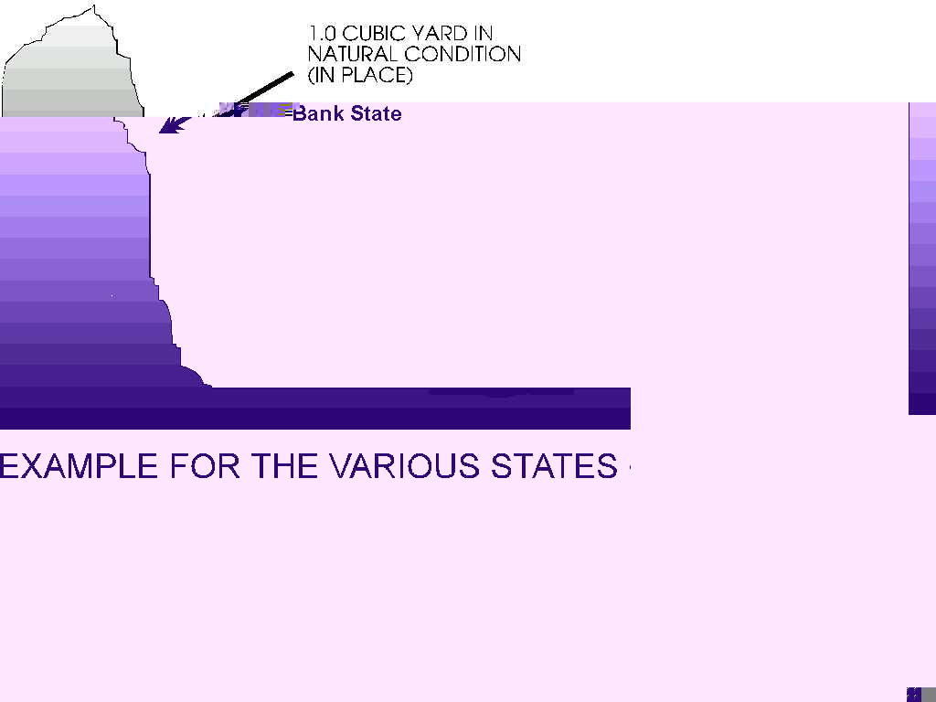
Bank State
Any soil that has not been disturbed from its natural state for at least ten years.
  This is also known as Bank Cubic Yards (BCY).

Slide 11
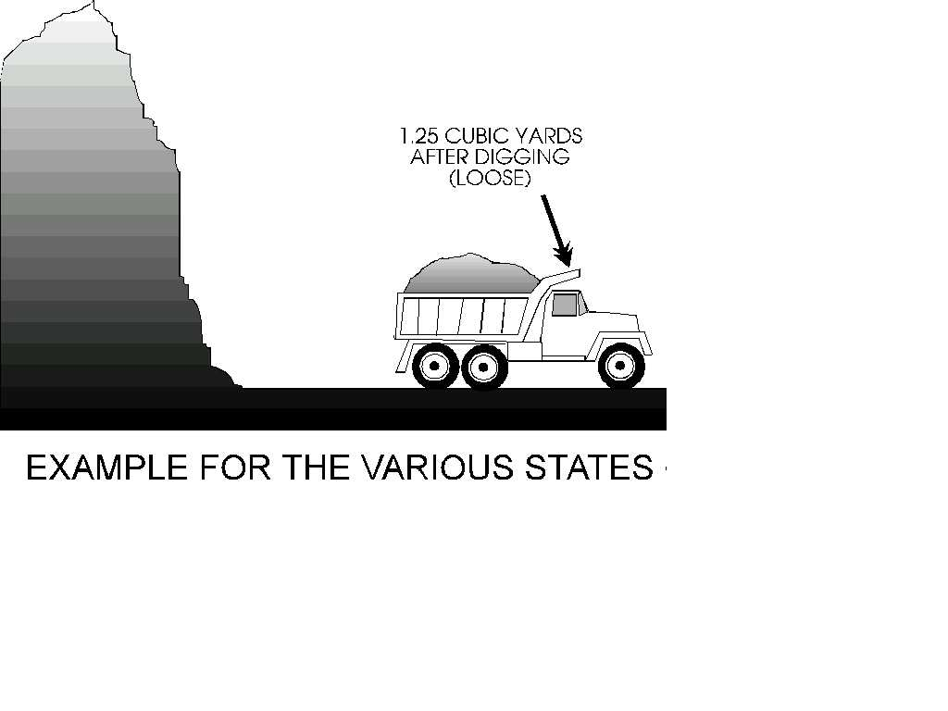
Loose State
Any soil that has been disturbed.
  Note: Soil is always in a loose state when hauled, worked or stockpiled.
  This is also known as Loose Cubic Yards (LCY).

Slide 12

Compacted State
Any soil that has been compacted by artificial means.
  This is also known as Compacted Cubic Yards (CCY).

Slide 13
Table #1-1 Soil Conversion Factors

Slide 14
Example
If we needed to make a road that is 1,500’ long with a 3” lift of gravel and 24’ wide, it would be necessary to compute the volume first in compacted cubic yards and then convert it to a loose state.
This determines how much material our haul units would have to move.
This is done by multiplying the volume of the compacted material by a conversion factor.

Slide 15
Solution
3” ÷ 12” = .25’
1500’ (L) x .25’ (H) x 24’ (W) =
9000’ ÷ 27 = 333.33 or 334 CCY
334 CCY
x1.17 Conversion Factor
390.78 or 391 LCY
Note: Round up to the next full cubic yard.

Slide 16
What Have You Learned?
Problem #1
Your crew is tasked to dig a trench which is 300’ long, 9’ wide, and 6’ deep.
  Earth loam, dry and the soil has been undisturbed for more than 10 years.
  Using a 420 DV
  How many loose cubic yards of soil will you remove?
Solution
300’ x 9’ x 6’
27 = 600 BCY
600 BCY x 1.25 =750 LCY

Slide 17
What Have You Learned?
Problem #2
In the previous problem you removed ___ LCY of soil.
However you requirement for a road you are working on is 16,600 CCY.
Will you have enough soil to do the road?
If yes, how much over?
If no, how much under?
Solution
750 LCY x .72 = 540 CCY
16,600 CCY
- 540 CCY
16,060 CCY under

Slide 18
Production Time
Each piece of equipment has its own production formula.
Basic Formulas
Cubic Yards Per Hour (CYPH)
Loose Cubic Yards/Hour (LCYPH)
Bank Cubic Yards/Hour (BCYPH)
Compacted Cubic Yards/Hour (CCYPH)

Slide 19
Cubic Yards Per Day (CYPD)
Total cubic yards moved per hour multiplied by the total hours worked per day.
Example:
  100 CYPH x 8 hr work/day =
  800 CYPD
  Note: Round down CYPD

Slide 20
Production Days
Total requirement of material needed divided by the total CYPD moved.
Example:
  16,600 req CY ÷ 800 CYPD =
  20.75 or 21 days
  Note: Round up days to next full day.

Slide 21
What Have You Learned?
Problem #1
  You are moving 150 LCYPH
  Working 5 hours per day.
  The requirement to be moved is 17,000 LCY.
  LCYPD?
  Total Days?

Slide 22
Solution
150 LCYPH x 5 Hrs/day = 750 LCYPD
17,000 Req LCY ÷ 750 LCYPD =
22.67 or 23 days

Slide 23
What Have You Learned?
Problem #2
  You are moving 250 LCYPH
  Working 8 Hrs/day.
  The requirement to be move is 18,000 LCY.
  LCYPD?
  Total Days?

Slide 24
Solution
250 LCYPH x 8 Hrs/day = 2,000 LCYPD
18,000 Req LCY ÷ 2000 LCYPD = 9 days

Slide 25
QUESTIONS?

Slide 26
QUESTIONS TO CLASS
a. What is estimating?
The art of determining the size, equipment,
personal, and quantities needed
for a project.
b. What are the three states of soil?
Bank, Loose, Compacted
c. What does CCYPH mean?
Compact Cubic Yards Per Hour (CCYPH)

Slide 27
BREAK!!!!!!!!!!

Slide 29
Scrapers
  Designed for loading, hauling and dumping on long haul earthmoving operations.
  Has 3 basic operational parts; the bowl, the apron, and the ejector.
  The bowl, which is equipped with a cutting edge on the front bottom, is the loading and carrying component.
  The apron is the front wall of the bowl, and can be raised and lowered independently of the bowl.
  The ejector is the rear wall of the bowl. It is moved back to load, and forward to discharge materials.

Slide 30
Scraper Uses
Scrapers serve the primary purpose of loading and hauling material.
  The distinct advantage of the scraper, is the ability to load, haul, and spread in one continuous cycle.
  Capacity is measured in heaped and struck capacity.
  Capable of working alone for leveling operations, but is supplemented with push-tractors for cut and fill operations.

Slide 31
Classification
Classified according to load capacity and rated load.
  A heap load is the maximum load of the machine.
  A struck load is the minimum effective load.

Slide 32
Characteristics
  Wheeled vehicle characterized by a tractor and a scraper.
  Prime movers in cut and fill operations and in bringing elevations to rough, final grades.
  Open bowl design, they can be loaded from above.
  3 types of cutting edges:
  Straight, Curved, and the 3 piece cutting edge.
  The 621B has a rated load weight of 48,000 lbs.

Slide 33
Operation
  Hydraulically operated and powered by a tractor.
  Most efficient during downhill loading.
  Other methods of production include straddle loading and pump loading.
  All loading should be accomplished with a pusher, within (1) minute, and within (100) feet of travel.

Slide 34
Types Of Loads
Struck load:
  Loaded with soil until the material is approximately even with the top of the side boards.
  The capacity of the 621B Scraper, when struck loaded, is 14 loose cubic yards.
Heap load:
  Loaded with soil when the material is overflowing the side boards.
  The capacity of the 621B Scraper, when heap loaded, is 18 Loose Cubic Yards.

Slide 35
Actual Load Size (ALS)
Actual load size (ALS) will vary considerably, being somewhere between struck & heap due to variables such as:
  Soil weight
  Moisture Content
  Manner in which scraper is being loaded.

Slide 36
QUESTIONS

Slide 37
Scraper Production
15 Step process

Slide 38
Soil Weight
Soil weight is used in all production.
To determine the actual soil weight (ASW) per cubic yard, start by taking the soil weight from table #2-2.

Slide 39
Table #2-2 Approximate Weight of Soil
PER CUBIC YARD
Type Of Soil Pounds Per (CY) Type Of Soil Pounds Per (CY)
Cinders 1,200 lbs. Limestone 2,500 lbs.
Clay, Dry 2,000 lbs. Sandstone 2,200 lbs.
Clay, Wet 3,000 lbs. Sand, Dry 2,900 lbs.
Clay, Gravel 2,700 lbs. Sand, Wet 3,100 lbs.
Gravel, Dry 3,000 lbs. Shale & Soft Rock 2,700 lbs.
Gravel, Wet 3,100 lbs. Slag, Bank 1,940 lbs.
Earth Loam, Dry 2,200 lbs. Slate 2,500 lbs.
Earth Loam, Wet 3,200 lbs. Trap Rock 3,500 lbs.
Hardpan 3,100 lbs. Coral, Hard 2,440 lbs.
Coral, Soft 2,030 lbs.

Slide 40
Moisture Content
Moisture weight in the soil.
  Although table #2-2 shows some soils with moisture, it may be necessary to get an exact moisture content to determine soil weight.
  The moisture will be expressed as a percentage of the dry soil.
Soil analysis personnel are trained to determine the moisture content, and the weight of this moisture must be calculated and added to the weight of the DRY soil.

Slide 41
Actual Soil Weight (ASW)
Method used to determine ASW.
Example:
Earth Loam with a 7% moisture content.
  Earth loam weighs 2,200 lbs/cubic yard.
  Multiply 2,200 by 1.07 to get the moisture weight of 2354 lbs.
The initial moisture content is 7% of the original weight.
  Therefore, the actual soil weight is 107% of the original weight.
  Convert the percentage to a decimal.
  Multiply the original soil weight by 1.07 and you get 2,354 lbs. ASW.

Slide 42
Actual Soil Weight (ASW)
For classroom purposes:
  If you are given a wet soil, take the weight of the wet soil off table #2-2.
  If you are not given either wet or dry condition, take the weight of dry soil off table #2-2.
  If you are given a wet soil and a moisture content, take the weight of dry soil and multiply the moisture content.
Never round off ASW

Slide 43
Scraper Production Step #1
Actual Soil Weight (ASW).
  Remember never round off ASW.
Example:
Earth Loam weighs 2,200 lbs./CY. With 7% moisture content.
2,200 x 1.07 = 2,354 ASW

Slide 44
Try A Few
Figure out the Actual Soil Weight (ASW) of the following:
  Wet clay, with 14% Moisture.
  Wet sand, with 17% moisture.
  Soft coral, with 2% moisture.
  Earth loam
  Clay & gravel, with 18% moisture.

Slide 45
Solutions
2,000 x 1.14 = 2,280 ASW
2,900 x 1.17 = 3,393 ASW
2,030 x 1.02 = 2,070.60 ASW
2,200 ASW
2,700 x 1.18 = 3,186 ASW

Slide 46
Scraper Production Step #2
Cubic Yards of a Load.
  You have to determine the maximum cubic yards you can haul without exceeding 48,000 lbs. (max load) or 18 cubic yards (max capacity).
  To do this divide 48,000 by the ASW/CY
Example:
48,000 lbs. (rated capacity)
2,354 lbs. (Actual Soil Weight)
20.39 CY No more than 18 CY
If the resulting figure is less than 18, use that entire number as it appears on the calculator in step #3.
If Push or Self Loading, this is your Actual Load Size (ALS) - go to Step #5.

Slide 47
Scraper Production Step #3
Buckets Loaded.
  Buckets loaded must be a whole number.
  Divide cubic yards of a load by the bucket size.
Example:
  Using a TRAM with a
  2 ½ or 2.5 cy. bucket
18 Cubic Yards
2.5 Cubic Yards (bucket size from table #3-2)
7.2 buckets or 7 bucket loads
Note: Round down to whole buckets loaded.

Slide 48
Bucket Sizes Table #3-2
Type of Equipment Bucket size
Tram 624KR 2½ or 2.5 CY
MC1155E 1¾ or 1.75 CY
MAC 50 CLAMSHELL 1¼ or 1.25 CY
420D Front Bucket 1 or 1.25
420D Backhoe Bucket ¼ or .25

Slide 49
Scraper Production Step #4
Actual Load Size.
  The true amount of soil in haul unit.
  Number of buckets multiplied by the bucket size.
Example:
7 #of Buckets
x 2.5 TRAM Bucket Size
17.5 cy Actual Load Size (ALS)
Note: Never round off ALS.

Slide 50
Scraper Production Step #5
Load Weight (LW).
  Multiply your ASW by your ALS.
  Keep your load weight under 48,000 lbs.
  Table #2-2 shows the weight of cinders as 1200 lbs./LCY.
  A struck load would weigh 16,800 lbs., while the heap load would weigh 21,600 lbs..
  These weights would be easily hauled, but it is a different story with other materials.
  Take a look at Earth Loam, wet for instance:
  3,200 weight of Earth Loam, wet/CY 3,200
  x 14 LCY Struck x 18 LCY Heaped
  44,800 lbs. Struck Loaded 57,600 lbs. Heaped

Slide 51
Example
Each cubic yard weighs 2,354 lbs. (step #1), and you are hauling 17.5 cubic yards.
2,354 ASW
x17.5 ALS
41,195 load weight (LW)
Note: Never round off load weight.

Slide 52

Scraper Production Step #6
Short Tons
  First determine the gross weight of the vehicle with load.
  Divide the gross weight by 2,000 lbs. (the weight of one ton).
Example:
A 621B weighs 66,590 lbs.
41,195 LW (step #5)
+66,590 Tractor weight
107,785 Gross weight
÷ 2,000 Weight of 1 ton
53.89 Short tons (ST)
Note: Never round off short tons (ST).
CLEAR CALCULATOR

Slide 53
PRACTICAL APPLICATION

Slide 54
What Have You Learned?
Problem #1
  Figure the ASW of Gravel with a 12% moisture content.
Solution:
3,000 Weight of dry gravel
x1.12 Moisture content
3,360 lbs. ASW

Slide 55
What Have You Learned?
Problem #2
  When hauling this gravel in a 621B loaded with a TRAM 624KR, what would the load weight be?

Slide 56
What Have You Learned?
Solution:
48,000 Rated Capacity
÷3,360 ASW
14.29 CY of load
÷ 2.5 Bucket size
5.72 or 5 # buckets loaded
5 # buckets loaded
x2.5 Bucket size
12.50 ALS
x3,360 ASW
42,000 LW

Slide 57
What Have You Learned?
Problem #3
  If the 621B has a load weight of 46,590 lbs., what would your short tons be?
Solution:
46,590 LW
+66,590 Tractor weight
113,180 Gross weight
÷ 2,000 1 ton
56.59 ST

Slide 58
BREAK 10 MIN

Slide 59
Scraper Production Step #7
Rolling Resistance
  The resistance of movement to wheeled vehicles over a haul surface caused by irregularities in the surface such as compacting and displacement of material, caused by the flexing of tire sidewalls on the roadway.
  Rolling resistance is measured by the rim pull in pounds per short ton required to overcome resistance.
  This resistance effects the cycle time.

Slide 60
Scraper Production Step #7
To do this multiply short tons (from step #6) by the rolling resistance factor (RRF) found in table #4-2).
The resulting answer will be your rolling resistance (RR).
Table #4-2 Rolling Resistance Factors

Slide 61
Example
Determine the rolling resistance for a 621B scraper traveling over firm, smooth-rolling roadway flexing slightly under load 1” penetration.
The weight of the soil in the scraper is 41,195 lbs.(from Step #5)
53.89 ST (from step #6)
x 65 RRF (from table #4-2)
3502.85 or 3503 RR
Note: Round Off Rule
  Round up 5 or greater, round down 4 or less for RR.

Slide 62
PRACTICAL APPLICATION

Slide 63
What Have You Learned?
Problem #1
  Figure the Rolling Resistance for the following situation.
  621B Scraper
  Struck loaded (self loaded)
  Hard pan
  Rutted, dirt roadway, flexing considerably under load with 2”-3” penetration.
Step #1
  3,100 ASW
Step #2
  N/A
Step #3
  N/A
Step #4
  N/A

Slide 64
What Have You Learned?
Step #5
  3,100 ASW
  x 14 ALS
  43,400 LW
Step #6
  43,400 LW
  +66,590 TR WT
  109,990 GW
  ÷ 2,000 1 ton
  55.00 ST
Step #7
  55.00 ST
  x 100 RRF
  5,500 RR

Slide 65
What Have You Learned?
Problem #2
Figure rolling resistance for the following situation.
  621B scraper
  Loaded with a Tram (2½ CY bucket)
  Trap rock
  Hard, smooth, stabilized roadway without penetration.
Step #1
  3,500 ASW
Step #2
  48,000 Rated Capacity
  ÷3,500 ASW
  13.71 CY of a load
Step #3
  13.71 CY of a load
  ÷ 2.5 Bucket size
  5.49 or 5 Bucket loads

Slide 66
What Have You Learned?
Step #6
  437250 LW
  + 66,590 TR WT
  110,340 GW
  ÷ 2,000 1 ST
  55.17 ST
Step #7
  55.17 ST
  x 40 RRF
  2,206.80 or 2,207 RR
Step #4
  5 Buckets loaded
  x2.5 Bucket size
  12.50 ALS
Step #5
  3,500 ASW
  x12.50 ALS
  43,750 LW

Slide 67
Scraper Production Step #8
Grade Resistance (GR) or Grade Assistance (GA).
  Grade resistance or Grade assistance is the increase, or decrease, in the amount of pounds of pull required as the result of adverse or favorable grades on haul roads.
  Rules of thumb generally accepted as reliable measures of the effect of grades are as follows:
  Grade resistance effects the cycle time by slowing the scraper.

Slide 68
Scraper Production Step #8
Each 1% of uphill grade increases the resistance by 20 lbs. Per short ton pull of gross vehicle weight.
Formula:
  Short tons x 20 (constant) x % of grade = Grade resistance or assistance.

Slide 69
Example
The total weight of the loaded scraper on the haul is 107,785 lbs. (from step #6)
  Calculate the grade resistance factor for climbing a (+2) uphill grade.

Slide 70
Example Solution
53.89 x 20 x 2 = 2155.6 or 2156
ST x 20 x % grade = grade resistance (GR)
Note:
  Round up 5 or greater, round down 4 or less (GR/GA).

Slide 71
Scraper Production Step #8
Each 1% of downhill grade decreases the amount of pull required by 20 lbs. Per short ton of gross vehicle weight.

Slide 72
Example
For the return, the tractor is empty so the total weight is 66,590 lbs.
  Calculate the grade assistance factor for (-2) downhill grade.

Slide 73
Example Solution
33.30 x 20 x -2 = -1,332
ST empty x 20 x % of grade = Grade Assistance (GA)
Note:
  Round up 5 or greater, round down 4 or less. (GR/GA)

Slide 74
PRACTICAL APPLICATION

Slide 75
What Have You Learned?
Problem #1
Determine Grade Resistance for a 621B with the following factors:
  Struck load
  Sand
  7% initial moisture
  3% Uphill grade

Slide 76
What Have You Learned?
Step #1
  2,900 Soil WT
  x 1.07 Moisture
  3,103 ASW
Step #2
  N/A
Step #3
  N/A
Step #4
  N/A
Step #5
  3,103 ASW
  x 14 ALS
  43,442 LW
Step #6
  43,442 LW
  +66,590 TR WT
  110,032 GW
  ÷ 2,000 1 ST
  55.02 ST

Slide 77
What Have You Learned?
Step #7
  N/A
Step #8
  55.02 ST
  x 20 Constant
  x 3 % of grade
  3,301.20 or 3,301 GR

Slide 78
What Have You Learned?
Problem #2
  Determine rolling and grade resistance for a 621B on the haul with the following factors:
  Heap load
  Sandstone
  Rutted, dirt roadway, no stabilization under load 4”-6” penetration.
  6% uphill grade

Slide 79
What Have You Learned?
Step #1
  2,200 ASW
Step #2
  N/A
Step #3
  N/A
Step #4
  N/A
Step #5
  2,200 ASW
  x 18 ALS
  39,600 LW
Step #6
  39,600 LW
  + 66,590 TR WT
  106,190 GW
  ÷ 2,000 1 ST
  53.10 ST

Slide 80
What Have You Learned?
Step #7
  53.10 ST
  x 150 RRF
  7,965 RR
Step #8
  53.10 ST
  x 20 Constant
  x 6 % of grade
  6,372 GR

Slide 81
Scraper Production
Take a break!

Slide 82
Scraper Production Step #9
Required Pounds Of Pull (REQPP)
  The total power required to move a unit.
  We can find our REQPP by adding GR with RR from uphill, or Subtract GA from RR for downhill.
  When on level ground, your RR is your REQPP.

Slide 83
Example
When traveling uphill a vehicle must overcome both rolling resistance and grade resistance.
  3,503 RR
  +2156 (+GR)
  5,659 REQPP Using table #5-2, you can see that the scraper will not give you enough Rim Pounds Pull(RPP) in 8th or 7th gear, but 6th gear you have enough RPP. The travel speed is 14 Mph.
  Table #5-2 Power Characteristics of 621B Scraper

Slide 84
Scraper Production Step #9
Note:
  If your TM doesn’t have the table, you can use the following formula to get your RPP.
  375 x Engine HP x 80% Efficiency
  travel speed in mph. =
  Rim Pounds Pull (RPP)

Slide 85
Example
When traveling downhill a vehicle must overcome rolling resistance less grade assistance.
  2,165 RR
  -1,332 GA
  833 REQPP
  Using table #5-2, we see that the scraper will give you enough RPP in 8th gear.
  The travel speed is 26 mph.
When traveling over level terrain, a vehicle must overcome rolling resistance only.
  3,503 RR = 3,503 REQPP
  Using table #5-2, we see that the scraper will give you enough RPP in 7th gear.
  The travel speed is 19 mph.

Slide 86

What Have You Learned?
Problem #12
  Determine travel speed with the following factors:
  621B scraper
  Struck Load
  Earth loam
  10% initial moisture
  Hard, smooth roadway with no penetration under load.
  4% downhill grade.

Slide 87
What Have You Learned?
Step #1
  2,200 Dry soil WT
  x 1.10 Moisture
  2,420 ASW
Step #2
  N/A
Step #3
  N/A
Step #4
  N/A
Step #5
  2,420 ASW
  x 14 ALS
  33,880 LW
Step #6
  33,880 LW
  + 66,590 TR WT
  100,470 GW
  ÷ 2,000 1 ST
  50.24 ST

Slide 88
What Have You Learned?
Step #7
  50.24 ST
  x 40 RRF
  2,009.6 or 2,010 RR
Step #8
  50.24 ST
  x 20 constant
  x -4 % grade
  -4,019.2 or -4,019 GA
Step #9
  2,010 RR
  -4,019 GA
  -2,009 REQPP
  8th gear 26 mph

Slide 89
What Have You Learned?
Problem #13
  Determine the travel speed with the following factors:
  621B Scraper
  Struck load
  Clay and gravel
  3% initial moisture
  Rutted, dirt roadway, no stabilization under load, 4”-6” penetration.
  6% uphill grade.

Slide 90
What Have You Learned?
Step #1
  2,700 Dry soil WT
  x1.03 Moisture
  2,781 ASW
Step #2
  N/A
Step #3
  N/A
Step #4
  N/A
Step #5
  2,781 ASW
  x 14 ALS
  38,934 LW
Step #6
  38,934 LW
  + 66,590 TR WT
  105,524 GW
  ÷ 2,000 1 ST
  52.76 ST

Slide 91
What Have You Learned?
Step #7
  52.76 ST
  x 150 RRF
  7,914 RR
Step #8
  52.76 ST
  x 20 Constant
  x 6 % grade
  6,331.2 or 6,331 GR
Step #9
  7,914 RR
  + 6,331 GR
  14,245 REQPP
  3rd gear 6 mph

Slide 92
Scraper Production Step #9
Return
  The return is done by repeating steps 6-9 and using empty vehicle weight to get short tons.
Example:
  Step #6: Short tons (ST) with empty vehicle weight.
  66,590 GW
  ÷2,000 1 ST
  33.30 ST (ST, constant for an empty 621B)
  Step #7: Rolling Resistance (RR)
  33.30 ST
  x 65 RRF
  2,164.5 or 2,165 RR
  Step #8: Grade Resistance/Assistance (GR/GA)
  33.30 ST x 20 x -2 =
  -1,332 GA

Slide 93
Scraper Production Step #9
Step #9: Required Pounds Of Pull (REQPP) & Travel Speed.
  2,165 RR
  -1,332 GA
  833 REQPP
  8th gear / 26 mph
Now that you have you travel speed for haul and return, you can formulate the cycle time (step 10).

Slide 94
Scraper Production Step #10
Cycle Time
  The time required to Load, Haul, Spread, and Return.
  This is figured by adding Fixed Time (Fix-T) and Travel Time (TT) to get Cycle Time (CT)

Slide 95
Scraper Production Step #10
Fixed Time:
  Is the time spent during an equipment cycle other than hauling and returning.
  This includes positioning , loading, unloading, turning, accelerating and decelerating, all of which are fairly constant or fixed.
  Fixed times are determined from Table #6-2.
  To use Table #6-2, start with what gear you are in.

Slide 96
Scraper Production Step #10
Table #6-2 Fixed Time
Equipment 1st,2nd,3rd 4th 5th,6th,7th,8th
Loading Gear Haul Gear Haul Gear Haul
Scraper
Struck Heap Struck Heap Struck Heap
Scraper Loading 2.50 N/A 2.80 N/A 3.0 N/A
Itself
1155E 7.0 9.0 7.30 9.30 7.50 9.50
TRAM 6.0 7.0 6.30 7.30 6.50 7.50
1085 w/1.5 bucket 12.0 14.0 12.30 14.30 12.50 14.50
1085 w/.75 bucket 16.0 22.0 16.30 22.30 16.50 22.50
HSHMC clamshell 16.0 19.0 16.30 19.30 16.50 19.50
Scraper Push 1.43 1.71 1.73 2.01 1.93 2.21
Loaded
Take a Look at the note in your handout.

Slide 97
Scraper Production Step #10
Travel Time:
  The time spent on the haul road transporting material and returning empty.
  Travel Time depends on: size of hauling unit, rolling resistance, grade resistance, and distance traveled.
  All of which have already been figured to get your gear selection and speed to put in your cycle time formula.

Slide 98
Scraper Production Step #10
To figure cycle time (CT) you must first figure travel time (TT).
  To get travel time divide the distance in feet of the haul or return road by the sum of the travel speed (TS) in mph multiplied by 88.
  Do this for the haul and return.
  The total time plus fixed time will equal total cycle time.
  Note: 88 is he conversion factor to change the speed in mph to feet traveled per minute.

Slide 99
Example
A 621B scraper, hauling 17.5 CY of material, travels 7500’ to the fill area using 6th gear and returns empty by a different route of 8200’ in 8th gear.
What is the total cycle time, if the 621B is being loaded by a TRAM.
7500’ haul dist.
14 TS x 88 =
6.09 HT
8200’ return dist.
26 TS x 88 =
3.58 RT
6.09 + 3.58 + 7.5 =
17.17 min
  Note: never round off time.

Slide 100

What Have You Learned?
Problem #14
  Figure total cycle time.
  621B, self loaded
  Haul distance - 8250’
  Return distance - 7125’
  Haul gear - 4th
  Return gear - 8th

Slide 101
Solution
8250’ HD
8 TS x 88 = 11.72 HT
7125’ RD
26 TS x 88 = 3.11 RT
11.72 + 3.11 + 2.80 =
17.63 CT

Slide 102
What Have You Learned?
Problem #15
  Figure total cycle time.
  621B, self loaded
  Haul distance - 9000’
  Return distance - 9176’
  Haul gear - 6th
  Return gear - 8th

Slide 103
Solution
9000’ HD
14 TS x 88 = 7.31 HT
9176’ RD
26 TS x 88 = 4.01 RT
7.31 + 4.01 + 3.0 =
14.32 min CT

Slide 104
Scraper Production
Take A Break!

Slide 105
Scraper Production Step #11
Trips Per Hour
  To determine trips per hour (TPH) divide the working minutes per hour (normally a 60 min. work hour) by the cycle time.
  Note: never round off TPH.
Example:
  How many trips per hour can a 621B make during a 60 min. work hour if it has a 17.17 min cycle time?
  60 min. worked/hr
  17.17 CT =
  3.49 TPH

Slide 106
Scraper Production Step #12
Hourly Production Rate (LCYPH)
  To determine the hourly production rate, you must know the actual load size (in LCY), the number of trips per hour, and the efficiency factor of the operator and equipment.
TPH
x ALS
x Efficiency Factor
= LCYPH
Note: always round down LCYPH.

Slide 107
Scraper Production Step #12
Table #7-2 Efficiency Factor
Example:
  What is the hourly production rate for a 621B with an average operator, working days, making 3.49 TPH, with a load of 17.5 LCY?
  3.49 TPH x 17.5 ALS x .60 = 36.65 or 36 LCYPH

Slide 108
Scraper Production Step #13
Soil Conversion (SC) (if needed)
  in some cases the hourly production rate may be needed in compacted cubic yards (CCY) for a road or runway.
  Note: round down CYPH.
Bank
Loose
Compacted

Slide 109
Scraper Production Step #14
Total Hours Required To Complete Mission
  To determine the total time required to complete the mission, you must know the total volume to be moved, the hourly production rate, and the number of scrapers you will use on the job.
Volume needed (_CY)
_CYPH x #of scrapers =
Total Hours Required
Note: never round off time.
Example:
  19,440 CCY
  25 CCYPH x 3 scrapers =
  259.20 hours required

Slide 110
Scraper Production Step #15
Total Production Days
  To get the production days required to complete the mission, divide total hours required by the hours worked per day, which will equal the total number of days required.
Example:
  259.20 hours req. ÷ 8 hrs/day
  = 32.40 or 33 days
Note: Round days to next full day.

Slide 111
What Have You Learned?
Problem# 16
Figure total number production days with the following factors:
  3 621B
  Struck loaded, loam
  7 hr. production day
  Excellent operator
  13.08 min. cycle time
  Compacted volume required for job 250,000 CY
  Working 60 min/hr

Slide 112
Solution
Step #11
  60 Min/hr
  ÷13.08 CT
  4.59 TPH
Step #12
  4.59 TPH
  x 14 ALS
  x1.0 Efficiency factor
  64.26 or 64 LCYPH
Step #13
  64 LCYPH
  x.72 Conversion Factor
  46.08 or 46 CCYPH
Step #14
  250,000 Req vol
  46 x 3 = 1,811.59 hrs
Step #15
  1,811.59 hrs req
  ÷ 7 Hrs/day
  258.8 or 259 Days

Slide 113
What Have You Learned?
Problem #17 A project requires you to build a parking lot using gravel. How many work nights, at 8 hours per night, are require to complete the project? You are working only during hours of darkness. The job conditions are as follows.
  5 621B, Compacted fill required 150,000 CY
  Struck loaded, Gravel, moisture content 14%
  Haul distance 7000 ft, return same route
  Grade of haul road 6% downhill, Average operator
  Rutted, dirt roadway, with no stabilization under 4” to 6” penetration.
  Working 60 min/hr

Slide 114
Solution
Step #1
  3000
  X 1.14
  3420 ASW
Step #5
  3420 ASW
  x 14 ALS
  47,880 LW
Step #6
  47880
  +66590
  114470
  ÷ 2000
  57.24 ST
Step #7
  57.24
  x 150
  8586 RR (HAUL)

Slide 115
Solution
Step #7
  33.30
  X 150
  4995 RR(RETURN)
Step #8
  57.24
  x 20
  x -6
  -6868.8 or 6869 GA (haul)
Step #8
  33.30
  x 20
  x 6
  3,996 GR (RETURN)
Step #9
  8586 RR
  -6869 GA
  1717 RPP (HAUL) 8TH 26MPH

Slide 116
Solution
Step #9
  4995 RR
  +3996 GR
  8991 RPP(RETURN)
  5TH 11MPH
Step #10
  7000’
  26 x 88 = 3.06 HT
Step #10
  7000’
  11 x 88 = 7.23. RT
  3.06 + 7.23 + 3.00 = 13.29
Step #11
  60 Min/HR
  ÷13.29 CT
  4.51 TPH

Slide 117
Solution
Step #12
  4.51 TPH
  x 14 ALS
  x .4 EFF. FAC.
  25.26 or 25 LCYPH
Step #13
  25 LCYPH
  x .86 Conv. Fac.
  21.50 or 21 CCPH
Step #14
  150000
  21 x 5 = 1428.57 THR
Step #15
1428.57 THR
  ÷ 8 HRS/NIGHT
  178.57 or 179 NIGHTS

Slide 118
QUESTIONS
a. How many steps are there in Scraper production?
15
b. When do you round off time?
NEVER
c. What does TPH mean?
Trips Per Hour (TPH)

Slide 119
BREAK 10 MIN

Slide 120
Push Loading
One of the most effective methods of loading a scraper.
Decreases time, and distance.
Usually, a 621B is pushed by a MCT.
The MCT has a reinforced blade for push loading.
Load time should be 1 min. or less.
The optimum loading distance is around 90’ - 125’.
The optimum depth of cut is 4” - 6”.
  Varies according to type of soil,moisture content, loadability, operator, load size,and method of employment.

Slide 121
Push Loading
Normally the gear used during push loading is second for the MCT and first for the 621B.
The Mph listed In table #5-2 for the scraper and table #8-2 for the MCT reflect maximum and/or average speed in mph.
When push loading is employed, the maximum mph will not be the loaded mph reflected in the tables, therefore, for classroom purposes, use 2 mph when push loading.

Slide 122
Push Tractor Step #1
Figuring the number of push tractors (PT) needed.
  Load Time (LT)
  The time required to load the haul unit during which the dozer is in contact with the push block of the scraper.
Length of cut
mph x 88 = LT in min.
Example:
  150’ length of cut
  2 mph x 88 = .85 LT

Slide 123
Push Tractor Step #2
Boost Time (BT)
  The time expended after the scraper is loaded during which the push tractor assists the scraper in attaining momentum. (for boost time use a constant of .25)

Slide 124
Push Tractor Step #3
Return Time (RT)
  the time required for the push tractor to return to the starting point.
  This portion of the cycle time will be greatly reduced by chain or shuttle loading.
LT x 1.4 = RT
Example:
  .85 LT
  x 1.4 Constant
  1.19 min.RT

Slide 125
Push Tractor Step #4
Formulate Cycle Time
  (Load Time x 1.4) + Boost Time = PT Cycle Time (CT)
Example:
  (.85 x 1.4) + .25 = 1.44 min PT CT
  NOTE: NEVER ROUND OFF TIME

Slide 126
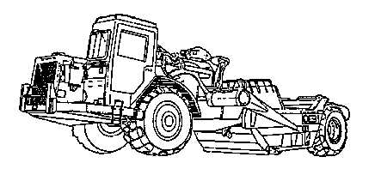
Push Tractor Step #5
Number Of Scrapers A Push-Tractor Can Support
  This is found by dividing scraper cycle time by the push-tractor time.
  Example:
  How many scrapers can a single push-tractor support if the scraper cycle time is 4 min. and the push-tractor cycle time is 1.3 min.?
4 min Scraper CT
÷1.3 min PT CT
3.08 Round down to 3 scrapers.

Slide 127
Push Tractor Step #6
Number of Push-Tractors Required
  This is found by dividing the number of scrapers on the job, by the number of scrapers a push-tractor can support.
  Note: Round up number of push-tractors required.
Example:
  How many push-tractors are required on a job that has 9 621B’s, if a single push-tractor can support 3 scrapers?
  9 Scrapers
  ÷ 3 Scrapers/tractor
  3 Push-tractors

Slide 128
What Have You Learned?
Problem #1
  Figure the number of push-tractors required for :
  4 621B
  12.58 min cycle time
  150’ cut

Slide 129
Solution
Step #1
  150 Length of cut
  ÷(2x88) mph & conv.factor
  .85 LT
Step #2
  .25 BT
Step #3
  .85 LT
  x 1.4 Conv. factor
  1.19 RT
Step #4
  1.19 RT
  +.25 BT
  1.44 min PT CT
Step #5
  12.58 CT
  ÷1.44 PT CT
  8.74 or 8 Scrapers/PT

Slide 130
Solution
Step #6
  4 Scrapers
  ÷ 8 Scrapers/PT
  .50 or 1 PT required

Slide 131

What Have You Learned?
Problem #2
  Figure the number of push-tractors required for:
  7 621B’s
  8.92 CT
  125’ Cut

Slide 132
Solution
Step #1
  125 Length of cut
  ÷(2x88) mph & conv. Factor
  .71 LT
Step #2
  .25 BT
Step #3
  .71 LT
  x 1.4 Conv. Factor
  .99 RT
Step #4
  .99 RT
  +.25 BT
  1.24 min PT CT
Step #5
  8.92 CT
  ÷1.24 PT CT
  7.19 or 7 Scrapers/PT

Slide 133
Solution
Step #6
  7 Scrapers
  ÷ 7 Scrapers/PT
  1 PT required

Slide 134

What Have You Learned?
Problem #3
  A project requires you build a road using clay and gravel with an 8% moisture content.
  The borrow pit area allows you to push load the 621Bs with MCTs.
  How many days are required?
  Show and label all figures and formulas.

Slide 135
Solution
Days
Step #1
  2,916 ASW
Step #2
  14 CY/load
Step #3
  N/A
Step #4
  N/A
Step #5
  40,824 LW
Step #6
  Haul
  107,414 GW
  53.71 ST
  Return
  33.30 ST
Step #7
  Haul
  5,371 RR
  Return
  3,330 RR
Step #8
  Haul
  7,519 GR
  Return
  4,662 GA

Slide 136
Solution
Step #9
  Haul
  12,890 REQPP
  4th gear 8 mph
  Return
  -1,332 REQPP
  8th gear 26 mph
Step #10
  9.38 HT
  2.88 RT
  13.99 CT
Step #11
  4.29 TPH
Step #12
  36 LCYPH
Step #13
  22 CCYPH
Step #14
  1,325.76 Hrs Req
Step #15
  133 Days

Slide 137
Solution
# of PT Required
Step #1
  .45 LT
Step #2
  .25 BT
Step #3
  .63RT
Step #4
  .88 PT CT
Step #5
  15 #scrapers/dozer
Step #6
  1 PT required

Slide 138
QUESTIONS
What is the only dozer in the Marine Corps that can be used as a push tractor?
Medium Crawler Tractor (MCT)
What are the three types of push loading??
Chain Loading, Shuttle Loading, Backtrack loading
c. What should the load time be?
One minute or less

Slide 139
Push Tractor Production
Take A Break!

Slide 140
Crawler Tractor
Introduction
  Dozers and scrapers are the most common pieces of equipment on a project.
  It is important to be able to properly use these earthmovers to, get maximum production, to establish production estimation rates, and to insure the prompt completion of an earth moving task.

Slide 141
Dozer Uses
Used as prime movers for pushing or pulling loads.
Used for power units for winches and hoists.
As moving mounts for dozer blades.
Used primarily where it is advantageous to obtain high drawbar pull and traction.
Most suitable equipment for pushing or pulling loads through marshy areas.

Slide 142
Dozer Classification
Crawler tractors are classified according to weight.
  Light (1150 & 1155)
  Medium (MCT)
  Heavy (D8)

Slide 143
Dozer Characteristics
Supported on the ground by track assemblies.
Commonly called bulldozers, they are the work horses of construction.
Usually the first piece of equipment on job site, last to leave.
Used to cut haul roads, move dirt, trees, rocks, and many other.
Simply a tractor with a blade mounted on the front which is used for pushing objects or materials.

Slide 144
Dozer Characteristics
Once the blade is removed, it’s used as a towing unit.
Since the weight of the machine is supported by the track sections, the crawler tractor has great traction pull.
The ability to “lock” one side section of track while pulling with the other one enables the crawler tractor to pull itself out of material that would easily cause a wheeled machine to become stuck.

Slide 145
Dozer Operation
Equipped with a diesel engine rated from 85 to 202 horsepower, and either 4 or 6 cylinders, depending on make and model.
Low ground bearing pressure, varying form 6 - 9 lbs./Sq. in., which gives it distinct “floatation” advantage.
Capable of operating in muck or water as deep as the height of the track.
Can move to jobsite on own power, but transporting is preferred.

Slide 146
Dozer Production
Estimated using the production from Table #9-3, and then adjusting the table with six correction factors.

Slide 147
Dozer Production
Formula
  Factor 1 x Factor 2 x Factor 3 x Factor 4 x Factor 5 x Factor 6 = LCYPH
  Note: Round down LCYPH
  For classroom purposes, if you are not given the information for any step, that step will be N/A.

Slide 148
Dozer Production Factor #1
Maximum Basic Production
  Find the average dozing distance line on the bottom of the scale.
  Read up until you intercept the production curve for the dozer you are using.
  Then read to the left to get the production rate in LCYPH.
Note:
  On the charts the 4S is the 1150E and the 7S is the MCT.
Example
  Determine the maximum basic production for a MCT with an average dozing distance of 200’.
  200 LCYPH
  Round down

Slide 149
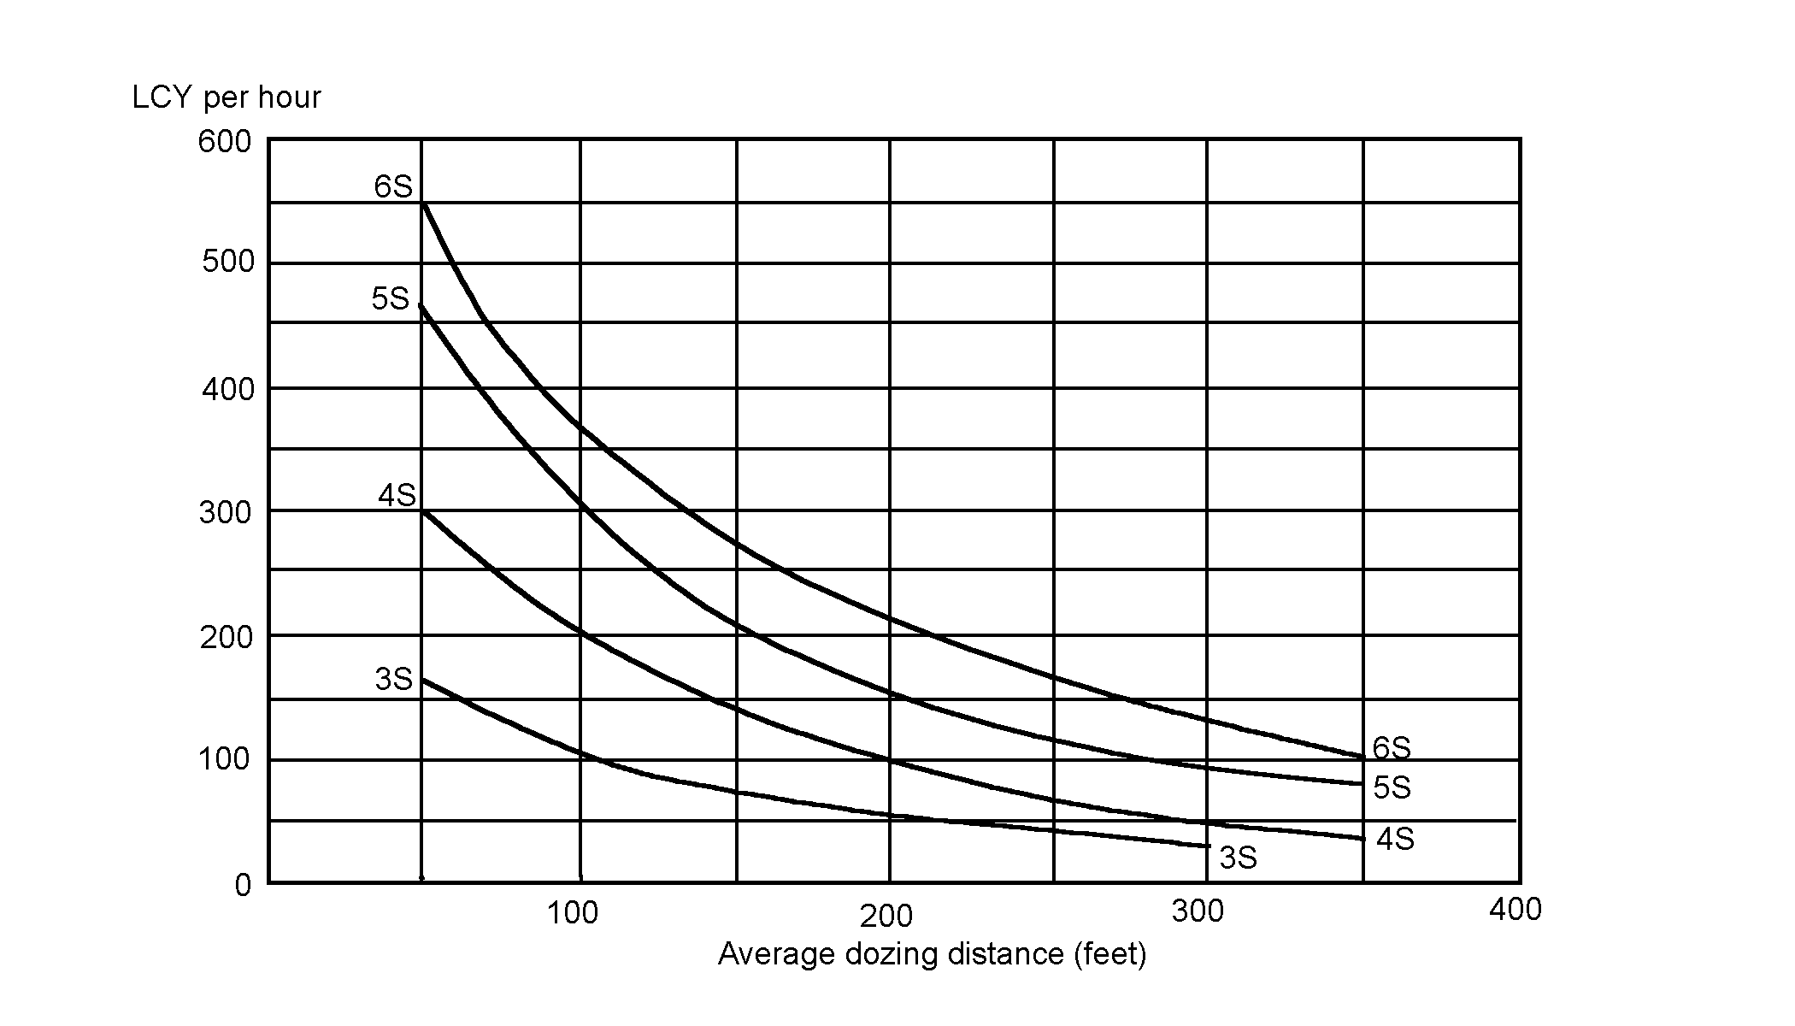
Dozer Production Factor #1

Slide 150
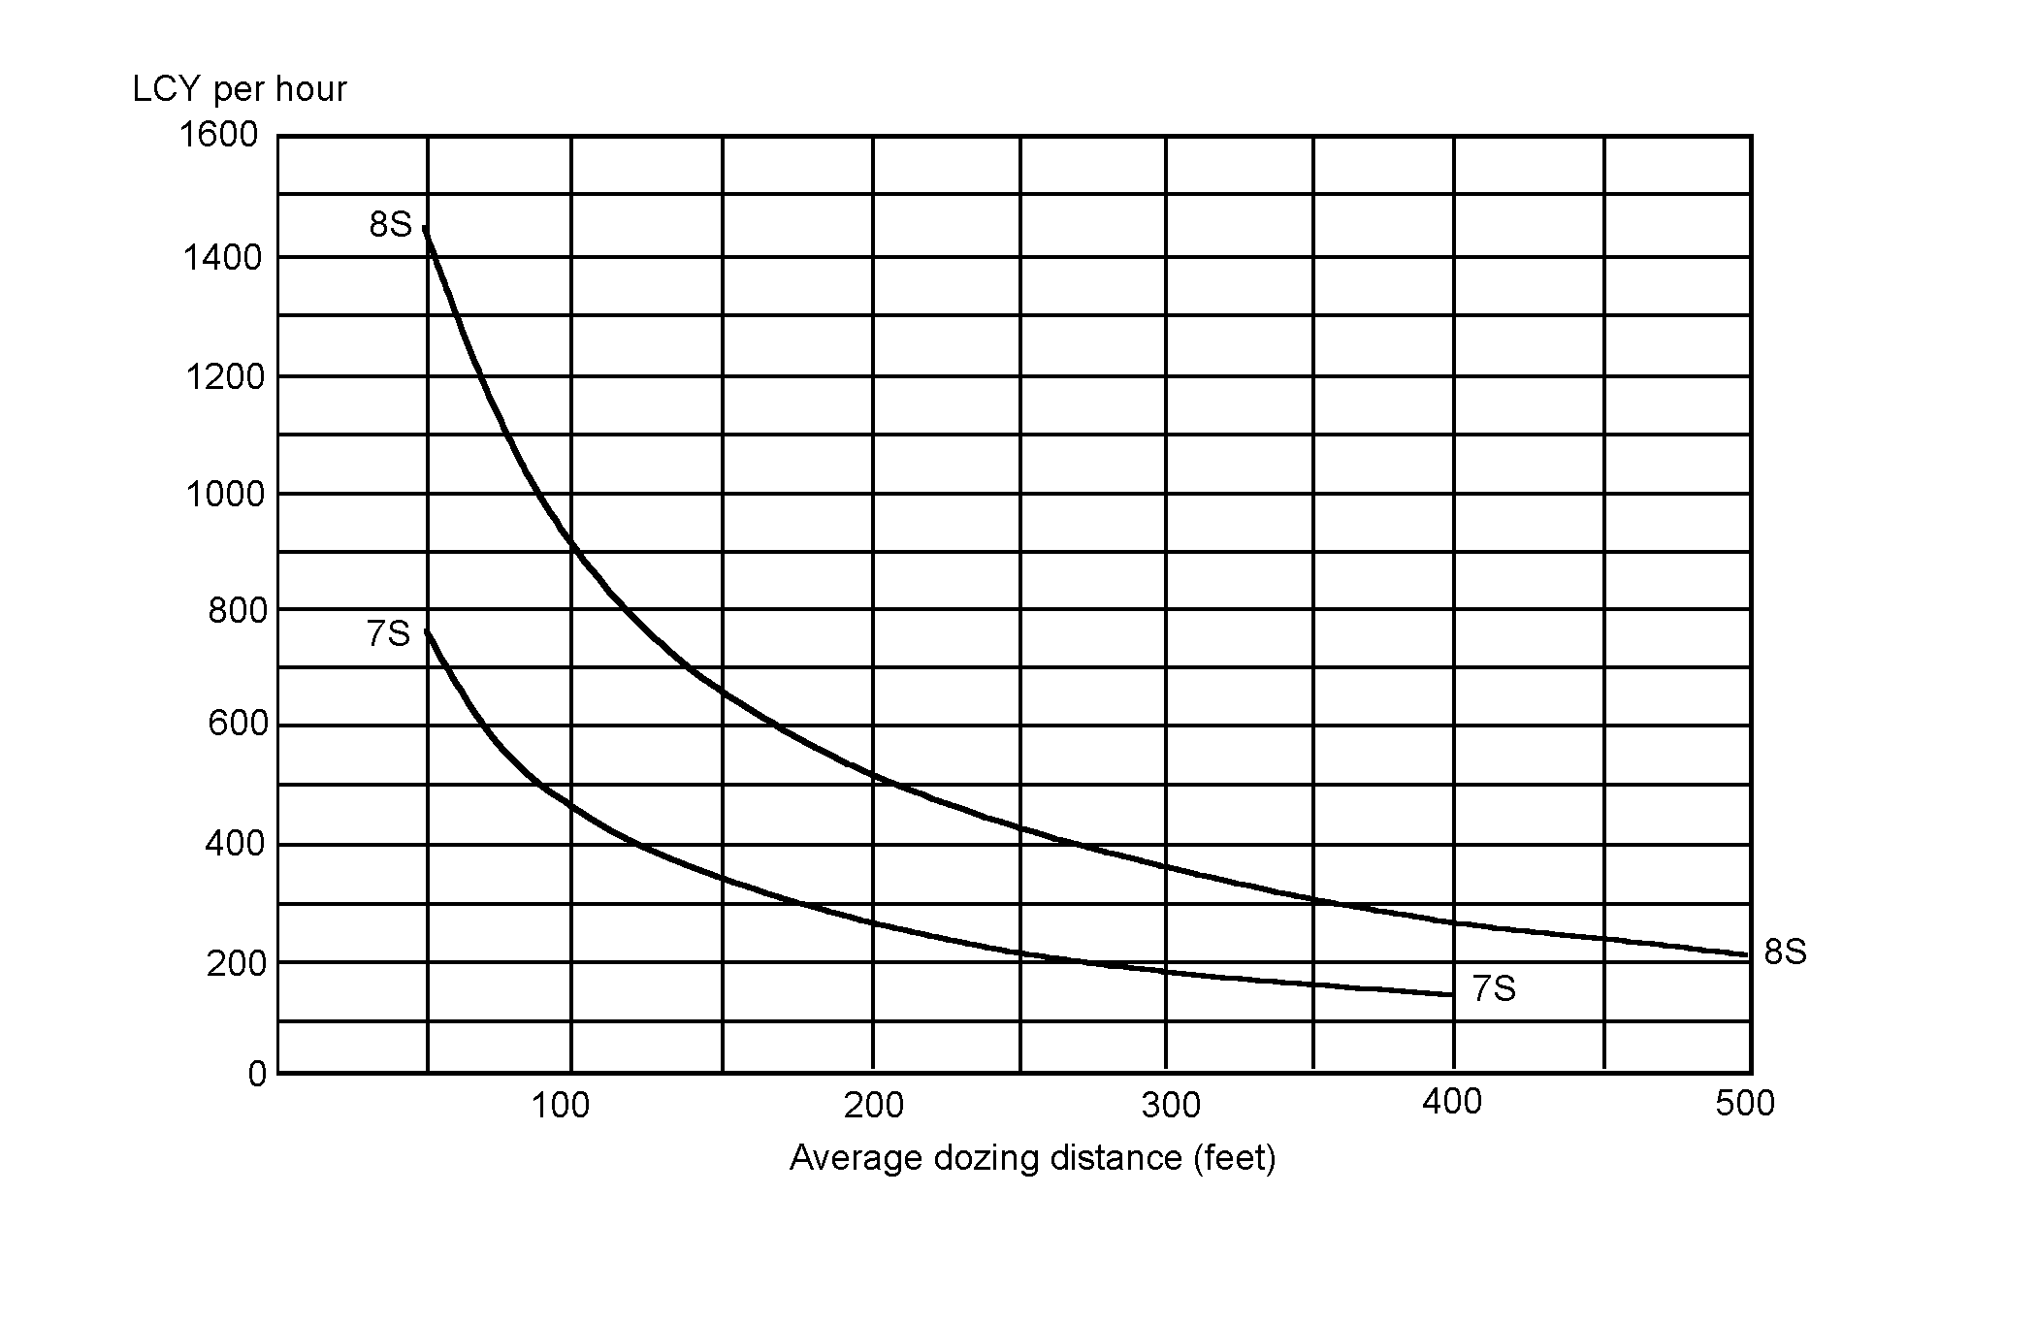
Dozer Production Factor #1

Slide 151
Dozer Production Factor #2
Grade Correction Factor
  Using table #10-3 find the % of grade (-) favorable, (+) unfavorable, on the top of the scale, read down until you intercept the grade correction curve.
  Read to the right to determine the grade correction factor.
  Each vertical line on this scale represents multiples of two.
  Each horizontal line represents 0.04.
  Note: For classroom purposes round off, up or down to the closest factor.

Slide 152
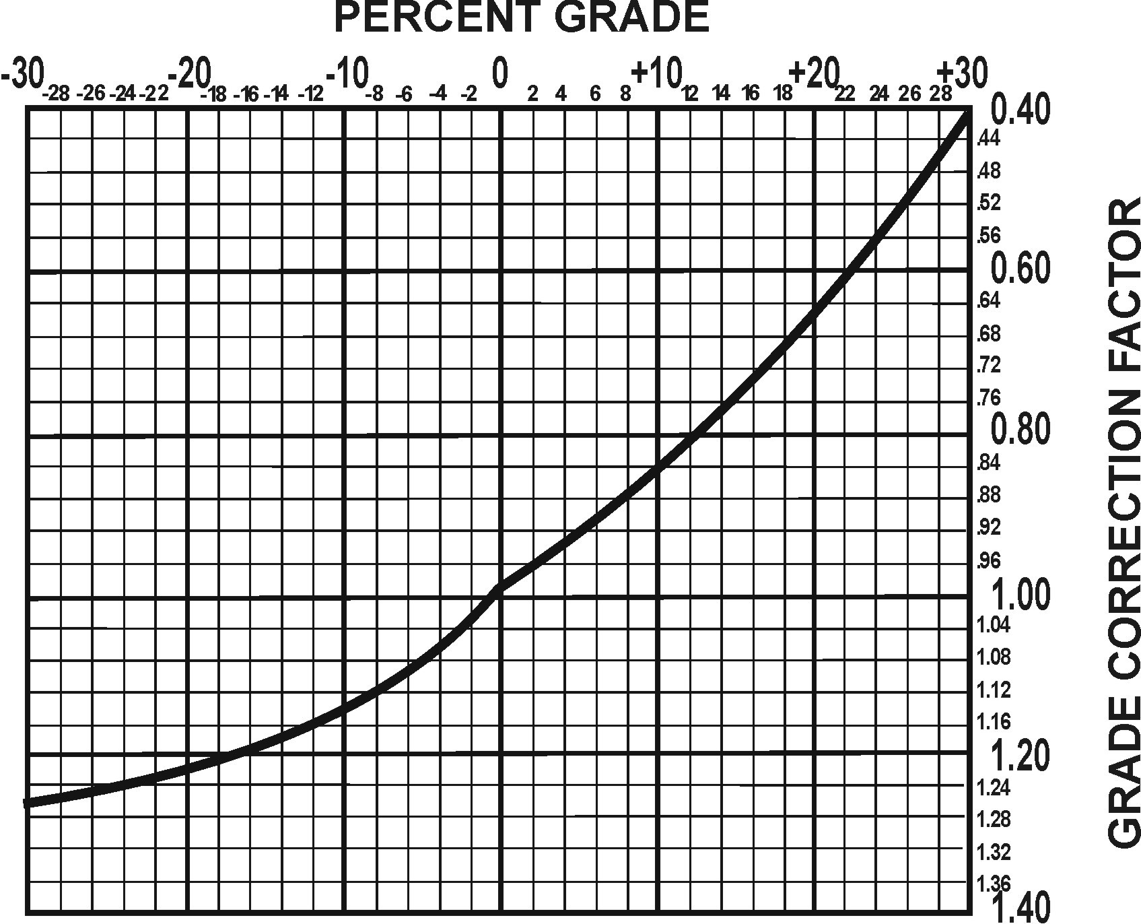

Slide 153
Example
If you had to move the material up a 2% grade (+), what would be your grade correction factor?
  .96

Slide 154
Dozer Production Factor #3
Soil Weight Correction Factor
  Using table #2-2 as before, get your ASW.
  Divide 2,300 lbs./CY by you ASW to find the correction factor.
  2,300 lbs. is a constant which is the weight of soil used to determine table #9-3.
Example:
  You are working in clay with a 5% moisture content.
  2,300 Constant
  ÷2,100 ASW
  1.10 Soil weight correction factor
  Note: Never round off.

Slide 155
Dozer Production Factor #4
Soil Type Correction Factor
  The dozer blade is designed to cut the material and give is a rolling effect for a production factor of 1.00.
  Material found in different states will effect dozer production as in the following table.
  Table #11-3 Soil Correction Factor

Slide 156
Dozer Production Factor #5
Equipment/Operator Efficiency Correction Factor
  These factors include operator efficiency and visibility (dust, rain, snow, fog, and darkness) with a job efficiency of a 60 min. hour.
Table #7-2 Equipment/Operator Efficiency Factor

Slide 157
Dozer Production Factor #6
Management Technique Correction Factor
Table #12-3

Slide 158
Dozer Production Step #1
Production Calculation
  Factor #1
  x Factor #2
  x Factor #3
  x Factor #4
  x Factor #5
  x Factor #6
  LCYPH/dozer
Note: Round down LCYPH

Slide 159
Dozer Production Step #2
Soil Conversion Factor (if required)
  Convert soil by using table #1-1 as before.
Bank
Loose
Compacted

Slide 160
Dozer Production Step #3
Example:
  How long would it take to move 4,500 CCY of clay, using 3 MCTs with a production rate of 143 CCYPH?
  4,500 CCY
  ÷(143x3) Basic prod. Rate x # dozers
  10.49 hrs. required
  Note: Never round off time.
Total Hours Required
  Quantity to be moved, divided by the hourly production rate, multiplied by the number of dozers you have employed, equals the total time in hours to complete the job.

Slide 161
Dozer Production Step #4
Total Production (Days)
Example:
  10.49 Hrs required
  ÷ 8 Hrs/day
  1.31 or 2 Days
Note: round days to next full day.

Slide 162
Dozer Production Step #5
Total Number of Dozers Required
  Quantity of material to be moved.
  Divided by the hourly production rate.
  Multiplied by the number of hours you have to complete the job.
Example:
  How many MCTs would be needed to move 4,500 CCY of loam in 5 hrs. if the dozers have a hourly production rate of 143 CCYPH?
  4,500 CCY required
  ÷ (143x5) CCYPH x hrs.
  6.29 or 7 D7Gs
Note: Always round up

Slide 163
What Have You Learned?
Problem #1
  Using the information in your handout, determine how long it will take 2 MCTs to complete the job:

Slide 164
Solution
Factor #1
  300 LCYPH Max. basic prod.
Factor #2
  .96 Grade correction factor
Factor #3
  2,040 ASW
  1.13 Soil wt correction factor
Factor #4
  .80 Soil correction factor
Factor #5
  .45 Equip/Op correct. factor
Factor #6
  1.15 Mngt. correct. Factor
Step #1
  134.73 or 134 LCYPH
Step #2
  84.42 or 84 CCYPH
Step #3
  9.21 Hours

Slide 165
What Have You Learned?
Problem #2
  Using the information in your student handout, determine how many MC1150Es are required to complete the job in 5 hours.

Slide 166
Solution
Factor #1
  200 LCYPH Max. basic prod.
Factor #2
  .92 Grade correction factor
Factor #3
  2200 ASW
  1.05 Soil wt correction factor
Factor #4
  .80 Soil correction factor
Factor #5
  1.00 Equip/op correct. factor
Factor #6
  1.20 Mngt. Correct. factor
Step #1
  185.47 or 185 LCYPH
Step #2
  N/A
Step #3
  3.22 or (4) MC1150Es

Slide 167

Dozer Production Estimation
Are there any questions?
Take a break!

Slide 168
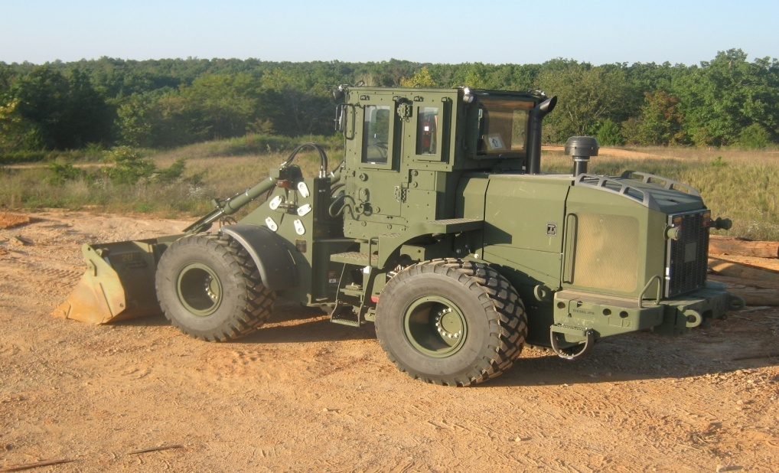
PRODUCTION ESTIMATIONS
LOADERS

Slide 169
Scoop Loader Production
Introduction
  Loaders are available in varied sizes and bucket capacities.
  Loaders have a hinged frame which provides the steering, this steering method is referred to as articulated, and provides greater maneuverability.
  Articulated steering provides zero clearance for personnel at the point of articulation.
  Most loaders have a towing pintle for towing small trailers.
  Special caution should be exercised when the bucket is fully raised, because the chances of rollover or tipping are greatly increased.

Slide 170
Production Estimation
Uses
  Primarily used for front end loading.
  Also used for excavating, snow removal, and back filling.
  It is capable of many other operations with the proper attachments such as; forks, sweeper, snowplow, and multi segmented bucket.
  Used around rock quarries, when equipped with rock-type tread tires.
  Used in various tasks, including, stripping overburden, charging hoppers, and carrying materials.

Slide 171
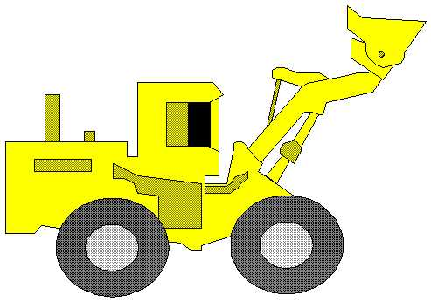
Production Estimation
Classification
  Classified according to bucket size.
  Normal bucket sizes are 2½ and 5 cubic yards.

Slide 172
Production Estimation
Characteristics
  Wheeled vehicles characterized by an attachment for lifting and loading.
  Most common scoop loader attachments are the shovel type bucket and the forklift.
  Hydraulically operated.
  Two types of buckets: the general purpose and the multi-segmented bucket.
  The GP is a one piece bucket made of heavy duty all welded steel.

Slide 173
Production Estimation
  The multi-segmented bucket is a hinged jaw bucket, commonly referred to as a clamshell.
  The two piece bucket has many capabilities not available to the single piece.
  These include, clamshell, dozer, and scraper operations.

Slide 174
Production Estimation
Operation
  Hydraulically operated and powered by a diesel engine.
  Extremely versatile and capable of many operations.
  When working in a stockpile, the bucket should be parallel to the ground when loading and raised after penetration.
  Crowding the material will prevent spilling, and maximize loading.
  When loading trucks the “V” method should be used.
  A loader can dig excavations such as defilades and gun emplacements.

Slide 175
Production Estimation
Production
  Scoop loaders are affected by numerous factors which must be considered prior to their employment.
  Among these factors are:
  Operator skill
  Extent of prior loosening of material
  Weight and volume of the material
  Slope of the operating area
  Height of material
  Climatic conditions
  Management factors.

Slide 176
Production Estimation
The Marine Corps has 2 scoop loaders in the system.
  MC1155E
  624KR TRAM
  The 420DV can also be used.
Estimating using the following formula:

Slide 177
Production Estimation
Step #1: Determine Basic (Maximum) Production
  Bucket size (CY) x Secs. working/hour
  Loader cycle time (Secs.) =
  Basic Production (LCYPH)
  Note: you can find the seconds you are working per hour by multiplying the minutes you are working per hour by 60.
  Example:
  2.5 x 3,600
  35 = 257.14 or 257 LCYPH

Slide 178
Production Estimation
Step #2: Determine Efficiency Factor (Table 17-5)
  Efficiency depends on both job conditions and management conditions.
  To arrive at an efficiency factor, these conditions must be subjectively evaluated.
  Job Factors - the physical conditions that affect the production rate of specific jobs, other than the type of material to be handled.

Slide 179
Production Estimation
Job Factors to Consider:
  Topography and work dimensions, including depth of cut and amount of movement required.
  Surface and weather conditions, including the season of the year and drainage conditions.
  Specifications that control handling of work or indicate the operational sequence.
  Equipment maintenance, and directing personnel.

Slide 180

Production Estimation
Management Factors to Consider:
  Planning, organizing, and laying out the job; supervising and controlling the operation.
  Selecting, training, and directing personnel.

Slide 181
Production Estimation
Table #17-5 Management Factors

Slide 182
Production Estimation
Step #3: Determine Net Production (LCYPH)
  To determine the net production in LCYPH, multiply the basis production in LCYPH by the efficiency factor.
Example:
  What is the NET production in LCYPH of a scoop loader with a basic production rate of 257 LCYPH, and an efficiency factor of .71?
  257 LCYPH
  x .71 Eff. Fact.
  182.47 or 182 LCYPH

Slide 183
Production Estimation
Step #4: Soil Conversion (If Needed)
  If your requirement, or quantity to be moved, is expressed in either CCY or BCY, you must convert your net production.
Bank
Loose
Compacted

Slide 184
Production Estimation
Step #5: Total Time Required (HRS)
  Determine the total time required to complete the mission.
Qty. to be moved
Hrly prod rate x # of loaders =
Total Time (hrs)
Never round off time

Slide 185
Production Estimation
Step #6: Total # of Days Required
  Determine the total # of days the project will take.
# hrs req
# hrs wk/day = # days
Note: round up to the next full day

Slide 186
Production Estimation
What have you learned?
Problem #1
Problem #2

Slide 187
Solution #1
2.5 BUCKET SIZE
x 3,600 SECS/HR Worked
9,000
÷ 120 LOADER CT
75 LCYPH
x .65 EFF FAC
48.75 or 48 LCYPH
x .72 CONV FAC
34.56 or 34 CCYPH

Slide 188
Solution #2
1.75 BUCKET SIZE
x 2,700 SECS/HR Worked
4,725
÷ 90 LOADER CT
52.50 or 52 LCYPH
x .52 EFF FAC
27.04 or 27 LCYPH

Slide 189
Production Estimation
Ratio of Loading Units to Hauling Units
  You need to determine how many loaders is required to keep up with the haul units.

Slide 190
Production Estimation
Use the following formula to figure out how many haul units 1 loader can handle with no waiting.
  Haul Unit Cycle Time
  Load Time (Table #18-5) = # haul units/loader
Note: Round down # of haul units.
Table #18-5 Loading Time

Slide 191
Production Estimation
Notes:
  If the actual load size falls between a struck and a heap load, use the heap load time for the load time.
  These are average fixed times only and are based on an average operator who is familiar with the attachments and equipment operation.
  These times are a basic starting point only.
  Actual fixed times can vary considerably due to varying conditions.
  Timing of several actual cycles is necessary in order to obtain a more realistic fixed time average for a job.

Slide 192
Production Estimation
Example:
  How many haul units can 1 Tram handle, if the haul units are hauling 15 CY of material and their cycle time is 14.5 minutes?
  14.5
  6 = 2.42 or 2 haul units
  Round down
Next you need to determine the total number of loading units needed.
All you would need to do is divide the number of haul units by the amount of haul units 1 loader can handle.

Slide 193
Production Estimation
Total Number of Loading units Needed:
  Use the following formula:
  # HAUL UNITS ÷ HAUL UNIT CYCLE TIME = # LOADING UNITS NEEDED
  LOAD TIME (TABLE# 18-5)
  Note: Round up # loading units

Slide 194

Production Estimation
What have you learned?
Problem #3
Problem #4

Slide 195
Solution #3
8.42 HAUL UNIT CT
÷ 5 LOAD TIME
1.68 or 1 HAUL UNIT

Slide 196
Solution # 4
7 # Of HAUL UNITS
÷ 33 HAUL UNIT CT
.21
x 6 LOAD TIME
1.27 or 2 LOADING UNITS
REQUIRED

Slide 197
QUESTIONS

Slide 198
Production Estimation
BREAK…..

Slide 199
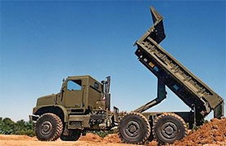
Production Estimation
Dump Truck

Slide 200
Production Estimation
Introduction:
  The most common hauling equipment used for military purposes are the 2½, 5, 7 (MK29 MK30),15 and 20 ton trucks.
  The 2½ ton truck is capable of hauling 2½ cubic yards of material.
  The 5 ton 5 cubic yards.
  The 20 ton, used mainly at a quarry, carries 12 cubic yards.
  This will vary according to the type of material being used.
  Materials weighing more than 2,000 lbs./LCY will reduce load size.

Slide 201
Production Estimation
Uses:
  Primarily used to haul and deliver material.
  Also used to transport troops and equipment in support of the unit mission.
  Equipped with a towing hook and are a tremendous asset for moving equipment and trailers.
  Trucks equipped with winches are valuable for recovery operations.

Slide 202
Production Estimation
Classification:
  Classified by weight they carry in tons, by truck volume in cubic yards, or by the heaped capacity in cubic yards.
  For example a 5 ton truck can carry 5.88 cubic yards of loose dry clay weighing 1,700 lbs/LCY but is restricted to the 5 cubic yard capacity.
  Wet clay weighing 3,200 lbs/LCY, for instance would be restricted by the 5 ton capacity.

Slide 203
Production Estimation
Characteristics:
  Characterized by a hydraulic lift cylinder that is used to raise and lower the bed.
  Most trucks are capable of all wheel drive that permit operation in different terrain's.
  The truck becomes top heavy when fully raised, so caution should be taken on side slopes.
  For safest operation, the assistant operator should dismount and act as ground guide.

Slide 204
Production Estimation
Operation:
  Hydraulically operated and powered by a diesel engine.
  Haul at the highest speed possible, without speeding.
  When several trucks are hauling it is essential to maintain proper speeds in order to prevent delays or bottlenecks.
  Lay out traffic patterns in loading and dumping sites to minimize backing, passing, and cross traffic.
  Keep trucks clean. The time spent cleaning and oiling truck bodies must be considered in computing transportation requirements.

Slide 205
Production Estimation
Operation (Cont.)
  The 900 series dumps cannot raise the bed and move forward at the same time.
  Where as the 800 series MK29 and MK30 dumps can, allowing them to spread the loaded material.
  Dump truck capacities are expressed 2 ways:
  Tons (Use Tables, #23-9, 1-3.1, 1-12.1 or check data plate for load weight.)
  Cubic yards (Use Table 23-9 for CY or call motor transport)

Slide 206
Production Estimation
Table #23-9 Truck Volumes
Note: Table information comes from TM 9 2320-260-10 and TM 9 2320-260-10

Slide 207
TABLE 1-12.1 Dump Body (MK29 and MK30)
Item | Specification
Struck Payload Capacity – Paved Surface | 21,060 lbs (9,561 kg)
Heaped Payload Capacity – Paved Surface | 28,000 lbs (12,712 kg)
Struck or Payload Capacity – Cross Country | 14,200 lbs (6,447 kg)
Recommended Personnel Capacity | 16 (NOTE: Also Refer to paragraph 2-31 for warning information)
NOTE: TABLE 1-3.1 AND 1-12.1 INFORMATION COMES FROM TM 10629-10B

Slide 208
Production Estimation
FOR CLASSROOM PURPOSES DO NOT EXCEED 10CY (20,000LBS) CAPACITY!
Outside the classroom, note the type of surface you are traveling on, this will change the capacity.

Slide 209
Production Estimation
Production:
  Other than scrapers, dump trucks are the primary haul units for earth work in the military inventory.
  Generally used for hauling distances more than 5,000’.
  There is ten steps to calculate dump truck production.

Slide 210
Production Estimation
Step #1: Actual Soil Weight
  To determine the actual soil weight per cubic yard, take the dry soil weight from (Table #2-2).
  If you are given a moisture content, multiply the weight of the soil dry by the moisture content.
  This gives you your ASW in pounds.

Slide 211
Production Estimation
Step #2: Cubic Yards Of A Load
  Remembering that you want to keep the weight of the load under 20,000 lbs., determine how many cubic yards can be hauled without exceeding 20,000 lbs.
  To do this divide 20,000 by the ASW per cubic yard.
  20,000 lbs. (rated capacity)
  ÷2,354 ASW (step #1)
  8.50 CY or no more than 10 CY
  If the resulting figure is over 10 cubic yards, you must go with 10.
  If the resulting figure is less than 10, use that figure in step #3. (note: No more than the max. volume of the truck.).

Slide 212
Production Estimation
Step #3: Buckets Loaded
  Determine the number of bucket loaded that is equal to or less than the figure determined in step #2. Divide that figure , in this case 8.50, by the size of each bucket load (Table #3-2) which for the TRAM is 2.5.
  8.50 CY
  ÷2.5 CY (bucket size from table #3-2)
  3.40 or 3 buckets

Slide 213
Production Estimation
Step #4: Actual Load Size Or Volume
  To determine the volume of the load, take the answer from step #3, 1 bucket/load, and multiply by the bucket size (2.5 for a TRAM).
  3 # of bucket/load
  x 2.5 TRAM bucket size
  7.5 Actual Load Size (ALS)
  Note: Never round off load size or volume.

Slide 214
Production Estimation
Step #5: Load Weight
  Always try to keep your soil weight under 10,000 lbs.
  Use Table #2-2 to determine you load weight.
  2,354 ASW (from step #1)
  x 7.5 ALS (from step #4)
  17,655 Load Weight (LW)
  Now you know your load weight. You can now calculate your cycle time.

Slide 215
Production Estimation
Step #6: Cycle Time
  Use Table #24-9 to get your travel speed.
  The table is for classroom purposes only.
  To figure cycle time you need to determine the travel time (TT).
  To get TT divide the distance in feet by your travel speed (TS) multiplied by 88.
  Do this for the haul and return to get your total cycle time.
  Note: 88 is the conversion factor to change the speed in mph to feet per min.

Slide 216
Production Estimation
Haul:
  Distance in feet
  TS x 88 = Haul Time (HT)
Return:
  Distance in feet
  TS x 88 = Return Time (RT)
HT + RT + 2 min. fixed time = CT
Note: Use 2 min. as a constant fixed time for dump trucks in the classroom.

Slide 217
Production Estimation
Example:
  Haul:
  7,500’
  35 TS x 88 = 2.44 HT
  Return:
  8,200’
  50 TS x 88 = 1.86 RT
  2.44 HT + 1.86 RT + 2 min = 6.30 CT
  Note: round off cycle time 2 places after the decimal point.

Slide 218
Production Estimation
Step #7: Trips Per Hour
  To determine trips per hour (TPH), divide the working minutes per hour by the cycle time.
  Working Min./Hr
  Cycle Time = Trips/Hr (TPH)
Example:
  How many trips per hour can a dump truck make during a 60 min. work hour and a cycle time of 6.30 min/trip?
  60 min/hr
  6.30 CT = 9.52 TPH
  Note: Never round off TPH

Slide 219
Production Estimation
Step #8: Hourly Production Rate
  To determine the hourly production rate you must know the size of the load (in LCY), the number of trips per hour, and the efficiency of the operator and equipment (Table #7-2 this is the same table used in scraper production).
  TPH x ALS x Efficiency Factor = LCYPH
Example:
  What is the hourly production rate of a dump truck with an average operator, working a day shift, making 9.52 TPH, with a load of 7.5 LCY?
  9.52 TPH x 7.5 ALS x .60 Eff. Fact. = 42.84 or
  42 LCYPH

Slide 220
Production Estimation
Step #9: Soil Conversion (If Needed)
  Convert you type of soil from one state to the other depending on what the job requires.
Bank
Loose
Compacted

Slide 221
Production Estimation
Step #10: Ratio Of Trucks To Scoop Loader.
  Determine the number of trucks to keep 1 scoop loader moving with no down time.
  Step #1: Loads/hr
  Loader Production (LCYPH) (step# 1to3 of loader prod.)
  Trucks ALS (LCY/load) = Loads/Hr. Do not round off
  Step #2: Loading Time Per Truck
  Min worked/hr
  Loads/hr = Loading Time/Truck (min)
  Step #3: Formulate
  Truck CT (from step 6)
  _____________________ + 1 = Trucks Req.
  Loading Time/Truck (min)

Slide 222
Production Estimation
Example:
  The TRAM is putting out 150 LCYPH and you are using a 7 ton w/ 2.5 LCY/load. You are working 50 min/hr.

Slide 223
Production Estimation
Step #11: Total Hours Required to Complete Mission
  To determine the total time required to complete the mission, you must know the total volume to be moved, the hourly production rate, and the number of trucks you will use on the job.
  1,900 CCY required
  10 CCYPH x 3 Dump Trucks = 63.33 Hrs.
  Note: Never round off time.

Slide 224
Production Estimation
Step #12: Total Production Days
  To get the total days, divide total time required by the hours worked per day.
  Example:
  63.33 Hrs. Required
  8 Hrs./Day = 7.92 or 8 Total Days

Slide 225
Production Estimation
What have you learned?

Slide 226
SOLUTION:
2,000 DRY CLAY
x 1.08 MOISTURE
2,160 ASW
20,000 MAX LOAD SIZE
÷ 2,160 ASW
9.26 CY OF THE LOAD

Slide 227
9.26 CY OF THE LOAD
÷ 2.5 BUCKET SIZE
3.70
OR 3 BUCKETS LOADED
x 2.5 ALS
7.5 ALS
2,160 ASW
x 7.5 ALS
16,200 LW

Slide 228
6,600 HD
35 X 88 = 2.14 HAUL TIME (HT)
6,600 RD
50 X 88 = 1.50 RETURN TIME (RT)
_ 2.14 + 1.50 + 2.00 = 5.64
HAUL TIME RETURN TIME FIXED TIME CYCLE TIME
60 MIN/HR
÷ 5.64 CT
10.64 TPH

Slide 229
10.64 TPH
7.5 ALS
x .6 EF
47.88
OR 47 LCYPH
47 LCYPH
x .63 CONV FACTOR
29.31
OR 29 CCYPH
5.64 TCT 170,000 FILL REQUIRED
÷ .50 LCT ­÷ (29 x 12)
11.28 488.51 THR
+ 1.00
12.28 488.51
OR 12 TRUCKS REQUIRED ÷ 10
48.85
OR 49 DAYS REQUIRED

Slide 230
QUESTIONS

Slide 231
BREAK 10 MIN

Slide 232
LOGISTICAL ESTIMATION SUPPORT

Slide 233
RESPONSIBIITIES
ENGINEER OFFICER
ENGINEER CHIEF
ENGINEER NCO

Slide 234
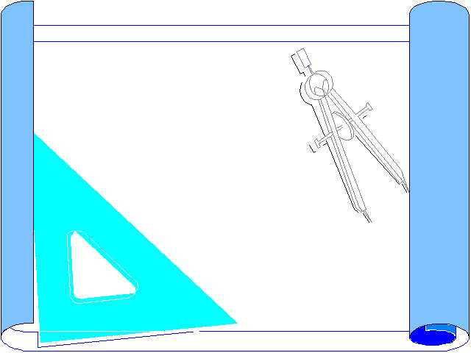
ENGINEER OFFICER
CONDUCT SITE RECONNAISSANCE
ORDER SURVEY
ORDER SOIL ANALYSIS
ORDER ENVIRONMENTAL IMPACT STUDY

Slide 235

ENGINEER OFFICER
ORDER GRADE STAKES TO BE PLACED AND ENVIRONMENTAL AREAS MARKED
SUPPLY BLUE PRINT AND ENVIRONMENTAL STUDY TO CHIEF

Slide 236
ENGINEER OFFICER
ORDER CHIEF TO MAKE WRITTEN ESTIMATIONS FOR EACH AREA OF CONCERN
COLLECT DATA FROM ALL CHIEFS AND FORMULATE TOTAL ESTIMATION

Slide 237
ENGINEER OFFICER
IDENTIFY CONSTRUCTION REQUIREMENTS / LIMITATIONS / RESTRICTIONS
USE CRITICAL PATH METHOD TO PLAN PROJECT
ISSUE ORDERS TO CONDUCT MISSION

Slide 238
ENGINEER CHIEF
CONDUCT SITE RECON.
READ SURVEY (BLUE PRINT)
GET SOIL ANALYSIS INFO
VIEW ENVIRONMENTAL IMPACT STUDY

Slide 239
ENGINEER CHIEF
MAKE ESTIMATIONS OFF OF MEASUREMENTS GIVEN IN BLUE PRINT

Slide 240
ENGINEER CHIEF
MAKE MATHEMATICAL ESTIMATIONS FOR EQUIPMENT, PERSONNEL, TIME, AND MATERIALS
PLAN ORDER OF WORK USING CRITICAL PATH METHOD

Slide 241
ENGINEER CHIEF
RETURN WRITTEN ESTIMATION TO ENGINEER OFFICER
ISSUE THE ORDER TO THE NCO’S TO EMPLOY EQUIPMENT

Slide 242
ENGINEER NCO
REQUEST THE SUPPORT OF FUEL, OILS, WATER AND CHOW
COORDINATE EQUIPMENT TO AND AT THE JOB SITE
SUPERVISE CREWS AND TEAMS

Slide 243
QUESTIONS?
Any Questions??
Take a break

Slide 244
ESTIMATING LOGISTICS

Slide 245
LOGISTICAL ESTIMATIONS
TO MAKE THE WRITTEN ESTIMATIONS REQUIRED, THE FOLLOWING FORMULAS MUST BE USED

Slide 246
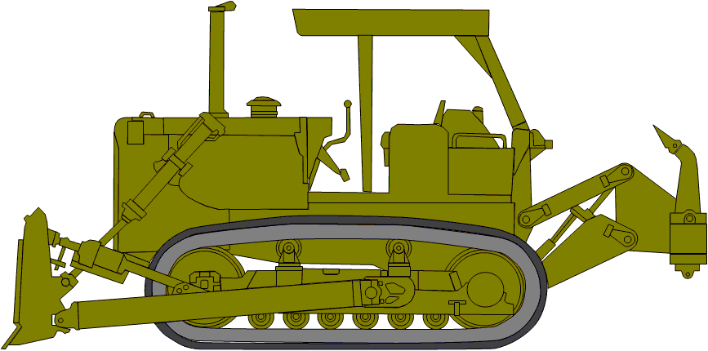
FUEL CONSUMPTION
# _________ X ________ X _________X __________ =
# OF EQUIP X GALS/HR X HRS/DAY X # OF DAYS =
TOTAL GALS OF FUEL

Slide 247
USE TABLE #1 FOR GALS PER HOUR FOR EACH TYPE OF ENGINEER EQUIPMENT
ADD TOTALS FOR EACH TYPE OF EQUIPMENT TOGETHER TO GET TOTAL FUEL REQUIREMENT

Slide 248
FUEL CONSUMPTION
TABLE #1 FUEL CONSUMPTION
EQUIPMENT | TYPE OF FUEL | GALS/HOUR
LOADER 624KR | DIESEL/JP8 | 6.00
MAC 50 (ATC) | DIESEL/JP8 | 6.00
GRADER (120M) | DIESEL/JP8 | 4.00
COMPACTOR(563D) | DIESEL/JP8 | 4.00
SCRAPER (621B) | DIESEL/JP8 | 10.00
DOZER (1150E) | DIESEL/JP8 | 6.00
DOZER (1155E) | DIESEL/JP8 | 6.00
DOZER (MCT) | DIESEL/JP8 | 8.00
BACKHOE (420E) | DIESEL/JP8 | 4.00

Slide 249
SEE EXAMPLE IN HANDOUT
DEMONSTRATION
TOTAL FUEL CONSUMPTION FOR 3 SCRAPERS (621B) WORKING 12 HR/DAY FOR 10 DAYS AND 2 TRAMS (624KR) WORKING 12 HR/DAY FOR 4 DAYS, ALSO 2 GRADERS (120M) WORKING 12 HR/DAY FOR 13 DAYS

Slide 250
SOLUTION
EQUIP X GALS/HR X HRS/DAY X #DAYS = TOTAL FUEL REQUIRED
  621B 3 X 10 X 12 X 10 = 3,600
  644E 2 X 6 X 12 X 4 = 576
  130G 2 X 4 X 12 X 13 = 1,248
  TOTAL = 5,424 GALS

Slide 251
WHAT HAVE YOU LEARNED
WORK THE “WHAT HAVE YOU LEARNED” PROBLEM IN YOUR STUDENT HANDOUT

Slide 252
SOLUTION
EQUIP X GALS/HR X HRS/DAY X #DAYS = TOTAL FUEL REQUIRED
  3 X 8 X 10 X 8 = 1,920
  2 X 4 X 10 X 3 = 240
  1 X 10 X 10 X 2 = 200
  TOTAL = 2,360 GALS

Slide 253
P. O. L.
ONCE TOTAL GALLONS OF FUEL HAVE BEEN COMPUTED ALL OTHER P.O.L. REQUIREMENTS CAN BE ESTIMATED

Slide 254
P.O.L. STEP 1
10 WT THROUGH 50 WT
  .02 X TOTAL GALS FUEL = TOTAL OE

Slide 255
P.O.L STEP 2
80 WT THROUGH 90 WT
  .005 X TOTAL GALS FUEL = TOTAL GO

Slide 256
P.O.L STEP 3
GREASE OR GAA
  STEP 1 DETERMINE ESTIMATED METER HOURS
  # OF EQUIP X HR/DAY X #DAYS =
  EST METER HOURS

Slide 257
P.O.L STEP 3 CONT.
EST METER HOURS
8 X .25 = GAA LBS
The 8 is for 8 hours on the meter the .25 is for 1/4 lbs. of grease for every 8 meter hours.

Slide 258
EXAMPLE
2 GRADERS (120M) WITH AN ESTIMATED TOTAL FUEL CONSUMPTION OF 1,248 GALS, AND AN ESTIMATED 13 TOTAL DAYS OPERATED.

Slide 259
SOLUTION
10 WT THROUGH 50 WT
.02 X 1,248 EST FUEL NEEDED = 24.96 OR 25 GALS OE
80 WT THROUGH 90 WT
.005 X 1,248 EST FUEL NEEDED = 6.24 OR 7 GALS GO
GREASE OR GAA
312
8 X .25 = 9.75 OR 10 LBS GAA

Slide 260
WHAT HAVE YOU LEARNED
WORK THE “WHAT HAVE YOU LEARNED” PROBLEM IN YOUR STUDENT HANDOUT

Slide 261
SOLUTION
3 TRAMS (624KR)
.02 X 3,500 EST FUEL NEEDED = 70 GALS OE
.005 X 3,500 EST FUEL NEEDED = 17.5 OR 18 GALS OE
3 Trams X 7 HRS/DAY X 8 DAYS = 168 EST MTR HRS
EST METER HRS
168
8 X .25 = 5.25 OR 6 LBS GAA

Slide 262
SOLUTION CONT.
2 420E
.02 X 1,200 EST FUEL NEEDED = 24 GALS OF OE
.005 X 1,200 EST FUEL NEEDED = 6 GALS OF GO
2 420E X 7 HR/DAY X 8 DAYS = 112 EST MTR HRS
EST METER HRS
112
8 X .25 = 3.5 OR 4 LBS GAA

Slide 263
SOLUTION CONT.

Slide 264
WATER CONSUMPTION
POTABLE
NON-POTABLE

Slide 265
WATER CONSUMPTION
USE TABLE #2 TO COMPUTE WATER REQUIREMENTS FOR:
  SOIL PREPARATION AND DUST CONTROL (NON-POTABLE)
  EQUIPMENT (NON-POTABLE)
  DRINKING (POTABLE)
  PERSONAL HYGEINE (POTABLE)
  SHOWERS (POTABLE)
  LAUNDRY (POTABLE)

Slide 266
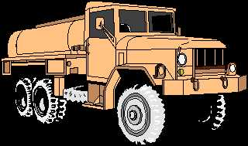
SOIL PREPARATION AND DUST CONTROL
NON-POTABLE
TOTAL SQ. YD. X 1 GAL/SQ. YD. X 1.10 WASTE = GALS REQ

Slide 267
EQUIPMENT FORMULA
NON-POTABLE
QTY OF EQUIP X 1 GAL/DAY X EST DAYS X 1.10 WASTE =
GALS REQ

Slide 268
SHOWERS FORMULA
POTABLE
# PERSONNEL X TABLE 2 X 1.10 WASTE = GALS REQ

Slide 269
LAUNDRY FORMULA
POTABLE
# PERSONNEL X TABLE 2 X DAYS X 1.10 WASTE
= GALS REQ

Slide 270
HYGIENE FORMULA
POTABLE
# PERSONNEL X TABLE 2 X DAYS X 1.10 WASTE
= GALS REQ

Slide 271
DRINKING WATER FORMULA
POTABLE
# PERSONNEL X TABLE 2 X DAYS X 1.10 WASTE = GALS REQ

Slide 272
EXAMPLE
ESTIMATE THE WATER CONSUMPTION FOR 250 PERSONNEL WORKING FOR 28 DAYS IN A HOT CLIMATE. COMPUTE THE REQUIREMENT FOR 50 VEHICLES. YOU WILL BE WORKING ON A ROAD THAT IS 4,000’ LONG AND 28’ WIDE FROM DITCH TO DITCH.

Slide 273
SOLUTION
SOIL PREPARATION
NON POTABLE
4,000’ L X 28’ W
9 = 12,444.44 OR 12,445 SQ YD
12,445 SQ YD X 1 GAL X 1.10 = 13,689.5 OR 13,690 GAL

Slide 274
SOLUTION CONT.
EQUIPMENT
NON POTABLE
50 VEHICLES X 1 GAL/DAY X 28 DAYS X 1.10 WASTE = 1,540 GALS

Slide 275
SOLUTION
LAUNDRY AND SHOWERS
POTABLE
Laundry:
250 PERSONEL X 2.1 GAL/DAY X 4 DAYS X 1.10 WASTE = 2,310 GALS
Showers:
250 PERSONEL X 1.0 GAL/DAY X 4 DAYS X 1.10 WASTE = 1,100 GALS

Slide 276
SOLUTION CONT.
HYGIENE WATER
POTABLE
250 PERSONS X 1.7 GAL/DAY X 28 DAYS X 1.10 WASTE = 13,090 GALS

Slide 277
SOLUTION CONT.
DRINKING WATER
POTABLE
250 PERSONS X 3 GALS/DAY X 28 DAYS X 1.10 WASTE =
23,100 GALS

Slide 278
Table for Water Consumption
 | POTABLE | NON-POTABLE
SOIL PREPARATION |  | 13,690
EQUIPMENT |  | 1,540
LAUNDRY | 2,310
SHOWERS | 1,100
HYGEINE | 13,090
DRINKING WATER | 23,100
TOTALS | 39,600 | 15,230

Slide 279
WHAT HAVE YOU LEARNED
WORK THE “WHAT HAVE YOU LEARNED” PROBLEM IN YOUR STUDENT HANDOUT

Slide 280
SOLUTION
SOIL PREP
6,099’ L X 24’ W
9 = 16,264 SQ YD
16,264 SQ YD X 1 GAL X 1.10 WASTE = 17,891 GALS

Slide 281
SOLUTION CONT.
EQUIPMENT
25 VEHICLES X 1 GAL/DAY X 60 DAYS X 1.10 =
1,650 GALS

Slide 282
SOLUTION CONT.
LAUNDRY ( ONCE A WEEK)
75 MEN X 2.1 GAL/MAN X 8 DAYS X 1.10 =
1,386 GALS

Slide 283
SOLUTION CONT.
SHOWERS (ONCE PER DAY)
75 MEN X 1.0 GAL/MAN X 60 DAYS X 1.10 =
4,950 GALS

Slide 284
SOLUTION CONT.
PERSONAL HYGIENE
75 MEN X 1.7 GAL/MAN X 60 DAYS X 1.10 =
8,415 GALS

Slide 285
SOLUTION CONT.
DRINKING
75 MEN X 3 GAL/MAN X 60 DAYS X 1.10 =
14,850 GALS

Slide 286
SOLUTION CONT.
 | POTABLE | NON-POTABLE
SOIL PREPARATION |  | 17,891
EQUIPMENT |  | 1,650
LAUNDRY | 1,386
SHOWERS | 4,950
HYGEINE | 8,415
DRINKING WATER | 14,850
TOTALS | 29,601 | 19,541

Slide 287
MEALS READY TO EAT
Most common form of sustenance
Easy to carry/transport

Slide 288
MRE FORMULA
#PERSONNEL X 3 MEALS/DAY X #OF DAYS =
TOTAL # OF MEALS
TOTAL # OF MEALS
12 = TOTAL # OF CASES

Slide 289
EXAMPLE
THE UNITS SIZE IS 175 PERSONNEL, WORKING 60 DAYS, DETERMINE THE QUANTITY OF MEAL READY-TO-EAT, BY THE CASES.

Slide 290
SOLUTION
175 PERSONNEL X 3 MEALS/DAY X 60 DAYS = 31,500 TOTAL MEALS
31,500 TOTAL MEALS / 12/CASE = 2,625 CASES

Slide 291
WHAT HAVE YOU LEARNED
WORK THE “WHAT HAVE YOU LEARNED” PROBLEM IN YOUR STUDENT HANDOUT

Slide 292
SOLUTION
30 PERSONNEL X 3 MEALS/DAY X 20 DAYS = 1800 TOTAL MEALS
1,800 TOTAL MEALS / 12/CASE = 150 CASES

Slide 293
PRACTICAL APPLICATIONS
Worksheet 1
Worksheet 2
Worksheet 3

Slide 294
QUESTIONS?

Slide 295
SUMMARY

