Slide 1

RECORDS / FORMS AND PQDR
GYSGT WEBBER

Slide 2
RECORDS/FORMS & PQDR
OVERVIEW
The purpose of this period of instruction
is to provide you with the knowledge and skills necessary to manage and supervise all Engineer Equipment records and forms, Modification and Calibration programs, and Support and Test Equipment

Slide 3
696D
NAVMC 10524 & 23 (Con Log/Trip Ticket)
Load Test Equipment Daily Checklist
SF 91 & 94
NAVMC 10560 (LTI)
NAVMC 10561 (PMCS Roster)
NAVMC 10031 (Daily Dispatch Log)
PQDR
Chapter 2

Slide 4
Modification
Calibration
Support and Test Equipment

Slide 5
LEARNING OBJECTIVES
TERMINAL LEARNING OBJECTIVES
ENABLING LEARNING OBJECTIVES

Slide 6
METHOD / MEDIA
Informal lecture, Demonstration, and prac ap.
Power Point Presentation, and a Quiz.

Slide 7
ADMINISTRATIVE INSTRUCTIONS
IRF
CLASSROOM RULES
SAFETY

Slide 8
EVALUATION
WRITTEN EXAM WITHOUT THE AID OF REFERENCES.
PERFORMANCE EXAM WITH THE AID OF REFERENCES.

Slide 9

?

Slide 10
NAVMC 696D
MOTOR VEHICLE AND ENGINEER RECORD FOLDER

Slide 11
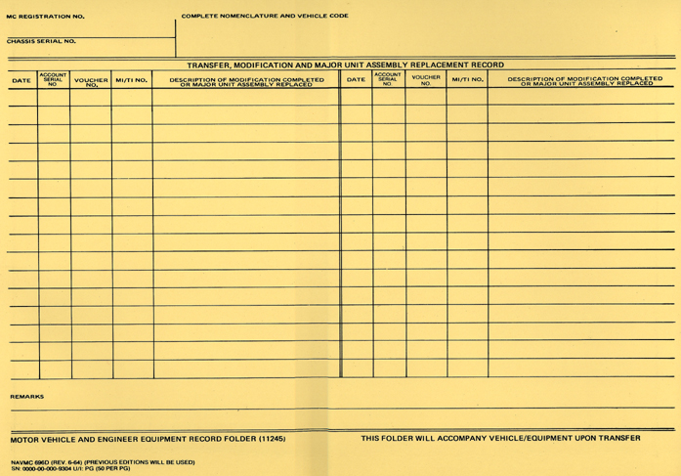
FOUND IN TM 4700-15/1H, PAGE 2-14-1

Slide 12
PURPOSE
Used to maintain historical data of;
  Transfers
  Receipts
  Modifications
  Major Assembly Replacements

Slide 13
PURPOSE CONT.
Serves as a file folder for completed records and forms.

Slide 14



RESPONSIBILITIES
Will be maintained on each item of Motor Transport, Engineer, and Garrison Mobile Equipment.

Slide 15
RESPONSIBILITIES CONT.
Equipment that is controlled by one TAM number, but is associated with other commodity equipment, a separate record jacket will be maintained for that specific item.
In this case both records will reflect the MC Reg. Number, Chassis Ser. Number, TAM Number, NSN, and ID Number of the TAM as a single entity.

Slide 16
RESPONSIBILITIES CONT.
MCLB first receives equipment and establishes 696D.
If equipment is received direct from manufacturer, or the 696D is lost, that unit is responsible for establishing the 696D.

Slide 17
RESPONSIBILITIES CONT.
When establishing or reconstructing, use the date of that action in a five digit Julian Date format.
For example: 07120.

Slide 18
RESPONSIBILITIES CONT.
The custodian is responsible for the up-to-date entries while equipment is in his/her custody.
When Engineer Equipment has more then one power plant, maintain a NAVMC 10523 and 10524 on each power plant (i.e. Runway Sweeper). *

Slide 19
PREPARATION INSTRUCTIONS
Descriptive data for the equipment will appear on the top.
Enter appropriate entries in the Transfer, Modification, and Major Unit Assembly Replacement Record portion as required.

Slide 20
PREPARATION INSTRUCTIONS
Enter Received/Transferred from one Reporting Unit Allowance File (RUAF) to another RUAF.
Account Ser# column refers to the owning units activity code(RUC) of unit having custody of the item when the entry is made.

Slide 21
PREPARATION INSTRUCTIONS
MCO P11262.2_ AND MCO P11240.106_ govern load testing and Annual Condition Inspections for tactical and garrison mobile equipment.
The results of the ACI and Load Test Certificates must be filed inside the 696D.

Slide 22
Get your 696D out so you can learn how to fill this form out!

Slide 23
TAM:
NSN:
ID:
DATA PLATE
AS IT READS ON THE DATA PLATE
DATA PLATE
DATE: FIVE DIGIT JULIAN DATE
  MODIFICATION COMPLETED
  MAJOR ASSEMBLY REPLACEMENT
ACCOUNT SERIAL NO.
  AC OF THE UNIT ACCOUNTABLE
VOUCHER NO.
    DOCUMENT NO. OF THE ACCOUNTABLE
  TRANSACTION FROM ONE RUAF TO ANOTHER.
MI/TI No.
      ENTER THE MI NUMBER UPON COMPLETETION OF MOD.
DESCRIPTION OF MOD. COMPLETED OR MAJOT UNIT ASSEMBLY REPLACED
        BRIEF DESCRIPTION OF MI.
        BRIEF DESCRIPTION AND SERIAL NO. OF THE NEW MAJOR UNIT ASSEMBLY.
        TRANSFERRED OR RECEIVED.
ALL PRECEEDING ENTRIES ARE NOT REQUIRED FOR TACTICAL EQUIPMENT!
Not listed or no Data
Plate, use info on the
Parts Manual.

Slide 24

PREPARATION INSTRUCTIONS CONT.
Remarks.
  When equipments time indicator is replaced, enter the date changed and the old and new hours.
  Enter the date when performed for all equipment that requires Load Test, ACI, and NDT.

Slide 25
REMARKS CONTINUED
  Hook Throat Spread measurement will be entered when Load Tested.
  CARC painted equipment shall note the date when painted, (Example: Painted w/CARC 21 May 1986).
  When equipment has antifreeze changed, enter the type and date changed (Antifreeze changed 12 Sep 02
  Ethylene Glycol).
  Temporary entries may be entered in pencil.

Slide 26
REMARKS CONTINUED
  TM 4750-15/1_, Pg. 1-3, Para. 1-2.c also states the CARC Paint entry shall be placed in the Remarks section.
  MCO P11262.2A, Pg. 1-3, Para. 2002.2, states HTSBD shall be measured upon receipt.
  HTSBD is established by installing two tram points on the hook, measure between these points to +/- 1/64”.

Slide 27
REMARKS CONTINUED
HTSBD shall be retained for the life of the hook.
HTS shall be measured quarterly.
Hooks showing and increase in the HTS by more than 15% from the HTSBD shall be discarded.
NDT will be annotated in the Remarks section.-
As appropriate, the commencement dates of the warranty will be annotated in the Remarks section

Slide 28
TAM #: B00387B
NSN: 3810-01-538-4030
ID # 11262A
627524
ALL TERRAIN CRANE (ATC) MAC 50
WMG42183277000115
LOAD TESTED:5 JUL 07 ACI:15 AUG 10
NDT:5 JUL 07
HR.MTR RPL:
10 JAN 09
OLD:1234
NEW: 0
PAINTED W/CARC:21 MAY 2007
HTSBD:7.090” /HTS:7.390 DATE:10 OCT 10
ANTI-FREEZE CHANGED:12 JUL 10 ETHYLENE GLYCOL
Warranty:15 OCT 07 – 15 Oct 12

Slide 29
FILING
The NAVMC 696D will be filed with the Record Jackets or as directed by the Commanding Officer.
Face of 696D becomes full, retain inside the new 696D. *

Slide 30
DISPOSITION
When vehicle is transferred, the NAVMC 696D will be packaged and shipped with the associated Basic Issue Item (BII) and Collateral Material (CM) to the gaining unit.
When equipment is determined to be unserviceable and a Letter of Unserviceable (LUP) is received, destroy all records.

Slide 31
  QUESTIONS
  ?

Slide 32
QUESTIONS TO YOU!
Q. How long is the NAVMC 696D maintained?
A. For the life of the item of equipment.

Slide 33
QUESTIONS TO YOU!
. What information is required in the “REMARKS” section of the 696D?
A. EOT Indicator RPLC old & new readings and date, HTSBD, Dates of LT, NDT, ACI, CARC Paint, Warranty dates, Anti-Freeze and type.

Slide 34
BREAK!!!

Slide 35
NAVMC 10524
CONSOLIDATED ENGINEER EQUIPMENT OPERATIONAL LOG AND SERVICE RECORD

Slide 36
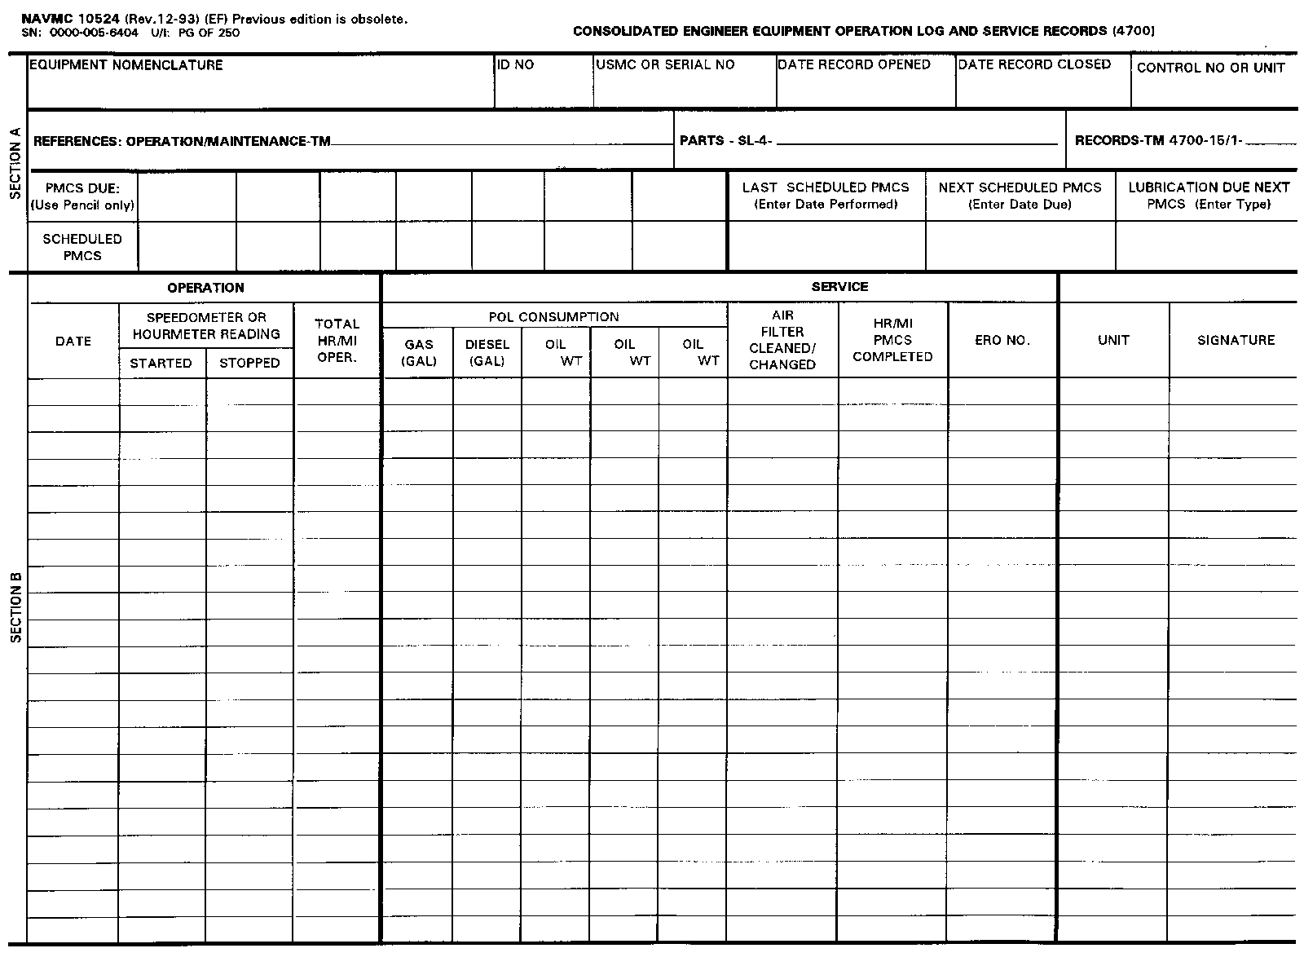
FOUND IN TM 4700-15/1, PG. 2-21-1

Slide 37
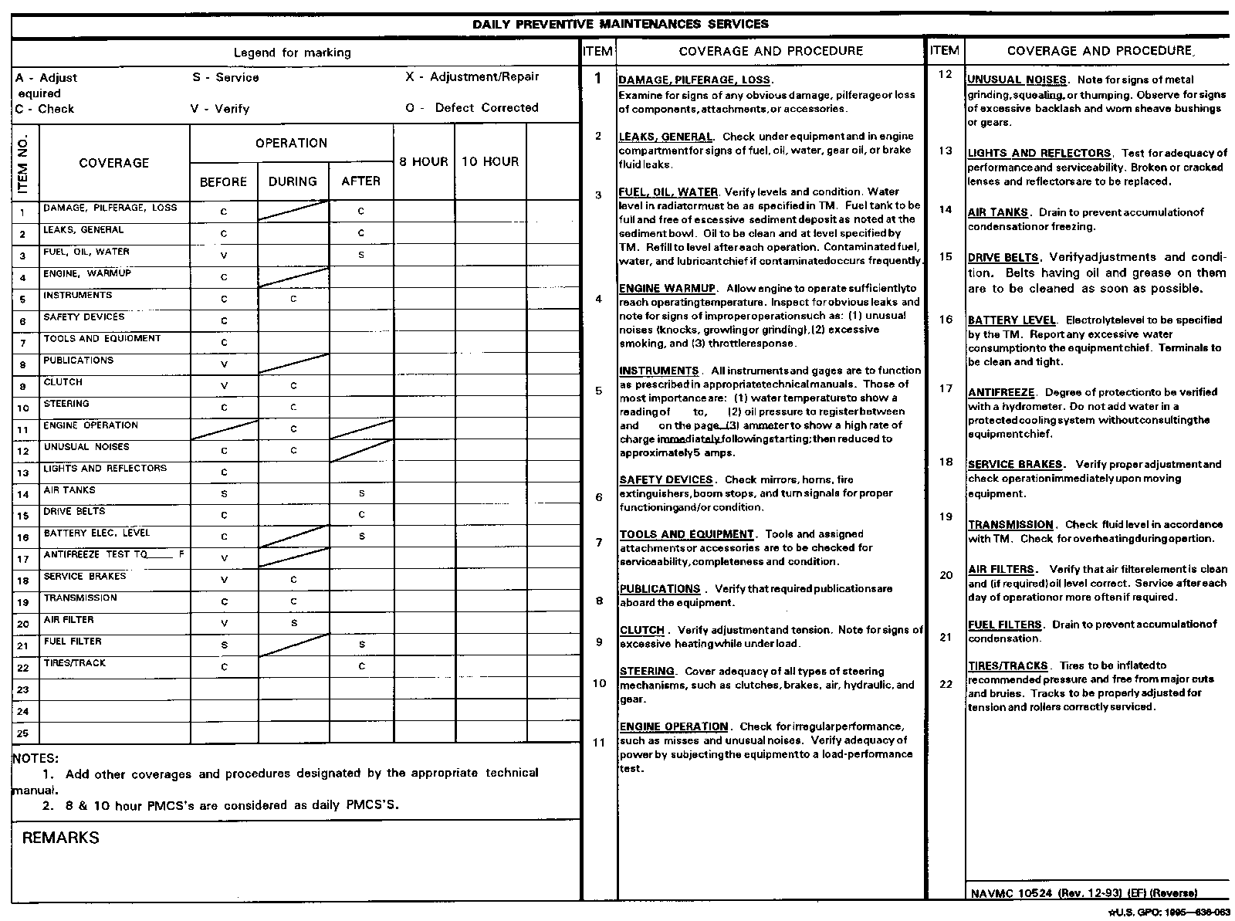

Slide 38

PURPOSE
Provides authority for an operator to operate on an assigned mission.
May be used in place of the NAVMC 10523(Engineer Equipment Operational Record) when operated for an extended periods time.

Slide 39
PURPOSE CONT.
Provides a checklist for conducting BEFORE, DURING, and AFTER checks and services. (PMCS).
Provides means to record mileage/hours for PMCS scheduling.
The back is used as a template for indicating required operator daily PMCS on the NAVMC 10523.
Not required when a ERO has been submitted and equipment is operated from pool area to maintenance shop.

Slide 40

RESPONSIBILITIES
Maintained by the dispatcher.
Must be kept up-to-date so that the scheduled PMCS is performed when due.

Slide 41

DISPATCHER RESPONSIBILITIES
  Request for the assigned mission is authorized.
  Operator has a valid operator’s license (OF-346).
  Section “A” is updated with any 2nd EOM or higher PMCS due on equipment. Leave blank if equipment has no operational time indicator.

Slide 42
DISPATCHERS RESPONSIBILITIES
  NAVMC 10031 (Daily Dispatching Record of Vehicles) is updated using the information from the NAVMC 10524.
  Equipment Officer or Chief is notified, when NAVMC 10524 indicates CM or PMCS work is required.

Slide 43
DISPATCHERS RESPONSIBILITIES
  Updated after receipt of the completed NAVMC 10523 when required.
  Before, During and After operation PMCS are indicated on the Daily Preventive Maintenance Services side.
  Dispatcher is not required to schedule 8 or 10 hour PMCS.

Slide 44
EQUIPMENT CHIEF RESPONSIBILITIES
  Section “A” is updated after completion of a 2nd echelon or higher, scheduled or unscheduled, PMCS.
  NAVMC 10561 (Preventive Maintenance Checks and Services Roster) is updated.
  Any PMCS or CM is done prior to being dispatched.

Slide 45
OPERATOR RESPONSIBILITIES
The operator will ensure the following:
  Completes all blocks pertaining to the operator before returning to the equipment pool.
  Hr/Miles PMCS Completed Block requires initials for daily PMCS.

Slide 46
FSMAO CLARIFICATION
DTD 21Dec 01, Encl. (3), Pg. 17, Para. k, clarifies completion requirements for operator’s daily PMCS (NAVMC 10524).
  Back of the 10524 should be completed when the form is established for the equipment and filed in the NAVMC 696D. The back of the form serves as a guide for the dispatcher, when dispatching equipment, to determine which services are applicable to the item of equipment being dispatched.

Slide 47
Get your 10524, first we will go over how to fill out Section “A”, and computing your Hourly PMCS schedule as it would look like in the 696D.

Slide 48
ALL TERRAIN CRANE (ATC) MAC 50
11262A
627524
15 OCT 07
00172
11262A-OR/3A
11262A
250
500
1000
1500
3000
250
500
OCT 09
LEAVE BLANK
1000
1500
3000
OCT 10
IAW TM
TM 4700 STATES
NOTHING ABOUT THESE
BLOCKS!
This is what your 10524 WOULD look
like in the 696D. When section “B”
is not required.

Slide 50
COMPUTING THE HOURLY PMCS SCHEDULE
How to figure your hourly PMCS schedule will not be found in any MCO, TM, or UM.
The following slides will explain how this can be accomplished.

Slide 51
FORMULA WHEN A HOURLY PMCS HAS BEEN COMPLETED
SCHEDULED PMCS (COMES FROM LINE 4)
+ HOUR METER READING (TAKEN FROM ERO)
= NEW PMCS DUE (THIS READING IS PLACED IN THE APPROPRIATE BLOCK)

Slide 52
EXAMPLE
250 | 500 | 1000 | 1500 | 2000
250 | 500 | 1000 | 1500 | 2000
YOUR EQUIPMENT IS DUE FOR A 250 HR PM, YOU SEND IT TO
MAINT. THEY COMPLETE IT, THE ERO STATES THE EQUIPMENT
HAS 250 HRS ON IT. THIS IS WHAT YOUR UPDATED 10524 WOULD
LOOK LIKE NOW.
500 | 500 | 1000 | 1500 | 2000
250 | 500 | 1000 | 1500 | 2000

Slide 53
FORMULA WHEN THE HOUR METER HAS BEEN REPLACED
**The following formula applies to the PM schedule when the new hour meter has “0” hours.
**This formula must be applied to each hourly PM separately.
PMCS DUE (LINE 3)
- OLD HOUR METER READING (ERO/HR METER)
= NEW PMCS DUE (THIS READING IS PLACED IN THE APPROPRIATE BLOCK)

Slide 54
YOU SEND IT TO MAINT. TO HAVE THE HOUR
METER REPLACED, MAINT. RELACED THE HOUR
METER AND THE NEW HOUR METER HAS “0”. THE
OLD HOUR METER HAD “275” HOURS. THIS IS
WHAT YOUR 10524 CURRENTLY LOOKS LIKE.
500 | 500 | 1000 | 1500 | 2000
250 | 500 | 1000 | 1500 | 2000

Slide 55
EXAMPLE
500
-275
225
500
-275
225
1000
-275
725
1500
-275
1225
2000
-275
1725
old
old
old
old
225
725
1225
1725
250 | 500 | 1000 | 1500 | 2000
225

Slide 56
FORMULA WHEN THE HOUR METER HAS BEEN REPLACED
**The following formula applies to the PM schedule when the new hour meter has hours already accumulated on it.
**This formula must be applied to each hourly PM separately.
PMCS DUE (LINE 3)
- OLD HR MTR READING (ERO/HR MTR)
xxxx (RESULT)
+ xxxx (NEW HR MTR)
= xxxx (NEW PMCS DUE) (PLACE IN THE APPROPRIATE BLOCK)

Slide 57
YOU SEND IT TO MAINT. TO HAVE THE HOUR
METER REPLACED, MAINT. RELACED THE HOUR
METER AND THE NEW HOUR METER HAS “65” HRS.
THE OLD HOUR METER HAD “30” HOURS. THIS IS
WHAT YOUR 10524 CURRENTLY LOOKS LIKE.
225 | 225 | 725 | 1225 | 1725
250 | 500 | 1000 | 1500 | 2000

Slide 58
EXAMPLE
225
-30
195
+65
260
225
-30
195
+65
260
725
-30
695
+65
760
1225
-30
1195
+65
1260
1725
-30
1695
+65
1760
old
old
old
old
new
new
new
new
250 | 500 | 1000 | 1500 | 2000
260
260
760
1260
1760

Slide 59
PRACTICAL APPLICATION “A”

Slide 60
SECTION “B” 10524
Optional, except when equipment is being operated at an isolated job site for an extended period.
If required the Major Subordinate Commands Maintenance Management Standing Operating Procedures (MSCMMSOP) will state those requirements.
No EOT Indicator, the NAVMC 10523 is mandated to capture hours.

Slide 61
FSMAO CLARIFICATION
DTD 21Dec 01, Encl. (3), Pg. 8, Para. c, clarifies requirements for using Section “B” (NAVMC 10524).
  The intent of Pg. 2-21-6, Para. (2) of the 4700 is to provide the unit commander the option to use or not to use section “B”. The exception is when equipment is operated at an isolated job site for extended periods of time. The MMSOP must clearly state if section “B” is to be used, and, if not, what procedures must be followed in order for shops to determine when hourly PMCS’s are due on their equipment.

Slide 62
10524 IN 696D
WHEN ENTRIES IN SECTION “B” IS MANDATED BY THE MMSOP.
Each time the equipment is operated, the operator will enter the following

Slide 63
ALL TERRAIN CRANE (ATC) MAC 50
11262A
627524
15 OCT 07
00172
11262A-OR/3A
11262A
495
500
1000
1500
3000
250
250
500
OCT 09
SEPT 09
SEPT 10
1000
1500
3000
OCT 10
IAW TM
GAA
LBS
15/
30
10
90
13Jul09
25
0
25
AT056
00172
Sign
15Jul09
25
31
6
.25
15
1qt
16Jul09
31
34
3
18Jul09
34
40
6
20Jul09
40
47
7
.25
25
1qt
21Jul09
47
50
3
25Jul09
50
54
4
26Jul09
54
56
2
30Jul09
56
60
4
1Aug09
60
65
5
.25
26
1qt
5Sep09
245
245
0
245
AT200
00172
Sign
TOTALS
40
.75
66
1qt
2qt

Slide 64
10524 EXTENDED JOBSITE
NOW LETS LOOK AT WHAT THE 10524 MAY LOOK LIKE WHEN IT IS FILLED OUT BY THE OPERATOR(S) ON A JOBSITE FOR AN EXTENDED PERIOD OF TIME.

Slide 65
ALL TERRAIN CRANE (ATC) MAC 50
11262A
627524
13 JUL 09
01 AUG 09
00172
11262A-OR/3A
11262A
250
500
1000
1500
3000
250
500
1000
1500
3000
OCT 09
OCT09
IAW TM
GAA
LBS
10
30
90
13Jul09
20
25
5
CL
BKB
.25
15
1qt
CL
15Jul09
25
31
6
  BKB
16Jul09
31
34
3
CL
BKB
18Jul09
34
40
  6
CL
BKB
20Jul09
40
47
7
.25
25
1qt
CL
BKB
47
50
7
CL
BKB
21Jul09
3
25Jul09
50
54
4
CL
BKB
26Jul09
54
56
2
CL
BKB
30Jul09
56
60
4
CL
BKB
1Aug09
60
65
5
.25
26
1qt
CL
BKB
TOTALS
40
.75
66
1qt
2qt

Slide 66
FILING AND DIPOSITION
Filed in the 696D.
When the sheet is filled, the accumulated totals and other data is transferred to a new NAVMC 10524.
Retain the last completed or filled NAVMC 10524.

Slide 67
  QUESTIONS
  ?

Slide 68
QUESTIONS TO YOU!
. What is the purpose of Section “B” of the NAVMC 10524?
A. To provide a means of recording equipment mileage and hours, preventive maintenance scheduling, POL consumption.

Slide 69
QUESTIONS TO YOU!
. Who maintains the NAVMC 10524?
A. Dispatcher

Slide 70
BREAK!!!

Slide 71
NAVMC 10523
ENGINEER EQUIPMENT OPERATIONAL RECORD

Slide 72
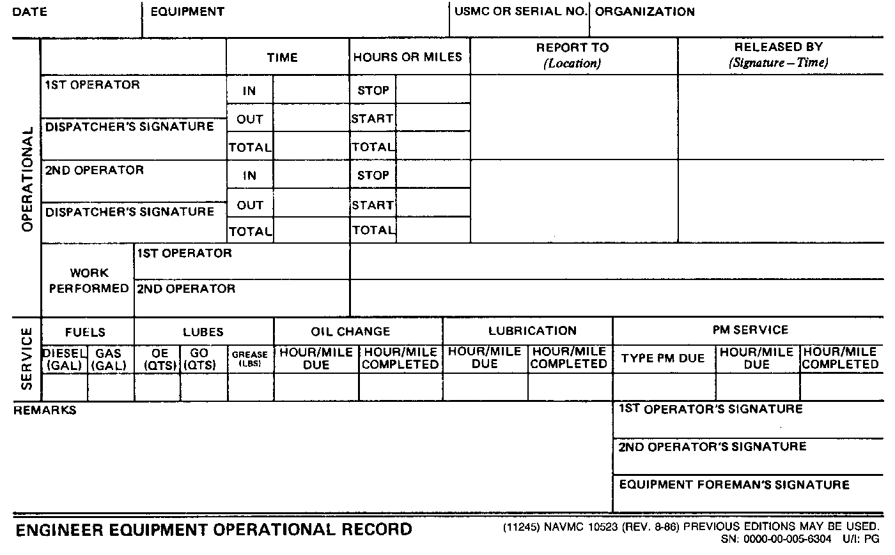
FOUND IN TM 4700-15/1H,
PG. 2-20-1

Slide 73
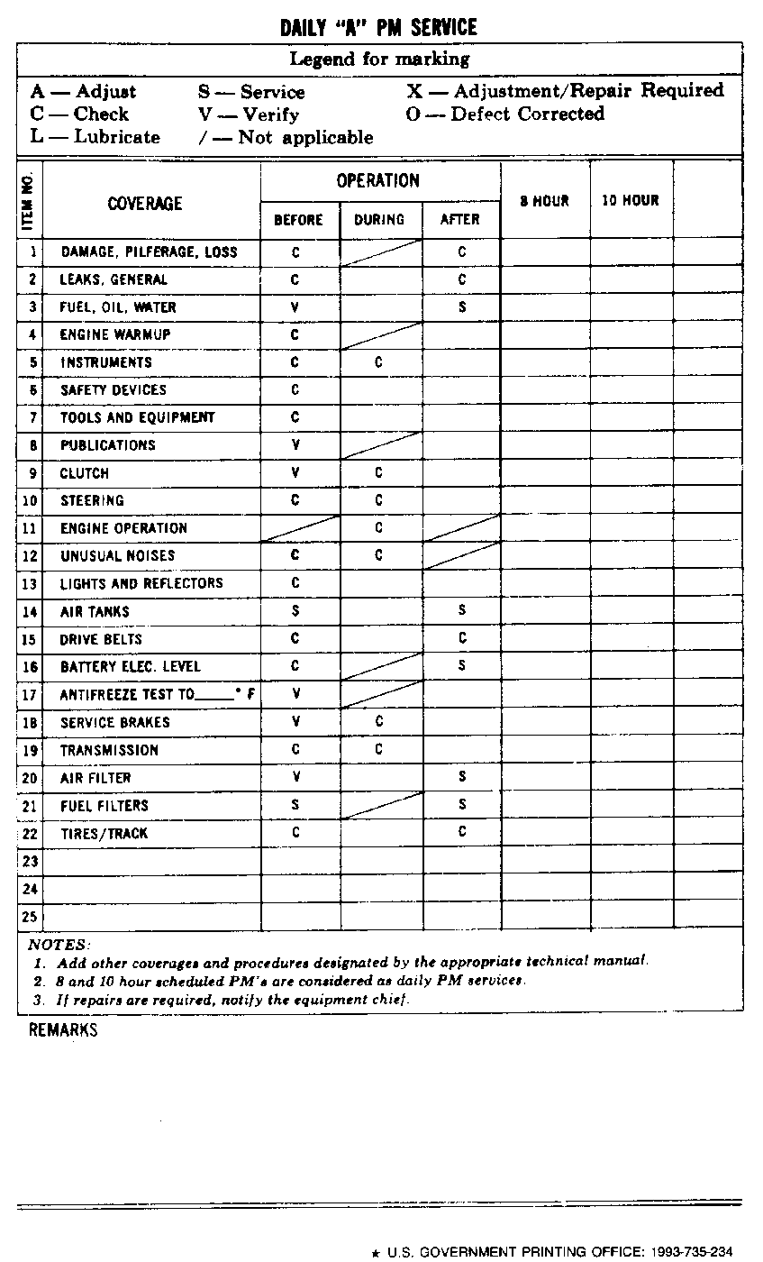

Slide 74
PURPOSE
Provides the operator with the authority to operate a piece of equipment on an assigned mission.
Provides the operator with a checklist for conducting daily PMCS.

Slide 75
PURPOSE CONT.
Provides a means for recording mileage or hours for equipment operation so that PMCS may be scheduled and POL consumption determined.
NAVMC 10523 need not be prepared when equipment has an ERO submitted and is being operated from pool area to maintenance shop.

Slide 76

Maintained by the Dispatcher.
The Dispatcher will ensure:
  The request for the assigned mission is authorized.
  Operator has a valid operator’s license (OF-346)
  NAVMC 10523 is updated with any PMCS due.
  The NAVMC 10031(Daily Dispatching Record of Vehicles) is updated with applicable data from the the NAVMC 10523.
  Equipment Officer or Chief is notified when the NAVMC 10523 indicates equip. needs corrective maintenance.

Slide 77
Dispatcher
  Oil change or lube service due. Not required when no time indicator.
  2nd echelon or higher PMCS due on equipment. Leave blank when equipment has no time indicator.
  Update NAVMC 10524 when NAVMC 10523 is completed.
  The required daily PMCS located on the back of NAVMC 10523 is filled out as indicated on the NAVMC 10524.
  Dispatcher is not required to schedule 8 or 10 hr PMCS.
  The completed NAVMC 10523 is forwarded to the Equip. Officer, Chief, or Foreman for signature.

Slide 78

The Equipment Chief will ensure the following:
  Any required PMCS or CM is accomplished before equipment is dispatched.

Slide 79
The operator will ensure the following:
  Complete blocks pertaining to operation and maintenance of the equipment.
  Complete blocks pertaining to daily PMCS Operator will treat and conduct 8 or 10 hour PMCS, recommended by the manufacture in the appropriate TM, as daily PMCS.
  Operator will forward the completed NAVMC 10523 to the dispatcher

Slide 80
GET OUT YOUR NAVMC 10523 AND TAKE NOTES

Slide 81
DISPATCHER ENTERS THE FOLLOWING. 2ND OPERATOR NOT REQUIRED.
12 Jun 10
DATA PLATE
627524
MWSS-172, MWSG-17, 1ST MAW
OF-346
LOCATION OF WHERE
THE OPERATOR IS
TO REPORT TO.
0700
MUST BE AUTH.
MAY BE LEFT BLANK IF ENROLLED
IN JOAP
500
245
500
245
500
500
245

Slide 82
* DISPATCHER WILL ENTER THE LEGEND AS LISTED ON THE NAVMC 10524 FOR THE: BEFORE, DURING, AFTER.
NOTE: OPERATOR WILL
TREAT AND CONDUCT
THE 8 OR 10 HOUR
PMCS, RECOMMENDED BY
THE MANUFACTURE IN
THE TM, AS DAILY
PMCS.

Slide 83
OPERATOR ENTERS THE FOLLOWING
12 Jun 10
ALL TERRAIN CRANE (ATC) MAC 50
627524
MWSS-172, MWSG-17, 1ST MAW
OF-346
1400
130
LOCATION OF WHERE
THE OPERATOR IS
TO REPORT TO.
Operator obtains
Signature from the
Job supervisor
0700
125
MUST BE AUTH.
7
5
SIGN BEFORE RETURNING TO THE DISPATCHER
10 1 1 .25
500 250 500 250 500 500 250
VERIFIES PMCS WAS COMPL.
ENTER ANY AMPLIFYING COMMENTS FOR
CM THAT REQUIRES 2ND EOM OR HIGHER
OIC, CHIEF, FOREMAN

Slide 84
IN THE “OPERATIONS BEFORE”
THE OPERATORS INITIALS,
VERIFYING IT HAS BEEN COMPL.
PER THE LEDGEND OF MARKINGS
AND APPROPRIATE TM BEFORE
LEAVING THE MOTOR POOL.
THE LEDGEND OF MARKINGS
AND IN THE “OPERATIONS DURING”
THE OPERATORS INITIALS,
VERIFYING IT HAS BEEN COMPL.
PER APPROPRIATE TM DURING
EQUIPMENT OPERATIONS.
IN THE “OPERATIONS AFTER”
THE OPERATORS INITIALS,
VERIFYING IT HAS BEEN COMPL.
PER THE LEDGEND OF MARKINGS
AND APPROPRIATE TM PRIOR TO
RETURNING 10523 TO THE
DISPATCHER.
ENTER ANY AMPLIFYING COMMENTS FOR
CM THAT REQUIRES 2ND EOM OR HIGHER

Slide 85

DISPOSITION
  Retain for a minimum of 30 days.
  If equipment was involved in a accident and an investigation is being conducted, retain till no longer required or equipment is disposed of or repaired.

Slide 86
QUESTIONS
?

Slide 87
QUESTIONS TO YOU!!!
. What does the signature in the “Work Performed” block, signify?
A. Verifies that the work is completed.

Slide 88
QUESTIONS TO YOU!!!
. Who can sign the “Released By” block when the operator cannot obtain the signature from the jobsite supervisor?
A. The equipment officer, chief, or foreman can sign.

Slide 89
BREAK!!!

Slide 90
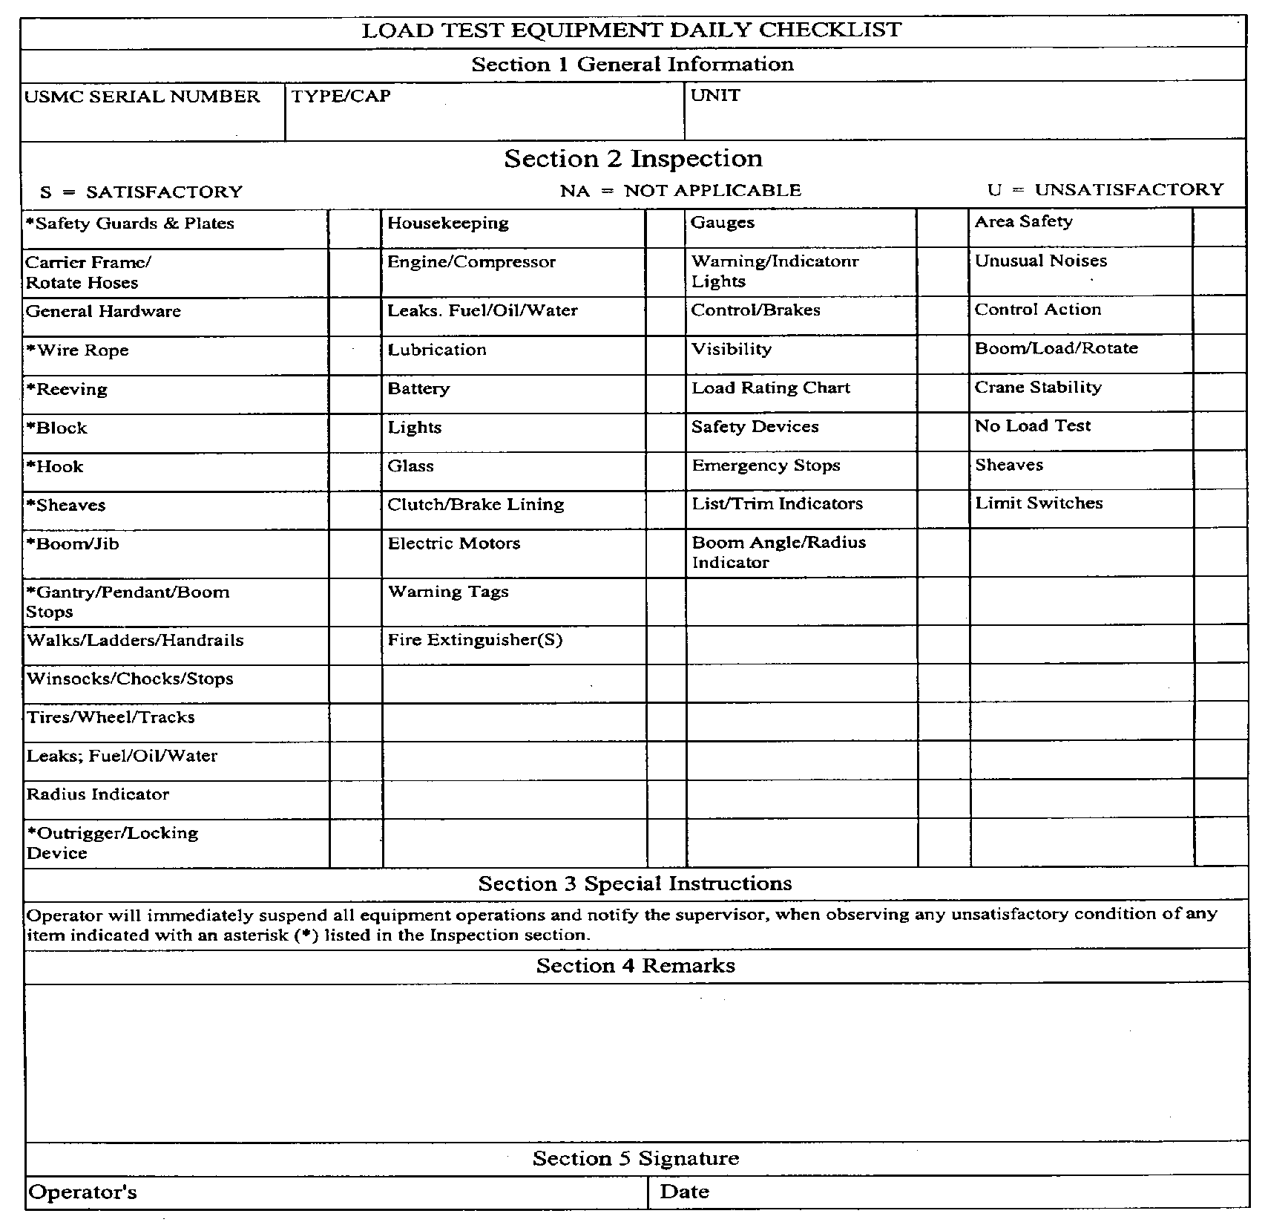
FOUND IN TM 4700-15/1H, PG. 2-24-1, OR MCO P11262.2A, PG. 4-8, TABLE 4-1.

Slide 91
LOAD TEST EQUIPMENT DAILY CHECKLIST
PURPOSE. to provide a record of the results of the load test equipment daily inspection.
  Produced locally. For example, copy form the TM-4700-15/1H or MCO P11262.2A.

Slide 92
LOAD TEST EQUIPMENT DAILY CHECKLIST
RESPONSIBILITIES. Operators will perform a Load Test Equipment Daily Checklist on all load lifting equipment.
It used to be cranes only.

Slide 93
FSMAO CLARIFICATION
DTD 21 DEC 01, ENCL. (3) PG. 18, PARA. (n) CLARIFIES INFORMATION PERTAINING TO THE LOAD TEST EQUIPMENT DAILY CHECKLIST.
n. Use of Load Test Equipment Daily Checklist: After reviewing TM 4700-15/1H, para. 2-24.b, the phrase “for example forklifts and retriever…” is misleading and implies that the Load Test Equipment Daily Checklist should be utilized as a checklist for forklifts, when the majority of the items listed on the checklist are for cranes only. The information provided on the Load Test Equipment Daily Checklist is very similar to the checklist in MCO P11262.2A, pg. 4-8, except the words “CRANE OPERATORS DAILY CHECKLIST” is annotated on the bottom left hand corner of the checklist. A recommendation was made and concurred with by HQMC (LPP) that the Load Test Equipment Daily Checklist be utilized with the NAVMC 10523 and 10524 during the operation of cranes.

Slide 94
FSMAO CLARIFICATION
DTD 21 DEC 01, ENCL. (3) PG. 18, PARA. (o) CLARIFIES INFORMATION PERTAINING TO THE LOAD TEST EQUIPMENT DAILY CHECKLIST.
o. Load Test Equipment Daily Checklist: During the operation of cranes, the Load Test Equipment Daily Checklist Referenced in TM 4700-15/1H will be utilized with the NAVMC 10523 or NAVMC 10524.

Slide 95
GET OUT YOUR
LOAD TEST EQUIPMENT DAILY CHECKLIST AND TAKE NOTES

Slide 96

I
N
S
T
R
U
C
T
I
O
N
S
P
R
E
P
A
R
A
T
I
O
N
627524
(ATC) MAC 50
MWSS 172 HE OPS
OPERATOR ENTERS AMPLIFYING COMMENTS ON ALL ITEMS
MARKED UNSATISFACTORY.
SIGNATURE 12 JUN 10

Slide 97
FILING AND DISPOSITION
  Operator returns to supervisor upon completion of commitment.
  Supervisor will review, and take corrective action.
    If corrective action is required. Equip. will be transferred to the maintenance section. After action has been transferred to ERO/SRO/WON, it will be retained with the trip ticket and disposed of when the trip ticket is destroyed.
    If no corrective action is required, it will be retained with the trip ticket and disposed of when the trip ticket is destroyed.

Slide 98
QUESTIONS
?

Slide 99
QUESTIONS TO YOU!!!
. What is the purpose of the Load Test Equipment Daily Checklist?
A. To provide a record of the result of the load test equipment daily inspection.

Slide 100
QUESTIONS TO YOU!!!
. Can the Load Test Equipment Daily Checklist be destroyed once all corrective action is transferred to the ERO?
A. No!

Slide 101
SF 91
MOTOR VEHICLE
ACCIDENT REPORT
FOUND IN THE TM 4700-15/1H, PG. 2-17-1
PARA. 2.17

Slide 102
PURPOSE
Is to provide a detailed report of any accident involving a motor vehicle.

Slide 103
RESPONSIBILITIES
Operator of any vehicle involved, is responsible for submitting this report.
  Second party can initiate for the operator using any witnesses.
  Operator’s supervisor(OIC) fills out their portion.
  Investigating Officer will complete the accident investigator portions per the Manual of Judge Advocate General.

Slide 104
SF-91
Preparation Instructions. All entries are self-explanatory.
  Submit to the Equip. Officer for review and appropriate action.
Filing. Carry a blank SF 91 with each vehicle.
Disposition. Retain the SF 91 with the accident investigation per the JAG Manual.

Slide 105
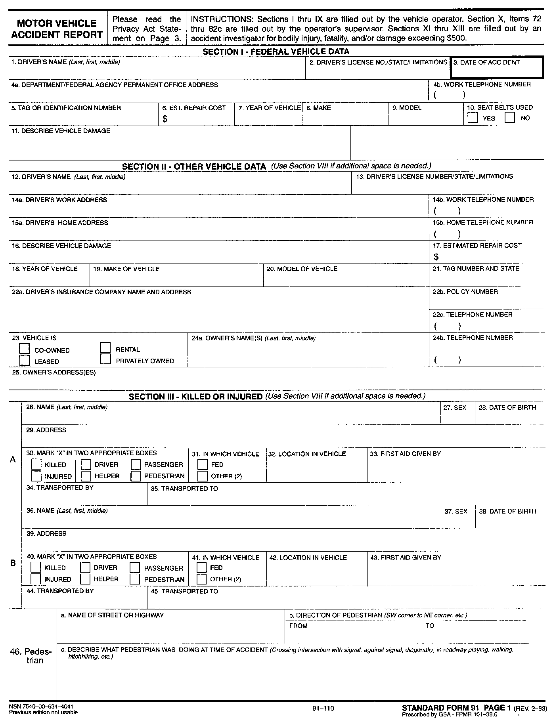
SF-91 PAGE 1

Slide 106
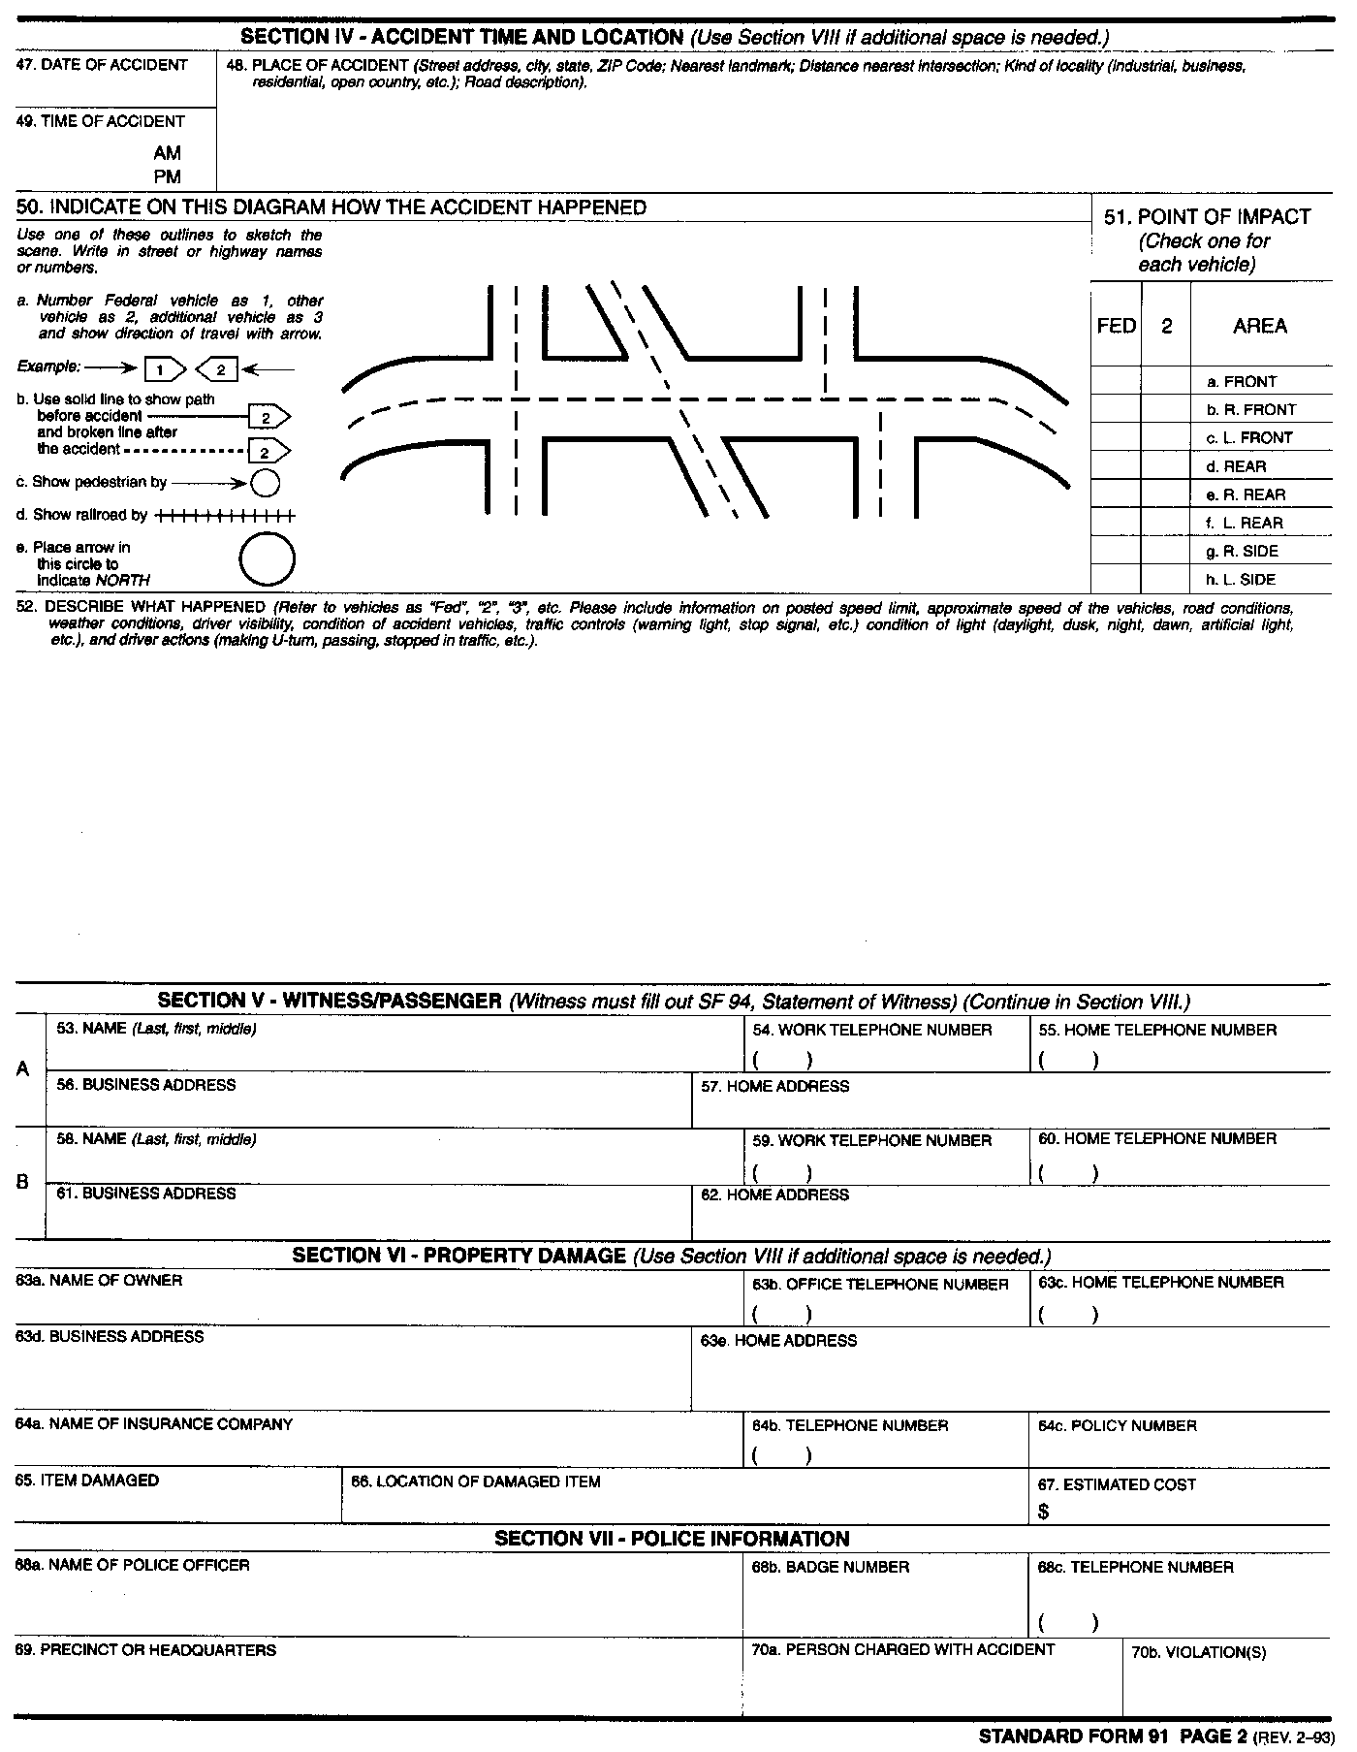
SF-91 PAGE 2

Slide 107
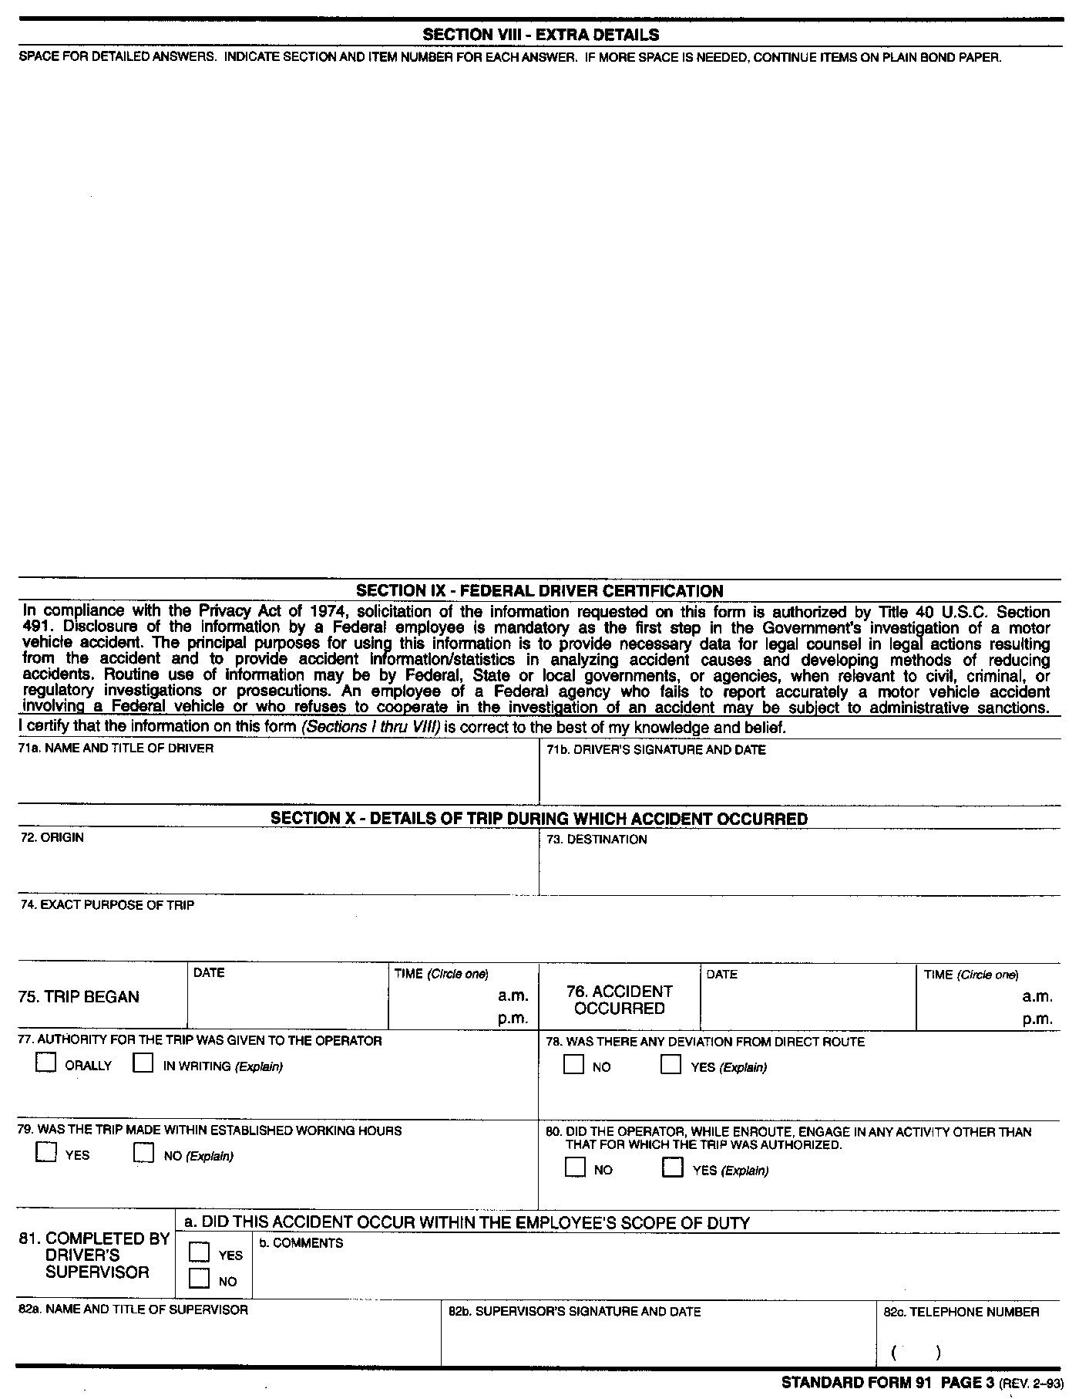
SF-91 PAGE 3

Slide 108
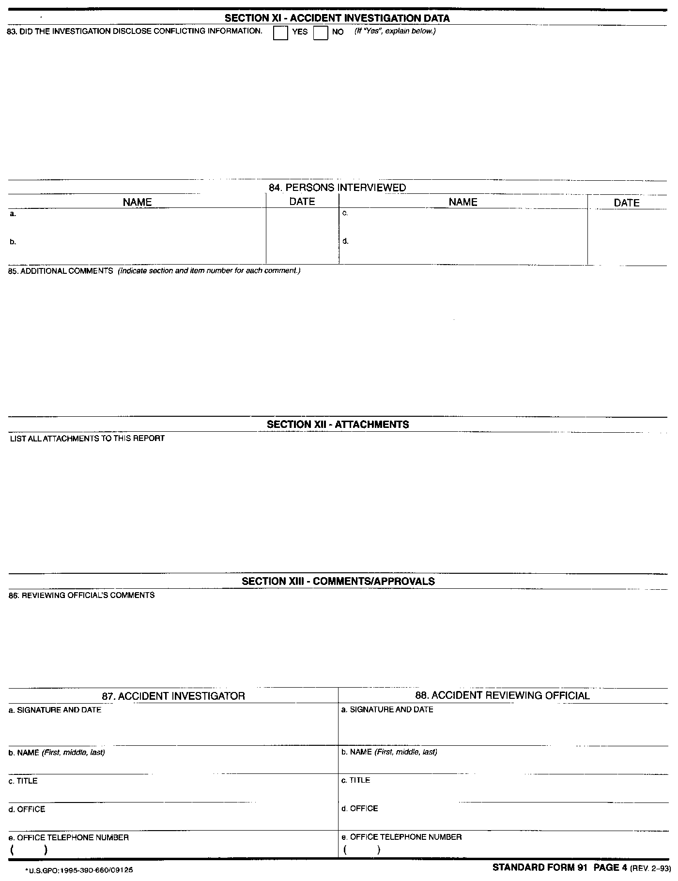
SF-91 PAGE 4

Slide 109
SF-94
STATEMENT OF
WITNESS
FOUND IN TM 4700-15/1H,
PG. 2-17-1
PARA. 2.17.1

Slide 110
SF-94
Purpose. To provide a detailed statement from an accident witness per section V of the SF 91.
Responsibilities. Individual that is responsible for completing the SF 91 will request that witnesses complete the SF 94.
  Not mandatory for the public.
  Mandatory for the military and federal employees.
    Compliance statement on the back of the SF 94.

Slide 111
SF-94
Preparation Instructions. All entries are self-explanatory.
Filing. Retain two SF 94’s in each vehicle.
Disposition. Retain with completed SF 91.

Slide 112
QUESTIONS
?

Slide 113
QUESTIONS TO YOU!!!
. What is the purpose of the SF-91?
A. To provide a detailed report of accident involving a motor vehicle.

Slide 114
QUESTIONS TO YOU!!!
. What is the purpose of the SF-94?
A. To provide a detailed statement from an accident witness per section V of the SF-91.

Slide 115
BREAK!!!

Slide 116
NAVMC 10560
WORKSHEET FOR PREVENTIVE MAINTENANCE AND TECHNICAL INSPECTION FOR ENGINEER EQUIPMENT

Slide 117

PURPOSE
To provide a check list for performing and recording:
  PMCS.
  LTI’s
    Including acceptance, prior to major repair, and at the discretion of the Engr. Equip. Officer/Chief.
  Also used as a guide when performing an annual/safety condition check.
  NOTE: Units are required to perform an LTI prior to equipment being placed in service. (Acceptance LTI)

Slide 118
EQUIP. FORMS & RECORDS ON TEMPORARY LOAN (TM 4700-15/1H, Ch. 1, pg. 1-5, Para. 1-9)
Owning unit will provide a skeleton record.
  Any short term transfer that does not involve formal transfer of custody, (Command Adjustment of Allowances).
  Tag each record w/ the type and due date of the next Scheduled PMCS.
  Borrowing unit will maintain records/skeleton records up-to-date of all entries and maintenance actions performed.

Slide 119
EQUIP. FORMS & RECORDS ON TEMPORARY LOAN (CONT.)
  Borrowing unit will update the FMSS when loaded, or provide info necessary for owning unit to update FMSS.
  Borrowing unit will return all forms & records containing maintenance actions performed.
  Lender will update original records & file the copies per the TM 4700.

Slide 120
EQUIP. FORMS & RECORDS ON TEMPORARY LOAN (CONT.)
  At a minimum, skeleton records will consist of the joint LTI.
  White copy of all ERO’s for maintenance actions performed while on temp. loan.
  SL-3 Extract for all SL-3 components that were temp. loaned with equipment.

Slide 121
RESPONSIBILITIES
Equipment Chief is responsible for preparing this worksheet on PMCS.
Prepare a template, refer to the appropriate TM’s, Technical Bulletins, etc.
Non-applicable portions may be blanked out.
The maintenance unit, with assistance from the operator will perform the required services and signs.
Equipment Chief will ensure required repairs are inspected and recorded before equipment is repaired.

Slide 122
GET OUT YOUR NAVMC 10560 AND TAKE NOTES

Slide 123
PREPARATION INSTRUCTIONS
Preparing activity may be the owner or user.
  Temp loaned.
  Maintenance section if evacuated to higher echelon.
Items marked with a pound sign (#) are completed by the preparing activity.
Their are fifteen sections to this NAVMC.

Slide 124
PREPARATION INSTRUCTIONS
Use the “Servicing Symbols” to list requirements for PMCS noted in the “SS” column of sections “D” through “M”.
Use the “Legend For Markings” to list requirements for CM noted in the “SS” column of sections “D” through “M”.

Slide 125
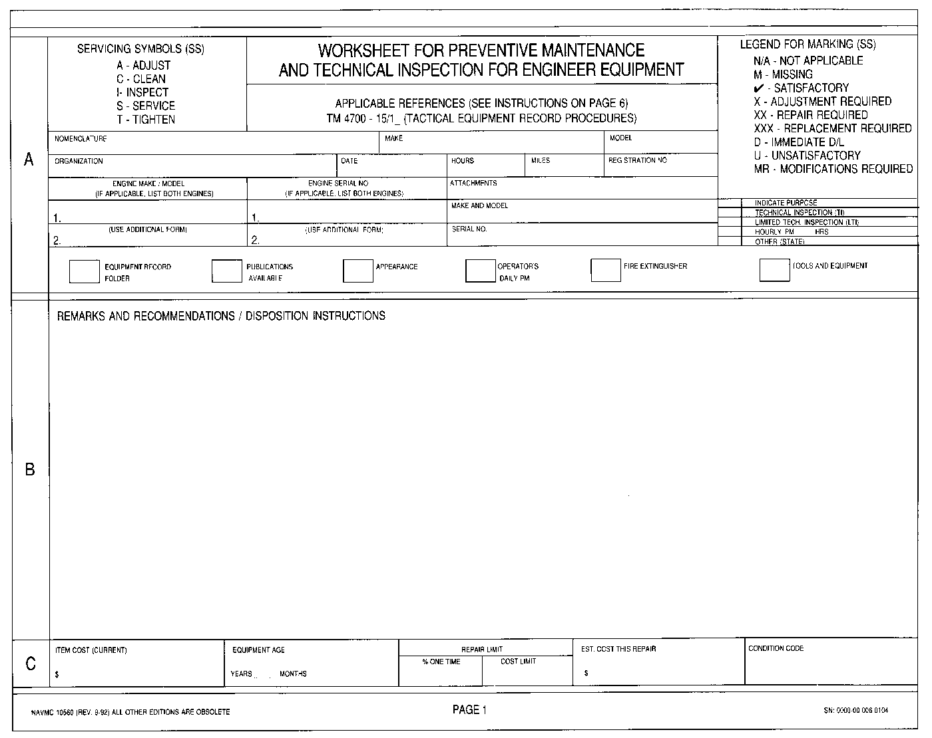
ALL TERRAIN CRANE (ATC) MAC 50
TEREX
R1699900
MWSS-172 MWSG-17 1ST MAW 00172
13 JUL 10
1349
627524
CUMMINS Q8C 8.3-C305
G-A23896
X 250
USE THE LEGEND OF MARKING SYMBOLS
OPTIONAL WHEN COMMENTS ARE WRITTEN DIRECTLY TO THE ERO
List all items that are not satisfactory in the (SS) column of sections “D”
Through “M”.
List all Mods. And TI’s that need to be accomplished.
List all items listed in section “B” to the ERO/SRO.
Is only required when a condition code is requested.
MHIF or FEDLOG
-current yr.
from data plates
65%
???
???
UM-4400-124,
Pg. 4-4-22
MCO 4790.19 pg.3, para.2.g

Slide 126
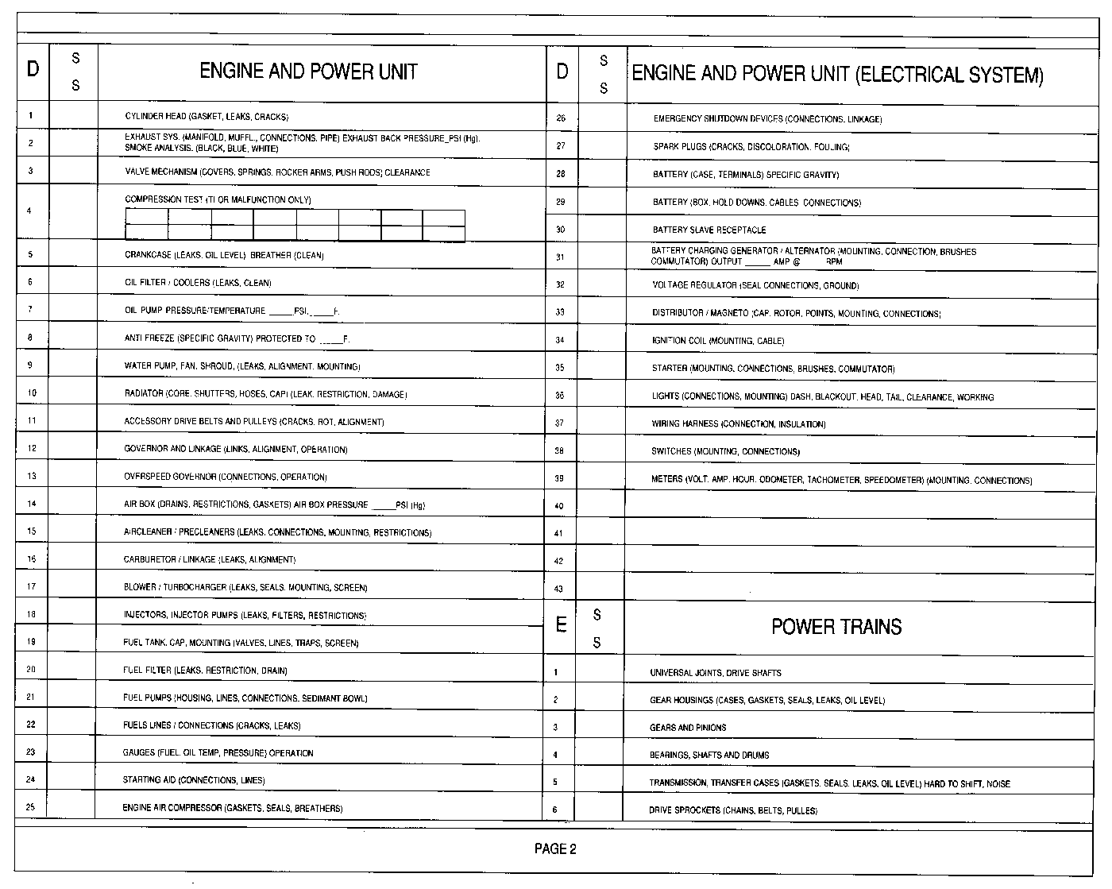

Slide 127
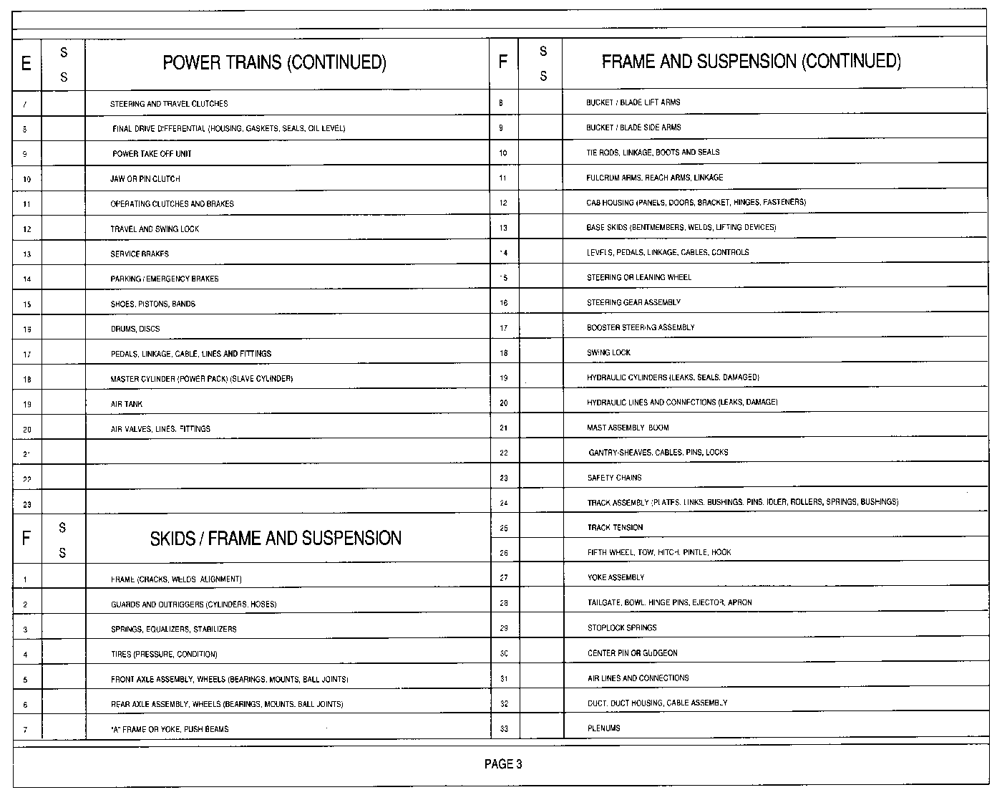

Slide 128
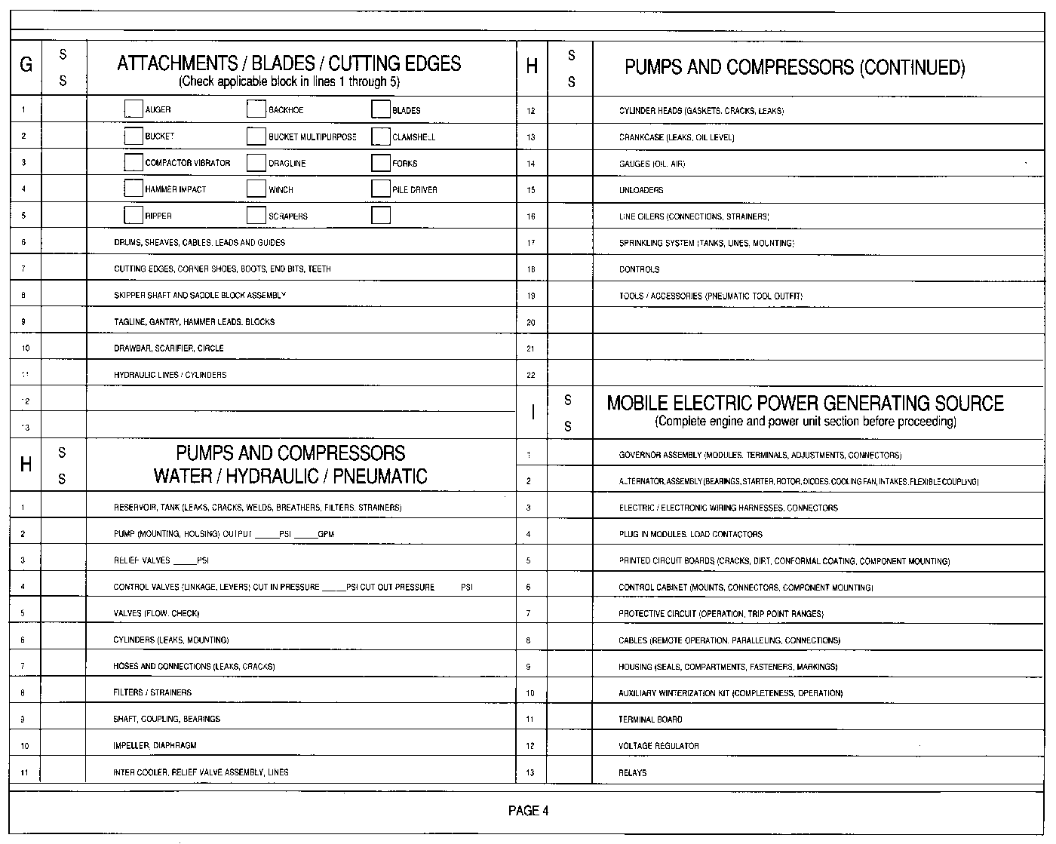

Slide 129
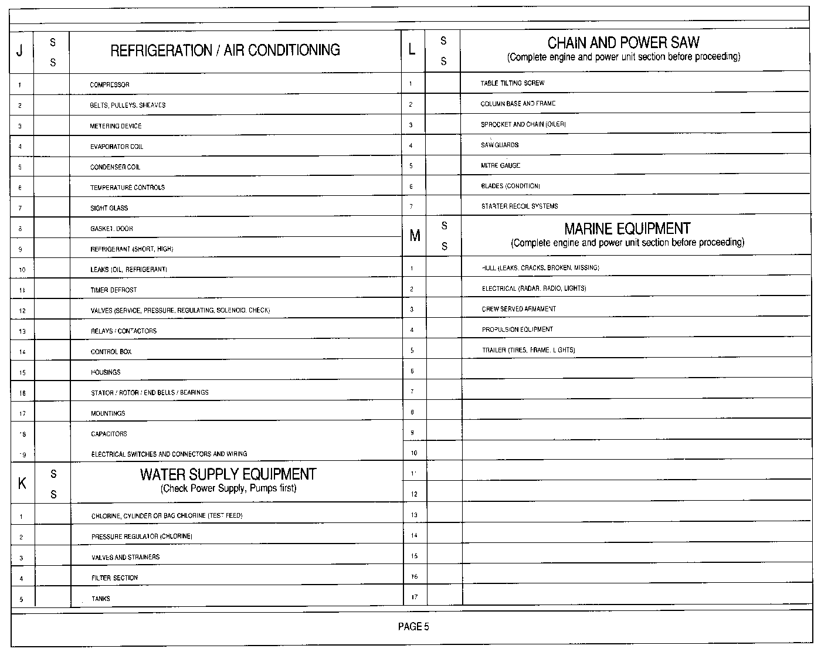

Slide 130
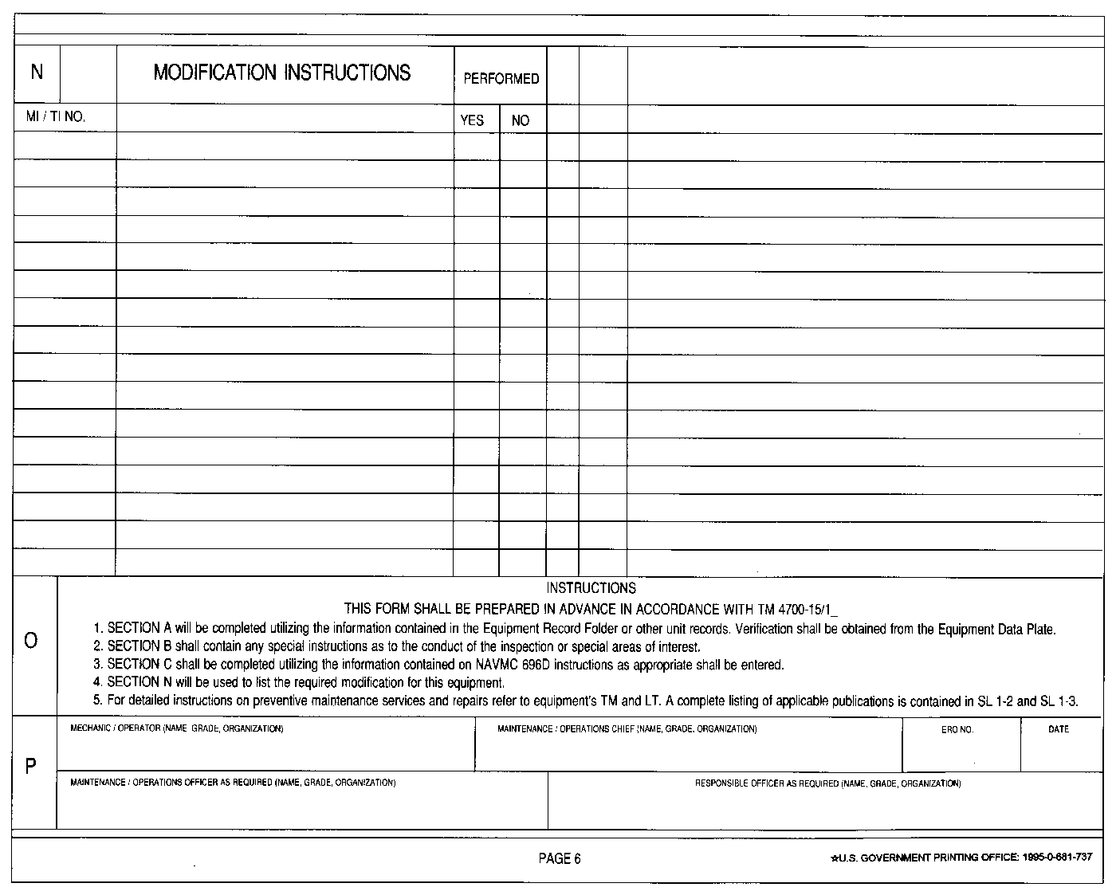
MI- # TITLE OF MI OR TI
Name,Grade,Organization
Name,Grade,Organization
ERO #
DATE
AS REQUIRED
AS REQUIRED

Slide 131
TACTICAL ENGINEER EQUIPMENT
Use a NAVMC 10245 (ERO) in conjunction with the NAVMC 10560 to record all PMCS and CM performed & the NAVMC 10925 to request parts.

Slide 132
GARRISON MOBILE EQUIPMENT
Use a NAVMC 9-11200/3A (SRO) in conjunction with the NAVMC 10560 to record scheduled maintenance (SM) and corrective maintenance (CM) performed and parts used.

Slide 133
FILING AND DISPOSITION
When maintenance officer/chief verifies that all requirements listed in Section B have been transferred to the ERO/SRO, it will be destroyed.
Retain when used in conjunction with an investigation.
  When released, use it for corrective maintenance.

Slide 134
QUESTIONS
?

Slide 135
QUESTIONS TO YOU!!!
. What is the purpose of the NAVMC 10560?
A. To provide a check list for performing & recording PMCS & LTI’s to include Acceptance LTI, LTI’s prior to major repair, at discretion of Engr.Equip. Officer/Chief, and a guide for performing ASCC’s.

Slide 136
BREAK!!!

Slide 137
NAVMC 10561
PREVENTIVE MAINTENANCE CHECKS AND SERVICES ROSTER

Slide 138
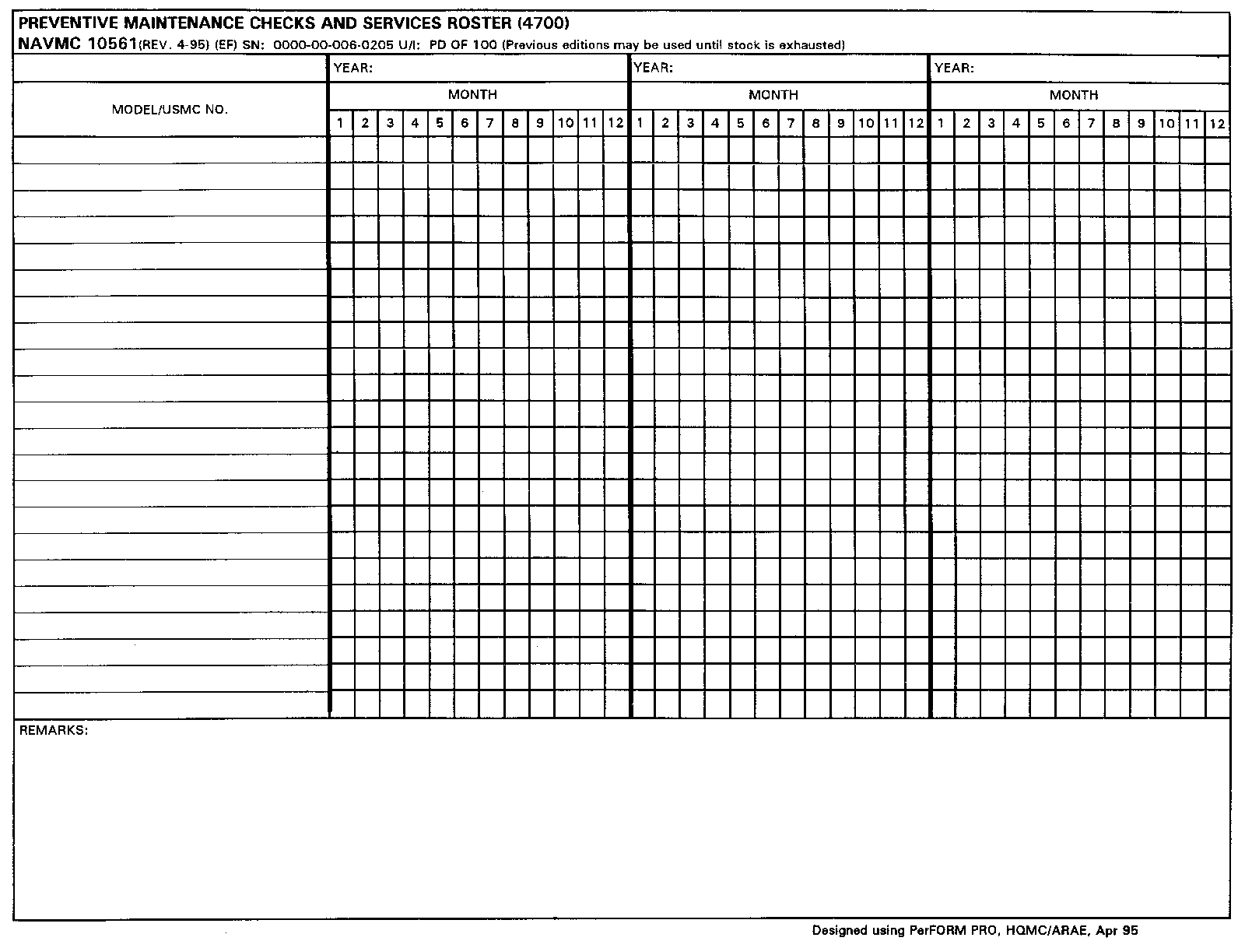
FOUND IN TM 4700-15/1H, PG. 2-4-1

Slide 139
PURPOSE
To systematically schedule and record 2nd echelon and higher PMCS.
  On Marine Corps ground equipment.
Units are authorized to use automated programs only when information duplicates the NAVMC 10561.

Slide 140
RESPONSIBILITIES
Scheduling of PMCS rest on the equipment office/chief or appointed individual.
  Commanders will establish an interval of no less than annually when no interval is listed in the equipment’s technical publications.
  First echelon need not be accomplished or scheduled if no requirement for 2nd echelon or higher is listed in appropriate technical publication or no publications exists.
  Scheduling of 2nd echelon or higher PMCS does not relieve the unit of its responsibilities to perform 1st echelon PMCS.

Slide 141
RESPONSIBILITIES CONT.
  Care must be taken to ensure workload is staggered.
  No more frequently than monthly
  Multiple commodity equipment is considered as an individual item when scheduling and performing.
    Responsible Officer will coordinate PMCS between various maintenance activities to allow for operational availability for unit commander.

Slide 142
RESPONSIBILITIES CONT.
Maintain at least one active schedule.
One interval under preparation.
  Used to schedule the next PMCS.
  Completed PMCS, schedule one year out for next PMCS.
Additional years can be maintained.

Slide 143
GET OUT YOUR NAVMC 10561 AND TAKE NOTES

Slide 144
PREPARATION INSTRUCTIONS
MODEL/USMC NO. Enter Model and Serial Number of equipment.
  Schedule and perform equipment with more than one TAMCN concurrently.
    Skip a line between types of equipment.
    (MCT) & (Winch) to maintain a matched schedule the end item may have the attachment listed on the following line.

Slide 145
RT420
614006
613946
624KR
639924
639925
850JR
640618
RIP 8AT36576600108
640567
WIN P16GHIJ1208E47

Slide 146
PREPARATION CONT.
YEAR. Enter the calendar year.
MONTH. Enter appropriate symbol.
  Use ink for completed entries.
  Use pencil for scheduled PMCS.
  Do not erase penciled entries made prior to completion of PMCS.
  Completed during scheduled month trace over with ink.
  PMCS completed other than originally scheduled, enter symbol in ink.

Slide 147
BE ADVISED OF THESE NOTES.
Chapter 3, Pg. 3-1-3 contains more information concerning the 10561.
  Para. (23)(c)2b states, a completed Hourly PMCS’s will be enter by using an inked “H”
  Para. (23)(c)2c states, equipment that fails to receive a 2nd EOM or higher Hourly PMCS within one year will receive an Annual Safety/Condition Check (ASCC).

Slide 148
NOTES CONT.
  Para. (23)(c)d states, perform an ASCC at least once a year, NAVMC 10560 will be used as a guide.
  Para. (23)(c)d(1) states, a completed 2nd EOM or higher hourly PMCS fulfills the ASCC requirement.
  Para. (23)(c)d(2) states, upon completion of an Hourly PMCS, reschedule the ASCC 1 year from the completed Hourly PMCS.

Slide 149
NOTES CONT.
  Para. (23)(c)d(3) states, completion of the ASCC, using an inked “A”, schedule the next ASCC in a penciled “A”.
  Para. (23)(c)d(4) states, when the ASCC is required within 50 hours of the next scheduled 2nd EOM or higher Hourly PMCS, every effort will be made to conduct both requirements during the ASCC.

Slide 150
PREPARATION CONT.
Remarks. Enter a justification for any PMCS that was not completed as originally scheduled.
Automated Forms.
  Upper case characters will represent inked entries.
  Lower case characters will represent penciled entries.

Slide 151
2010
2011
2012
RT420
613946
A
H
a
a
614006
A
a
a
624KR
639924
A
a
a
639925
A
a
a
850JR
640618
A
a
A
a
A
a
RIP 8AT36576600108
A
a
640567
A
a
a
WIN P16GHIJ1208E47
A
a
a
640618 ANNUAL PM PULLED LATE DUE TO OPERATIONAL COMMITMENT.

Slide 152
NAVMC 10561
FILING. Maintain current (active) 10561 with the equipment custodian or as directed by the commanding officer.

Slide 153
NAVMC 10561
DISPOSITION.
  Retain 10561 that has all required PMCS completed for a minimum of one year.
  2 years for biennial PMCS (Motor Transport)
  Units that have limited qty. may list items for subsequent years.
  Units using automated systems may retain printouts.

Slide 154
QUESTIONS
?

Slide 155
QUESTIONS TO YOU!
. What is the purpose of the NAVMC 10561?
A. To systematically schedule and record 2nd EOM and higher PMCS’s on Marine Corps Ground Equipment.

Slide 156
QUESTIONS TO YOU!
. Does 1st EOM need to be recorded on the NAVMC 10561?
A. No.

Slide 157
NAVMC 10031
DAILY DISPATCHING RECORD OF VEHICLES

Slide 158
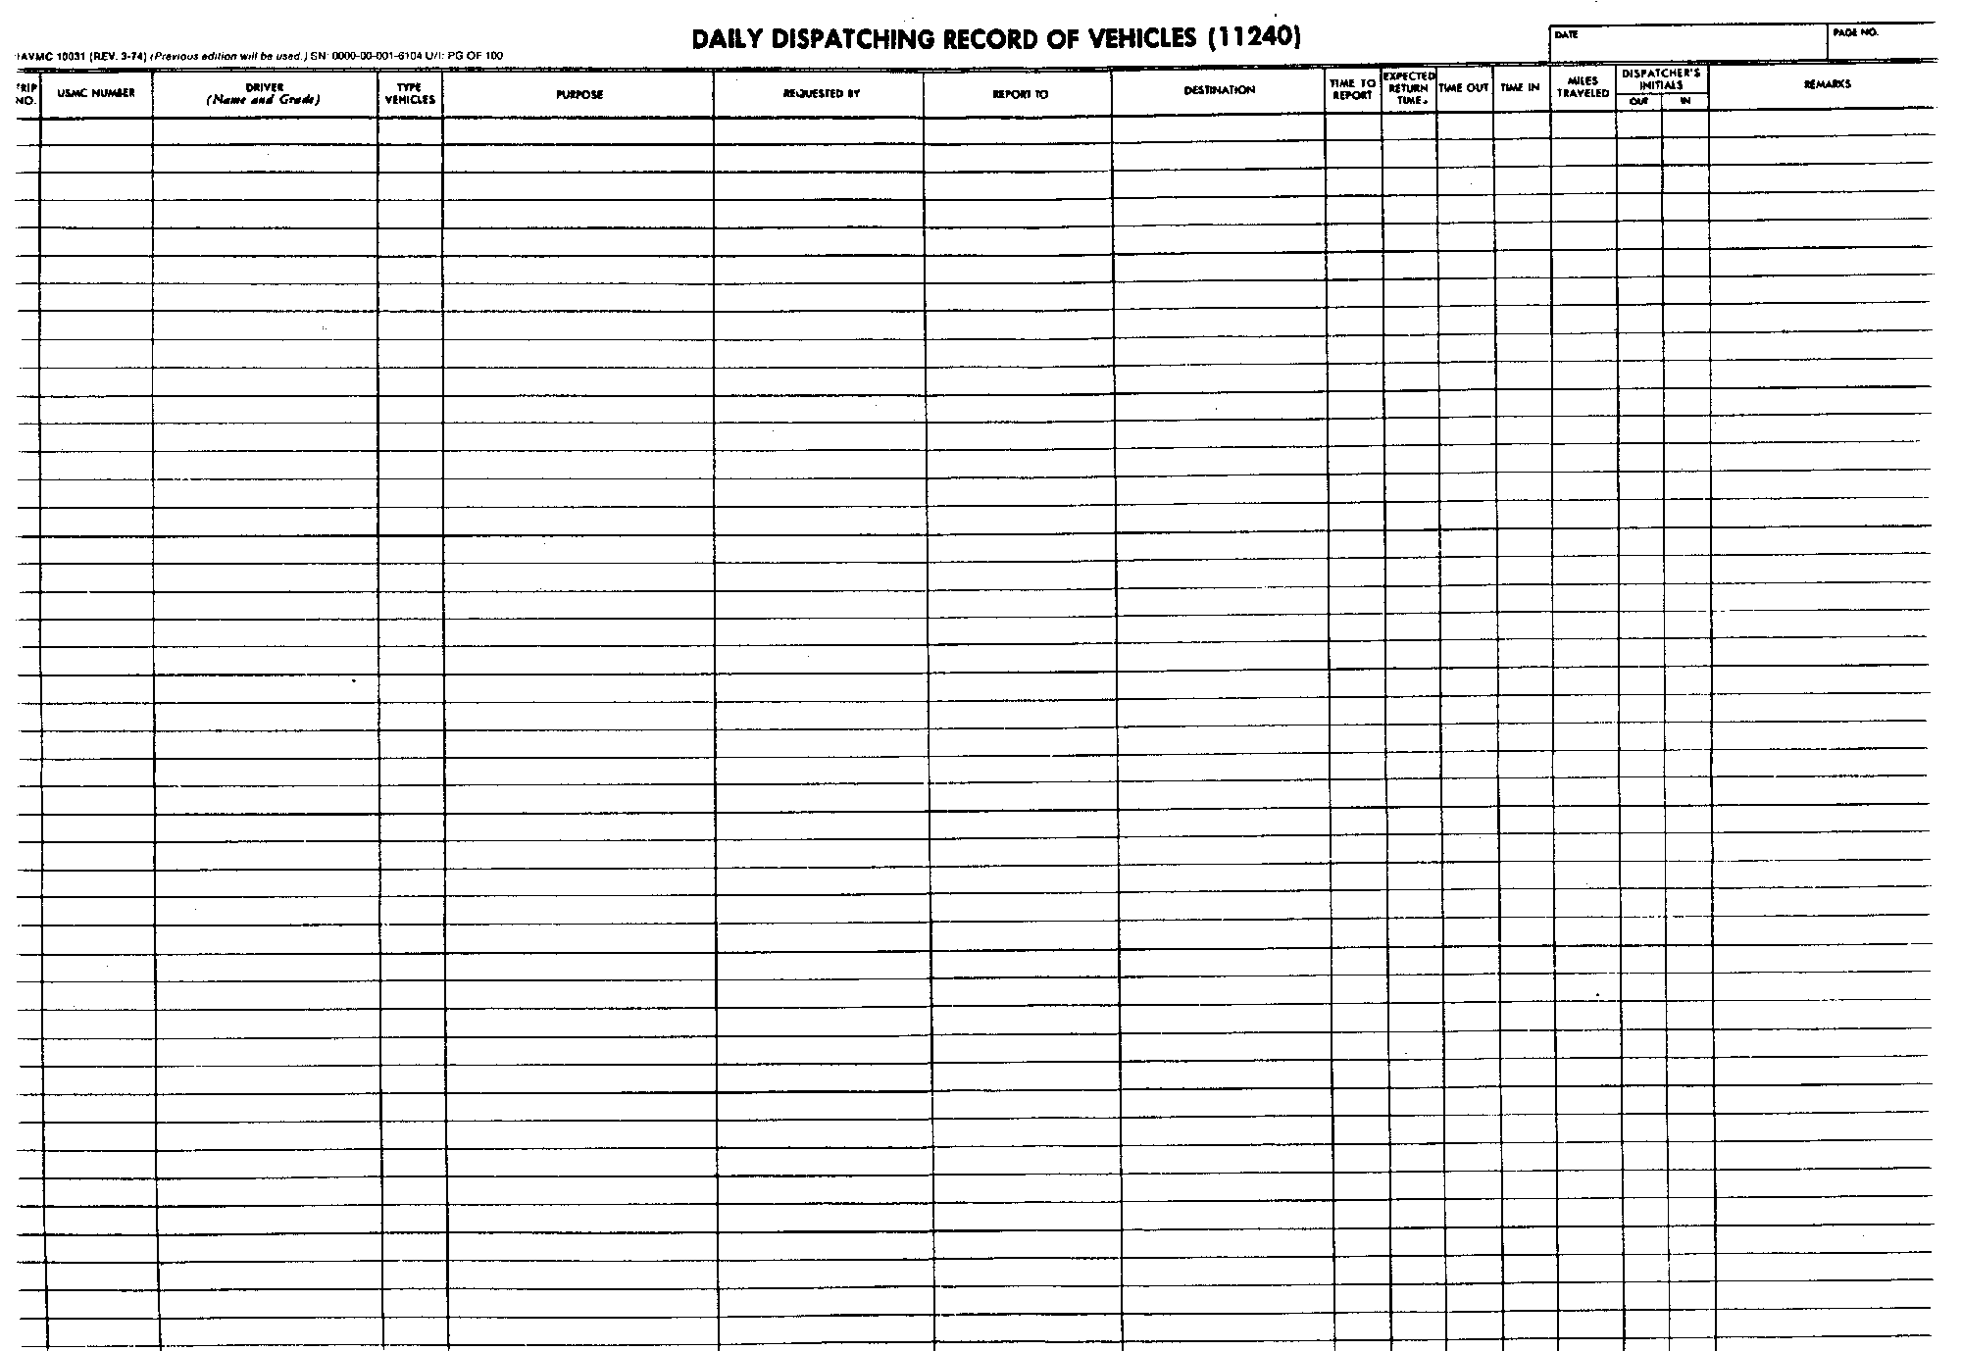
FOUND IN THE TM 4700-15/1H PG. 2-15-1

Slide 159
PURPOSE
To consolidate a daily record of all vehicles dispatched on a daily basis.

Slide 160
GENERAL INFO.
Equipment Officer will be used to describe the billets of MTO, Engr. Officer, and GME Fleet Manager.
The term Trip Ticket will be used describe the form that provides the authority to operate the equipment.

Slide 161
RESPONSIBILITIES
Initiated and maintained by the dispatcher.
  Must be assigned in writing by the Equipment Officer.
Lists in daily chronological order, all equipment released from the equipment pool.

Slide 162
RESPONSIBILITIES CONT.
Equipment Officer or designee will inspect at the conclusion of each day.
  This is to verify the correct preparation, and to review the utilization of equipment dispatched.

Slide 163
GET OUT YOUR 10031
AND TAKE NOTES.

Slide 164
Before dispatching the dispatcher will enter the following prior to issuing the trip ticket:
DATE Enter the calendar date.
May be used for consecutive days, in this case the date is centered on the next blank space after the “REMARKS” block where the Equip. Officer or designee signs. i.e. Report To block
2.PAGE NO. Enter the page number. This field is optional.
13 JULY 2009
1

Slide 165
3. TRIP NO. Enter the trip number in chronological order.
4. USMC NUMBER Enter the equipments serial number.
5. DRIVER (Name and Grade) Enter the operator’s name as listed on the OF-346.
Grade is optional.
1
557600
BUTLER, SMEDLEY D.
2
557616
SMITH, TEDD P.

Slide 166
6. TYPE VEHICLES Enter the equipment’s model number.
7. PURPOSE Enter the purpose the equipment was dispatched.
8. REQUESTED BY Enter the name of the individual that requested the equipment.
624KR
624KR
Load trucks
Load trucks
Capt. Dumdum
SSgt Shy

Slide 167
9.REPORT TO Enter the name of the individual the operator is to report to.
10.DESTINATION Enter the location the operator is to report.
11.TIME TO REPORT Enter the time the operator is to report.
GySgt Smarty
Bldg. 1134
0700
0730
Cpl Gertz
Bldg. 5046

Slide 168
12. EXPECTED RETURN TIME Enter the expected time the equipment is to return.
13. TIME OUT Enter the time the operator was logged out.
14. DISPATCHER’S INITIALS OUT Indicates that the equipment has been dispatched.
1530
0630
PRH
1600
0700
PRH

Slide 169
15. REMARKS Signed by the dispatcher for the first item of equipment of the day.
NOTE Dispatcher must be assigned in writing by the Equipment Officer.
13 JULY 2009
1
PRH
Paul R. Hunt
PRH

Slide 170
DISPATCHER
CAN NOW GIVE
THE TRIP TICKET
TO THE OPERATOR.

Slide 171
Upon return the dispatcher will enter
the following:
TIME IN Enter the time the equipment returned updated from the trip ticket.
2. MILES TRAVELED Enter the total miles/hours the equipment was operated as indicated on
the trip ticket.
3. DISPATCHER’S INITIALS IN Indicates that the equipment has returned.
13 JULY 2009
1
0700
0730
1530
0630
1500
5
PRH
PRH
P. R. HUNT
1600
0700
1630
6
PRH
PRH

Slide 172
At the end of each day the equipment officer or designee will record the TOTAL MILES/HOURS for that day, and signs in the “remarks” block on the line following the last entry.
  In the “MILES TRAVELED” column enter the TOTAL MILES OR HOURS for the day.
13 JULY 2009
1
1500
1630
5
6
Paul R. Hunt
07001530 0630
07301600 0700
PRH
PRH
PRH
PRH
11
James Cobb

Slide 173
NOTE
TM 4700-15/1H, Para. E. pg. 2-15-4, applies to Motor Transport, for field exercises or deployments.
Does not pertain to Engineer Equipment.

Slide 174
DISPOSITION FOR ENGINEER EQUIPMENT
Dispatcher will dispatch the same as previously mentioned with a few exceptions.
Following procedures will be used when making related entries on the 10031 from the 10524.

Slide 175
DISPOSITION FOR ENGINEER EQUIPMENT CONT.
All blocks from “TRIP NO” to “DESTINATION” are filled out the same as previously mentioned.

Slide 176
On the 10031 enter the Estimated date of return in the “Expected Time of Return” column. Leave the “Time In” and “Hours Operated”, blank. Enter Remain on Job Site in the “Remarks” column.
8 JAN 2009 3
15
Jan 09
Paul R. Hunt
REMAIN ON JOBSITE
0800
0730
PRH
0
James Cobb

Slide 177
Upon return enter:
  Entry will be made on that days 10031.
  Blocks from “ITEM NO” to “DESTINATION” are filled out the same as the day of dispatch.
  Following will be left blank, “TIME TO REPORT”, “EXPECTED RETURN TIME”, “TIME OUT”, “DISPATCHER’S INITIALS OUT”.
15 Jan 2009 4
0700
32
PRH
Paul R. Hunt
Dispatched
On 8Jan01

Slide 178
FSMAO CLARIFICATION
Encl. (3) pg. 18, Para. (m) reads as follows:
  Line-outs on dispatch records are authorized and should be made in black ink unless directives specifically call for temporary entries which would be completed in pencil. Black ink can be a felt tip marker provided it does not bleed through the form or make other entries illegible.

Slide 179
FILING & DISPOSITION
Will be filed in the dispatchers office.
Will be retained for one year.
If a vehicle was involved in an accident the 10031 will be retained until investigation, when required, is complete and is repaired or disposed of.

Slide 180
QUESTIONS
?

Slide 181
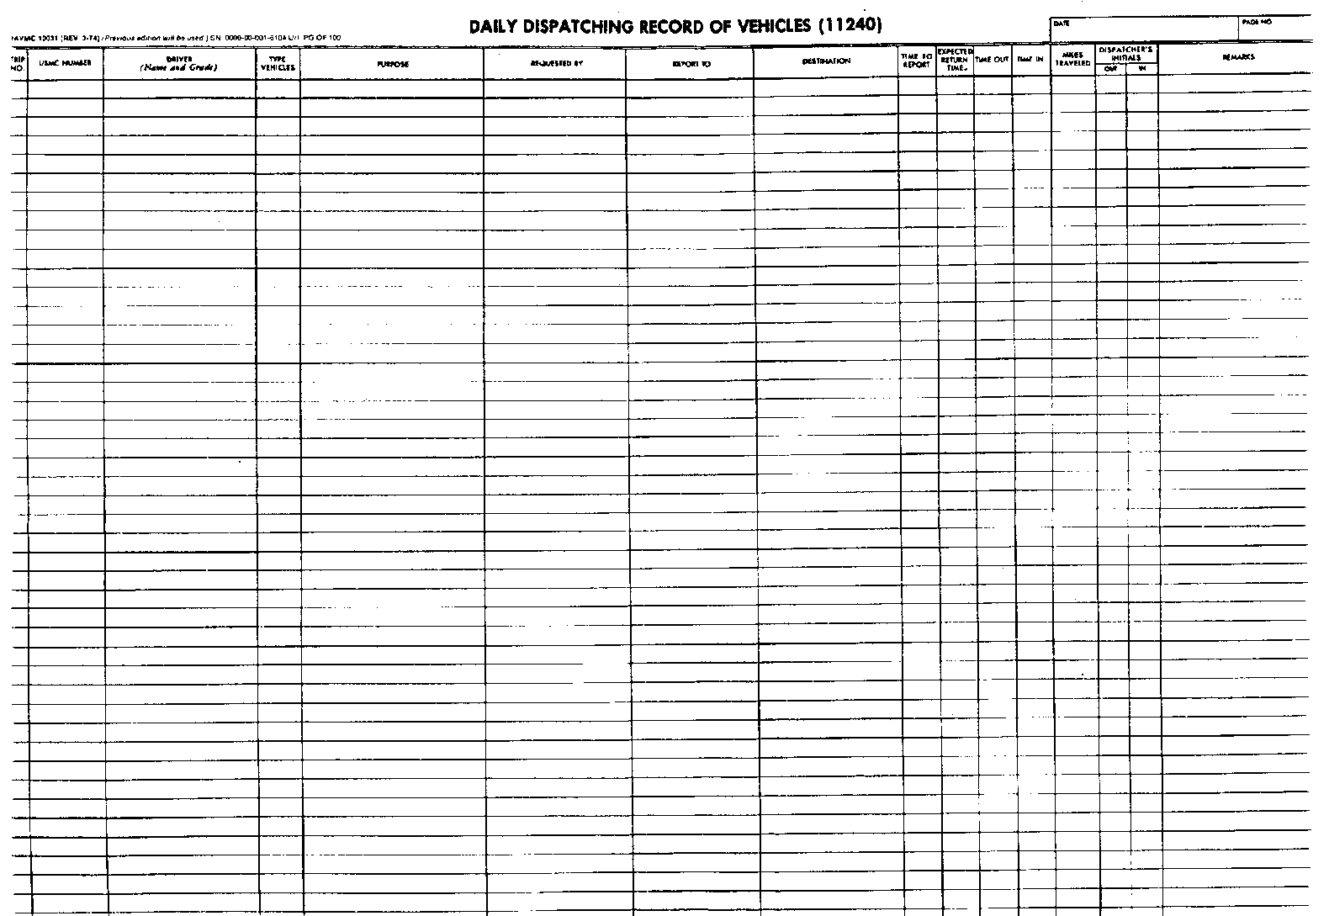
DEMONSTRATION
NAVMC 10031

Slide 182
SCENARIO
The Dispatcher throughout the entire demonstration will be Cpl. Jim Tressel. You the student are the Equipment Officer/Designee.
Classroom SOP:
1. Operators names are as they appear on their OF-346
2. Use time equipment returned to Motor pool for time in.

Slide 183
SCENARIO
The following is a list of your equipment:
NOMEN MODEL SERIAL#
RTCH RT-240 123456
All Terrain Crane (ATC) MAC 50 789123
7 ½ Ton Crane LRT-110 456789
Grader 120M 987654
TRAM 624KR 345678
SkyTrak MMV 654987
Terex TX5119M 789456
Backhoe 420E 369258

Slide 184
SCENARIO
Capt. Woody Hayes requested a TRAM for 01 Apr 10, to load pallets onto a LVS. It was requested that the TRAM report to a GySgt A.J.Hawk at Hangar 187, at 0600. Cpl. Jim Tressel dispatched, Cpl. Wells, Beanie M. at 0530. Expected return time is 1500. Cpl Wells returned to the motor pool at 1330 and turned in the NAVMC 10523 to the dispatcher at 1400. The NAVMC 10523 showed 4 equipment hours.

Slide 185
SCENARIO
Capt. Hayes requested a TRAM for 01 Apr 10.

Slide 186
01 Apr 2010
Optional

Slide 187
SCENARIO
Cpl. Jim Tressel dispatched, Cpl. Wells, Beanie M. at 0530.

Slide 188
345678
Cpl. Wells, Beanie M (OF-346)
1
Cpl. Abbot

Slide 189
SCENARIO
The following is a list of your equipment:
NOMEN MODEL SERIAL#
RTCH RT-240 123456
All Terrain Crane (ATC) MAC 50 789123
7 ½ Ton Crane LRT-110 456789
Grader 120M 987654
TRAM 624KR 345678
SkyTrak MMV 654987
Terex TX5119M 789456
Backhoe 420E 369258

Slide 190
TRA
624KR
LOAD PALLETS
Capt. Hayes

Slide 191
SCENARIO
It was requested that the TRAM report to a GySgt A.J.Hawk at Hangar 187, ext. 6-5300 at 0600.

Slide 192
GYSGT HAWK
HANGAR 187
0530
0600

Slide 193
SCENARIO
Cpl Wells returned to the motor pool at 1330 (SOP) and turned in the NAVMC 10523 to the dispatcher at 1400. The NAVMC 10523 showed 4 equipment hours.

Slide 194
1500
0600
1330
8.5
JT
JT
4
4

Slide 195
SCENARIO
Maj. Manning requested a Grader from 2 - 5 Apr 10, to grade a road. It was requested that the vehicle report to MSgt. Brady at TLZ Horseshoe, at 0900. Cpl. Tressel dispatched Sgt. Pryor, Terrell V. on the Grader at 0630. Expected return time is 05 Apr 10. Cpl. Tressel issued the Operator a NAVMC 10524.

Slide 196
2 Apr 2010
5 Apr 2010
JT
Jim J. Tressel
REMAIN ON JOBSITE
0900
0630
Justin Webber

Slide 197
SCENARIO
The Marine that was dispatched on 02 Apr 10 completed his mission at 1400 on 05 Apr 10 and returned to the motor pool at 1630. The Con. Logs showed the total hours for the Grader to be 41 hours.

Slide 198
5 Mar 2010
Dispatched
On 2 MAR 10
1400
4
41
JT
Jim J. Tressel
41
Justin Webber

Slide 199
Questions?

Slide 200
PRACTICAL APPLICATION “B”

Slide 201
QUESTIONS TO YOU!!!
. What is the purpose of the NAVMC 10031?
A. To provide a consolidated daily record of all items of equipment that are required to be dispatched on a daily basis.

Slide 202
QUESTIONS TO YOU!!!
. What is required at the end of each day on the NAVMC 10031.
A. The Equipment Officer or designee will sign in the remarks block after the last entry and record the total hours/miles for that day.

Slide 203
BREAK!!!

Slide 204
SF 368 PQDR
VIDEO

Slide 205
QUESTIONS
?

Slide 206
PRACTICAL APPLICATION “C”

Slide 207
BREAK!!!

Slide 208
RECORDS & FORMS QUIZ

Slide 209
QUESTIONS TO YOU!!!
. What Marine Corps Order assigns specific responsibilities facilitating submission and processing of PQDR’s?
A. MCO 4855.10

Slide 210
QUESTIONS TO YOU!!!
. Who can submit a PQDR?
A. Anyone, the individual that
discovered the deficiency

Slide 211
QUESTIONS TO YOU!!!
. What is the timeframe for the originator to submit a Cat I PQDR to the originating point?
A. 24 HOURS

Slide 212
BREAK!!!

Slide 213
MODIFICATION PROGRAM
NAVMC 11053/11054

Slide 214
PURPOSE
To provide the unit commodity manager with a means of accurately determining the modification status of assigned equipment.

Slide 215
Commodity Manager
Who is assigned to Mods?
Ensure all the unit’s equipment that requiring a Mod. Have been completed and recorded.

Slide 216
EQUIPMENT MODIFACTION
Equip. Mod. are those actions performed to change:
    Design or assembly characteristics.
    End items
    Components
    Assemblies/subassemblies
    Parts.

Slide 217

MODIFICATIONS
This is done to improve:
  Functioning
  Maintainability
  Reliability
  Safety characteristics
PQDR’s and Beneficial suggestions is normally where modifications begin.

Slide 218
“URGENT” MODIFICATIONS
Prevent death or serious injury to personnel
Prevent major damages to equipment-
Changes that are considered so essential that the mods. should be completed as soon as possible.

Slide 219
MODIFICATIONS
The MI will break it down how to perform the Mod to include:
  Specific types/items of equipment to modified.
  Maintenance resources.
  Skills.
  Time necessary (URGENT)-
  Specify the EOM authorized.

Slide 220
MODIFICATIONS
Equipment will only be modified when directed by CMC. (Welders)

Slide 221

MODIFICATIONS
Commodity managers will maintain records based on info from other records and physical observation.
Automated system is authorized.
    Information must match what is required by the NAVMC 11053 or 11054.
Both forms may be used.

Slide 222
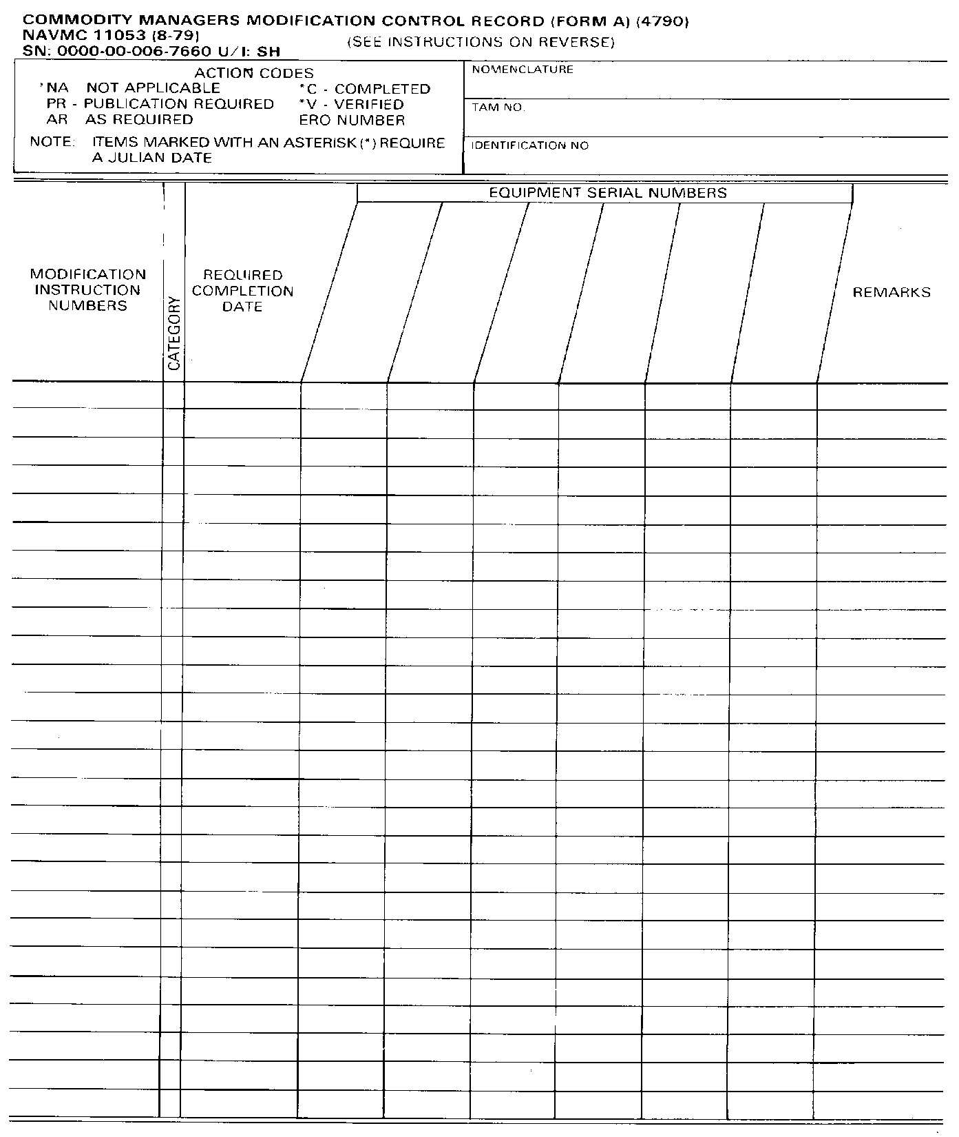
11053 allows more MI numbers than serial numbers

Slide 223
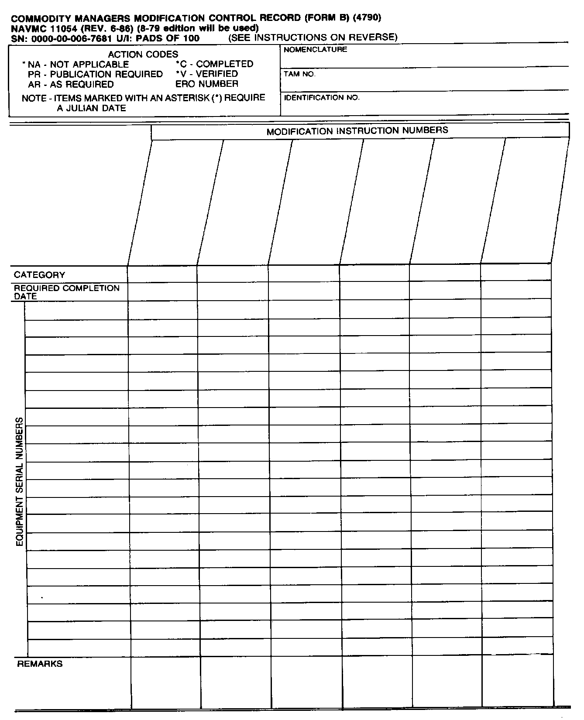
11054 allows more serial #’s than MI #’s

Slide 224
REQUIREMENT DETERMINATION
Verify Mods upon initial receipt
  Initiate ERO for missing modifications.
  Nature of mod. cannot be determined, item will be evacuated to the IMA.
  Once mods are verified or completed the 11053/11054 will be updated.

Slide 225
PREPARATION INSTRUCTIONS
A Mod. Control Record will be prepared on each major T/E or special allowance equip. that has had an MI issued.
A separate record will be prepared for each ID#.
Components/secondary repairables that have MI’s issued will be recorded for the end item.

Slide 226
Enter Nomen., TAMCN, ID # in appropriate field

Slide 227
NOTE
SL-6-1/6-2 can be used to identify “Part Of” and “Consist Of” ID numbers for end items.
  “Part Of” is an item that is a component or repair part to another item.-
  “Consist Of” refers to one item that has different components or repair parts that have their own ID#.

Slide 228
PREPARATION INSTRUCTIONS CONT.
Enter Ser.# for each T/E & special allowance item with a MI published.-
  If a ser# has not been assigned, a local serial number will be assigned per the UM-4400-124.

Slide 230
PREPARATION INSTRUCTIONS CONT.
List all MI’s from the SL-1-2 and TI-5600 for each ID#.
  Changes that are administrative will be recorded under the basic MI. (i.e. part # or NSN change)
    MI xxxx xxxx w/ch 1
  Changes that alter the configuration, or adds/deletes serial, control, or manufacturers numbers.
    Separate entry is required for verification purposes.

Slide 232
NOTE:
Marine Corps Pubs. Web site may be used to identify current mods on equipment.

Slide 233
PREPARATION INSTRUCTIONS CONT.
CATEGORY & REQUIRED COMPLETION DATE:
  “U” = Urgent Modification
    Identified in the SL-1-2 by “URG” following the MI#.
    Indicates upon receipt, or does not have a date enter “N/A”.-
    Required Completion Date can be found in the Time Compliance Paragraph.

Slide 234
NOTE:
Urgent modifications may D/L or sharply curtail the use of the item until applied.
  Acceptance scheduling normally will not be feasible.
  Other “URG” Mods. may lend themselves to acceptance scheduling.
  The urgency of the Mod. will be considered in determining priority.

Slide 235
PREPARATION INSTRUCTIONS CONT.
CATEGORY & REQUIRED COMPLETION DATE (Cont’d.):
  “N” = Normal Modification
    Not identified in the SL-1-2 as “URG”.
    Required Completion Date may be found in the Time Compliance Paragraph.
    Does not have a date, RCD is one year from the date of publication.

Slide 237
PREPARATION INSTRUCTIONS CONT.
Level “A” Pack, need not be opened to perform Normal modifications.
  Mod. Kits will be ordered and stored until item is removed.

Slide 238
NOTE:
Normal Mods. should be planned to coincide with normal maintenance actions. (scheduled maint.)
Major factor in determining application of Mod. is operational commitments.
  Mods. Should be applied prior to deployments or extended operations.

Slide 239
PREPARATION INSTRUCTIONS CONT.
Determine applicability of each MI to the item.
  Found in the “Major Item affected” paragraph.
Determine current status of MI by:
  Inspection.
  Records.

Slide 240
Enter appropriate Action Codes:
  NA. Apply to specific serial numbers, this code identifies those items the MI does not apply to.
    Req’d Julian date.
  PR. Applies when the unit requires the publication. (Date the pub was ordered and doc # in remarks)-
  AR. Apply to equip. that require a specific repair action. Example, 5th Ech. repairs.

Slide 241
FSMAO CLARIFICATION
The action code, “AR” should be used on the modification control records for end items that may not require the modification to be applied (e.g., radio mounts; not all unit’s vehicles would require these mounts, so the modification is optional yet required to be identified for that particular end item). The “AR” entry allows the flexibility of changing the modification record in the event the modification is applied to that end item at a later date. AR action code entries are made in pencil and do not require a Julian date.

Slide 242
ACTION CODES (Cont’d.)
  C. Completed while in custody.
    Includes item modified from the supporting maintenance activity.
    Julian Date.
  V. Applies to equipment that has had the MI applied prior to receiving.
    Julian Date.-
  ERO#. Goes in the action code column when it has been identified that a mod is required but not complete and an ERO opened.

Slide 243
PREPARATION INSTRUCTIONS CONT.
Remarks Block. Used to add any additional information such as:
  Nomenclature for sec/reps that have been modified.
  Document numbers. (PR)-
  Non-availability of equipment. (deployment, admin storage/deadline)

Slide 244
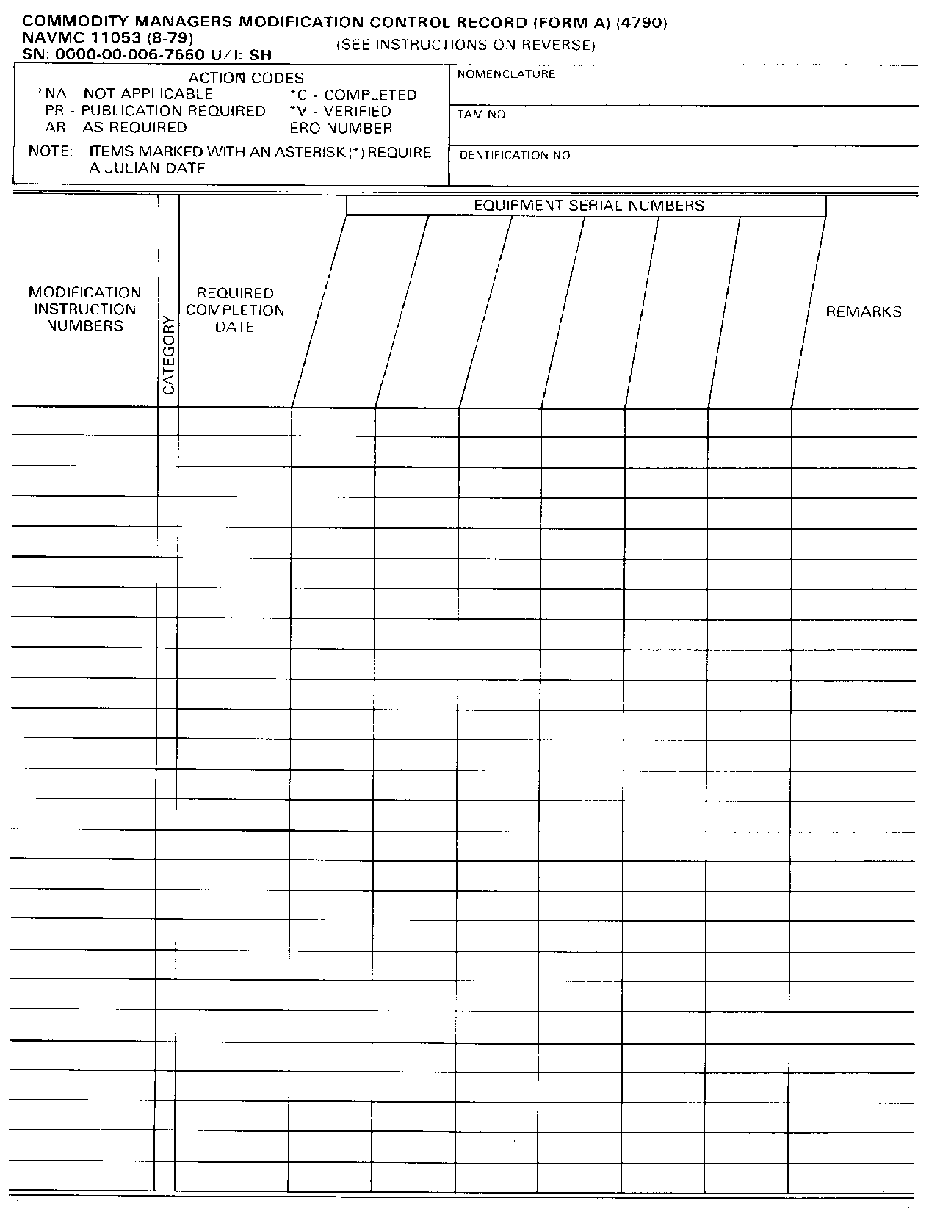
DTC 8606 4000 lbs Forklift
B2566
09135A
548892
09135-25/10
N
23FEB87
C-86100
Action Codes “N/A”, “C”, and “V”
Require a julian date. These entries
Will be entered in pen.
All other action codes “PR”, “AR”,
And ERO# will be in pencil.

Slide 245
PREPARATION INSTRUCTIONS CONT.
Using each revision of SL-1-2 and TI-5600, verify each record to ensure all mod information is current.

Slide 246
PREPARATION INSTRUCTIONS CONT.
Upon receipt of a new MI you must:
  Determine if you have that gear.
  Enter the MI #, category and required completion date.
  Determine applicability to those items held by the unit.
  Initiate appropriate action.
  Update records upon completion of action.-
Use pencil for temporary entries.

Slide 247
PREPARATION INSTRUCTIONS CONT.
When equipment has been dropped from the unit’s account:
  Its not necessary to reconstruct a record.
  Delete item neatly and indicate the reason for deletion.
    Letter of Unserviceable Property.
    Excess.-
    Replaced by new model.

Slide 248
CONTROL
Units will establish a modification control point for internal reviews. (MMO)
If MMO is not assigned, the individual commodity maintenance officer will be responsible for reviewing.

Slide 249
FILING & DISPOSITION
Commodity Managers Control Record will be maintained in the commodity manager’s office.
Will be held as long as the unit holds the equipment.
If transferred or evacuated beyond the using unit, make a copy and send it with the record jacket.

Slide 250
QUESTIONS?

Slide 251
DEMOSTRATION
11053

Slide 252
SCENARIO
As the Engineer Chief/Officer, you are inspecting a record for the following piece of engineer equipment to ensure the NAVMC 11053 is properly filled out:
a. TAMCN – B0063
b. NOMENCLATURE – TRAM 624KR
c. ID NO – 11412A

Slide 253
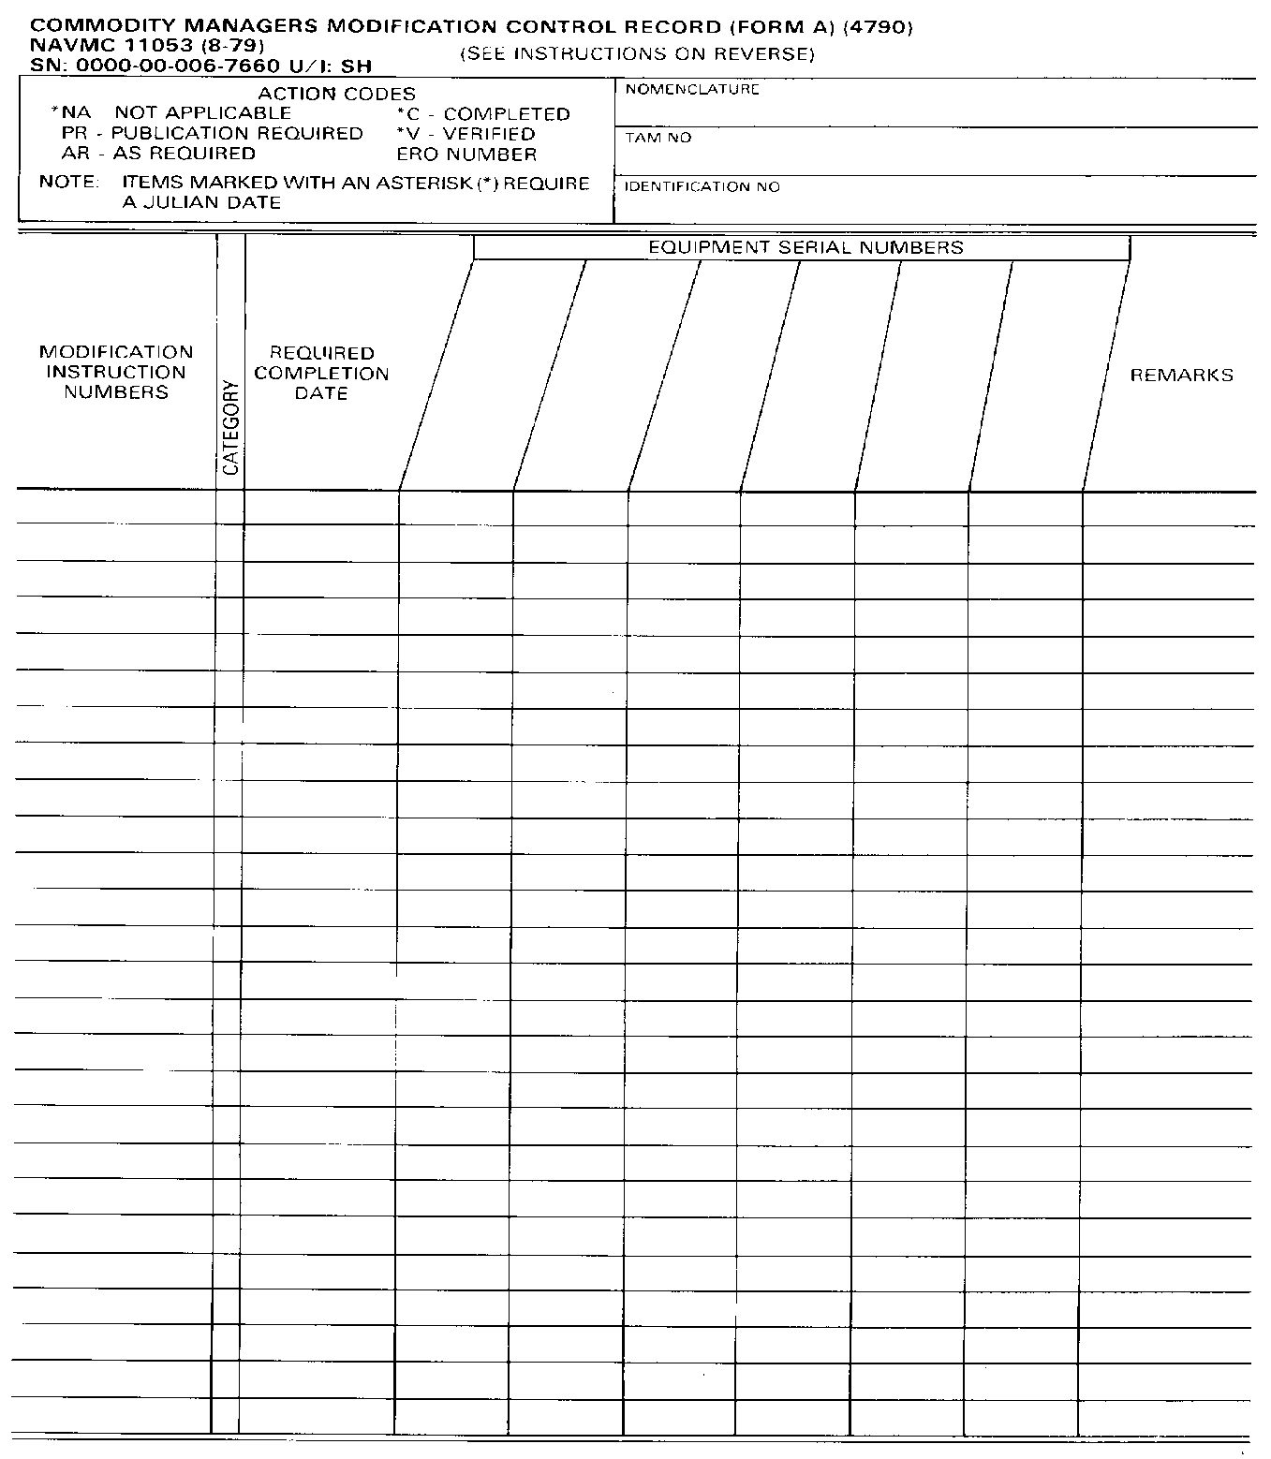
TRAM 624KR
B0063
11412A

Slide 254
SCENARIO
MI-11412A-12/1, this is an urgent mod, completion date 09072.
MI-11412A-12/2, this is a Normal mod, publication date 10082.
MI-11412A-35/1, this is a normal mod, publication date 11042.
MI-11412A-35/2, has not been completed
The following equipment Serial numbers apply:
(1) 234678
(2) 876432

Slide 255
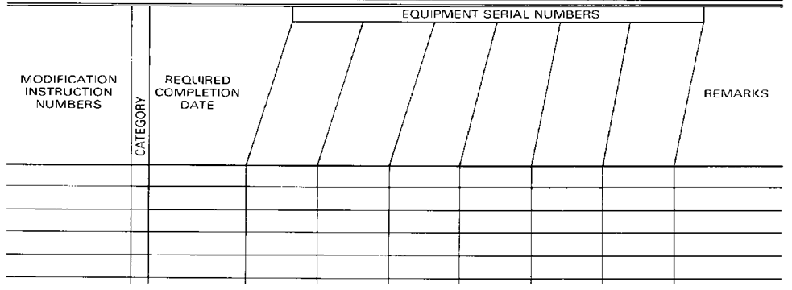
TRAM 624KR
B0063
11412A
234678
234678
234678
234678
876432
N
N
N
09072
10082
11042
11412A-12/2
11412A-35/1
11412A-35/2
11412A-12/1
09072
10082
11042
N
N
N
U
N
N
11412A-12/2
11412A-35/1
11412A-35/2

Slide 256
SCENARIO
You inspected all modifications on Jan 12, 11 (11012) and found MI-11412A-12/1 & MI-11412A-12/2 had been completed while in custody of the unit.
MI-11412A-35/1 needed to have parts ordered. They were on order on ERO# XR911.
for MI-11412A-35/2, publications were not on hand, but were ordered under Document Number 9876543.

Slide 257
TRAM 624KR
B0063
11412A
234678
876432
234678
234678
876432
11412A-12/1
U
N
N
09072
10082
11042
C-09050 10082
XR911
PR
C-09050
10082
XR911
PR
C-09050
C-10082
XR911
PR
C-09050
C-10082
XR911
PR
11412A-12/2
11412A-35/1
11412A-35/2
9876543

Slide 258
QUESTIONS
?

Slide 259
PRAC APP!!!

Slide 260
QUESTIONS TO YOU!!!
. Which action codes require a Julian date?
. NOT APPLICABLE, COMPLETED, AND VERIFIED.

Slide 261
QUESTIONS TO YOU!!!
. When a Urgent modification is received, and the MI states the required completion date is “Upon Receipt” what shall be placed in the Modification Control Record?
. N/A

Slide 262
QUESTIONS TO YOU!!!
. Can an automated control program be used in lieu of the NAVMC 11053 or 11054?
. YES!

Slide 263
BREAK!!!

Slide 264

CALIBRATIONS PROGRAM

Slide 265
PURPOSE & POLICY
Test, Measurement, and Diagnostic Equipment (TMDE).
MCO 4733.1B Calibration and Maintenance Program (CAMP).
PURPOSE
To provide and maintain prescribed accuracies in standards of measurement and ensure satisfactory performance of all MC TMDE.

Slide 266
PURPOSE & POLICY CONT.
MARINE CORPS POLICY
Have all TMDE calibrated only to the extent and at intervals necessary to adequately perform the measurements involved.
Accomplish calibration in the most cost-effective manner.
Use MC Calibration Facilities (CF) as the preferred source.

Slide 267
PURPOSE & POLICY CONT.
DEPT. OF NAVY POLICY (SECNAVINST 3960.6)
To provide organizational, intermediate, and depot maintenance levels with diagnostic capabilities, which means…
  Detect and isolate faults
  Design threshold levels.-
To ensure all TMDE are maintained at the lowest practical maintenance level.

Slide 268
PURPOSE & POLICY CONT.
Inter-service calibration support can be used at the discretion of the Commanding Officer.

Slide 269
REPONSIBILITIES
MCO P4790.2_, Appendix “D” is used to establish and maintain control over calibrations.
Units holding TMDE shall:
  Submit all TMDE required to be calibrated.
  Schedule TMDE so that you have sufficient amount of TMDE to preclude loss of testing capabilities.

Slide 270

REPONSIBILITIES CONT.
  Ensure TMDE is complete and has proper PMCS performed, to include op checks.
  Ensure TMDE protected during transportation to and from the CF.
  TMDE w/o a Cal. Label shall not be used.-
    TMDE received from the supply system with a Cal. Label should not be used until crosschecked with the CF.

Slide 271
REPONSIBILITIES CONT.
  Submit a list of TMDE to the CF that are to be included in the Calibrations Program
    Measured in specific quantitative amts
    OTC 3
  Analyze measurement requirement and request Special Cal. When the full measurement is not being used.
  Request Inactive Labels for TMDE that is not being used.
    3 yrs

Slide 272
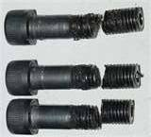
REPONSIBILITIES CONT.
  Ensure TMDE is used properly to preclude damage.
  Request assistance from the CF for training and proper use of TMDE, as necessary.

Slide 273
CF RESPONSIBILITIES
Intermediate Maintenance Activities will repair and calibrate within their authorized level.
  Forward TMDE to higher EOM as necessary.

Slide 274
CF RESPONSIBILITIES CONT.
You can assist the Cal program by:
  Informing those in your shop of the requirements and resources the CF offers.
  Identifying need for additional capability.
Provide intra-/inter-service support, commercial contracts, as necessary.

Slide 275
CF RESPONSIBILITIES CONT.
CF’s are designated by HQMC and are authorized necessary equipment to perform cal. and repair. Encl (2) per MCO 4733.1B
Cal. Support is received from MC CF’s (ELMACO)
  If no MC facility, Cal. will be done by the local facility (Army, Civilians).

Slide 276
CONTROL PROGRAM
IDENTIFY TMDE.
  Inventory all TMDE to ensure records are accurate & complete, at least annually.
  T/E, Allowance List, Special Allowances can be used by MMO’s and Maintenance personnel to identify what is rated.

Slide 277
CONTROL PROGRAM
FEDLOG also identifies TMDE that requires to be calibrated.
  # 3 under the OTC.
  OTC can be found in the Management View Screen under MGMT CTL data element, 6th position.
  Questions concerning interval or if needed to be calibrated CONTACT YOUR CF.

Slide 278
CONTROL PROGRAM
LOCATE TMDE.
  TMDE shall be located.
  Control System shall identify the section/area the TMDE is being held.
  During the search of TMDE, keep in mind some items may be components. (i.e. batteries)

Slide 279
CONTROL PROGRAM
INVENTORY TMDE.
  When all TMDE has been located appropriate personnel should match the TMDE Control Systems with the T/E, & Unit Allowances to ensure everything is accounted for and complete.

Slide 280
CATEGORIES, LABELS, SEALS, & TAGS
There are four categories of calibration.
Each TMDE item shall fall into one of these categories.
Each item will have a current label affixed.-
Category assignment should be based on current, as well as potential future use.

Slide 281
CATEGORIES, LABELS, SEALS, & TAGS CONT.
FULL CALIBRATION.
  Accurate across its full range of measurement.
  Label indicates that it is in specifications approved by the MC.
  Label is Black on White, and comes in three sizes.

Slide 282
CALIBRATED/FULLY CAL
UNITED STATES MARINE CORPS
CALIBRATION PROGRAM
CALIBRATED
LAB ________________
TECH ________________
DUE ________________

Slide 283
CATEGORIES, LABELS, SEALS, & TAGS CONT.
SPECIAL CALIBRATION.
  Accurate across a portion of its full range of measurement, & CF has been provided with specific ranges.
  One tag affixed, indicating limitations.
  Label & Tag are Black on Green. Label comes in three sizes.

Slide 284
SPECIAL CALIBRATION
UNITED STATES MARINE CORPS
CALIBRATION PROGRAM
SPECIAL
CALIBRATED
REFER TO ATTATCHED TAG
LAB ________________
DUE ________________
SN: 0000-555-0160

Slide 285
CATEGORIES, LABELS, SEALS, & TAGS CONT.
CNR.
  Not used in any Quantitative or Qualitative application.
  Training only.
  Unlimited time frame.
  Will not be calibrated unless requested by the using unit.
  Label is Orange on White.

Slide 286
CALIBRATED NOT REQUIRED
UNITED STATES MARINE CORPS
CALIBRATION PROGRAM
CALIBRATION
NOT REQUIRED
LAB ________________
TECH ________________
DUE ________________

Slide 287
CATEGORIES, LABELS, SEALS, & TAGS CONT.
NOTE:
  CNR; Not require to resubmit for cal. unless:
    Defective.
    LTI.
    Unit requires status to be changed.

Slide 288
CATEGORIES, LABELS, SEALS, & TAGS CONT.
INACTIVE.
  Not used and is not expected to be used in the near future.
  Must be calibrated prior to use.
  Must be reviewed every three years.
  Still not expected to be used, unit should consider requesting a change in T/E.

Slide 289
CATEGORIES, LABELS, SEALS, & TAGS CONT.
Units shall request Inactive & CNR labels from the CF by Naval letter or directly. Requirements for ltr:
  Model Number/Nomenclature.
  Serial number.
  Cal. due date.
  Barcode-
  Exact label desired.

Slide 290
CATEGORIES, LABELS, SEALS, & TAGS CONT.
  CF shall maintain letter for a minimum of 3 years.
  Item not currently calibrated or operational, must be submitted for full operational check.
  Inoperative, submit for repair.-
  Label is Green on White.
Encl. 1

Slide 291
INACTIVE
UNITED STATES MARINE CORPS
CALIBRATION PROGRAM
INACTIVE
CALIBRATE
BEFORE USE
LAB ________________
TECH ________________
DUE ________________

Slide 292
ENCLOSURE (1)
FLOW CHART

Slide 293
CATEGORIES, LABELS, SEALS, & TAGS CONT.
REJECTED LABEL.
  Item returned to unit for failure to meet criteria.
  Tag shall remain on item until repaired or calibrated.
  Tag and Label are Black on Red.

Slide 294
REJECTED
UNITED STATES MARINE CORPS
CALIBRATION PROGRAM
REJECTED
(REFER TO
ATTACHED TAG)
LAB ________________
TECH ________________
DUE ________________

Slide 295
CATEGORIES, LABELS, SEALS, & TAGS CONT.
“CAL VOID IF SEAL IS BROKEN” LABEL.
  Purpose. Increased confidence in the reliability of TMDE, which has a label affixed to it.
  Broken seal may indicate that the item may have been tampered with and calibration is questionable.-
  Label is Red on White.

Slide 296
SEALS
CALIBRATION VOID IF SEAL IS BROKEN
MARINE CORPS CALIBRATION PROGRAM

Slide 297
CATEGORIES, LABELS, SEALS, & TAGS CONT.
REMOVAL.
  Only Calibration facility personnel are authorized to remove tags, labels, or seals.
  Exception made for units that are provided CNR and INACTIVE labels.

Slide 298
SCHEDULING PROCESS
Establish due dates for all TMDE.
  Units must ensure that enough assets are on hand for every day operations.
Scheduling is AUTOMATIC.
  Next Cal. due date is the date that is on the label.
Turn in TMDE promptly when due. Some exceptions are:

Slide 299
SCHEDULING PROCESS CONT.
  Several items of the same type due at the same time due to:
    Repair
    Receipt of new equipment.
    Training exercise.
  Training or actual commitments, may need to change scheduling.-
  May be mission essential, or replacement has been delayed in its return from the CF.

Slide 300
SCHEDULING PROCESS CONT.
The exceptions and poor management can cause uneven scheduling.
Unit may have a reduced capability to perform its mission having s specific item due at the same time.
Even spread is required.

Slide 301
CONTROL OF TMDE
CO will designate in the MMSOP which of the two manual control systems will be used.
Units are authorized to use an automated system.
  Basic data in the manual systems must be included in this system.
MMSOP will also state process for opening ERO and Evacuation.

Slide 302
CONTROL OF TMDE CONT.
Which ever system is used card, chart, or automated; it must be maintained:
  Centrally for whole unit.-
  Decentralized within each commodity area.

Slide 303
CALIBRATION PROCESS
By due date:
  Remove from working area.
  Identify extent of calibration on ERO-
  Unit should have a ERO or WO initiated for all TMDE due calibration.
    Unit MMSOP

Slide 304
CALIBRATION PROCESS CONT.
Preparation of ERO for induction to the CF is optional IAW TM-4700-15/1_. (Pg. 2-2-1, par. (3)(a))
  (3) Preparing a 2nd EOM ERO is optional for the following:
    (a) When transmitting TMDE into the Calibration lab.

Slide 305
CALIBRATION PROCESS CONT.
Units normally collect TMDE 2 to 4 times a month, depending on location, number of items due and need of equipment.
  May result in TMDE in processing area, AWTG EVC. past due date. .
  Time AWTG EVC Kept to minimum and no longer than 15 days past due date.

Slide 306
CALIBRATION PROCESS CONT.
TMDE will be evaluated at least annually to ensure:
  Correct category.
  Consistent with mission.
  Required or not required.

Slide 307
CALIBRATION PROCESS CONT.
Control record should contain ERO# which inducts item into the CF.
Item returns from the CF, control point shall update control record with new due date IAW TM-4700-15/1_.

Slide 308
INSPECT
During normal internal inspections within a unit, MMO and Maintenance Officer’s/Commodity managers must ensure all items are:
  Labeled appropriately-
  Within intervals

Slide 309
PM REQUIREMENTS
Organizational PM. Requires no scheduling, and consists of:
  Clean and complete.
  Missing components have valid requisition.
  Operational check IAW TM.-
INACTIVE, remove batteries.

Slide 310
PM REQUIREMENTS CONT.
Intermediate.
  Performed by the CF IAW TM.
  Some units are authorized (IMA).
  Normally conducted during calibration.
  Requires no scheduling.

Slide 311
PREPARATION OF CALIBRATION CONTROL SYSTEMS
CARD INDEX SYSTEM.
  Best suited for units with large quantities of TMDE.
  Provides historical data through use of NAVMC 11052.

Slide 312
PREPARATION INSTRUCTIONS CARD INDEX SYSTEM CONT.
Utilizing annual inventory, prepare a NAVMC 11052 on each TMDE and enter the following:
  Nomenclature.
  Serial Number.
  ID Number.
  NSN.-
    If item is a component, enter end item Nomen., ID#, Serial# in the “Location/Component of” block.
    If item is the end item, enter the actual location in “Location/Component of” block.

Slide 313
PREPARATION INSTRUCTIONS CARD INDEX SYSTEM CONT.
Date Calibration Due.
  Enter the date on the label that is affixed to the item.
  If never been calibrated, submit it. (unless CNR or inactive are desired)
  Items w/ Inactive or CNR, enter date of the next validation is due.
Date Calibration Performed.
  Inactive or CNR enter the date validation occurred.
  Other categories this field is optional.

Slide 314
PREPARATION INSTRUCTIONS CARD INDEX SYSTEM CONT.
Remarks: Use this column as follows:
  Indicate CNR or INACTIVE and date.
  Indicate Special Calibrations, and parameters.
  ERO, Doc,Voucher number in pencil for items inducted.
  Location of item deployed-
  Additional amplifying information
TM-4700-15/1_, pg. 2-7-4 provides instructions.

Slide 315
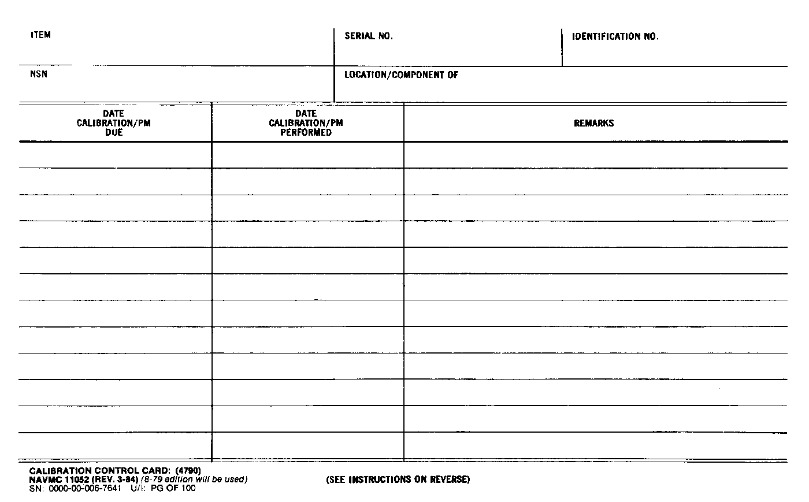
WRENCH, TORQUE
12345678
00054C
2530-01-478-7521
BLDG. 1134/TOOL ROOM
02 JUN 93
ERO# XB115 FULL CAL.
02 JUN 94
10 FEB 94
CNR 10 FEB 94
10 FEB 95
10 FEB 95
CNR 10 FEB 94
10 FEB 96
10 FEB 96
CNR 10 FEB 94
10 FEB 97
28 MAY 96
ERO# XB200 FULL CAL.
28 MAY 97
“LOCATION/COMPONENT OF” BOX:
END ITEM: ACTUAL LOCATION (BLDG/ROOM)
COMPONENT: END ITEM NOMENCLATURE, ID#, AND SERIAL#

Slide 316
PREPARATION INSTRUCTIONS CHART AND AUTO SYSTEM CONT.
Chart System.
  Can be made a wall chart or standard size paper.
  Must have all info pertaining to the TMDE.
Automated Calibration System.
  Units are authorized to use this system as long as all info required for the manual system are incorporated.

Slide 317
FILING & DISPOSITION
Shall be maintained centrally or decentralized to each section. (MMSOP)
  Retain as long as item is held by the unit.-
  Destroy or delete, when item is no longer held.

Slide 318
REMARKS
If units have a centralized TMDE center, it is advisable that each section still establish their own control system.
Card, Chart, or Automated may be used.
  If they are duplicate they must be accurate.

Slide 319
NEW ITEMS OF EQUIPMENT
Requirements for new items should be determined upon receipt.
If item is totally new, requirements can be obtained from the Cal. Lab.
  In either case they need to be submitted to the Cal. Lab.
If not required (CNR) or put in a Inactive status, the appropriate labels will come from the Cal. Facility.

Slide 320
UNSERVICEABLE EQUIPMENT
If item is declared unserviceable or beyond repair and recoverable item report has been submitted:
  Delete entry or pull file card.
  Order new item IAW supply procedures.
  If item is a component, indicate in the remarks section of the requisition and identify the end item.

Slide 321
ENCLOSURE 2
Has a list of pertinent references addressing TMDE CAMP

Slide 322
QUESTIONS
?

Slide 323
PRACTICAL APPLICATION

Slide 324
QUESTIONS TO YOU!
Q. What are the three calibrations control systems that can be used?
A . CARD, CHART, OR AUTOMATED.
. How often should units conduct an inventory of all its TMDE?
A. ANNUALLY.
. How often must units review the status of items designated as “INACTIVE”?
A. EVERY THREE YEARS.

Slide 325
BREAK!!!

Slide 326
SUPPORT AND TEST EQUIPMENT

Slide 327

TABLE OF ORGANIZATION
The T/O serves as the basic source document for all resources for that particular unit.
  Mission statement.
  Organization.
  Concept of employment.
  Administrative capabilities.
  Logistics capabilities.

Slide 328
TABLE OF ORGANIZATION CONT.
Mission statement determines the unit’s required:
  Personnel skills.
  Equipment.
  Start point for resource requirement review.
Organization paragraph
  Contains a list of Subordinate elements.
  Identifies the internal maintenance support and maintenance requirements.

Slide 329
TABLE OF ORGANIZATION CONT.
Concept of employment is as vital to the CO as it is to the Operations staff. It determines:
  Type of support required-
  Manner in which that support must be provided.

Slide 330
TABLE OF ORGANIZATION CONT.
Administration and logistics capabilities specify exact functions authorized to the command WRT:
  Administration.
  Supply-
  Maintenance.

Slide 331
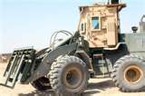
TABLE OF EQUIPMENT
Is a list of equipment that the unit is required to possess and maintain, to accomplish their mission.
When used with the T/O, serves as basis for requirements such as:
  Publications
  Additional equipment

Slide 332

CONTROL OF SUPPORT/TEST EQUIPMENT
Identify and locate:
By using the unit’s T/E , allowance list, and special allowance the MMO, Supply and Maint. officers can identify all Support and Test Equipment.
Each item within the unit needs to be located
  RO or designee

Slide 333
CONTROL OF SUPPORT/TEST EQUIPMENT CONT.
Inventory: MMO, SupO, RO, Maint. Officer need to match items with the T/E for accountability.
  It then needs to be inventoried using the appropriate SL-3/Extract or US Army Supply Catalog
  Common/Special tools not on T/E needs inventoried as well
  A copy of all inventories must be maintained per the TM-4700-15/1_, 2-6-1, and local MMSOP.

Slide 334
TYPES OF INVENTORY LISTS
SL-3 MARINE CORPS STOCK LISTS:
  List all components of collective type items.
    Chests, Kits, TMDE
  Components for Principal End Items (PEI).
    Vehicles
    TMDE Kits (Air Conditioning)
  Arranged in column form and provides information to:
    Identify items
    Determine the Type of Issue

Slide 335
TYPES OF INVENTORY LISTS CONT.
SL-3 EXTRACTS:
  From the SL-3
  Locally produced (TM 4700-15/1_, 2-6-2/3)
  Last page (Signature page)
    2 Types
    Supervisor enters date the inventory was conducted.
AUTOMATED INVENTORY LIST: Is authorized

Slide 336
PREP INSTRUCTIONS
SL-3 Inventory/SL-3/SL-3 Extract must contain:
INVENTORY FOR: Enter noun name.
EXTRACT OF: Enter publication number and date.
  Local kits, enter authorizing letter and date.
TOOL BOX#: Enter number assigned to kit or PEI.

Slide 337
INFO ON INVENTORY
ITEM NO.: Enter the item number for each item as listed in publication.
  Components of kits/sets will be listed one of two ways:
    Individually, under their parent kit
    Locally produced SL-3 extract for the kit or set.
NOMENCLATURE: Enter nomenclature of item:
  Entry of NSN will aid in ordering (Optional).

Slide 338
INFO ON INVENTORY CONT.
U/I: Enter the unit of issue or unit of measure.
QTY: Enter quantity authorized.
MONTH: Calendar date inventory was conducted.
  Use symbols in the legend block.

Slide 339
INFO ON INVENTORY CONT.
REMARKS: Enter any amplifying comments;
  Doc. Numbers
  ERO Number
  Serial Number of serialized components
  Temporary entries in pencil

Slide 340
INFO ON INVENTORY CONT.
INVENTORIED BY (SIGNATURE): This signifies that the person inventorying has done a proper inventory.
SUPERVISED BY: This signifies that the inventory was supervised, conducted, and corrective action has been initiated.
DATE: Supervisor enters the date.

Slide 341
FILING
Maintain a copy of completed record either:
  In/with the tool set, chest, or kit.
  File folder maintained by Tool Room NCO/Commodity manager in secure area.

Slide 342
DISPOSITION
Completed inventories will be maintained for one year.

Slide 343
EXCESS TOOLS
Will be rolled back to the supply system per the MCO P4400.150_

Slide 344
CONTROL
Categories that tool sets, chest, or kits can be placed in and their required inventory intervals are as follows:
  Issued to individual, inventoried semiannually.
  Securely stored, inventoried annually.
  Issued to a responsible Officer (RO), inventoried upon change of RO.
A duplicate key/combo should be maintained by the RO.

Slide 345
CONTROL CONT.
All Support and Test Equipment will be inventoried using the appropriate form.
  Supply System Responsibility Item (SSRI) and Using Unit Responsibility Item (UURI) requisition per MCO P4400.150_.
Unit’s must budget for tool replacement.
  Eliminates shortage of funds for critical tools.

Slide 346
CONTROL CONT.
SSRI/Basic Issue Items (BII).
  Furnished by the supply system when PEI is issued.
  Transferred with PEI during redistribution or other changes of custody unless otherwise specifically directed by appropriate authority.
  Required to be maintained on hand, ordered, or identified as un-funded deficiency unless specifically directed within SL-3.

Slide 347
CONTROL CONT.
SSRI/BII (Cont’d.)
Requisition of SSRI/BII that need replacement, when PEI is outside stores distribution system (phased out), is the owning unit’s responsibility.
PEI’s that are components of a PEI (i.e., Gen Mechanics Tool Box, component of Contact truck) are accounted for under the serial number for the primary NSN.

Slide 348
CONTROL CONT.
UURI:
  Not issued with the PEI during Initial Issue Provisioning (IIP) and subsequent fielding.
  Using unit will order these items not to exceed stated quantity.
  CO can authorize to hold less than stated Qty.
AR (As Required): When AR is the stated Qty:
  CO must establish such Qty.
  Must be reviewed and updated at least annually.

Slide 349
CONTROL CONT.
Items held by the section's tool room for issue to individuals should be maintained in an area secure against pilferage.
The MMSOP will include a method to account for issues and receipts, such as:
  Logbook
  Stamped tags
  Sign-out cards

Slide 350
REQUISITIONING CONTROL
Once deficiencies have been identified you must have control over requisitions for those items.
  Logbook.
  Suspended copies of requisitions. 4 Card w/SF
  Reporting unit’s demand listing (UDL), by supplementary addresses on the requisitions. (RUC)
  Use of DPR using the Cat. Code of “S” on the ERO’s, and Appendix “C” of the MCO P4790.2_.

Slide 351
INSPECT
Despite normal inventory requirements, MMO’s still have a requirement to inspect tools and verify inventory records and requisitions during normally scheduled inspections with a unit.

Slide 352
GARRISON TOOL ALLOWANCES
FMF unit commanders are authorized to establish special allowances (in writing) for tools not currently held in T/E sets, chests, or kits, provided these tools are:
  Required to meet garrison peculiar requirements
  Locally fabricated tools (established in TM)
This authority does not extend below Bn/Sqdrn level, except for detached units.

Slide 353
GARRISON TOOL ALLOWANCES CONT.
GARRISON PECULIAR TOOLS: Tools needed to support requirements that would not exists in a deployed situation.
  Tools required to perform authorized EOM on organic equipment or in support of the T/O mission will be either T/E items or components of T/E items

Slide 354
GARRISON TOOL ALLOWANCES CONT.
LOCALLY FABRICATED TOOLS: Tools that are fabricated per the technical publication.
  Authorization letter will reference the technical publication that sets the requirement for the tool.
Request for T/O&E or changes to SL-3/TM:
  Check other PEI/tool kits already in units T/E for the required tool(s) prior to submitting request.

Slide 355
EQUIPMENT SL-3/TM COMPONENTS
Accounted for on locally devised inventory sheets.
  Will be based on the appropriate SL-3 or TM.
  Will reflect the Serial# of PEI.
  Will reflect Serial# of serialized components.
Detailed instructions can be found in the MCO P4790.2_.

Slide 356
EQUIPMENT SL-3/TM COMPONENTS CONT.
MCO only addresses tool kits, sets, and chests;
HOWEVER,
The procedures previously discussed procedures will be used for all SL-3/TM inventories:
  Items used, inventory Semi-Annually.
  Not used, but stored in secure area, inventory Annually.
  Issued to an RO, also inventory upon change over of RO.

Slide 357
QUESTIONS
?

Slide 358
QUESTIONS TO YOU
. How many signatures are required on the signature page of the inventory?
. TWO

Slide 359
QUESTIONS TO YOU
. Tool sets, chest, and kits that are issued to an individual where locks and a secure storage area are provided will be inventoried how often?
. SEMI-ANNUALLY

Slide 360
QUESTIONS TO YOU
. How often must “As Required” items be reviewed and updated?
. AT LEAST ANNUALLY

Slide 361
SUMMARY
During the past four days we have covered the purpose, responsibilities, preparation, filing and disposition of NAVMC 696D, NAVMC 10524, NAVMC 10523, Load Test Equipment Daily Checklist, SF 91, SF 94 AND SF 368 PQDR.
The Commodity Managers Modifications Control Program and Records. (NAVMC 11053/11054)-

Slide 362
SUMMARY Cont.
The procedures for determining required support and test equipment, inventory control procedures, and requisitioning procedures for test and support equipment as well as equipment SL-3/TM components.
And the Marine Corps Test, Measurement, and Diagnostic Equipment (TMDE) Calibration and Maintenance Program (CAMP)

Slide 363
BREAK!!!!

