Slide 1
Notes:
INTRODUCTION: The elements of any good shop come from Marines that are functional in their positions. There are many billets to be held in a maintenance shop, not just “mechanic.” While obtaining the skills and knowledge necessary to become a good mechanic is your main goal here, you, the student, need to know some other elements that play a key role in the overall shop functionality: The basic structure of a shop, how to use a Technical Manual and parts list, how to properly fill out paperwork involved with tasks, how tool control works, and the basic pieces of equipment that you will see in the Marine Corps.

Slide 2
TERMINAL LEARNING OBJECTIVES
Provided references, maintenance facility, maintenance forms, personnel, tools, and engineer equipment, conduct shop operations, to maintain unit readiness without injury to personnel or damage to equipment. (1341-ADMN-1001).
Provided tool sets, chests, kits, and references, conduct inventory of tool sets, chests, kits, to reconcile inventory records for accountability and serviceability per the references. (1341-ADMN-1002)
Given an assigned maintenance role, computer and required equipment forms/records, use the Maintenance Automated Information System (MAIS) to record engineer equipment status, per the established maintenance management policy. (1341-ADMN-10XX)
SG Pg#11
Notes:
TLO: Provided references, maintenance forms, tools, and engineer equipment, conduct shop operations IAW current references.

Slide 3
ENABLING LEARNING OBJECTIVES
Provided references, identify the operational risk management process, per the MCO 3500.27, OPNAVINST 3500.39, and MCDP 1. (1341-ADMN-1001a)
Provided reference, identify maintenance levels, per the MARADMIN 581/03. (1341-ADMN-1001b)
Provided reference, identify maintenance phases to conduct engineer equipment maintenance per the MCO 4790.2_. (1341-ADMN-1001c)
Provided the reference, identify the characteristics of engineer equipment, per the TM 11275-15/3D. (1341-ADMN-1001d)
Provided references, and student handout, perform technical manual research per the 11503A-OI/3, TM 10794A-24/2, TM 10794A/B-24P/3 and TM 11503A-OI/4. (1341-ADMN-1001e)
Provided reference, identify the technical manual that provides instructions for preparation, use, and disposition of engineer equipment records and forms per the student handout. (1341-ADMN-1001g)
Provided reference, identify engineer equipment records and forms per the TM 4700-15/1_. (1341-ADMN-1001h)
Provided reference, engineer equipment records and forms, identify the mechanics required entries per the TM 4700-15/1_. (1341-ADMN-1001i)
Provided references, and student handout, perform parts research per the TM 10794A/B-24P/3 and TM 11503A-OI/3. (1341-ADMN-1001f)
Notes:
ELO’s: Provided references, identify maintenance levels, categories, echelons, acronyms, and terms common to the engineer equipment field IAW current references.
Provided references, identify Marine Corps engineer equipment IAW current references.
Given references and practical exercises, perform technical manual and stock list research IAW current references
Provided references, identify and correctly complete maintenance records and forms IAW current references
Provided inventory forms, tools, and appropriate containers, conduct tool inventories IAW current references.

Slide 4
ENABLING LEARNING OBJECTIVES
Provided reference, identify tools kits, per the TM 10510-OD/1K. (1341-ADMN-1001j)
Provided reference, demonstrate correct use of tools, per the TM 10209-10/1. (1341-ADMN-1001k)
Provided a general mechanics tool kit (GMTK), an inventory sheet, and references, inventory the GMTK for accountability per the TM 4700-15/1_, and SL-3-11668A. (1341-ADMN-1002a)
Provided a GMTK, an inventory sheet, and references, inventory the GMTK for serviceability of tools per the TM 4700-15/1_, and SL-3-11668A. (1341-ADMN-1002b)
Given an assigned maintenance role, computer and required equipment forms/records, create a service request for approval, per the established maintenance policy. (1341-ADMN-10XXa)
Given an assigned maintenance role, computer and required equipment forms/records, create a parts request for approval, per the established maintenance policy. (1341-ADMN-10XXb)
Given an assigned maintenance role, computer and required equipment forms/records, update the service request to record maintenance status, per the established maintenance policy. (1341-ADMN-10XXc)
Notes:
ELO’s: Provided references, identify maintenance levels, categories, echelons, acronyms, and terms common to the engineer equipment field IAW current references.
Provided references, identify Marine Corps engineer equipment IAW current references.
Given references and practical exercises, perform technical manual and stock list research IAW current references
Provided references, identify and correctly complete maintenance records and forms IAW current references
Provided inventory forms, tools, and appropriate containers, conduct tool inventories IAW current references.

Slide 5
METHOD/MEDIA.
Notes:
METHOD/MEDIA.

Slide 6
Instructional Rating Forms

Slide 7
EVALUATION

Slide 8
SAFETY/CEASE TRAINING (CT) BRIEF

Slide 9
Operational Risk Management
SG Pg#15

Slide 10
ORM CONCEPT
Decision making tool
Used by all people at all levels
Increase operational effectiveness
Anticipating hazards
Reducing the potential for loss
Increasing probability of a successful mission

Slide 11
ORM CONCEPT
Increases our ability to make informed decisions by providing the best baseline of knowledge and experience.
Minimizing risks to acceptable levels based on mission accomplishment
Risk in war > than in peacetime
Process is still the same

Slide 12
ORM CONCEPT
Applying the ORM Concept will:
Reduce mishaps
Lower costs
Provide for more efficient use of resources

Slide 13
ORM TERMS
Hazard - A condition with the potential to cause:
Personal injury
Death
Property damage
Mission degradation
Risk - Expression of possible loss in terms of:
Severity
Probability
Risk Assessment
A process of detecting hazards & Assessing associated risks

Slide 14
ORM TERMS
Operational Risk Management
A process of dealing with risks associated with Military operations, which include:
Risk assessment
Risk decision making
Implementation of effective risk controls

Slide 15
ORM PROCESS
Five steps:
Identify hazards
Assess hazards
Make risk decisions
Implement controls
Supervise

Slide 16
ORM PROCESS
1) Identify Hazards:
Outline/chart major steps in the operation
(Operational analysis)
Conduct preliminary hazard analysis
List all hazards associated with each step
List all causes of those hazards

Slide 17
ORM PROCESS
2) Assess Hazards:
Each hazard identified
Determine associated risk
Probability
Severity

Slide 18
ORM PROCESS
3) Make Risk Decisions:
Develop risk control options
Serious risk first
Select controls to reduce risk
(Mission accomplishment)
Controls in place - decide
Benefit of operation outweigh risk?
Communicate with higher authority
Chain of Command

Slide 19
ORM PROCESS
4) Implement Controls
These are measures that can be implemented to eliminate hazards or reduce the degree of risk.
Engineering controls
Administrative controls
Personal protective equip

Slide 20
ORM PROCESS
Engineering Controls
Engineering methods to reduce risks.
Design
Material selection
Material substitution
Technically - feasible
Economically

Slide 21
ORM PROCESS
Administrative Controls
Reduce risk through specific admin actions.
Provide suitable:
Warnings
Markings
Signs
Notices
Establish written:
Policies
Programs
Instructions
SOPs

Slide 22
ORM PROCESS
Administrative Controls (Cont.)
Train Personnel to:
Recognize hazards
Take appropriate actions
Limit the exposure to a hazard
Reduce number of personnel/assets
Length they are exposed

Slide 23
ORM PROCESS
5) Supervise
Conduct-follow up evaluations of controls to ensure they:
Remain in place
Have the desired effect
Continuously monitor for changes and take corrective action when needed

Slide 24
LEVELS OF ORM
ORM exists on three levels:
Time-critical
Deliberate
In-depth
Commander selects which level of ORM depending on:
Mission
Situation
Time available
Proficiency level
Assets available

Slide 25
LEVELS OF ORM
Objective of ORM:
Develop sufficient proficiency in applying the process so that ORM becomes an automatic or intuitive part of our decision making methodology.

Slide 26
LEVELS OF ORM
Time Critical
“On the run” mental or oral review of the situation
Uses the five-step process without recording the information on paper
Employed by experienced personnel
Used to consider risks in a time-compressed situation
Normally used:
During the execution phase of training or operations
In planning during crisis response scenarios
Helpful in choosing course of action when an unplanned event occurs

Slide 27
LEVELS OF ORM
Deliberate
This is the complete application of the five-step process:
Used for planning an operation or evaluating procedures
Most effective when conducted in a group

Slide 28
LEVELS OF ORM
In-Depth
Deliberate process with a more thorough assessment
Research of available data
Use of diagram and analysis tools
formal testing
Long term tracking of the hazards

Slide 29
FOUR PRINCIPALS OF ORM
1) Accept risk when the benefits outweigh the cost
MCDP, War fighting, states
“Risk is inherent in war and is involved in every mission. Risk is also related to gain; normally greater potential gain requires greater risk.”
The goal of ORM is not to eliminate risk, but to manage the risk so that the mission can be accomplished with a minimum amount of loss.

Slide 30
FOUR PRINCIPALS OF ORM
2) Accept no unnecessary risk
MCDP also states,
“We should clearly understand that the acceptance of risk does not equate to the imprudent willingness to gamble…”
Take only risks necessary to accomplish the mission

Slide 31
FOUR PRINCIPALS OF ORM
3) Anticipate and manage risk by planning
Controlled easier when identified early

Slide 32
FOUR PRINCIPALS OF ORM
4) Make risk decisions at the right level
Leader directly responsible for the operation makes risk management decisions
Critical Elements:
Prudence
Experience
Intuition
Situational awareness of leaders

Slide 33
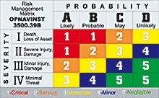
RISK ASSESSMENT MATRIX
Used during the second step of ORM
Can provide a consistent framework for evaluating work
Based on:
Elements of hazard severity
Mishap probability

Slide 34
RISK ASSESSMENT MATRIX
Hazard severity:
Assessment of the worst consequence or result of a hazard.
Severity - potential degree of:
Injury
Illness
Property damage
Loss of assets (time - $ - personnel)
Effect on mission

Slide 35
RISK ASSESSMENT MATRIX
Hazard severity: Four categories
Category I
Death
Loss of facility
Grave damage to national interests
Category II:
Severe injury
Property damage
Damage to national interests

Slide 36
RISK ASSESSMENT MATRIX
Hazard severity: Four categories (Cont.)
Category III:
Minor injury
Minor property damage
Minor damage to national interests
Category IV: Minimal Threat

Slide 37
RISK ASSESSMENT MATRIX
Mishap Probability:
Hazard will result in a mishap/loss based on:
Location
Exposure
Affected populations
Experience
Previous information

Slide 38
RISK ASSESSMENT MATRIX
Mishap Probability: 4 sub-categories
Sub-category A:
Likely to occur immediately or within a short period of time
Sub-category B:
Probably will occur in time
Sub-category C:
May occur in time
Sub-category D:
Unlikely to occur

Slide 39
RISK ASSESSMENT MATRIX
Risk Management Matrix
Probability
A
B
C
D
Likely
Probable
May
Unlikely
Death,
Loss of Asset
1
1
RAC 1 – Critical
RAC 2 – Serious
RAC 3 – Moderate
RAC 4 – Minor
RAC 5 – Negligible
I
2
3
II
Severe Injury,
Damage
1
2
3
4
Severity
III
Minor Injury,
Damage
2
3
4
5
IV
Minimal
Damage
3
4
5
5
Notes:
The RAC is an expression of risk which combines the elements of hazards, severity, and mishap probability. Using the matrix in Figure 1, the RAC is expressed as a single Arabic number, one through five, that can be used to help determine hazard reduction priorities.

Slide 40
ORM REVIEW
ORM concept
ORM terms
ORM process
Levels of ORM
Principles of ORM
Develop a risk assessment matrix

Slide 41
QUESTIONS
Q. What are the five steps of the Operational Risk Management Process?
A. Identify the hazards, Assess the Hazards, Make risk decisions, Implement controls, and Supervise.
Q. What are the three levels of Operational Risk Management?
A. Time-critical, deliberate and in-depth.
Notes:
QUESTIONS
What are the five steps of the Operational Risk Management process?

Slide 42
Notes:
BREAK

Slide 43
SG Pg#25
Notes:
For those that do not work on their own vehicles, where do you bring your car for an oil change? (Jiffy Lube, Grease Monkey, etc.) Why not a specially trained mechanic’s garage? An oil change is a basic process and does not require a lot of skill or knowledge to perform. The specially trained mechanic has more in depth repairs to work on rather than getting backed up with simple oil changes. Although the mechanic is capable of performing an oil change, it is not his primary goal and generally relies on the Jiffy Lubes and Grease Monkeys to perform that type of maintenance. Likewise, Jiffy Lube does not have the time, tools, and knowledge required to remove or rebuild an engine. All around shops may perform good work but they are not as productive as those that focus attention on specific types of maintenance.

Slide 44
Terms and Acronyms
DL: Deadline
To completely remove a piece of gear from service due to necessary repairs, damage, and/or malfunctions that has already or could eventually render it unsafe or impossible to operate

Slide 45
Terms and Acronyms (cont.)
PMCS: Preventive Maintenance Checks and Services
Maintenance performed by mechanics and operators at intervals to preserve the life of components and assemblies.
Involves inspecting, cleaning, servicing, lubricating, adjusting, and minor repair.
CM: Corrective Maintenance
Action taken to repair an item of equipment after failure which degrades its operational capabilities
PEB: Pre Expended Bin
Location where high use, low cost items and broken units of issue are kept

Slide 46
Maintenance overview
The Marine Corps utilizes different stages or levels of maintenance.
These levels are identified by categories and further broken down into echelons.
Specific responsibilities are assigned to each category of maintenance
Categories are further subdivided into echelons to more accurately define capabilities and responsibilities
Maintenance is allocated according to personnel, tools, equipment, and parts availability
Notes:
Crew, field, depot?

Slide 47
Categories AND ECHELONS OF MAINTENANCE
Three categories and five echelons of maintenance
Organizational Maintenance
1st and 2nd echelons of maintenance (EOM)
Intermediate Maintenance
3rd and 4th echelons of maintenance (EOM)
Depot Maintenance
5th echelon of maintenance (EOM)

Slide 48
ORGANIZATIONAL MAINTENANCE
Maintenance performed by, and is the responsibility of, the using unit on its assigned equipment
Operators (1st EOM) and mechanics (2nd EOM) share responsibilities for ensuring maintenance is performed
Maintenance performed ensures equipment readiness through PMCS and CM

Slide 49
1ST eom
Performed by the user, wearer, or operator
It includes the proper care, use, operation, cleaning, preservation, lubrication, and adjustment
They are authorized to perform minor repairs, testing, and parts replacement according to applicable TMs (TM-10 series) and authorized repair parts and tools

Slide 50
2ND eom
Performed by specially trained personnel (mechanics).
Authorized additional tools and parts, supplies, test equipment, and skilled personnel to perform maintenance beyond the capabilities and facilities of first echelon.
Responsibilities include performance of scheduled maintenance, diagnosis and isolation of readily traced equipment malfunctions; replacement of major assemblies/components which can be readily removed/installed and do not require critical adjustment
Replacement of easily accessible parts not authorized at first echelon.

Slide 51
INTERMEDIATE MAINTENANCE
Maintenance performed by designated activities in support of using units
Maintenance includes the calibration and repair or replacement of damaged or unserviceable parts and provides contact team support to using organizations
Made up of 3rd and 4th echelons but may include some 2nd echelon to fulfill organizational overflow requirements

Slide 52
3rd EOM
Diagnosis and isolation of equipment/modular malfunctions
Adjustment and alignment of modules using test, measurement, and diagnostic equipment (TMDE)
Repair by replacement of modular components and parts which do not require extensive post-maintenance testing or adjustment
Limited repair of modular components requiring cleaning, seal Replacement, application of external parts, and repair kits
Accomplishment of minor body work and evaluation of emissions of internal combustion engines.

Slide 53
4TH EOM
Associated with semi fixed or permanent shops of intermediate maintenance activities.
Maintenance includes diagnosis, isolation, adjustment, calibration, alignment, and repair of malfunctions to internal parts
Replacement of defective modular components not authorized at lower echelons
Repair of major modular components by grinding or adjusting items such as valves, tappets, and seats
Replace internal and external parts such as integrated and printed circuits
Performance of heavy body, hull turret, and frame repair.

Slide 54
DEPOT MAINTENANCE
Maintenance requiring major overhaul or the complete rebuilding of parts, subassemblies, assemblies, and end items
Commonly referred to as rebuild centers
Manufactures parts
Performs required modifications and testing
Performs maintenance beyond the responsibilities of lower echelons and provides them with technical assistance
Provides stocks of serviceable equipment
5th echelon of maintenance

Slide 55
5TH EOM
Maintenance normally performed by depot maintenance activities and at intermediate maintenance activities when authorized
It includes overhaul or rebuild of end items and modular components
Repairs which exceed the capability of lower echelon units where special environmental facilities or specific tolerances are required
Special inspection and modification requiring extensive disassembly or elaborate test equipment
Manufacturing items not available through Marine Corps supply
Provides stocks of serviceable equipment for exchange support

Slide 56
Levels of Maintenance
The Marine Corps will soon structure its maintenance priority into what will be considered Levels of Maintenance (LOM, formerly categories and echelons)
These levels have been identified by name to clarify responsibilities according to the type and depth of maintenance being performed
Specific responsibilities are assigned to each level of maintenance
Maintenance is allocated according to personnel, tools, equipment, and parts availability

Slide 57
Levels of Maintenance
Operator/Crew(formerly Organizational consisting of 1st and 2nd echelons of maintenance)
Maintenance performed by, and is the responsibility of, the using unit on its assigned equipment
Includes the proper care, use, operation, cleaning, preservation, lubrication, and adjustment according to their maintenance allocation
They have been given a more mechanical responsibility (from 2nd EOM) than in the past and are now authorized to perform minor corrective maintenance
Replacement of some easily accessible parts and components
Their objective is to sustain their equipment in a mission capable status

Slide 58
Levels of Maintenance
Field (Formerly Intermediate consisting of 3rd and 4th EOM)
2nd EOM is now part of Field LOM and 4th EOM has left some of their responsibilities but moved to “Sustainment LOM”
Maintenance performed by designated activities (trained technicians/mechanics) in support of using units
Includes the calibration and repair or replacement of damaged or unserviceable parts/components and provides contact team support to using organizations
Authorized an extended inventory of tools (above the Operator/Crew level) to fulfill maintenance requirements
Their objective is to return equipment to a mission capable status

Slide 59
Levels of Maintenance
Sustainment (formerly Depot consisting of 5th EOM)
Now utilizes the flexibility and mobility of 4th EOM as well
Maintenance requiring major overhaul or the complete rebuilding of components, subassemblies, assemblies, and end items
Manufactures parts
Performs in depth modifications and testing
Performs maintenance beyond the responsibilities of lower levels and provides them with technical assistance
Provides stocks of serviceable equipment
Their objective is to sustain equipment throughout its lifecycle

Slide 60
MAINTENANCE STRUCTURE REVIEW
The three Categories of Maintenance
The five Echelons of Maintenance
The three Levels of Maintenance

Slide 61
QUESTIONS
Q. Which echelon of Maintenance is the most important?
A. 1st echelon.
Q. What level of Maintenance sustains stocks of serviceable equipment?
A. Sustainment level of Maintenance.

Slide 63
SG Pg#35
Notes:
There are many pieces of engineer equipment you will work on. Some are manufactured by Cat, John Deere, Case, JLG, and Terex. Lets briefly take a look at some of those by reviewing their basic characteristics. FAMILIARIZATION

Slide 64
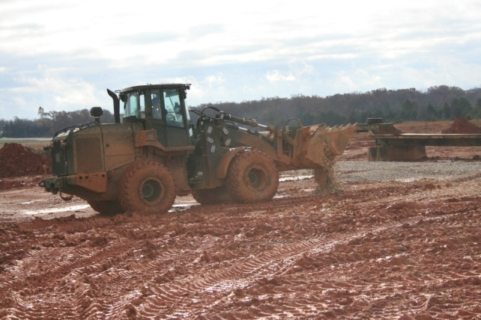
JOHN DEERE
TRAM

Slide 65
TRAM
DESCRIPTION AND FUNCTION
Tractor, Rubber-Tired, Articulated Steering, Multipurpose
Diesel-powered, four-wheel drive.
Capable of operating in rough terrain and in up to 60 inches of water.
Outfitted with a 2-1/2 Yard 4-In-1 Multi-Purpose Bucket, a 10,000 pounds Forklift Attachment
Maximum speed 24 mph (39 km/h)
Manufactured by John Deere Co.

Slide 66
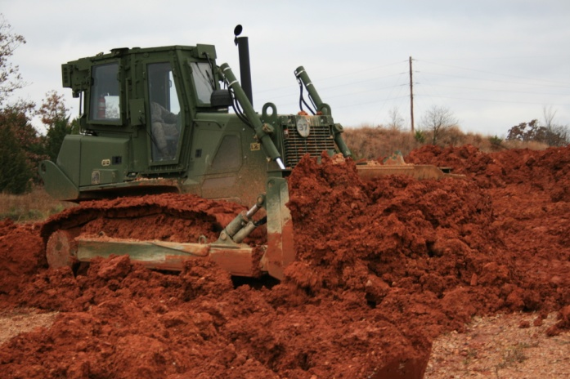
JOHN DEERE
850JR MCT

Slide 67
MEDIUM CRAWLER TRACTOR (MCT) 850JR
DESCRIPTION AND FUNCTION
Diesel-engine driven, militarized crawler type, medium-drawbar pull tractor.
Equipped with Roll Over Protection Structure (ROPS) and Falling Objects Protective Structure (FOPS)
Hydraulically powered semi-U (straight) type blade with a maximum drawbar pull of 35,000 pounds.
Equipped with all components necessary to enable the tractor to function the following attachments: a 3-shank ripper or a rear-mounted winch and drawbar/towing coupler.
Manufactured by John Deere Co.

Slide 68
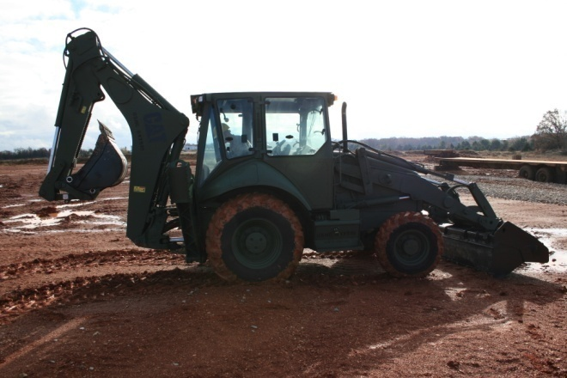
CATERPILLAR
420 BACKHOE

Slide 69
420EIT BACKHOE LOADER
DESCRIPTION AND FUNCTION
Highly mobile, light weight, rubber tired
Equipped with a front-end loader and backhoe excavator
Capable of operating hydraulic power tools
Reaches road speeds in excess of 20 mph

Slide 70
CATERPILLAR
130G GRADER

Slide 71
120M GRADER
DESCRIPTION AND FUNCTION
Self-propelled grading machine powered by a diesel engine.
Rubber tires, six-wheel drive, and an articulated frame with front-wheel steer design
Equipped with a 12’ blade with a maximum shoulder reach of 6’ outside the wheels and has a maximum lift above ground of 16”.
Reconfigurable to accept an armored cab kit. The advanced joy stick control system replaces the traditional array of levers and steering wheel, which greatly simplifies motor grader operation by placing total machine, drawbar, and moldboard control into both of the operator’s hands.
Applications of the 120M include grading coarse and fine soil, creating low and high bank slopes, flat and V-ditches, scarifying, removing snow, and building and maintaining roads and airfields.

Slide 72
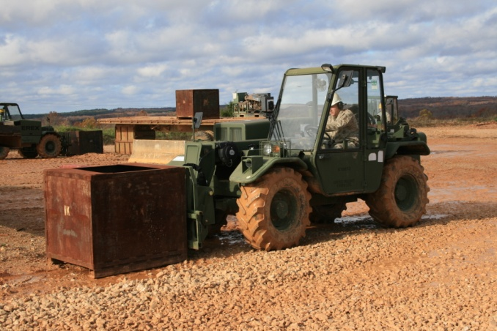
TEREX
5K LCRTF

Slide 73
TEREX 5K LCRTF
Description and Function
Light Capability Rough Terrain Forklift
Diesel powered, air transportable used for lifting palletized loads up to 5,070 pounds.
Equipped with a telescopic boom, 2-wheel, 4-wheel, and crab steering modes.
Required to clear landing zones of supplies and equipment, to load and unload combat vehicles, aircraft, and ISO containers.
Manufactured by Terex

Slide 74
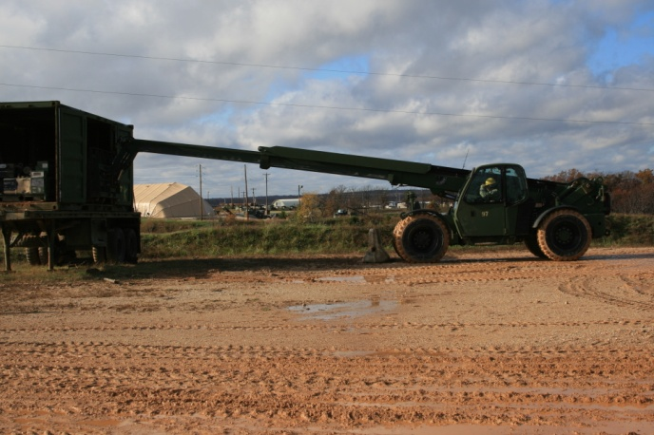
SKYTRACK
EBFL MMV

Slide 75
SKYTRACK EBFL MMV
DESCRIPTION AND FUNCTIONS
Extendable Boom Fork Lift
Military Millennium Vehicle (MMV)
Diesel powered, for lifting loads up to 11,000 pounds
Air transportable, rough-terrain, self-deployable material handler.
Primary function is to provide operating forces the capability to move/load/unload supplies, equipment, vehicles, containers, and palletized cargo from amphibious/merchant ships, aircraft, and vehicles over beaches as well as inland via unimproved/hard surfaces.

Slide 76
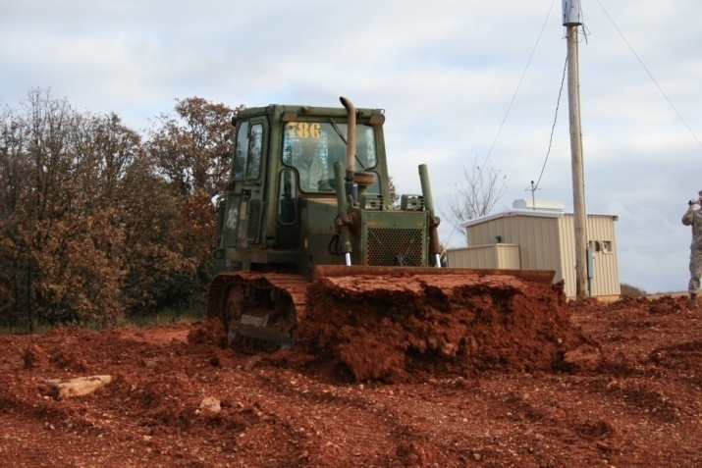
CASE
1150 DOZER

Slide 77
1150 DOZER
DESCRIPTION AND FUNCTION
Full-tracked, diesel engine driven tractor
Hydraulically operated angle blade and winch
Air transportable
Used for earthmoving and general construction work.
Manufactured by Case
Travels up to 6.3 mph (10 km/h).

Slide 78
ENGINEER EQUIPMENT REVIEW
TRAM
MCT
Backhoe loader
Grader
Terex
MMV
1150

Slide 79
QUESTIONS
Q: What is the maximum lifting capacity of the Terex 5K LCRTF?
A: 5070 lbs.
Q: What company manufactures the TRAM?
A: John Deer

Slide 80
Break

Slide 81
Notes:
To become an effective and efficient mechanic, you will need some guidance. Technical publications provide mechanics with the knowledge necessary to do exactly that: work on the equipment. This period of instruction will enable you to utilize a technical manual while working on engineer equipment.

Slide 82
INTRODUCTION
Every piece of equipment in the Marine Corps utilizes Technical Manuals (TM) and repair parts lists (SL-4, PC, etc.)
These manuals are necessary for performing maintenance and ordering parts
TMs provide step by step maintenance procedures in order to perform the maintenance accurately and efficiently.
Parts lists provide requisitioning data for every component or item on their associated piece of gear

Slide 83
TECHNICAL MANUAL (TM)
Ensures the correct action is taken to solve or prevent problems in a timely manner
TMs provide the mechanic and operator with PMCS, troubleshooting, and CM procedures to include:
Inspections
Adjustments
Preventive maintenance intervals
Troubleshooting and testing
Removal/installation of parts
Disassembly/reassembly of components
Special tools and TMDE

Slide 84
TECHNICAL MANUAL
With new pieces of gear come new technical manuals (TM)
Some may be constructed differently than others but they all cover the same basic concept as previously explained
New TMs are generally designed by the Manufacturer of the piece of equipment
The Marine Corps adds a “Short Title” and information applicable to our supply system and maintenance procedures.

Slide 85
TECHNICAL MANUAL
Identifying Front Cover Information
Short Title = TM 11503A-OI/4
TM = indicates this is a Technical Manual
11503 = Item Designator number (MCT)
A= indicates this TM covers a particular model. Lack of this indicates that more than one model is covered.
OI= This manual covers Organizational(Operator/Crew) and Intermediate(Field) maintenance.
Notes:
TMs may have a few items in common as far as design but they all provide the same intent. One area they share similarities is on the front cover

Slide 86
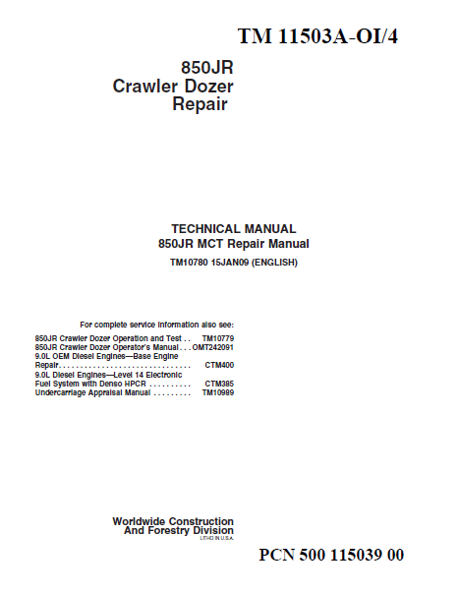
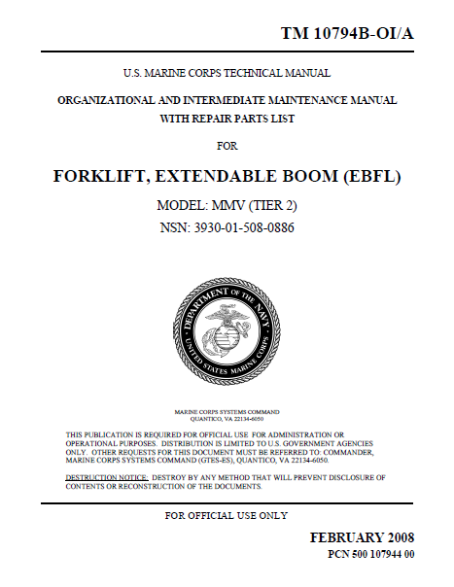
TECHNICAL MANUAL
Notes:
Here are cover pages from two different TMs. The one on the left is for an MCT. The one on the right is for an MMV. Note the location of the short title. They both also explain what type of maintenance the technical manual will cover. The two cover pages have their similarities but are also somewhat different. *Ensure students recognize what they are looking at on their copies of these TMs.

Slide 87
TECHNICAL MANUAL
The Medium Crawler Tractor utilizes multiple technical manuals to cover various maintenance aspects
Operation and test (TM 11503A-OI/3)
Theories of operation
Identifying problems using common sense and diagnostic trouble codes
Repair (TM 11503A-OI/4)
Repair of components
CTM (Component Technical Manual)
Repair of major assemblies
Engine, in-depth fuel system, winch
Notes:
Use the MCT TM as an example for the different types of TMs there are.

Slide 88
TECHNICAL MANUAL
How to Read
The manufacturer TMs seem less inclusive than older Marine Corps TMs but goes farther into detail and are seemingly simpler to read and comprehend. (e.g. Separate manuals for winch, ripper, etc.)
Introductions, safety information, and a table of contents are presented within the first section/s of the TM
Notes:
Have student scan through the first section of the MCT TM and stop when they get to the Contents section.

Slide 89
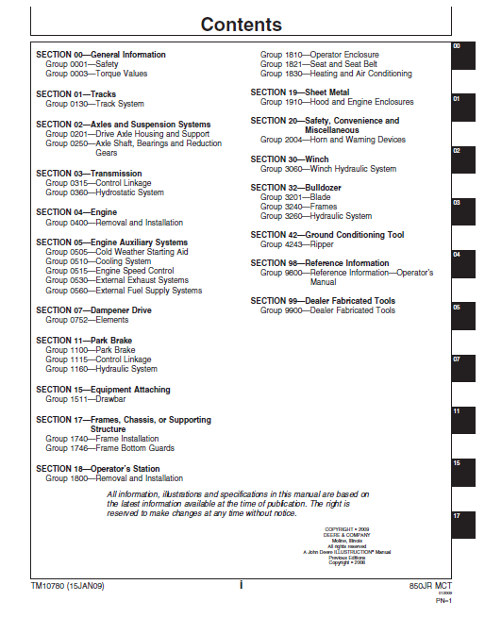
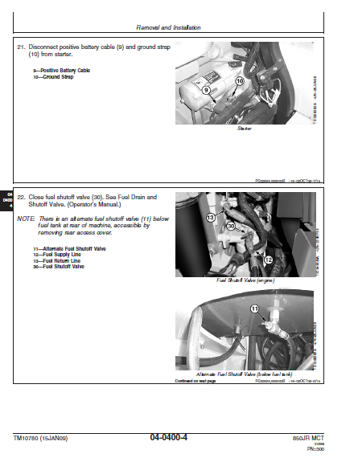
MCT TECHNICAL MANUAL
Notes:
Information is broken down per assembly, not individual parts. They list these in “Sections”
Each section is given a numerical value in sequential order.
Each value corresponds with a tab on the right hand side of the page.
Each section throughout the manual is tabbed in the same vertical position viewed within the table of contents. This black tab is extended to the very edge of each page and is therefore visible with the manual closed. This makes referencing sections quicker and more efficient.

Slide 90
MMV TECHNICAL MANUAL
Table of Contents
located in the front of the manual, lists all chapters in the publication.
Chapters divide the manual into major categories of information
Each Chapter is divided into work packages, which are identified by a 6-digit number (e.g., 0001 00, 0108 00) located on the upper right-hand corner of each page.
If you cannot find what you are looking for in the Table of Contents, refer to the alphabetical Index at the back of the manual.
Notes:
Point out the location of Chapter 3 (for instance). Show them the work package number and page number. Explain to them that Chapter 1 contains General Information. Chapter 2 contains Troubleshooting Procedures. Chapter 3 contains Preventive Maintenance procedures. Chapter 4 contains Organizational Maintenance procedures. Chapter 5 contains Intermediate Maintenance procedures. Chapter 6 contains Supporting information including a full repair parts listing.

Slide 91
Every piece of equipment in the Marine Corps utilizes Technical Manuals (TM) and repair parts lists (SL-4, PC, etc.)
These manuals are necessary for performing maintenance and ordering parts
TMs provide step by step maintenance procedures in order to perform the maintenance accurately and efficiently.
Parts lists provide requisitioning data for every component or item on their associated piece of gear
Notes:
To become an effective and efficient mechanic, you will need some guidance. Technical publications provide mechanics with the knowledge necessary to do exactly that: work on the equipment. This period of instruction will enable you to utilize a technical manual while working on engineer equipment.

Slide 92
TECHNICAL MANUAL REVIEW
What a TM covers.
Short titles.
How to read TM’s.

Slide 93
QUESTIONS
Q: What does 11503 mean in a short title?
A: This is the ID number.
Q: What does a parts list provide the mechanic?
A: Provides the requisitioning data for every component or item on that associated piece of gear.

Slide 95
SG Pg#71
Notes:
In order to make maintenance organized and to track maintenance that has been performed, there needs to be accurate documentation maintained. This period of instruction will cover documentation that is necessary to track maintenance performed.

Slide 96
RESPONSIBILITIES
It is your responsibility to ensure you are using the proper record or form and that you are using it correctly.
TM 4700-15/1 and UM 4790-2C are the references that provide guidance in regards to the use of maintenance records and forms.
TM 4700-15/1 provides instructions for the preparation, use, and disposition of required records and forms.
UM 4790-2C provides functional procedures of the maintenance Process.

Slide 97
NAVMC 10560
PURPOSE
Provides a checklist for performing and recording preventive maintenance checks and services (PMCS) and Limited Technical Inspections (LTI).
The equipment owner, user or custodian is responsible for initial preparation to include the heading
SG Pg#74

Slide 98
NAVMC 10560
TYPES
Acceptance LTI's - Performed by maintenance personnel upon receipt of equipment and prior to placing the equipment in service.
LTI's prior to Repair - The equipment chief will ensure that any equipment requiring repairs is inspected and results recorded on the NAVMC 10560 before the equipment is repaired.
Preventive Maintenance - The maintenance unit, with the assistance of the operator performs required services, records them on the NAVMC 10560, and signs the worksheet indicating that the services have been performed.

Slide 99
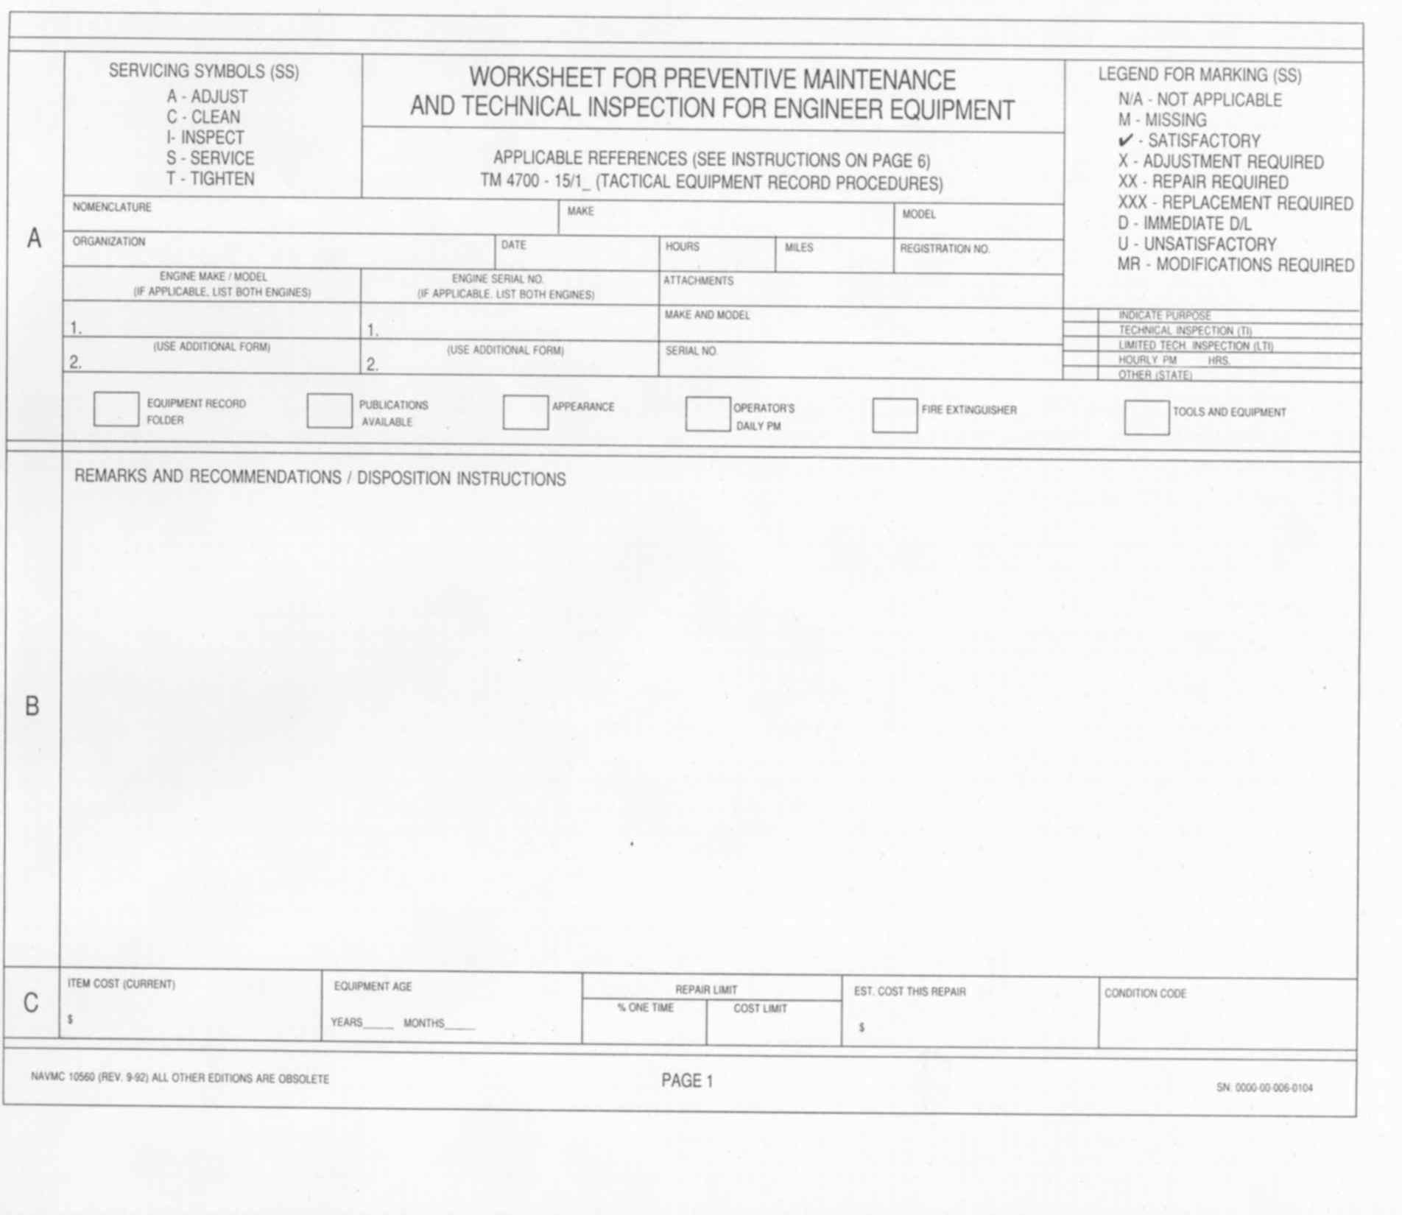
PM
CM
Medium Crawler Tractor
John Deere
850 JR
2D Maintenance BN
9249
832
N/A
640616
N/A
John Deere / 6090
08Z40429
N/A
N/A
X
ü
ü
ü
ü
N/A
N/A
Notes:
Section “A”
(a) Section A is filled out by the equipment dispatcher. We will cover the required information, as you will need to ensure the correctness of the information.
(b) Use Servicing Symbols (SS) to list PMCS requirements.
(c) A - Adjust. Used when an adjustment is required during a PM Service. (Example: D-3 adjust valve mechanism clearance.)
(d) C- Clean. Used to identify requirements for cleaning during the PM Service. (Example: Clean battery box.)
(e) I - Inspect. Used to identify requirements for specific inspection during the PM service. (Example: Inspect brake shoes for wear.)
(f) S - Service. This entry will denote a service requirement such as oil filter / engine oil change. Cleaning the air filter or hydraulic strainers may also be noted with this symbol. (Example: Service hydraulic oil, filter, and strainer.
(g) T - Tighten. This entry will be used when a specific assembly is required to be tightened or torque. (Example: Torque wheel mounting nuts.)
(h) Use Legend for Marking (SS) to list CM requirements.
(i) N/A - Not applicable to this particular type of equipment. The equipment chief or dispatcher usually marks this off. (Example: D-17 a carburetor is not found on a D-7G.)
(j) M - Missing is self-explanatory. An item that belongs on this piece of equipment is simply not there. (Example: D-21 fuel tank cap is not on the vehicle. You would place an M in the Servicing Symbol Block #21, Section D.)
(k) CHECK-MARK - Satisfactory. The component is present and has no defects or discrepancies. (Example: D-9 the water pump, fan and shroud are in good working order.)
(l) X - Adjustment required. When the repair can be corrected immediately, the mechanic should take the steps to do so. (Example: D-2 valve cover loose.)
(m) XX - Repair required. This marking is used when a part is in need of repair. (Example: D-37 broken wire under dash.)
(n) XXX - Replacement required. This symbol is used when a part has to be replaced. (Example: D-36 front right headlight is out. Replace headlight.)
(o) D - Immediate deadline or D/L. This symbol is used when further operation will cause damage to the equipment and/or the operator. (Example: F-13 the vehicle has no brakes and cannot be stopped safely. This deadlines the unit until the brakes can be repaired.)
(p) U - Unsatisfactory. This symbol is mainly used in Section A. The boxes marked appearance or operator's daily PM.
(q) MR - Modification required. This is just as it reads. A modification has not been completed and is still required.
(r) Nomenclature - Enter the Nomenclature listed on the Data Plate.
(s) Make - Enter the make or manufacturer of the equipment.
(t) Model - Enter the model number of the equipment.
(u) Organization - Enter the full name of the activity that owns the equipment.
(v) Date - Enter the date the NAVMC 10560 is being prepared.
(w) Hours - Enter the equipment hour meter reading if so equipped, otherwise leave blank.
(x) Miles - Enter odometer reading if so equipped, otherwise leave blank.
(y) Registration No. - Enter the USMC registration number.
(z) Engine Make/Model - Enter the equipment engine make / model. List both engines if applicable.
(aa) Engine Serial No. - Enter the equipment's engine serial number. List both engines if applicable.
(bb) Attachments - Enter the equipment's attachments nomenclature, make and model, and serial number.
(cc) Indicate Purpose - Use an "X" to indicate if the NAVMC 10560 is used for:
Technical Inspection
Limited Technical Inspection
(3)Hourly PM - Enter which hour if applicable.
(4) Other (state) - List a description.
(dd) The Legend for marking is used to complete Equipment Record Folder, Publications Available, Appearance, Operators Daily PM, Fire Extinguisher, and Tools and Equipment.
2. SECTION “B”
a)List all items that are not satisfactory in the (SS) column of Sections "D" - "M". List all Modification and Technical Instructions that need to be accomplished.
c) List all items listed in section "B" onto the ERO.

Slide 100
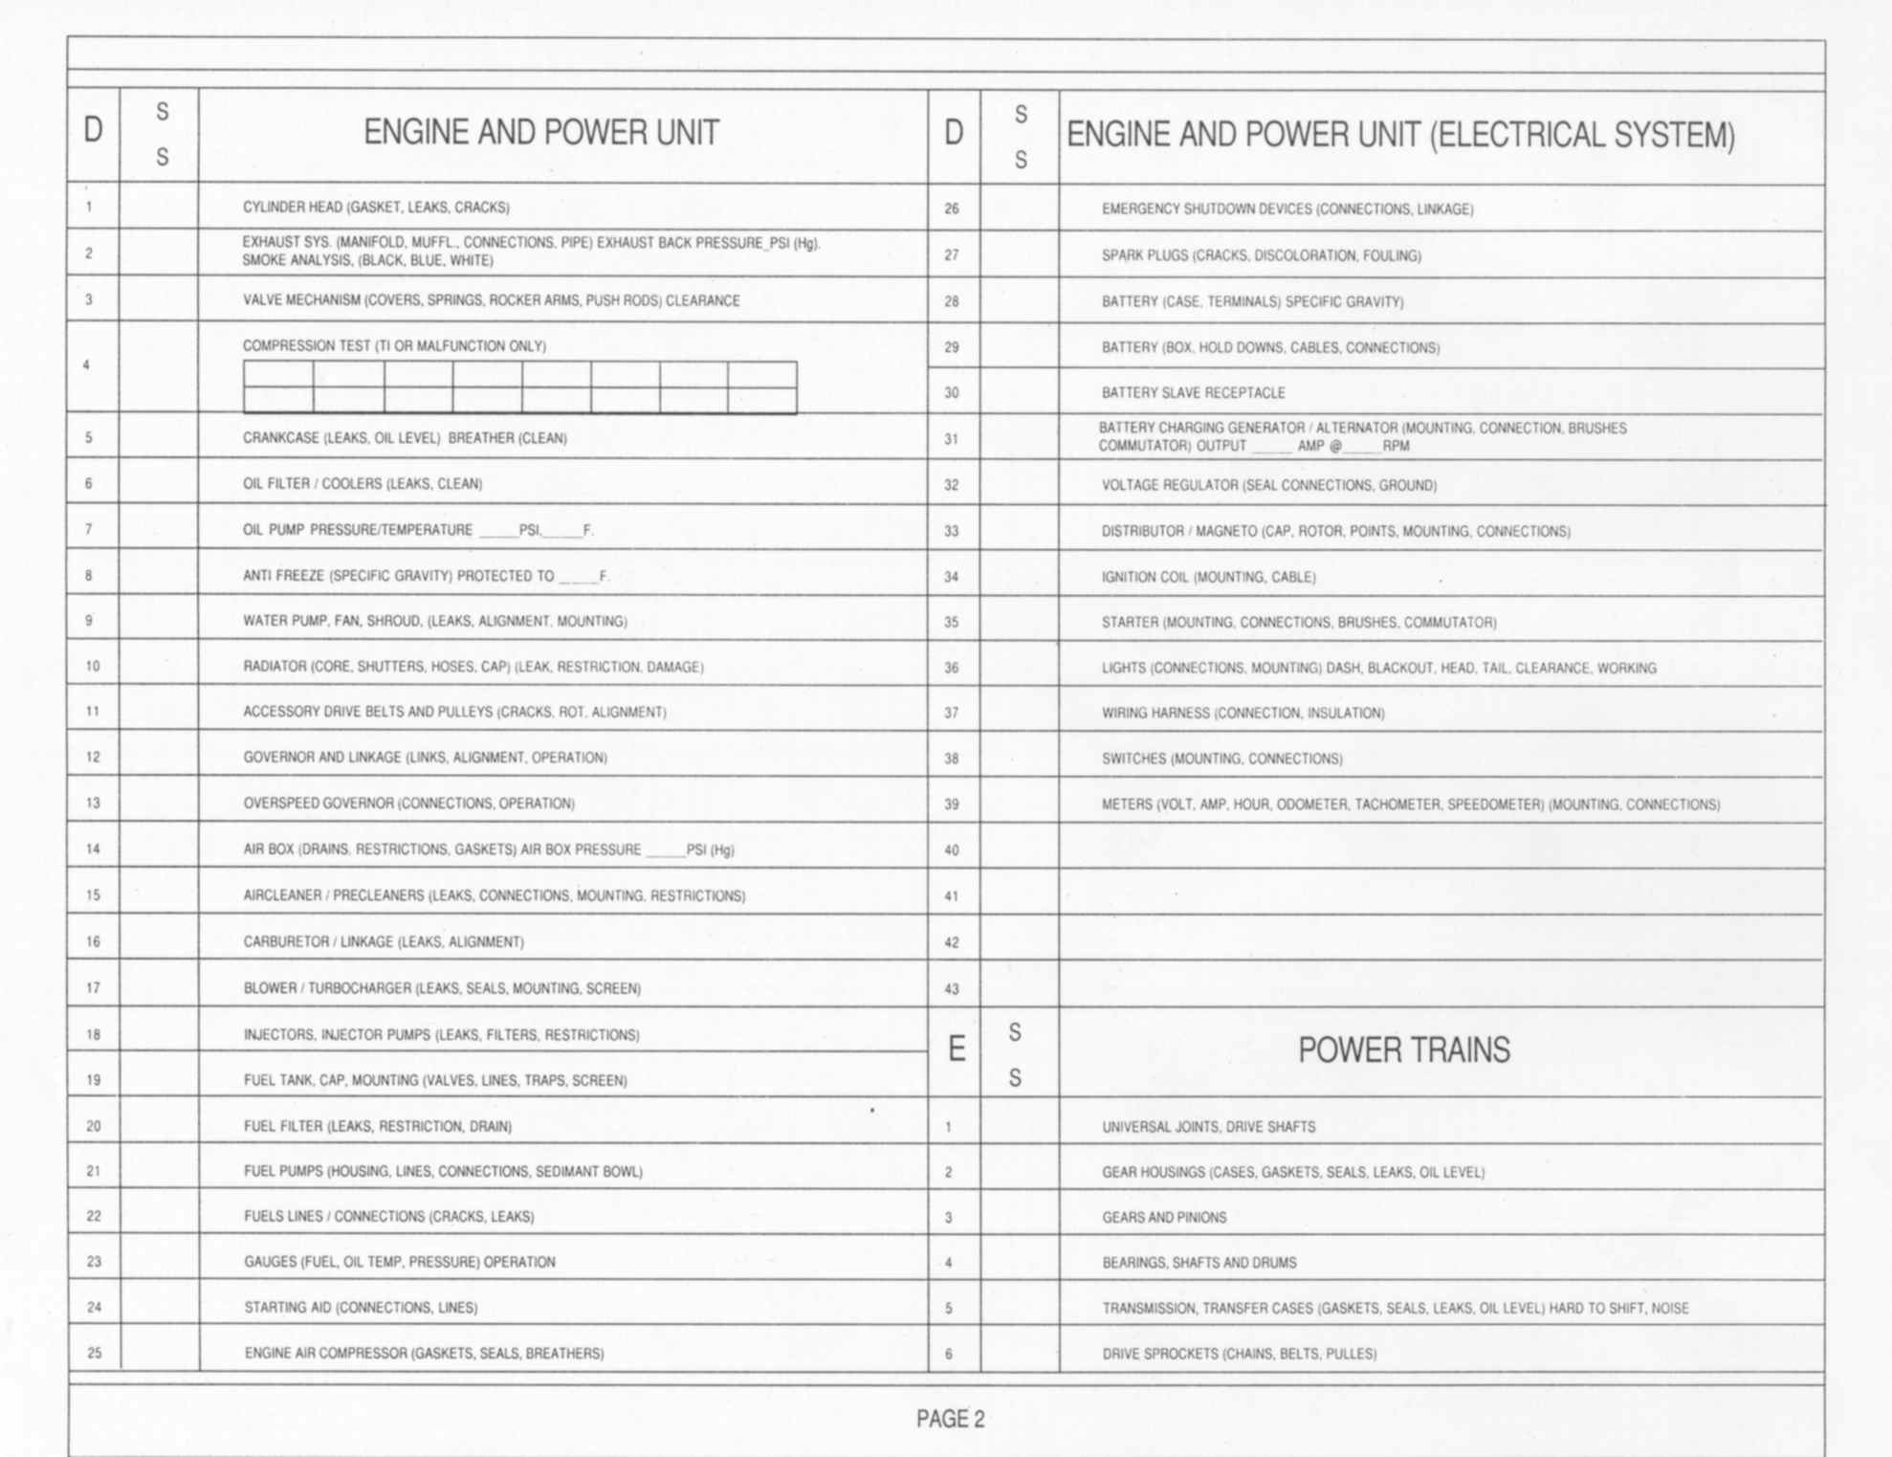
XXX
ü
ü
N/A
ü
ü
ü
N/A
N
O
T
XXX
Cap missing
ü
T
A
K
E
N
ü
ü
ü
26V
1000
ü
28
210
N/A
ü
- 40
N/A
ü
ü
ü
XX
Broken wire R/S
X
loose
ü
ü
ü
N/A
ü
ü
XXX
N/A
ü
ü
ü
ü
ü
ü
ü
ü
N/A
Notes:
Section D - Engine and Power Unit
This section is used to check the engine and related components.
The "SS" column is where the Servicing Symbols (SS) or the Legend for Marking (SS) is placed.

Slide 101
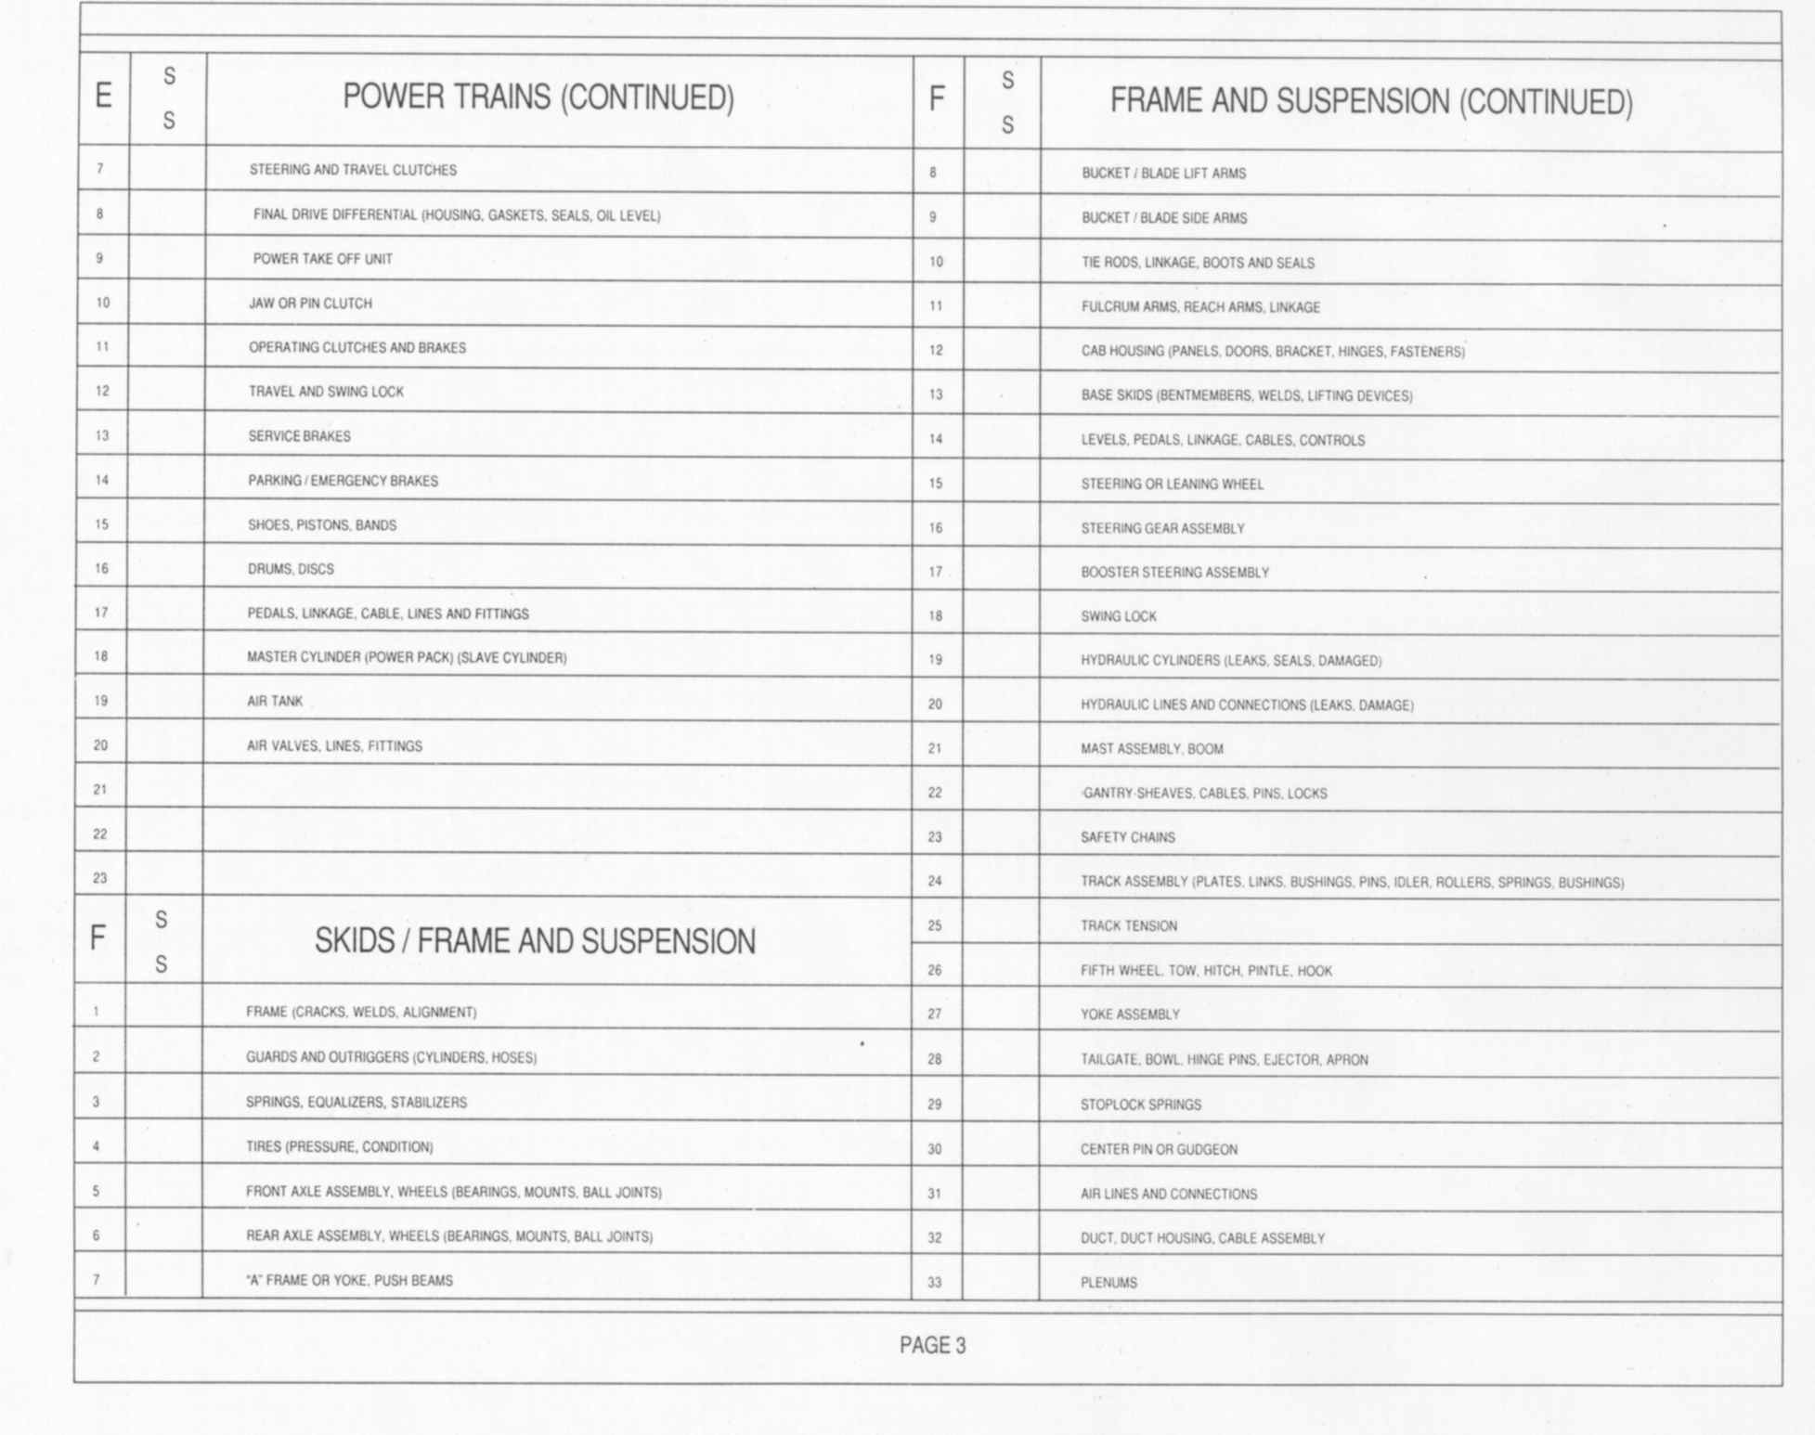
Notes:
Section E - Power Trains
This section is used for the power trains. U-Joints, gear housings, transmissions, and brake shoes, drums or discs.
Section F - Skids / Frame and Suspension
This section is used for the main frame, outriggers, tires, and hydraulic cylinders.

Slide 102
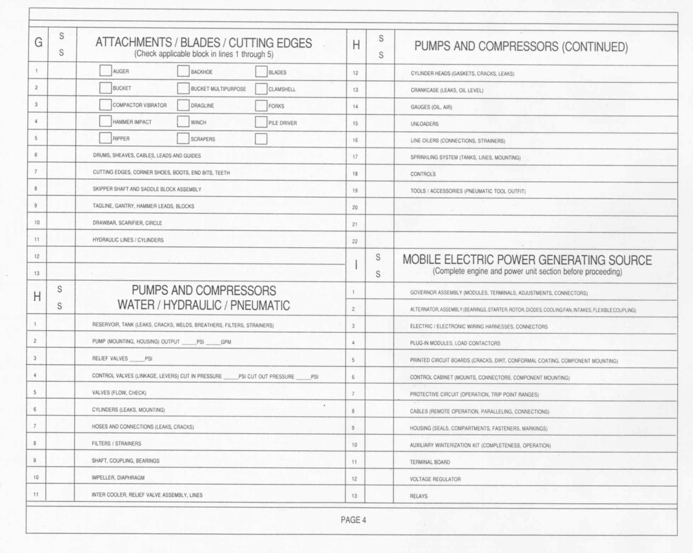
ü
X
N/A
N/A
N/A
N/A
ü
ü
N/A
N/A
ü
ü
N
A
Notes:
Section G - Attachments / Blades / Cutting Edges
This section is used for attachments, winch cables, and cutting edges.
Section H - Pumps and Compressors Water/ Hydraulic / Pneumatic
This section is used for separate pumps and compressors such as a 250 CFM Air Compressor, or a 55 GPM Water Pump.
If this section does not apply it would be lined out.
Section I - Mobile Electric Power Generating Source
This section is for end item generators.
This section would be lined out if not working with this type of gear.

Slide 103
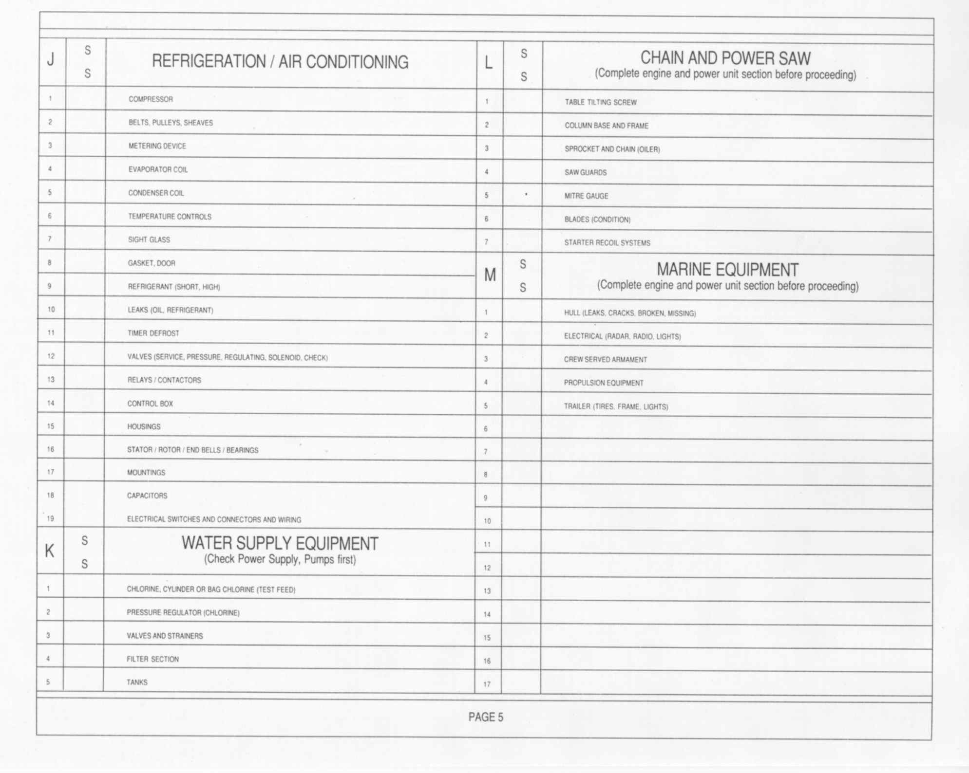
N
N
A
A
Notes:
Section J - Refrigeration / Air Conditioning
This section is used for refrigeration and air conditioning assemblies. This section would be used for end items also.
This section would be lined out.
Section K - Water Supply Equipment
This section is for water purification units or laundry units.
This section would be lined out.
Section L - Chain and Power Saw
This section would be used when working on chain saws. Special Tool Kits and some Equipment (SEE Tractor) contain chain saws which will require periodic maintenance.
If not applicable this section would be lined out.
Section M - Marine Equipment
This section is used for watercraft and related equipment.
If not applicable this section would be lined out.

Slide 104
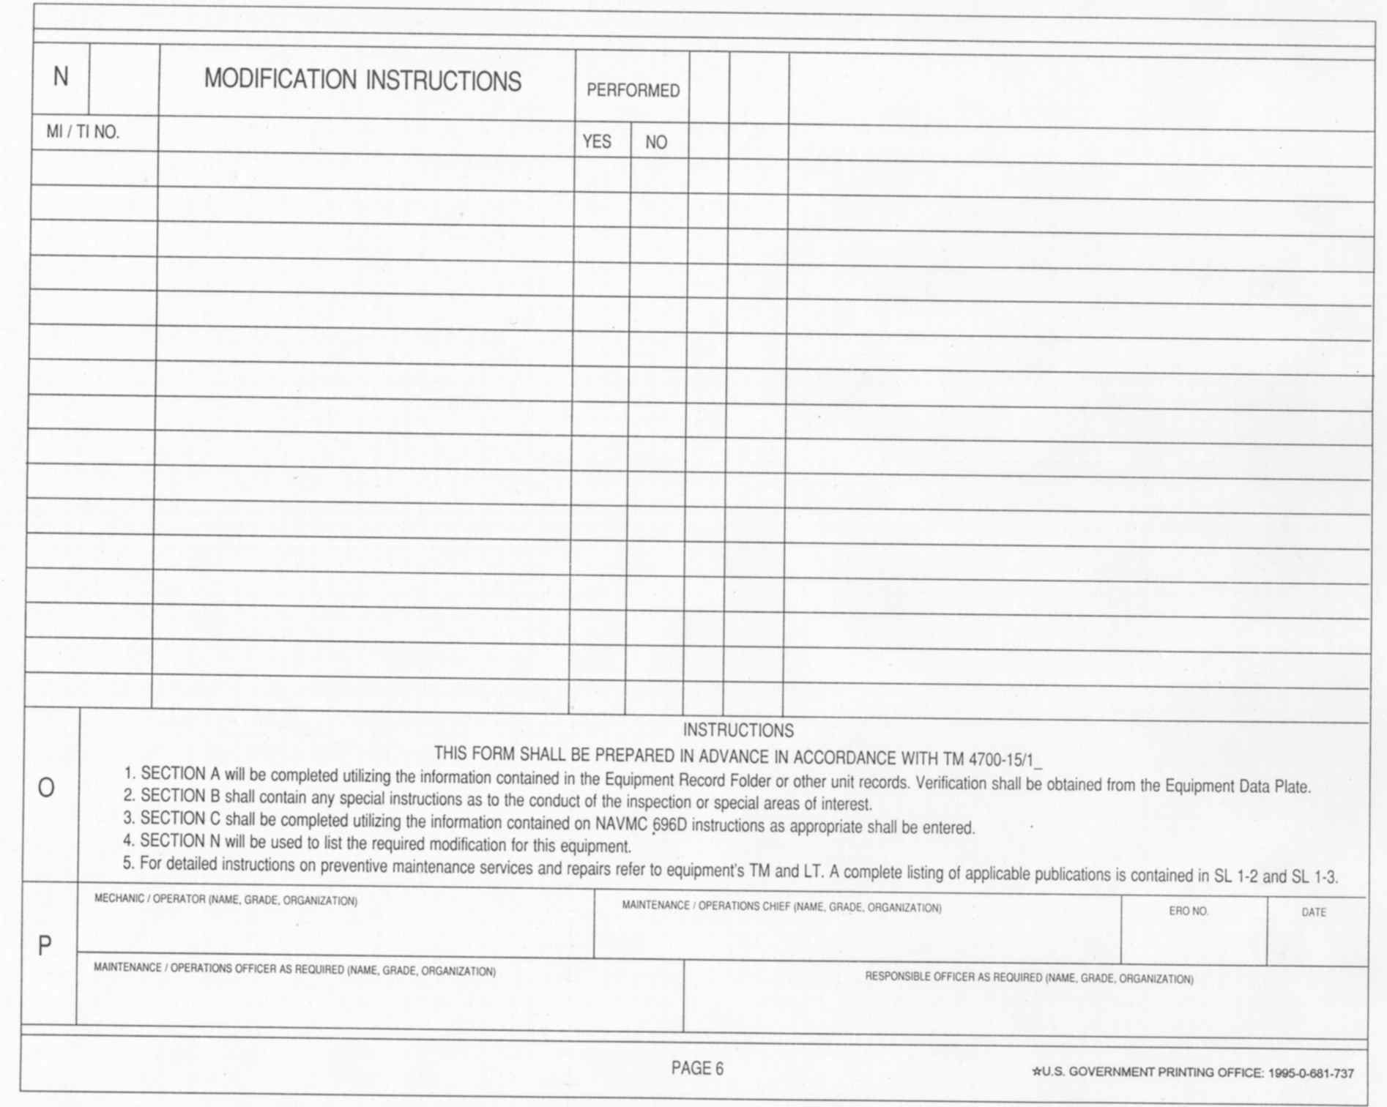
Your Signature , PVT, 2ND Maint
Samuel D. Adams GySgt, 2nd Maint
9249
Notes:
Section N - Modification Instructions
Enter all applicable MI / TI numbers in this block. The Title of the MI / TI is entered in the block immediately following the MI / TI number.
Enter a checkmark in the "Performed" block to indicate if the modification has or has not been performed.
Section O – Instructions
This section contains simple instructions for completing this form.
Number 5 refers you to the Equipment Technical Manual for detailed instructions and service / maintenance requirements for completing this form.
Section P - Signature Block
In the Mechanic / Operator (Name, Grade, Organization) block, enter the name, grade, and organization of the person preparing sections "B" through "M".
In the Maintenance / Operations Chief (Name, Grade, Organization) block, enter the name, grade, and organization of the maintenance / operations chief of the mechanic / operator entered in the previous block.
In the ERO block enter the ERO number assigned to this task (PM Service, LTI, corrective maintenance).
In the Date block enter the date the ERO was assigned.
The Maintenance / Operations Officer will sign the appropriate block as required.
The Responsible Officer will sign the appropriate block as required.

Slide 105
PM
CM
Medium Crawler Tractor
John Deere
850 JR
2D Maintenance BN
9249
832
N/A
640616
Winch
John Deere / 6090
08Z40429
John Deere / 850 JR
TO850JR 175862
X
ü
ü
ü
ü
N/A
N/A
D-1 Cylinder head gasket leaks
D-11 Fan belts loose
D-15 Air-cleaner Dirty
D-30 Slave receptacle cap missing
D-36 Broken wire to R/S blackout light

Slide 106
RECORDS AND FORMS REVIEW
References for records and forms
Purpose of the NAVMAC 10560
How to fill out a NAVMAC 10560 (LTI Sheet)

Slide 107
QUESTIONS
Q: What are the two references used for records and forms?
A: UM 4790.5c and TM 4700-15/1H
Q: What form provides a checklist for performing and recording preventative maintenance checks and services (PMCS) and Limited technical inspections (LTI)?
A: NAVMC10560 (LTI sheet)

Slide 109
Notes:
We will discuss different parts and components manuals.

Slide 110
PARTS MANUALS
John Deere (MCT 850JR)
PC10086 (Parts Catalog)
Lists all repair parts and components applicable to the MCT
JLG (MMV EBFL)
TM 10794B-OI/A (repair AND parts manual combined)
Lists all repair parts and components applicable to the MMV
SL-3-11668A (GMTK Stock List)
In general, an SL-3 provides a listing of parts and/or components that make an item complete or are to be used with/for an item
Tool inventories will be conducted using an SL-3

Slide 111
MCT PARTS MANUAL
PC10086 (MCT Parts Catalog)
Cover page is read in the same manner as the TM
PGs 00I-2 through 00I-29 (general information and contents)
Provide information regarding the equipment’s serial numbers, remarks and abbreviations, and contains the alphabetical index with page numbers referencing where parts and components are located throughout the manual
PGs 0131-2 through 4201-10 (parts/components listing)
Provides a listing of parts, components, and requisition data
PGs 00II-1 through 00II-21 (Numerical Index)
Used to look up part numbers in an alpha-numeric format

Slide 112
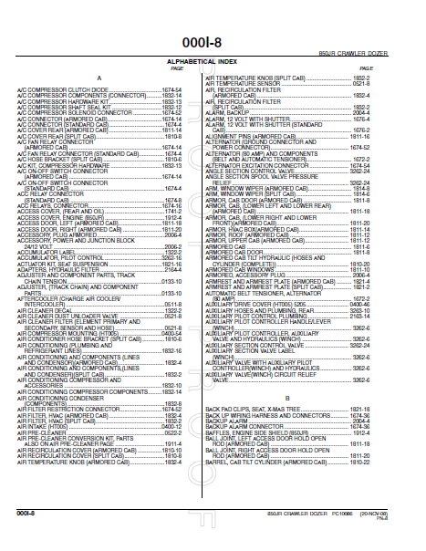
MCT PARTS MANUAL
Alphabetical Index
PART NAME
PAGE NUMBER
Notes:
Each part is listed in alphabetical sequence. The page number is given for each part listed.

Slide 113
MCT PARTS MANUAL
Parts Listing
This line provides part information and is referenced to the illustration using a key number.

Slide 114
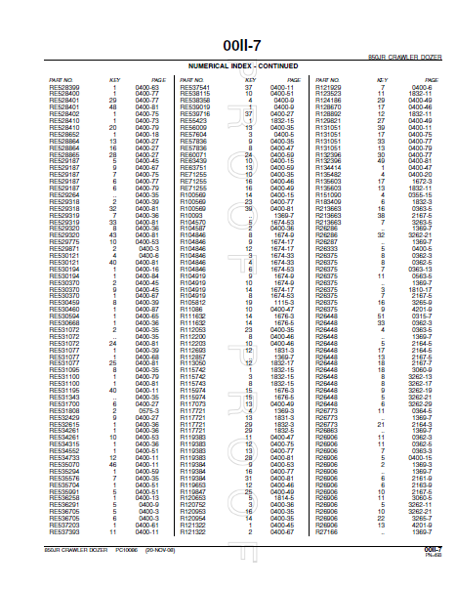
MCT PARTS MANUAL
Numerical Index
Notes:
Column one displays the part number associated with that particular part. Column two displays the key number; remember the engine from the previous slide? And column three displays the page number the part is located on.

Slide 116
MMV PARTS MANUAL
TM 10794B-OI/A (MMV repair manual and parts list)
This TM is a repair manual but it also incorporates a full repair parts list for the MMV
The first section was covered during a previous instruction.
Repair parts are located within Chapter 6. This chapter provides you with references, diagrams and schematics, torque limits, tool ID lists, expendable and durable items list, load rating chart, and a repair parts list (on page 0107 00-1).
Notes:
Ensure students are able to locate this part of the TM. Turn to the correct page that gives parts information

Slide 117
MMV PARTS MANUAL
TM 10794B-OI/A (cont.)
The first section of the Repair parts list provides you with general information (Scope) on how to decipher the information within.
It authorizes the requisitioning, issue, and disposition of spares and repair parts as indicated by the Source, Maintenance and Recoverability (SMR) codes
These are five digit codes that provide you with the source of the particular part, levels of maintenance authorized to remove, use, and replace the part, repair of the part or component, and who is authorized to dispose of the item.

Slide 118
MMV PARTS MANUAL
SMR Codes
Pg 0107 00-2
0107 00-3
0107 00-4

Slide 119
MMV PARTS MANUAL
SMR Codes
Pg 0107 00-2
0107 00-3
0107 00-4
=SOURCE CODE=
METHOD OF OBTAINING
THE ITEM
=MAINTENANCE CODES=
RECOVERABILITY
CODE
USE, REMOVE
REPLACE
REPAIR
OBTAIN
PA
1 2
POSITIONS
USE
O
3
POSITION
REPAIR
Z
4
POSITION
DISPOSE
Z
5
POSITION
Notes:
Explain to the students that PAOZZ is an SMR code and that we are just using it as an example

Slide 120
MMV PARTS MANUAL
SMR Codes
KFOZZ
XBHZZ
PAHZZ
PAFHD
Notes:
Have students decipher these codes using the TM

Slide 121
MMV PARTS MANUAL
TM 10794B-OI/A (cont.)
Just like the SL-3 and the MCT parts manual, this TM provides illustrations of the parts listed
Lists are composed of functional groups in installation sequence
Each group lists parts in ascending figure and item number sequence.
Bulk items and repair parts kits are listed separately in their own functional group.
Items listed are shown on the associated illustrations

Slide 122
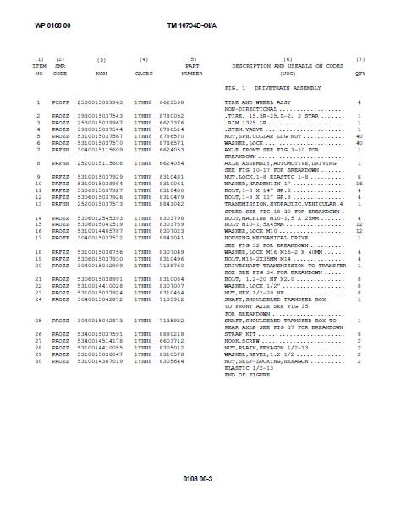
MMV PARTS MANUAL
Repair parts list provide requisition data
The parts are listed within their groups or major assemblies

Slide 123
MMV PARTS MANUAL
TM 10794B-OI/A (cont.)
The next section of the parts list is an NSN cross reference
When a National Stock Number is given, use the NIIN (remove the first four numbers of the NSN) to identify where the part is located in the parts listing by figure and item number
Used to visually identify parts with a known NSN and to gather requisitioning data and identify components of the SMR code
Following the NSN cross reference is the Parts number cross reference
It is read and used for the same reasons as the NSN cross reference

Slide 124
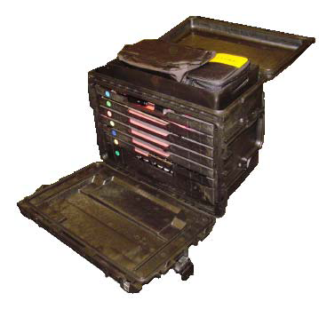
COMPONENTS LIST
SL-3-11668A (General Mechanics Tool Kit)
Used to list and identify tools within the kit
Provides requisitioning data, nomenclature, and an inventory checklist
Illustrations are a part of the SL-3 to further identify tools within the kit

Slide 125
COMPONENTS LIST
SL-3-11668A (cont.)
The first portion of this SL-3 provides you instruction on the following:
How to use the manual and what each column indicates
Components and publications requisitioning information
Special notes on the material contained

Slide 126
COMPONENTS LIST
SL-3-11668A (cont.)
The next section makes up the majority of the manual
First provides you with technical data applicable to that particular components list
Then goes right into the listing…

Slide 127
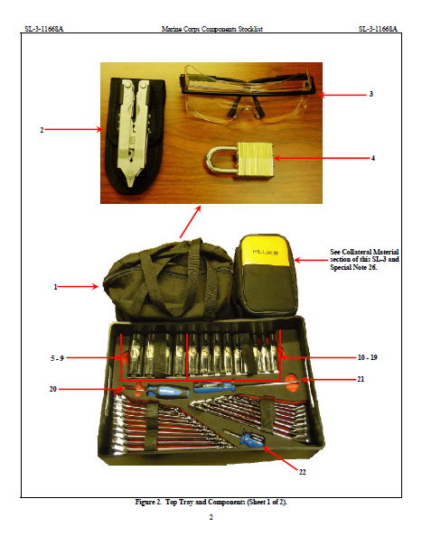
COMPONENTS LIST
Illustrations are given to visually identify each component
Each component is assigned an item number and is cross referenced to its NSN, identification, and unit of measure within the parts listing

Slide 128
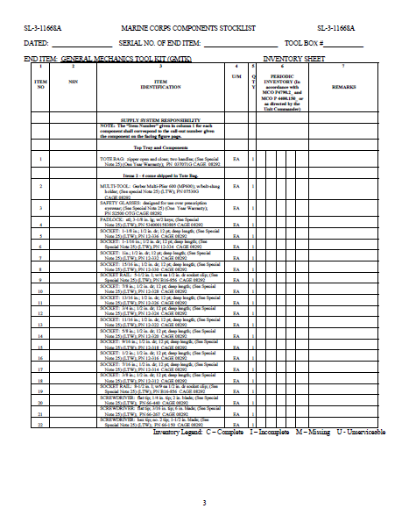
COMPONENTS LIST
Remember the illustration from the previous slide? What was the number given for the safety glasses? Notice the correlation…
There is no NSN given due to the fact that this kit is new and under warranty. The components will be requisitioned through normal supply channels and the manufacturer of the set.
Notes:
This is the main section of the SL-3. You will use this to inventory tools within the kit. Inventory of these tools is made easier with the foam cutouts provided for each. Therefore, serviceability is a key goal for the inventory.

Slide 129
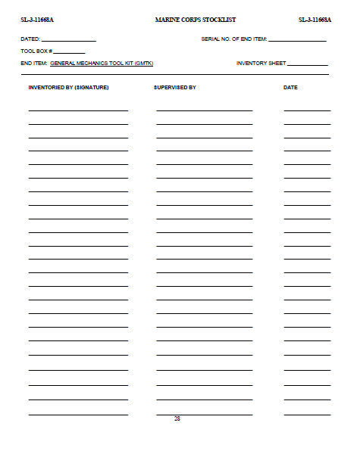
COMPONENTS LIST
This page provides lines for signatures when inventories of the tool box assigned are conducted. There will be one SL-3 assigned to each tool box and it is the mechanics responsibility to ensure all tools are properly accounted for on a regular basis. This is a supervised event and therefore a line is provided for their signature as well.

Slide 130
PARTS MANUAL REVIEW
Different manuals and how they are used.
How to read parts manuals and SL-3’s

Slide 131
QUESTIONS
Q: What manual is utilized for inventory purposes of the GMTK?
A: SL-3.
Q: What is the NIIN?
A: The NIIN is the NSN without the first four characters.

Slide 133
GCSS-MC

Slide 134
GCSS-MC
Global
Combat
Service
Support
Marine Corps

Slide 135
GCSS-MC
GCSS-MC provides the capability to see what equipment needs to be repaired, order parts, identify where the parts are located and who is available to perform the work.
The Maintainer will be able to plan for, and schedule, maintenance resources and will also have the ability to review item configuration, readiness information, and past historical and ownership in a data repository environment.

Slide 136
GCSS-MC SERVICE REQUEST
PURPOSE
Used to request equipment services, maintenance, record maintenance performed and report maintenance performed.
Includes but not limited to:
Preventive maintenance
Corrective maintenance
Limited Technical Inspections
Modifications
Calibration

Slide 137
GCSS-MC SERVICE REQUEST
RESPONSIBILITIES
The equipment owner, user and or custodian is responsible for initial preparation to include the heading and description of work.

Slide 138
GCSS-MC
Advice codes
Locators
Groups and Sub-groups

Slide 139
GCSS-MC
Parts Request Function
Used in conjunction with the Service Request Tasks to requisition, receipt for, cancel and record partial issues and credits of repair parts.

Slide 140
GCSS-MC
Creating a Service Request
SG Pg#79
Notes:
The instructor will now go through the UPK demonstration

Slide 141
GCSS-MC
Creating a Parts Request
SG Pg#79
Notes:
The instructor will now go through the UPK demonstration that applies to parts request.

Slide 142
GCSS-MC
Accounting for materials and time
SG Pg#79
Notes:
The instructor will now go through the UPK demonstration that applies to close a task.

Slide 143
GCSS-MC REVIEW
The definition of GCSS-MC.
The purpose and uses of GCSS-MC.
Advise codes.
Groups.
Locators and subinventory.

Slide 144
QUESTIONS
Q: What does the acronym GCSS-MC mean?
A: Global Combat Service Support- Marine Corps.
Q: What does the advise code 2P mean?
A: Item required in one continuous length.

Slide 146
SG Pg#85
Notes:
Just like a rifleman carries an M-16 as his weapon, a mechanic has their tools. Wrenches and screwdrivers are your weapons. If you don’t have some familiarization of these tools, how can you be expected to employ them at a moments notice?
Marine Corps expeditionary maintenance capabilities

Slide 147
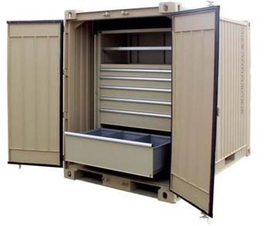
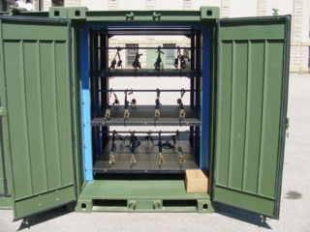
SHOP EQUIPMENT, GENERAL PURPOSE
Common #10
Common #12
Provides storage for general purpose shop tools.
Highly mobile and transportable
Enhances general maintenance support
Notes:
The Common No. 10 and No. 12 are mobile tool storage containers, intended for enhancing general maintenance support. The idea is for them to work together to provide tool storage in a general-purpose shop. They are highly mobile and transportable by a variety of methods.

Slide 148
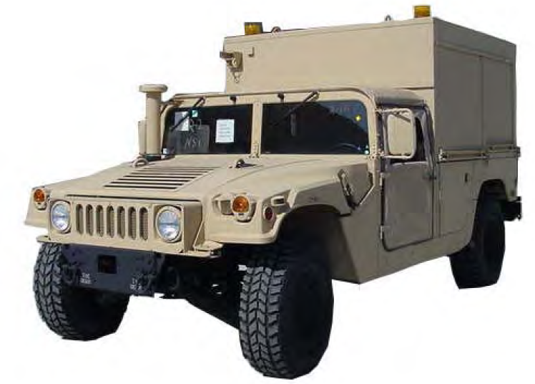
SHOP EQUIPMENT CONTACT MAINTENANCE COMMON NO. 20
Self-contained tool & equipment shelter mounted on a HMMWVA2
Hand tools, power tools, oxy/acetylene (gas) cutting & welding capability, with compressor and pneumatic tools
Utilized on contact teams
Notes:
The Shop Equipment, Contact Maintenance Common #20 is a self-contained tool & equipment shelter mounted on a HMMWVA2. It contains general purpose type hand tools, power tools, oxy/acetylene (gas) cutting & welding capability, with compressor and pneumatic tools all located within easy reach of the mechanic, and necessary components to perform authorized maintenance. Utilized on contact teams for contact and emergency on site maintenance. It is close to its maximum weight limit so installing armor would not be an option unless weight was reduced elsewhere, i.e.: removing tools.

Slide 149
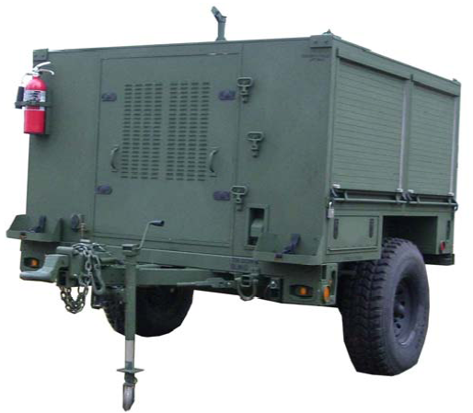
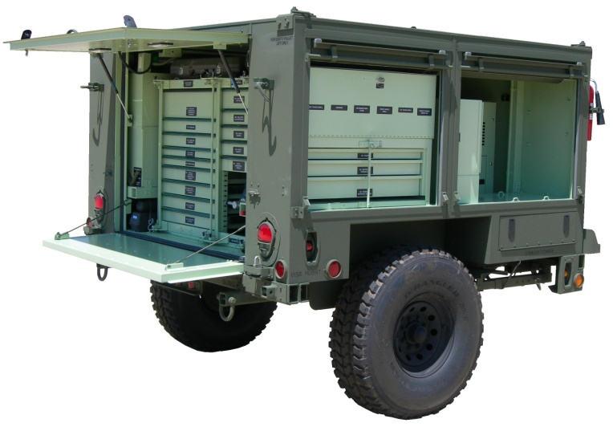
SHOP EQUIPMENT, GENERAL PURPOSE COMMON NO. 22
Notes:
used to assist in maintaining tracked and wheeled Marine Corps vehicles. mobile tool storage container intended for enhancing general maintenance support. compressed air to operate pneumatic tools.

Slide 150
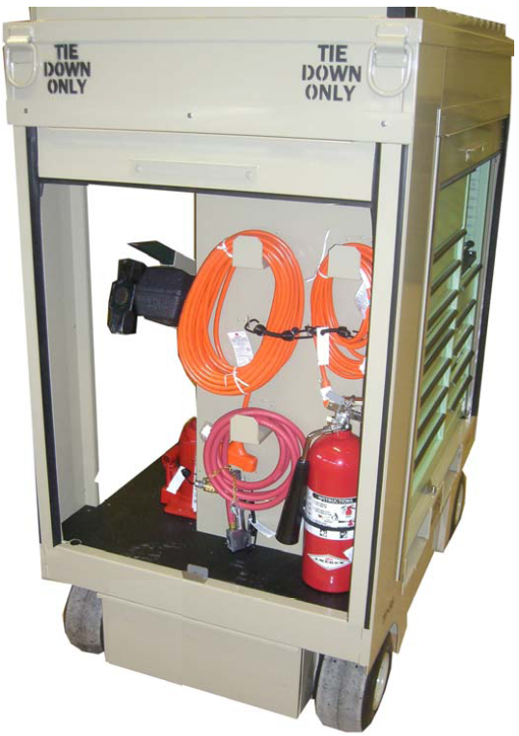
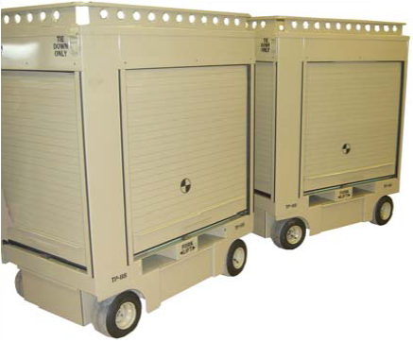
SHOP EQUIPMENT, GENERAL PURPOSE COMMON NO. 24
Notes:
consists of a pair of 5 ft. Pit Box type tool containers with roll up doors on each side of the Pit Box. includes four cabinets for tool storage and a steering system with pneumatic wheels for ease of movement. contains various hand tools, electric power tools, air powered tools and other commercial type standard shop items found in most maintenance facilities. Direct Support Field Level Maintenance(formally 2nd echelon). The Common No. 24, along with the Common No. 20 and Common No. 22, all have a similar tool load and configuration which allows mechanics to be immediately familiar with tool location in all three Shop Sets in the Common 2x family and to allow quick, at a glance, inventory.

Slide 151
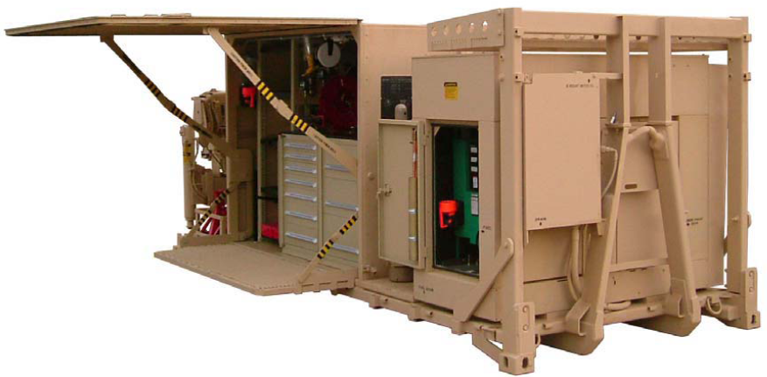
SHOP EQUIPMENT, GENERAL PURPOSE COMMON NO. 30
Notes:
general purpose tools required to perform medium to heavy maintenance at the field level of maintenance. In addition to the Common No. 30, this family also includes the Shop Equipment, General Purpose Common No. 32 and the Shop Equipment, General Purpose Common No. 34 (NOT OUT YET), which are both very specific in their tool load and configuration. drawers in the workbench have foam cut outs to expedite inventory, provide standardization/configuration management, and minimize tool loss. International standards organization (ISO) 20 foot by 8 foot flat-rack frame for the entire system, along with an
enclosed area (shelter) and can be transported by an LVS (MK-18). 35 KW diesel powered generator, a 50 CFM air compressor, a 10,000 lb Material Handling Crane (MHC), an acetylene gas cutting system, and sufficient storage space for hand, power tools, air-powered tools and equipment. The generator is the primary power source for the air compressor, Material Handling Crane (MHC), lighting, and power tools. The air compressor provides air to operate pneumatic tools, impact wrenches. Drills, and other necessary functions. The MHC performs the heavy lifting function (which includes removal and replacement of vehicle engines/power packs). The shelter storage space is enclosed for moisture control and security. While operational, the shelter sides can be opened to provide additional roof and floor space.

Slide 152
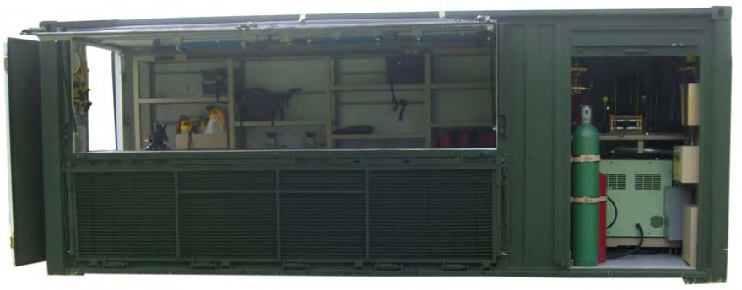
SHOP EQUIPMENT, GENERAL PURPOSE COMMON NO. 32
Notes:
Intermediate Maintenance, consists of general mechanic type hand tools and equipment used by maintenance personnel to perform maintenance and repairs. hand tools, power tools, air tools with self-contained air compressor and electrical power. The Common 32 also has storage capability for “B Kits” and other approved special purpose tool kits and TMDE. 20 ft iso. Critical to equipment readiness.

Slide 153
VEHICLE AUTOMATED DIAGNOSTIC SYSTEM (VADS)
Lightweight, portable diagnostic system
performs diagnostics on diesel engines, transmissions, central tire inflation systems, and other mechanical, electrical and hydraulic systems
Utilizes an Interactive Electronic Technical Manual (IETM)
The major component is a Test Adapter Vehicle (TAV)
Interfaced with a PC or laptop controller
Combined with a complete set of interconnect cables, transducer/adapters and two weather resistant transit cases.

Slide 154
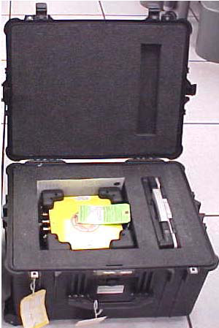
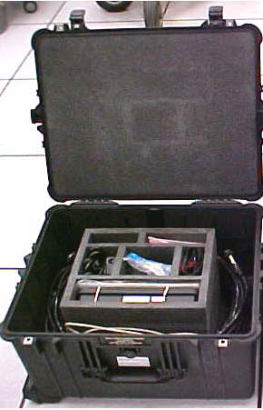
VEHICLE AUTOMATED DIAGNOSTIC SYSTEM (VADS)
Cables
Laptop
Test Adapter Vehicle (TAV)
Adapter Set

Slide 155
VEHICLE AUTOMATED DIAGNOSTIC SYSTEM (VADS)
It can measure voltage, resistance, and frequency on 90 different test points.
With the use of a computer, various types of tests can be run.

Slide 156
Required Items
Mechanics must ensure that they have the following:
General Mechanics Tool Kit
Proper Technical Manual
Personal Protective Equipment may vary on task to be completed

Slide 157
Keep in Mind
As a mechanic, it is your responsibility to maintain the tools you are assigned and any tools that you use. (Keep your tool set complete)
Keep your tools within easy reach and where they cannot fall on the deck or into equipment.
If working outside with the elements, ensure that your tool box remains closed. This will prevent rust from forming.
Use the right tool for the job. (Don’t use a ¼ inch ratchet to bust rusted bolts.)

Slide 158
TOOLS REVIEW
Common tool kits.
VADS system.
Required items when working on gear.

Slide 159
QUESTIONS
Q: What level of maintenance utilizes the common 24?
A: Direct support field level.
Q: What are the three things needed when working on a piece of equipment?
A: General mechanic tool box, proper technical manual, and PPE.

Slide 160
BREAK

Slide 161
summary
Review Shop Operations main ideas
Questions?
10 Minute break
In-depth review of Shop Operations

