Slide 1
2020 Civilian Career
Development Information Forum
Assistant Deputy Commandant for Manpower and Reserve Affairs
Mr. Jeffery W. Bearor
February 2020

Slide 2
2020 Civilian Career
Development Information Forum
Presented by MPC-30
and the
Communities of Interest

Slide 3
We’re here to inform you about your career development opportunities…
We will start by talking about:
  Career Planning
  Career Tracks
  Civilian Workforce Development Framework
  Civilian Workforce Strategic Plan
  Marine Corps Acculturation
Then we will discuss a few specific programs and activities available to assist you in achieving your goals:
  Self-assessments
  Academic Degree, Academic Courses, and Certifications
  Leadership Development
  Individual Development Plan
  Mentoring

Slide 4
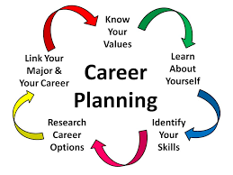
Is Your Career by Design or by Default
What is it?
Career planning is the ongoing process where you: Explore your interests and abilities; Strategically plan your career goals; and Create your future work success by designing learning and action plans to help you achieve your goals
Career Planning Requires:
Thought
Effort
Cultivation

Slide 5
Training, Education & Professional Development
Technical, Leadership, and Supervisory Tracks
Career Trajectory
Executive Training
Functional/Technical
Training
Leadership Education
Executives
Managerial & Supervisory Training
Managerial Training
New Manager Training within 1 year of appointment and at least once every 3 years thereafter.
Supervisors & Managers
Supervisory Training
New Supervisor Training within 1 year of appointment and at least once every 3 years thereafter.
Aspiring & Emerging Leader Training
All Employees
Initial & Recurring Mandatory Training

Slide 6
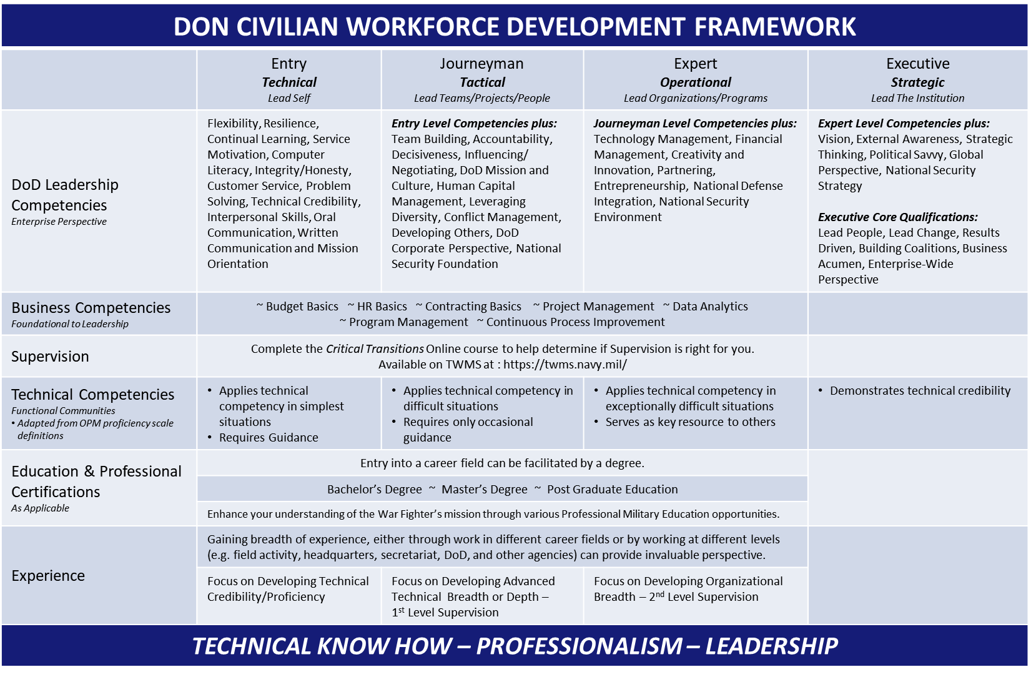

Civilian Development Framework
Notes:
Guide civilians in their individual efforts to develop their skills and abilities as well as increase their knowledge through competency development AKA “Atlas” Employees need help determining which educational opportunities would be best for them

Slide 7
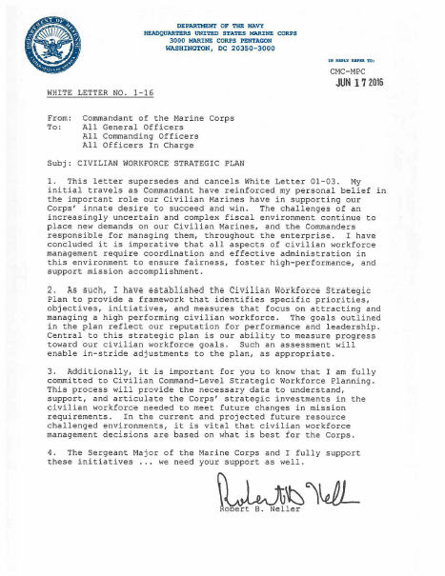
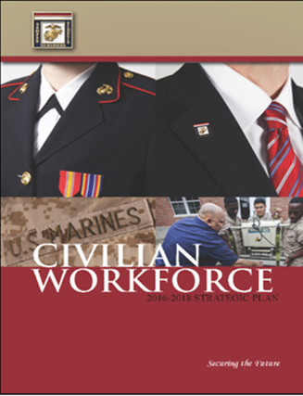
Is there a plan for Civilian Marines?
White Letter 1-16
Civilian Workforce Strategic Plan
“… I have established the Civilian Workforce Strategic Plan to provide a framework … that focus on attracting and managing a high performing civilian workforce.”
GOAL 2 Cultivate a learning culture that trains, educates, and develops Civilian Marines to effectively meet evolving mission requirements
“… my personal belief in the important role our Civilian Marines have in supporting our Corps’ innate desire to succeed and win.”

Slide 8
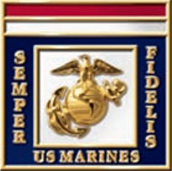
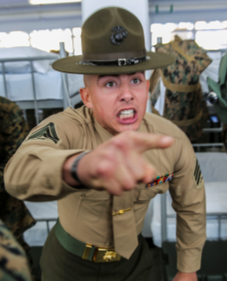
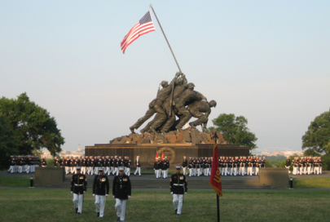
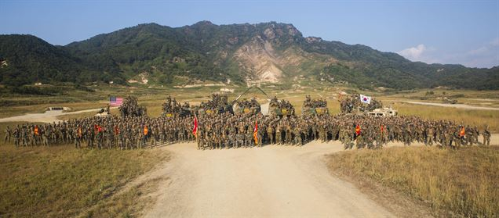
What’s my role with the Marine Corps?
The Marine Corps is unique, steeped with tradition and professionalism
General Krulak, 31st Commandant of the Marine Corps (CMC) first referred to civilian workforce as “Civilian Marines” in White Letter 01-99
In ALMAR 005/03 General Hagee, 33rd CMC established the Civilian Marine Service Pin
In 2004, the Marine Corps Acculturation Program was developed to teach new civilians about Marine Corps:
  History
  Culture
  Organizational Structure
Acculturation helps us understand the important role of Civilian Marines as part of the Total Force
At the end of every course attendees receive a Civilian Marine Service Pin

Slide 9




So … how do I begin designing my career?
Talk with your Supervisor
Assess your Skills
Identify your Goals
Identify training that:
- Improves skills
- Helps you reach Career Goals
Think about…
… furthering your education
… developmental assignments
When it comes to planning for your development...
“The sky’s the Limit”

Slide 10
So…how do I assess my current skills and abilities?
What is a Self-Assessment…
  A way to learn about yourself
  Work-related values, interests, abilities, and personality type
Why use a Self-assessment…
  Enrich your career path by assessing, planning, and developing your critical skills
  Helps to determine strengths and developmental needs
Is there a tool for me to use…
  Online and are available to all civilian Marines

Slide 11
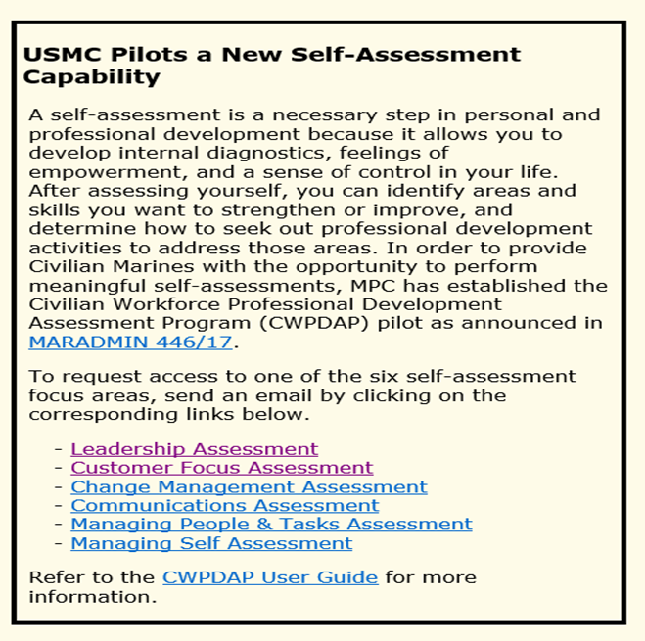
Request Participation
Go to https://www.manpower.usmc.mil/wfd to Request Access
Complete the Request for Access Email
Send the Email to MPC30@usmc.mil
26 separate assessments
Six focus areas

Slide 12

Do you want to get a degree? A certification?
Identify goals (Associates, Bachelors, certification, etc.) and courses on your Individual Development Plan (IDP)
Take an assessment
Register for mentoring
Submit request (SF 182) for approval 60 days prior to course
  Funded courses must support the work you do
Supervisor must approve each request

Slide 13
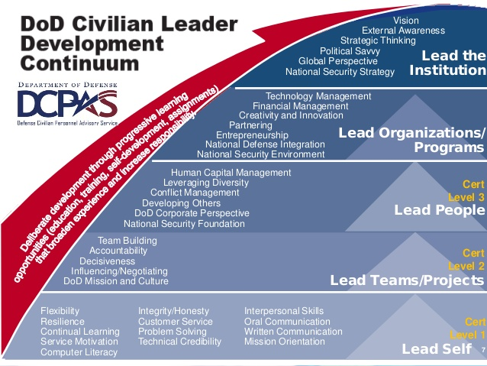
One day I would like to lead…The Leader Development Continuum

Slide 14
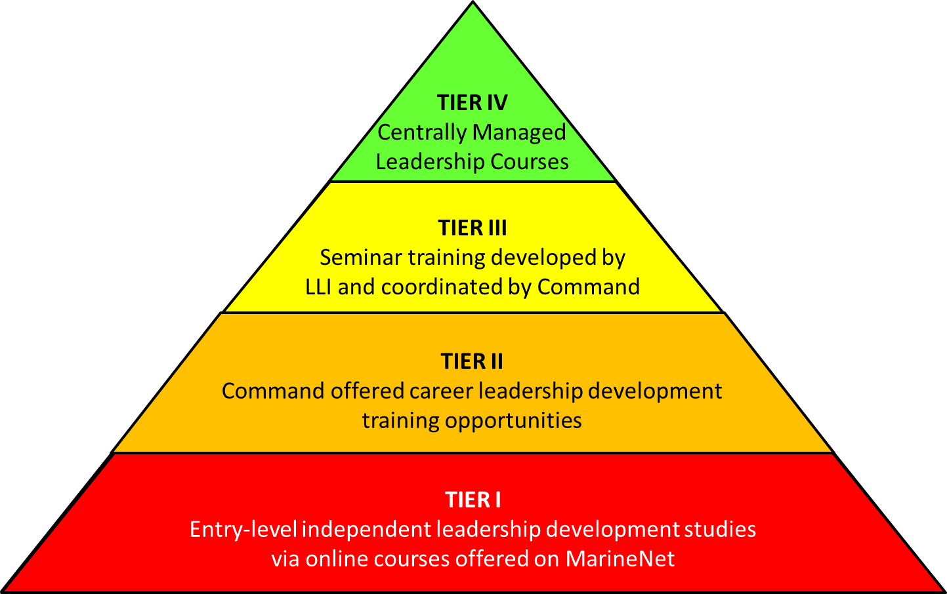
Marine Corps Civilian Leadership Development: The Four Tiers

Slide 15
Tier IV: Centrally Managed Courses
Aspiring Leader Program (GS 4-6)
New Leader Program (GS 7-11)
Executive Leadership Program (GS 11-13)
Executive Potential Program (GS 13-15)
Defense Civilian Emerging Leader Program (GS 7-12)
Defense Senior Leader Development Program (GS 14-15)
Dwight D Eisenhower School (GS 14-15)
Executive Leadership Development Program (GS 12-14)
Federal Executive Institute (GS 15)
Capitol Hill Fellowship Program (FELLOWS) (GS 13-15)
Seminar XXI (GS 14-15)
White House Leadership Development Program (GS 15)
Excellence In Government Fellows Program (GS 14-15)
Navy Capitol Hill Workshop (GS 11 and above)
Bridging The Gap Leadership Development Program

Slide 16

Your Career Roadmap
If you have access to a computer, use the MyIDP online tool located on the Total Workforce Management Services (TWMS) . Go to our website to review the user guide:
https://www.manpower.usmc.mil/TWMS

Slide 17
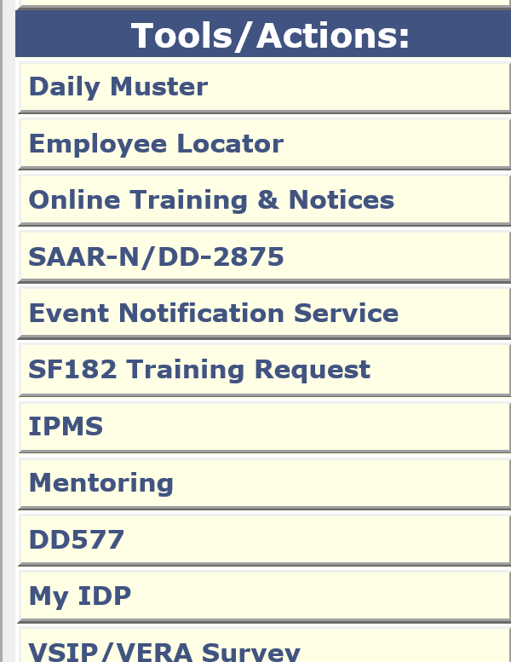
MyIDP
Go to https://twms.navy.mil to access My IDP module
Complete your IDP 1-30 April each Calendar Year
Supervisor approve NLT 30 April
Periodically revisit with supervisor…”living document”
Select

Slide 18
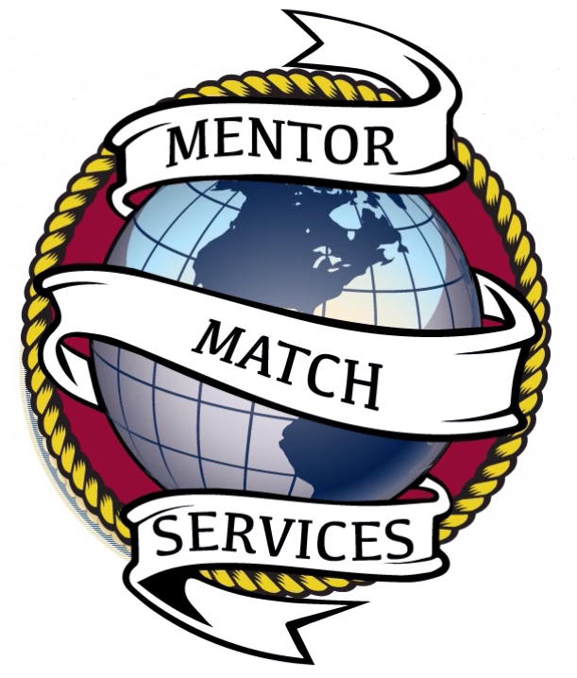
Is there someone that can help me develop?
Mentors and Coaches
Experts and Leaders outside your office
Can help improve your technical and leadership skills
Can make introductions and grow your network
But how do you find them?
Introducing Mentor Match Services (MMS)
Online registry of talented individuals
Technical and leadership expertise throughout the Marine Corps and the Department of the Navy.
Anyone looking for a Mentor or Coach can register
Online registry is searchable by both Mentors and Mentees
MMS is available to anyone with a Common Access Card (CAC) at https://mytwms.navy.mil
Find out more at: https://www.manpower.usmc.mil/mentoring

Slide 19
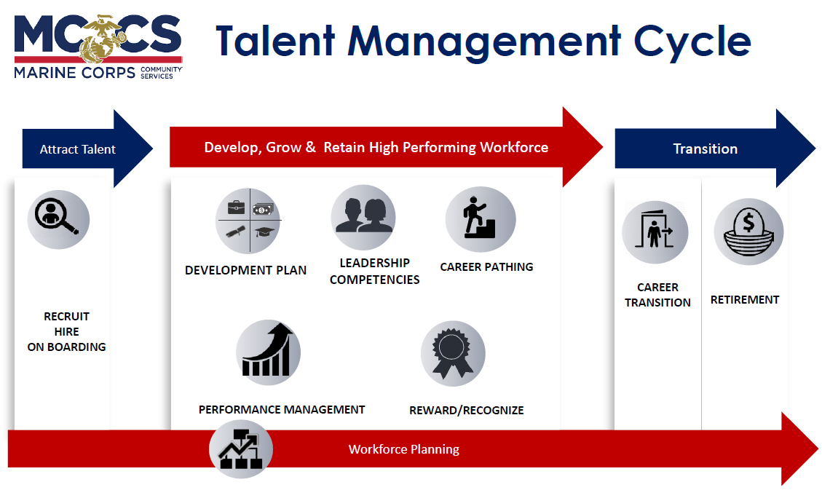
NAF Workforce Development

Slide 20
Onboarding
New Employee Orientation
  Enterprise Roll out to Enterprise - Completed December 2018
  Includes standardized content framework; delivery format flexibility
  Plans underway for developing virtual NEO content
Onboarding Retention Link
  Best Practices Data demonstrates correlation between NEO and retention
  Framework includes 30 day/90 day/1 year employee onboarding check-in sessions; delivery format flexibility enterprise-wide
Functional Training by Position
  Rolled out in Ethos LMS for Retail Store Operations Positions NF2 – NF5 – Completed March 2019
  F& H employees with HR on deck
Notes:
Change all references from NEO Retention Link to Onboarding Retention Link (hidden slide for reference)
Determine whether to include quantitative and qualitative data to support retention link. Is there a NEO success story to highlight from Installation level, maybe higher retention rates?
What percentage of enterprise complete employee follow-up after NEO; in person or virtual
Research by Glassdoor found that organizations with a strong onboarding process improve new hire retention by 82 percent and productivity by over 70 percent.
Gallop found that only 12 percent of employees strongly agree their organization does a great job of onboarding new employees. That means 88 percent don't think their organizations do a great job of onboarding!

Slide 21
Development Plans
Rolled out to Enterprise in March 2018
  Training Materials, Handbook and Job Aids developed and provided via Ethos
  Position-Specific, Competency-Specific and Career Development LDP options with direct links to course library and registration
  Dynamic LDP templates for Retail Store Operations, Child & Youth Program Employees and others coming online in 2020

Slide 22
Leadership Competencies
Implemented DoN Supervisor Training Curriculum
  Addresses the Human Capital Management, Accountability, Developing Others, and Leading People Competencies
  67% of Enterprise Supervisors met this requirement in 2018
DoD Leadership Competency Assessment in Pilot and Production
  Tested the Competency Assessment with MRT Staff
  Piloting to be conducted in 2019 with 2 installations (seeking volunteers)
  POA&M to be developed for enterprise-wide implementation

Slide 23
Leadership Competencies
Most Lead Self – Lead Institutions Competencies
  Available via Online Library or Instructor-Led Training
  Core Courses
  Strategic Leadership Courses
  Manager’s Essentials Course in development
Implemented Flash Mentoring at HQ
  Assembling a Toolkit for optional installation implementation

Slide 24
Career Path
Exploring Automated Career Paths
Efforts centered on an objective approach defining best practices and documenting preliminary requirements
  Provided demonstration to MR Leadership on Ethos capabilities
  Leadership requested a side-by-side demo of Ethos and PeopleSoft capabilities before proceeding
  Requirements will be evaluated against system capabilities, current module alignment, system costs, and any prerequisites (i.e. standardized PDs)
Currently Conducting Competency and Career Pathing Workshops

Slide 25
Development Pyramid
UNC Strategic Leadership Course
Senior Executive Development Prg.
White House Leadership Develop. Prg.
Defense Senior Leader Develop. Prg.
Executive Leadership Develop. Prg.
EXECS &
SENIOR
LEADERS
Defense Civilian Emerging Leader
Managers’ Essentials
LSOT ™
Performance Coaching
Winning Conversations
The Change Element
Extended DISC
Sequential and Progressive
SUPERVISOR &
PROGRAM
MANAGEMENT LEVEL
All Associates
2500+
Ethos Online Learning
The Change Element ™
Extended DISC®
Winning Conversations
for Associates*
LSOT Foundations ™
POSITION-SPECIFIC COURSES
CORE
LEADERSHIP & CONTINUING EDUCATION COURSES

Slide 26
NAF Workforce Offerings
Talent Development. Train employees to coach development, manage conflict, and improve team communication and problem solving skills
Integrated, just in time (15 minutes or less in duration) blended learning (eLearning and instructor-led combinations) to address organizational needs and workforce competency requirements.
Increase employee retention by preparing Supervisors to develop Internal Talent on the job

Slide 27
NAF Workforce Offerings
Promote Career Path Development. Define functional, career and learning paths.
Increase Enterprise Course Development Capability (Articulate 360 Authoring Software Training)
Promote use of the Learning Management System to enable greater access and participation in the professional development

Slide 28
NAF Workforce Offerings
2500+ Personal & Professional Development Courses
150+ Continuing Education Unit Eligible Courses
Numerous Certification Prep Courses
Ted Talks, Coaching Master Classes, Federal Coaching Network
Position-Specific, Competency-Specific and Career Learning Development Plans
Flash Mentoring
Tuition Assistance
Competency Assessment (coming in 2020)
Career Center (Coming 2020-2021)
For More Info Contact: Bryant Carthan
NAF Training Branch Head – carthanb@usmc-mccs.org.

Slide 29
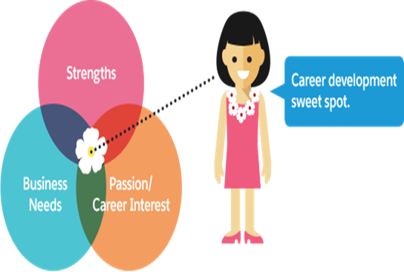
Putting it all together: Make your Career by Design
It’s All About You!
  To be powerful, Focus on the one Factor you ALWAYS have control: You
    Do as much as you can
    Within whatever limitations you have
    As well as you can
    Wherever you are
  You control your
    Thoughts
    Words
    Actions
  You are responsible for your
    Attitude
    Commitment
    Time
    Effort
    Ideas

Slide 30
So who at my Command can answer career development question(s)?
Lejeune
Leadership
Institute
MCLB Barstow
Chad.trusty@usmc.mil
M&RA (MPC-30)

Slide 31
  Questions/Comments

Slide 32
Communities of Interest
Nate Taylor
USMC COI Integrator

Slide 33
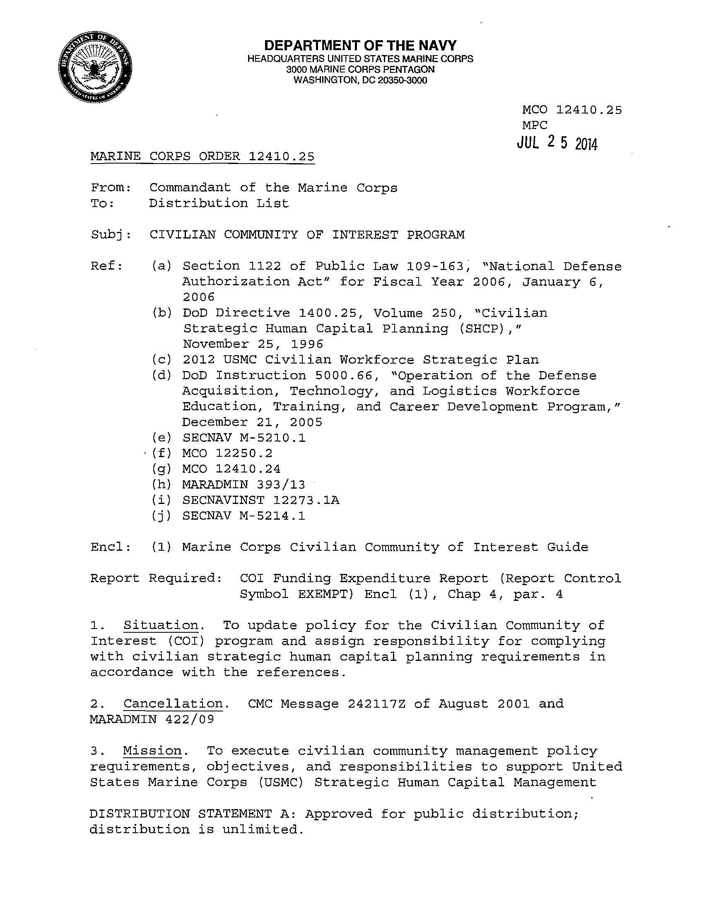
COI Program
USMC Civilian Community Management
MCO 12401.25
Establish communities based on similar work and job series
  Led by a Senior Executive
  Managed by Senior Technical expert from the community
19 Designated Communities of Interest (APF/NAF)
Understand the needs of the community
Perform annual community assessment
Establish a Vision and Strategic Direction for the Community
Enhance Community Capabilities
Activities
Identify technical competencies
Provide technical training opportunities
Develop career roadmaps
Assist community members with career management decisions

Slide 34
Organizational Structure
ADC M&RA
  Provides direct oversight and management functions for the COI Program
Civilian Workforce Management Branch (MPC-30)
  Provides framework, tools, procedures, and resources
  Integrator for DoD and DON community management
COI Leader: Sr. leader w/vested interest in representing a functional community
  Provide oversight and guidance for their respective COI
  Promote community-wide strategic vision and goals
  As applicable, coordinate with DoD/DON Functional Community Managers
COI Manager (Action Officer)
  Perform planning, programing, and budget execution for the community

Slide 35
Foundational Skills Training (FST)
MARADMIN 013/16:
  Announced Foundational Skills Training
  Established enterprise-wide common skills training in 5 Categories:
    Communication
    Project Management
    Information Technology
    Business Functions
    Personal/Professional Management Skills
  Service is provided by Industry leader in Web-based training, https://www.Linkedin.com
    Training provided by industry leaders, professors, etc.
    Access on demand via Computer or Mobile device
    Access to 7,400 plus courses in a variety of occupational disciplines

Slide 36
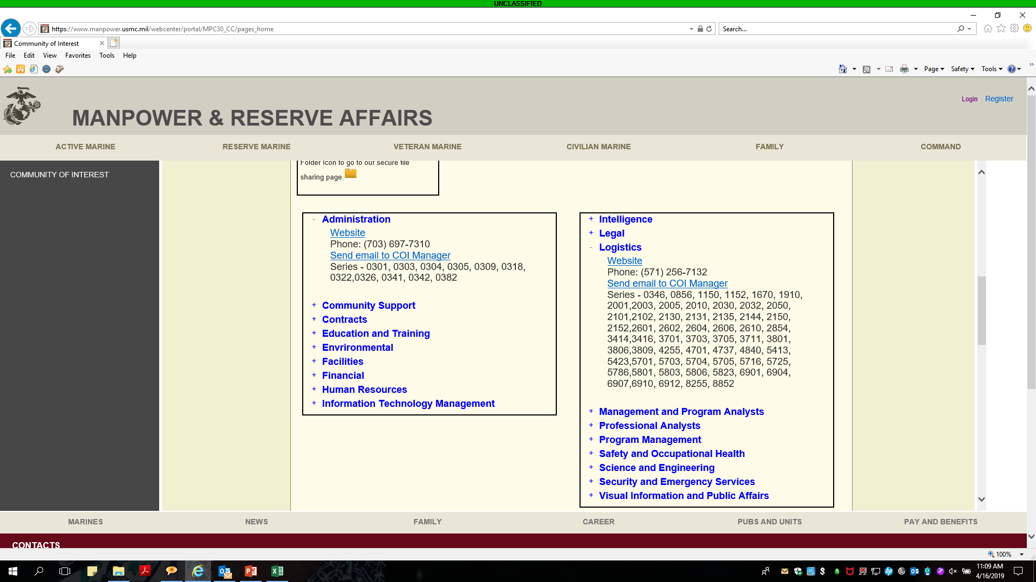
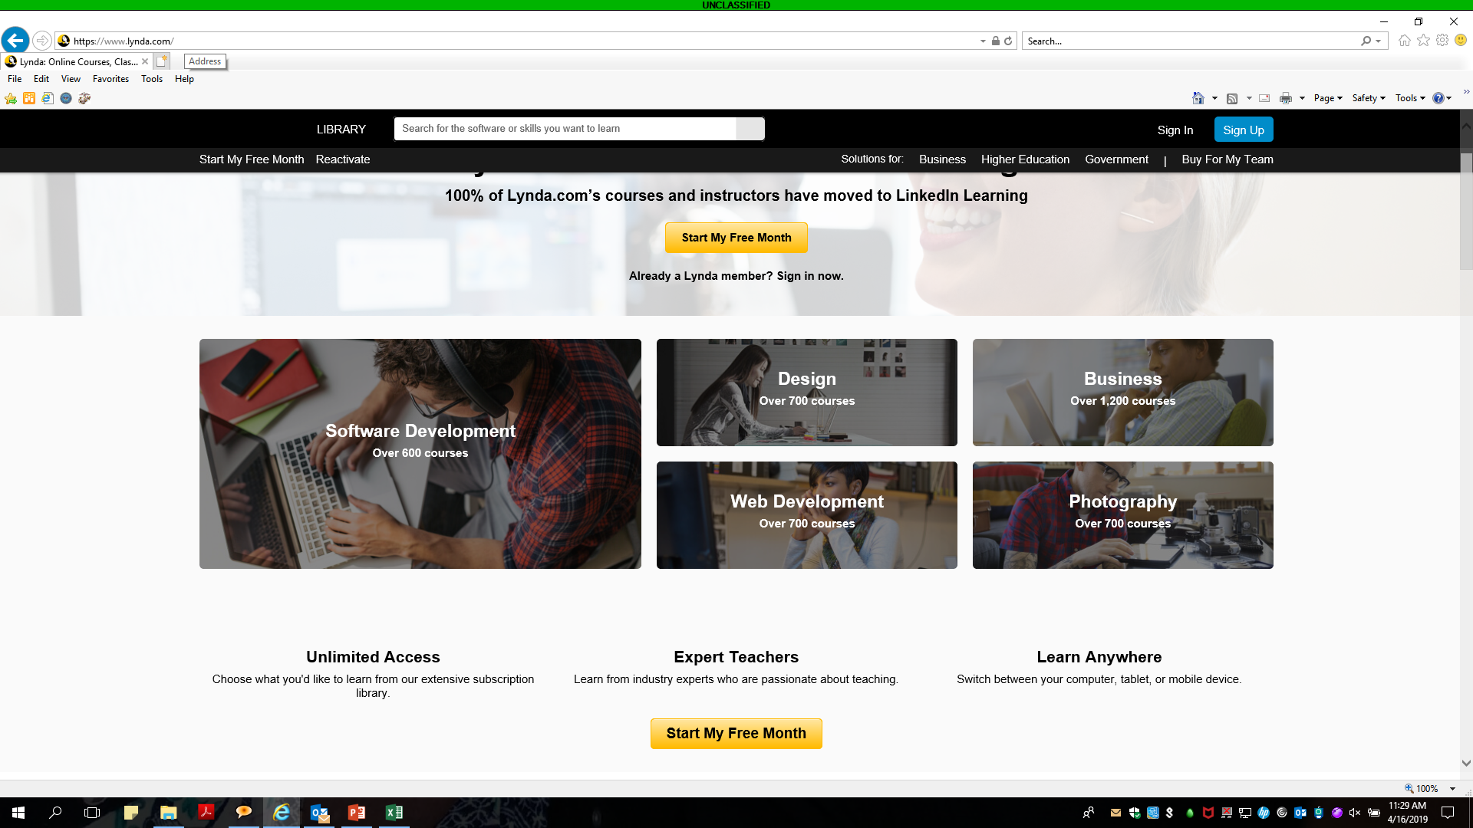
FST: LinkedIn Learning
Go to https://www.manpower.usmc.mil/COI
Select your COI and contact your COI Manager to Request Access
Complete Registration within 24 hours of Account
Complete Required Foundational Skill Training
eMail: MPC30@usmc.mil

Slide 37
“COI Manager Introductions”

Slide 38
COI Managers

Slide 39
Administration (COI)
Admin COI Leader: Mr. Steven Grozinski
COI Manager: Mr. Edward Mosley
Mission: Develops a systematic process for Civilian Marines to identify technical and behavioral competency requirements, training opportunities, and mentoring partnerships that support career development.
Vision: To encompass an innovative and adaptive administrative team dedicated to workforce excellence.
Goals
Align training and development with competencies
Provide opportunities to enhance analytical skills
Increase ability to organize effectively for efficiency and process improvement
Initiatives
Determine desired capabilities of today’s administrator within the workforce
Research developmental options that are targeted for the community, provide meaningful learning, and are cost effective
Create a collaborative platform where members of the Administration community can obtain information and developmental opportunities in a shared environment

Slide 40
Education & Training
COI Leader: SES Mr. Anthony Greco
COI Manager: Vacant
  Mission: To provide every Education & Training Community of Interest member with the opportunity to continue to learn and reach their potential, to lead fulfilling and productive careers, and to contribute positively to the mission of the Marine Corps by enabling each of his or her constituents to fully maximize their talents, imagination, skills and character.
Vision: Successful, skilled, and innovative education workforce
Goals:
  Revitalize commitment–oriented and motivated community to improve mission capacity, feedback, technical knowledge, skills and abilities
  Encourage participation for networking, on-the-job training, mentoring, and the use of Individual Development Plans
  Provide opportunities to enhance skills
Initiatives :
  Utilize the data received from the recent Education & Training COI Needs Assessment to provide training opportunities and address future needs of the community
  Stand-up E&T Advisory Group, will be soliciting for board members from the various occupational series
  Coordinate continuous learning and awareness community culture via forums/VTC/Telecon such as “Coffee with COI Leader”
  Rename and update the newsletter including input from community members

Slide 41
Human Resources
COI Leader: SES Mr. Jeffery Bearor
COI Manager: Ms. Mylechia Smalls
Mission: Develop and empower the technical capacity of the Human Resources community
Vision: Have a highly trained and fully engaged community of professionals recognized by customers as leading experts in their field.
Goals
Improve communication and networking
Provide strategic learning to close critical skill gaps
Initiatives
Promote increase use of online training tools
Fund training opportunities for targeted competencies (Classification and Qualification)
Increase use of the HR COI website, online discussion forums, and emails to open dialogue, increase crosstalk, and promote available developmental opportunities

Slide 42
Information Technology Management/Cybersecurity
COI Leader: SES Mr. Ken Bible
COI Manager: Mr. Alfredo Rodriguez
Mission: The ITM/CS Community of Interest mission is to create a working environment to attract and retain the best and brightest talent to support and develop a professional and sustainable ITM/CS Civilian Marine workforce.
  Vision: The ITM/CS Community of Interest vision is to achieve a professional, highly skilled and motivated ITM/CS Civilian Marine workforce recognized as integral to the accomplishment of the USMC mission.
Goals
  Extend operational reach across the community
  Invest in tools that provide the latest technical instruction
  Implement strategies that provide career path options
  Invest in mobile training efforts to deliver support to the foxhole
  Re-shape recruitment and staffing practices to bring a diverse and highly skilled workforce
Initiatives
  DoD 8140 Shaping efforts
  Latest Industry web based training and support
  Competency Model Development

Slide 43
Logistics COI
COI Leader: SES Ms. Deline Reardon
COI Manager: Mr. Rob Canady
Mission: The Logistics COI identifies and provides opportunities for the Civilian Workforce to enhance and support the mission of the Marine Corps in a joint and modernized environment.
Vision: A Logistics COI that promotes and fosters an interoperable Civilian Workforce by providing professional development opportunities, career progression, succession planning, mentorship, and community forums in support of the Marine Corps.
Goals:
Increase community awareness of available resources throughout the Marine Corps and DoD.
Provide a career roadmap for each logistics series for career development and to identify the knowledge and skillsets that USMC employees need to excel and advance in a professional role.
Initiatives:
Completed career roadmaps for 35 of 57 logistics occupational series; roadmaps can be found on the Logistics COI website: https://www.iandl.marines.mil/Logistics-COI/
Will continue to update and/or add additional roadmaps in FY2019.

Slide 44
Management and Program Analysis
COI Leader: SES Ms. Caral Spangler
COI Manager: Mr. Marlin Stevenson
Mission: Provide career development advocacy which supports, informs, and empowers COI members.
Vision: To be an acknowledged workforce sponsor for community professionals across the Marine Corps, by providing training opportunities to positively impact the careers of COI members.
Goals:
  Increase awareness of the COI
  Increase engagement across the COI
  Refine and develop core training competencies in order to develop a career roadmap for the Community
Initiatives:
  Providing training opportunity to obtain certification thorough external training agencies in order to support community member’s career progression
  Establishing a COI baseline to determine future educational opportunities for the community
  Providing funding for baseline educational opportunities

Slide 45
Safety & Occupational Health
COI Leader: Mr. Michael Miller
COI Manager: Ms. Kara Mbuko
Mission: To advocate and develop a competent and effective Safety & Occupational Health Community to enhance the USMC operational force in readiness through the preservation of personnel and materials.
Vision: To develop a competent and professional Safety and Occupational Health Community that enhances operational readiness.
Goals
  Establish training, education, and professional development that support career progression and growth.
  Provide advocacy & conduct outreach for the SOH Community of Interest.
  Advocate for upward mobility, advanced training, and mentorships to assist in attracting and retaining the highest qualified members
  Develop a “roadmap” to guide COI members in their individual development plans.
Initiatives
  Finalize Competencies for GS-0018. Participation DoN SOH (0018) Functional Community Career Development Plan
  Update minimum training requirements for each job series. Update NAVMC Dir 5100 > MCO 5100.29C (Draft).

Slide 46
Security/Emergency Services
COI Leader: SES Mr. Randy Smith
COI Manager: Mr. Maceo Franks
  Mission: Create professional development opportunities, provide community forums, and promote the interests of Marine Corps Security and Emergency Services organizations.
Vision: Be an essential partner with installations and operating forces by providing members individual career development opportunities and a network for exchanging knowledge, improving communications, sharing best practices, and finding innovative solutions.
Goals
Provide individual training opportunities
Recognize top performers
Serve as a forum for community best practices
Initiatives
Restart quarterly newsletter
Revamp training funds management
Annual awards program

Slide 47
  Questions/Comments

Slide 48
“COIs Not Present”

Slide 49
Community Support COI
COI Leader: SES Ms. Marie Balocki
COI Manager: Mr. Bryant Carthan
Mission: Invest in the personal and professional career development of the Community Support COI
Vision: The community of continued growth
Goals
  LDP Alignment to Career Goals
  Develop Targeted Competencies w/CEU credentialing
  Develop Curriculum
Initiatives
Course Offerings Increased and Extended to More Employees
Difficult Conversation, Conflict Resolution, Art of Influencing Others, etc.
Facilitation Certification

Slide 50
Contracts
COI Leader: SES Mr. Jamie Thompson
COI Manager: Ms. Kim Fernandez
Mission: The Contracts COI develops and manages processes and strategies that help provide and promote individual career growth across the contracting workforce. Contracting expertise is essential in order to procure quality goods and services for the Marine Corps.
Vision: The Contracts COI vision is to create a consistent, motivated and highly skilled community of contracting professionals capable of turning requirements into quality supplies and services in support of the USMC, through sound business decisions while executing fiduciary responsibility with honesty and integrity.
Goals:
  Continue to provide professional training opportunities across the contracting community
  Conduct community outreach to identify any training shortfalls or hidden opportunities
  Foster stakeholder partnerships with the Contracting Community leaders in order to achieve mutually beneficial outcomes
  Provide community advocacy and workforce management
Initiatives:
  Section 852 Defense Acquisition Workforce Development Funds (DAWDF Funding): DAWDF funding is available for individual classroom/online training, in the pursuit of the 24 hour semester credit hour (business/business-related) requirement (for DAWIA Certification; formal degrees, contract competency certification, and contracting expertise advancement).
  COI funding – Funding provided for Civilian group training (Military may also participate)– FY20 funding will be distributed to the Regional Contracting Offices (RCOs), NLT 2/29/2020– you may contact the Contracting COI Manager if additional funds are needed

Slide 51
Environmental COI
COI Leader: SES Dr. Todd Calhoun
COI Manager: Mr. Craig Sakai
Mission: The Environmental COI develops and sustains a superior environmental workforce by supporting professional growth and training personnel to match capabilities with existing and emerging requirements.
Vision: The Environmental COI provides a superior workforce that ensures, enhances, and sustains the Marine Corps mission and quality of life through sound stewardship of air, land, and sea resources.
Goals
Build and sustain professional development across the COI
Increase awareness and engagement across the COI
Ensure access to training for the COI members
Implement succession planning for the COI
Initiatives
Publish career roadmaps for each occupational series within the community
Develop Individual Development Plan templates
Develop position description templates for key occupational series
Update and publish an Environmental Training Course Catalog

Slide 52
Facilities COI
COI Leader: SES Dr. Todd Calhoun
COI Manager: Mr. Eric Odderstol
Mission: The Facilities COI develops and sustains a superior facilities workforce by supporting professional growth and training personnel to match capabilities with existing and emerging requirements.
Vision: The Facilities COI provides a superior workforce that manages the planning, design, construction, maintenance, and operations of Marine Corps installations as resilient right-sized platforms to generate force readiness.
Goals
Build and sustain professional development across the COI
Increase awareness and engagement across the COI
Ensure access to training for the COI members
Initiatives
Develop Facilities Training Catalog
Publish Career Roadmaps for each occupational series
Evaluate Career Resources (IDPs, PDs)

Slide 53
Financial
COI Leader: SES Mr. Edward Gardiner COI Manager: Ms. Taisha Wahab
Mission: The Financial Management Community of Interest exists to build an agile workforce responsive to the Marine Corps’ financial management requirements in support of operational forces. Our community will use competency-based criteria to identify the training and experience required within the Financial Management (FM) community. We will promote professional development, technical competency and ethical behavior to provide the Corps with Marines, equipment, and training.
Vision: The FM COI encompasses professionals that serve as experts in planning, programming, budgeting, and executing fiscal resources for the Marine Corps both today and in the future. We uphold Marine Corps values of honor, courage, and commitment by executing our fiduciary responsibilities with honesty and integrity. We are the stewards of the United States Marine Corps’ financial resources.
Goals:
Build and sustain professional development across the community
Streamline overhead, eliminate waste, and improve business processes to ensure the community is operating in an accountable and modern business environment
Achieve a consistent, motivated and highly skilled community
Strive for every FM member to be certified in the DoD FM Certification Program
Expand opportunities in FM career progression training courses
Improve systems, business processes and internal controls across all functional areas to achieve an unmodified audit opinion

Slide 54
Legal COI
COI Leader: VACANT
COI Action Officer: Ms. Terri Handy
Mission: The Legal COI develops the professional competencies for the civilian Legal civilian workforce of the Marine Corps. As the designated Marine Corps proponent, the Legal COI focuses on development of technical, mission-oriented competencies via internal training and external/commercial education.
Vision: The Legal COI consists of professionals that serve as subject matter experts, dedicated to supporting our Nation’s force in readiness, both today and in the future, while upholding Marine Corps values of honor, courage and commitment. Coordinating and combining the civilian legal workforces of the Counsel for the CMC and SJA to the CMC remains crucial to the success of our mission.
Goals:
Advocate for training opportunities to enhance proficiencies and mitigate any deficiencies of personnel in specialized practices.
Ensure support staff are trained in specialized areas through formal education, symposiums, and/or workshops.
Encourage community members to share knowledge and skills learned from formal and/or on-the-job training to enhance member development.
Initiatives:
Continue funding attorney state bar membership fees: mandate to meet CLE requirement as a Member-in-Good-Standing requires funding distribution.
Focus on support staff development to ensure the community is trained in all specialty areas and fully capable of mission accomplishment.
Request annual COI funding from MPC-30 for individual training requirements when an identified shortfall exists in local funding levels.

Slide 55
Intelligence
COI Leader: SES Mr. Steve Ramp
COI Manager: Ms. Emily Jackson
Mission: The mission of the Intelligence COI is to develop a workforce possessing the aptitude, training, education, and experience to understand the threat environment and provide Commanders with information, resources, and analysis needed to make sound and timely decisions.
Vision: The Intelligence COI is a blend of professionals that recognize the need for seamless connections between intelligence and operations encompassing:
A premier workforce that collects, analyzes, solves and translates knowledge of the enemy and environment into operational opportunities
Trained professionals with technical, tactical and leadership expertise to meet the challenge of future threats
Technical training focused on intelligence support to operations in the Information Environment
Goals:
Establish a an educational continuum that addresses intelligence operations in the information environment
Establish a civilian career roadmap to enhance the leadership and technical skills of community members
Develop and strengthen the supervisory cadre through meaningful performance management, Enterprise-promotion and recognition, and targeted civilian leadership development

Slide 56
Professional Analyst
COI Leader: SES Mr. Doug Hoffman COI Manager: Mr. Al Sawyers
  Mission: Promote career development and increase technical skills of the Professional Analyst community by providing access to learning opportunities and resources.
  Vision: Have a highly skilled, informed, and innovative community of professionals providing analytic insight to Marine Corps decision makers.
  Goals:
    Promote the value of quantitative analysis to Marine Corps leadership
    Increase the technical knowledge and professional abilities of community members
    Explore IT options to expand access to analytic applications
Initiatives:
    Promoting access to Lynda.com for online training opportunities
    In FY 19, conducted “Analytic Writing Seminar” (Mar 2019); “Analysis in Excel – VBA” (May 2019), and “Intermediate Computational Methods for Analysis Using Python” (Sep 2019)
    In FY 20, conducted “Probability Management Workshop” (Dec 2019); “Advanced Frameowrk for Simulation, Integration and Modeling (AFSIM) ” training (Feb 2020)

Slide 57
Program Management
COI Leader: SES Mr. Todd Wagenhorst
COI Manager: Ms. Theresa Conte
Mission: To provide developmental opportunities and training for the program management community.
Vision: To positively impact COI members by promoting their growth and development.
Goals:
Community growth from other series (0301 and 0343)
Ample training opportunities for COI members
Initiatives:
Recruiting current 0343 series personnel within the DoD/DoN/USMC to grow into 0340 program managers
Leveraging Defense Acquisition Workforce funding where appropriate, to increase training opportunities
Managing Lynda.com accounts to meet short term training requirements

Slide 58
Science & Engineering
S&E COI Leader: VACANT
COI Manager: Ms. Karrin Felton
Mission: Develop the professional competence of the engineering and scientific workforce by supporting the growth of Civilian Engineers and Scientists in the 0800 and 1300 series.
Vision: Provide a professional engineering and scientific USMC Civilian workforce who are a capable and committed to maintaining the readiness of the Nation’s expeditionary force.
Goals
Provide a focal point for dissemination of engineering and scientific knowledge.
Promote collaboration in engineering practice, education, and scientific research across the Marine Corps.
Improve the professional status of all Civilian Marines engaged in the disciplines of engineering and science.
Initiatives
Implementation of Agile concepts for development of systems such as software, hardware, and processes. Benefits include reduction of paperwork, increased engage with user community.
Development of Electronic Warfare (EW) Bootcamp fundamentals, concepts, and techniques with special interest given to advanced types of radar and communication threats.
Use of Model Based Systems Engineering to manage requirements and make data driven decisions.

Slide 59
Visual Information & Public Affairs
COI Leader: BGen Sean Salene
COI Manager: Mr. Glen Lollar
  Mission: The Visual Information COI exists to educate, train and inform active duty service members, civilian Marines and the public about the Marine Corps through effective verbal, written and visual communications. Our purpose is to foster public understanding and support through synchronized communications and to provide the warfighter with critical tools necessary to accomplish the mission.
  Vision: The Visual Information COI will be recognized and valued across the Marine Corps as an essential tool supporting the warfighter’s visual information needs.
  Goals:
Develop a training support plan incorporating a fair and equitable balance across all series and grades within the Visual Information community
Develop and validate core competencies for series within the Visual Information community
Establish Visual Information COI series key stakeholders and relationships within the Visual
Develop a tiered program of continuous learning
Develop standardized IDPs
Develop Visual Information COI Strategic Communication Plan

Slide 60
  Questions/Comments

